Slide 1


Slide 2

Building GraphQL in .Net Core
Linh Nguyen
Notes:
Customer
Admin edit customer information
Customer avatar
When we write rest API, how to write APIs to return the customer info for 2 cases above?
Thanks 2 answers, Regarding 2 answers, what advantage & disadvantages for them?

Slide 3
Agenda
Introduce GraphQL
HotChocolate
Q&A

Slide 4
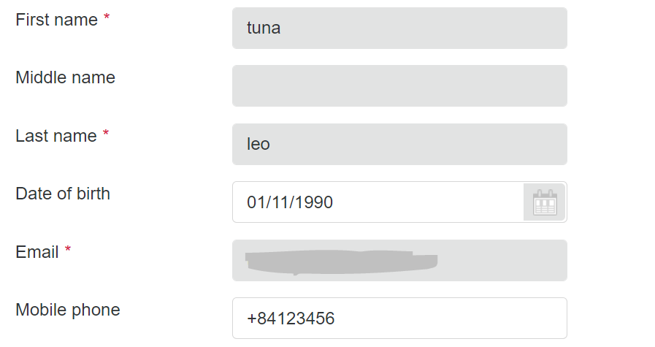

GraphQL
Edit customer
Avatar
Notes:
GraphQL was developed internally by Facebook in 2012 before being publicly released in 2015
Question:
Rest API:
Customer => full details
Customer => avatar

Slide 5
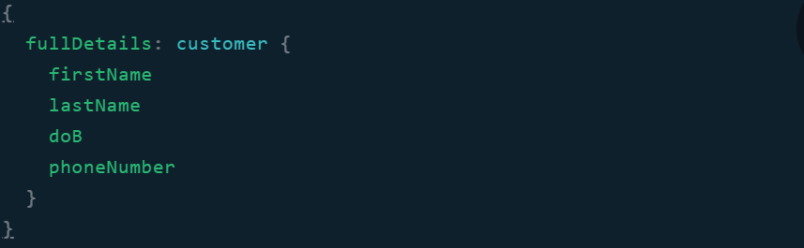
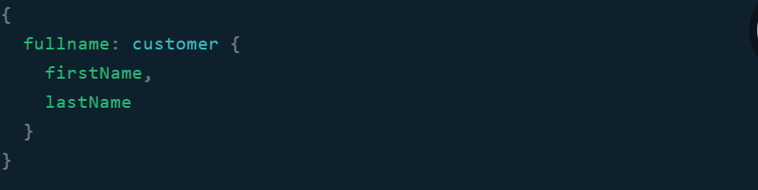
GraphQL
Edit customer
Avatar
Notes:
Open playground => introduce playground
Document
Query area
Make a simple query

Slide 6
GraphQL (recap)
Query language for API
One endpoint
Type
Query
Mutation

Slide 7

Hot Chocolate
Prerequisite
Asp.net core
HotChocolate.AspNetCore
HotChocolate.AspNetCore .Playground
Notes:
Init project .net 5
Add lib HotChocolate.AspNetCore, HotChocolate.AspNetCore.Playground
Create Type => no type, no graphql
Create RootQueries, RootMutations

Slide 8
Best practice
Max depth
Persisted query
DataLoader

Slide 9


Thanks for joining !
https://www.facebook.com/devcafevn

