Slide 1


Slide 2

.NET 5 – An Overview
Thien Nguyen

Slide 3
The Journey to One .NET
.NET Framework
Single SDK, one BCL, unified toolchain
Cross-platform native UI
Cross-platform web UI
Cloud native investments
Continue improvements in speed, size, diagnostics
Selective merged
.NET Core 3.1
.NET Core 5.0
Mono / Xamarin
Selective merged
No plan to ported technology | Recommended alternative
Web Forms | ASP.NET Core Blazor or Razor Pages
Windows Workflow (WF) | Open-source CoreWF
WCF | gRPC

Slide 4


.NET
Your platform for building anything
Desktop
Web
Cloud
Mobile
Gaming
IoT
AI

Slide 5
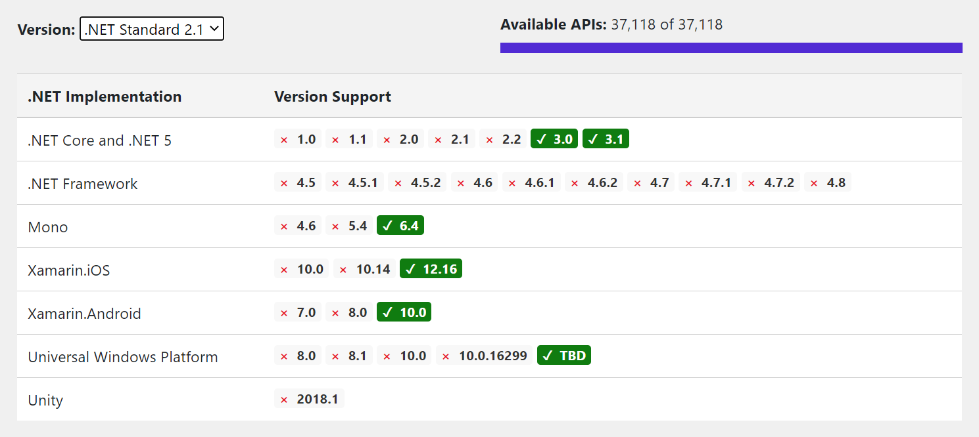
How about .NET Standard?
.NET 5 | .NET 6 | .NET 7
net5.0 | net6.0 | net7.0
 | net6.0-android | net7.0-android
 | net6.0-ios | net7.0-ios
net5.0-windows | net6.0-windows | net7.0-windows
Use netstandard2.0 to share code between .NET Framework and all other platforms.
Use netstandard2.1 to share code between Mono, Xamarin, and .NET Core 3.x.
Use net5.0 for code sharing moving forward.
Notes:
https://dotnet.microsoft.com/platform/dotnet-standard
https://devblogs.microsoft.com/dotnet/the-future-of-net-standard

Slide 6
.NET Schedule
Dec 2019
.NET Core 3.1
LTS
Nov 2020
.NET 5.0
Nov 2021
.NET 6.0
LTS
Nov 2022
.NET 7.0
Nov 2023
.NET 8.0
LTS
.NET 5.0 release in November 2020
Major releases every year
LTS for even numbered releases
Predictable schedule, minor releases as needed

Slide 7

Demo
C# 9.0
Entity Framework Core
Distributed Tracing
Notes:
Init only setters
Top-level statements
Records
Many to many
DbContextFactory
Reset DbContext state - ChangeTracker.Clear()

Slide 8
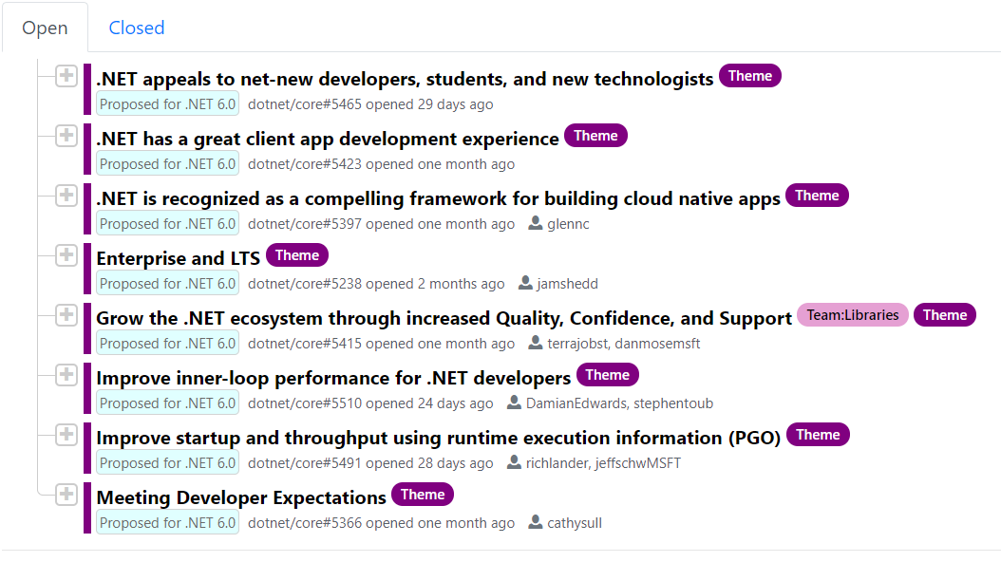
.NET 6.0 Roadmap
https://themesof.net/

Slide 9
Materials
Slide: https://github.com/devcafevn/dotnetconf2020/presentations
MyShop: https://github.com/thiennn/myshop/
Further: https://github.com/simplcommerce/SimplCommerce
Discussion: https://www.facebook.com/groups/dotnetvn

Slide 10


Thanks for joining !
https://www.facebook.com/devcafevn

