Slide 1


Slide 2

Building and Securing Blazor Applications
Phong Nguyen

Slide 3
Agenda
Introduction to Blazor
Building Blazor Application
Securing Blazor Application
Deploying Blazor Application

Slide 4
Blazor: What and Why?
Blazor is a feature of ASP.NET which lets you build interactive web UIs using C# instead of JavaScript.
Notes:
https://dotnet.microsoft.com/apps/aspnet/web-apps/blazor
https://docs.microsoft.com/en-us/aspnet/core/blazor/?view=aspnetcore-5.0

Slide 5
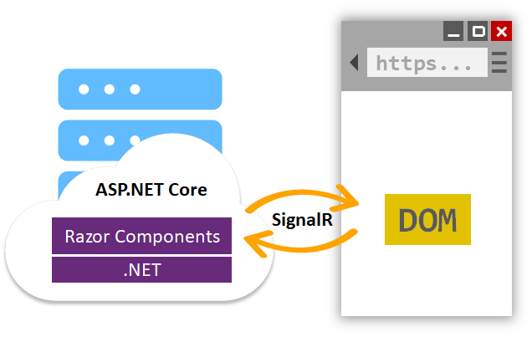
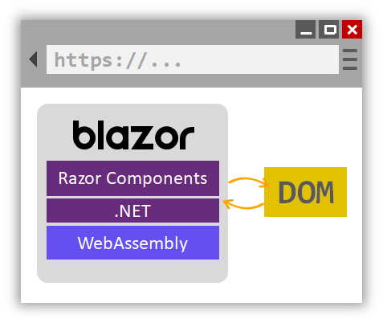
Blazor Hosting Models
Blazor Server-Side
Blazor WebAssembly
Notes:
https://docs.microsoft.com/en-us/aspnet/core/blazor/hosting-models?view=aspnetcore-5.0

Slide 6






What is WebAssembly?
A new type of code
A binary instruction format
Run code at near native speed
Other languages can be compiled to WebAssembly
Runs in modern web browsers – no plugin needed

Slide 7

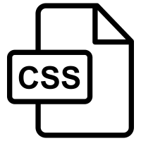


Web Browser
Web Sockets, WebRTC Canvas, WebGL
File API, Web Storage
Web Audio, Media DOM
Load
Run
Call Functions
JavaScript Runtime

Slide 8

Microsoft Blazor Toolchain
Compile
Run
dotnet.wasm
runtime
C#/ Razor
App.dll

Slide 9
Building Blazor Application

Slide 10
Component
Razor File
Partial Class vs Inherit
CSS Isolation
Templated Component (RenderFragment)

Slide 11
Routing
@page
Route Constrains
Route Parameters
Router Component
Route Scanning
NavigationManager

Slide 12
Dependency Injection
[Inject] Attribute
Registering Services
Blazor Server (Startup.cs)
Blazor WebAssembly (Program.cs)
Constructor Injection hasn’t been supported yet (https://github.com/dotnet/aspnetcore/issues/18088).

Slide 13
Form Input & Validation
EditForm Component
Input Components
Data Annotation
Model Validation (IValidatableObject)

Slide 14
Handling Events
@onclick
OnValidSubmit
…
Custom Events

Slide 15
Communication between Components
Passing Parameters
Raising Events

Slide 16
JavaScript Interop
Blazor Server-Side
Blazor WebAssembly
Notes:
https://docs.microsoft.com/en-us/aspnet/core/blazor/hosting-models?view=aspnetcore-5.0

Slide 17
Why JavaScript Interop
Browser
JavaScript Runtime
Browser APIs
Blazor App
DOM
JavaScript
Your Code
(C# + Razor)
LocalStorage
Online Status
Geolocation
History
Blazor + .NET
JavaScript Interop
3rd Party JavaScript
Libraries

Slide 18
State Management
Query String
Browser Storage
InMemory (using DI Container)

Slide 19
Logging
ILogger<T>
Server Side Logging
Client Side Logging

Slide 20
Debugging

Slide 21
Data Access

Slide 22
Blazor Server
Separate
Web API
Http Client
Direct Call
Database
Database

Slide 23
Blazor WebAssembly
Database
Backend
Http Client
Database
Separate
Web API
Http Client

Slide 24
Securing Blazor Application
Authentication & Authorization

Slide 25
Authentication
Blazor Server | Blazor WebAssembly (Hosted) | Blazor WebAssembly (Standalone)
Cookie Based Authentication Token Based Authentication | Cookie Based Authentication Token Based Authentication | Token Based Authentication

Slide 26
Authorization
Role Based Access Control
Attribute Based Access Control
Policy Based Access Control

Slide 27
Deploying Blazor Application

Slide 28
Deploying Blazor Application
Blazor Server | Blazor WebAssembly (Hosted) | Blazor WebAssembly (Standalone)
IIS Azure App Service Container Azure SignalR Service … | IIS Azure App Service Container Enable tree shaking to reduce files size and speed up loading time. … | IIS Azure App Service Container Azure Storage Static Website Hosting CDNs Enable tree shaking to reduce files size and speed up loading time. Configure URL Rewrite …
Notes:
https://docs.microsoft.com/en-us/aspnet/core/blazor/host-and-deploy/?view=aspnetcore-5.0&tabs=visual-studio

Slide 29
Reference
https://docs.microsoft.com/en-us/aspnet/core/blazor/?view=aspnetcore-5.0
https://dotnet.microsoft.com/apps/aspnet/web-apps/blazor
Code Demo: https://github.com/phongnguyend/Practical.CleanArchitecture

Slide 30





Slide 31


Thanks for joining !
https://www.facebook.com/devcafevn

