Slide 1
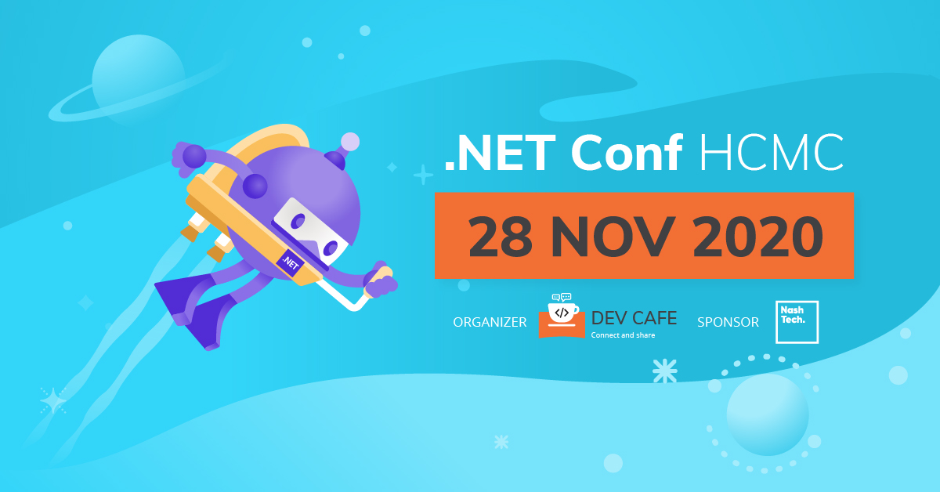

Slide 2
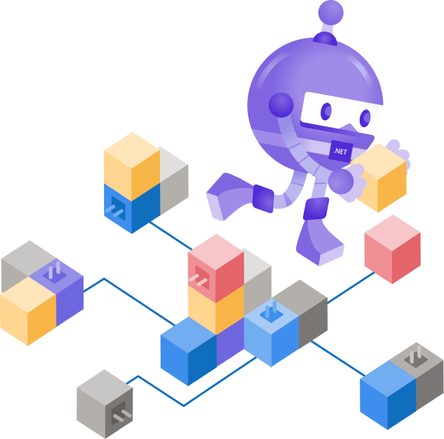
Multi-tenancy in microservice architecture
Thanh Tran
https://github.com/hoangthanh28

Slide 3
Agenda
Monolithic vs Microservices
Single Tenant vs Multi-Tenant
Microservice + multi-tenant – the complexity
Azure elastic pool and sharding
Demo
Q&A

Slide 4
Within this talk
MSA + Multi-tenancy architecture and why it matter
Persistence layer using relational Db like Azure SQL or SQL server, SQL managed instance
Azure technology stack

Slide 5
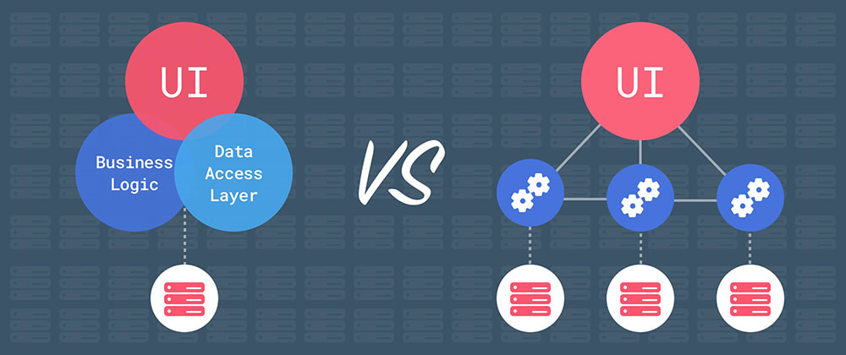
Monolithic vs Microservices
https://dev.to/alex_barashkov/microservices-vs-monolith-architecture-4l1m

Slide 6
Pros and cons
Monolithic | Microservices
Application is too large and complex to fully understand and made changes fast and correctly | Services are small, bounded and can be implemented by difference technology
You must redeploy the entire application on each update | It enables each service to be developed independently by a team that is focused on that service.
Monolithic applications can also be difficult to scale when different modules have conflicting resource requirements. | Microservice architecture enables each service to be scaled independently
Monolithic applications has a barrier to adopting new technologies. | Reduces barrier of adopting new technologies since the developers are free to choose whatever technologies
Simple to develop, test and deploy | Complex, hard to implement and control

Slide 7



Single Tenant vs Multi-Tenant
Tenant MS
Service A
Service B
Service C

Slide 8
Single Tenant vs Multi-Tenant
Tenant MS
Tenant NT
Service A
Service B
Service A
Service B
Service C
Service C
+ Complexity
+ Cost effective
+ Time to market
+ Development effort

Slide 9
Single Tenant vs Multi-Tenant
Tenant MS
Tenant NT
Service A
Service B
tenantMS: 123
tenantNT: 456
tenantMS: 123
tenantNT: 456
Service C
tenantMS: 123
tenantNT: 456

Slide 10


Single Tenant vs Multi-Tenant
Tenant MS
Tenant NT
Service A
Service B
Service C
Tenant MS
Service A
Service B
key: tenant+service
Service A-MS
Service B-MS
Service C-MS
Service C
Tenant NT
Service A-NT
Service B-NT
Service C-NT
MSA
DB Sharding

Slide 11
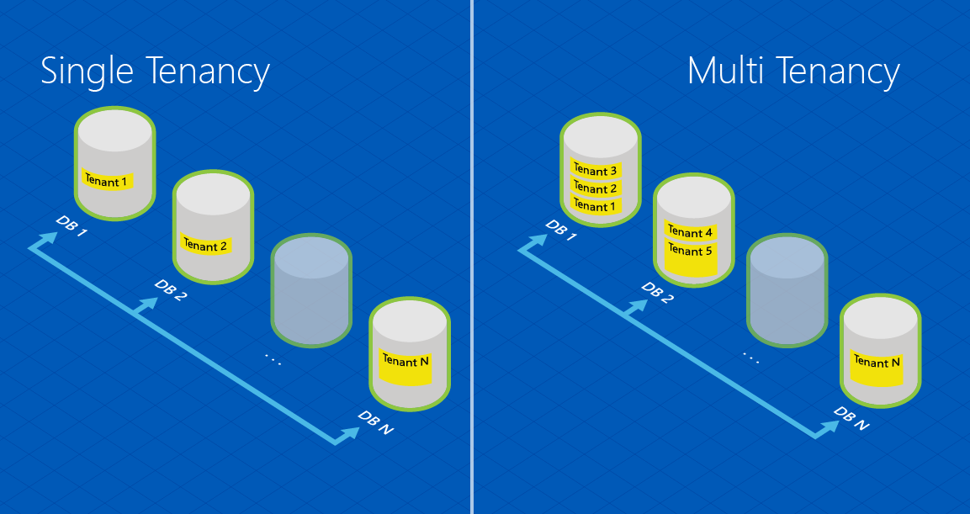
Single Tenant vs Multi-Tenant
https://docs.microsoft.com/en-us/azure/azure-sql/database/elastic-scale-introduction

Slide 12
Pros and cons
Pros | Cons
Cost effective | Complex and require mature in MSA
Scale independently by individual service | Aggregate data become difficult
Suitable for enterprise application

Slide 13
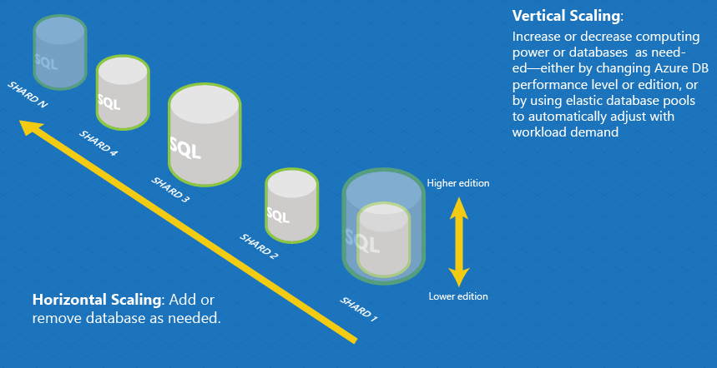
Horizontal vs vertical scaling
https://docs.microsoft.com/en-us/azure/azure-sql/database/elastic-scale-introduction

Slide 14
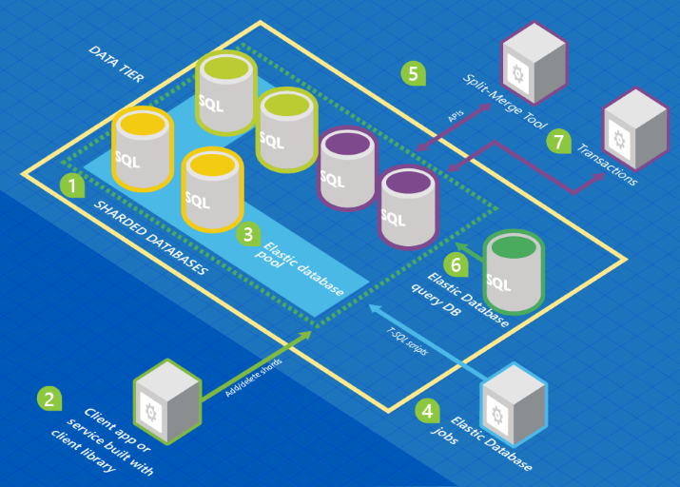
Elastic Database
https://docs.microsoft.com/en-us/azure/azure-sql/database/elastic-scale-introduction
Notes:
A set of SQL databases is hosted on Azure using sharding architecture.
The Elastic Database client library is used to manage a shard set.
A subset of the databases is put into an elastic pool. (See What is a pool?).
An Elastic Database job runs scheduled or ad hoc T-SQL scripts against all databases.
The split-merge tool is used to move data from one shard to another.
The Elastic Database query allows you to write a query that spans all databases in the shard set.
Elastic transactions allow you to run transactions that span several databases.

Slide 15

Demo
“Talk is cheap. Show me the code.” - Linus Torvalds

Slide 16
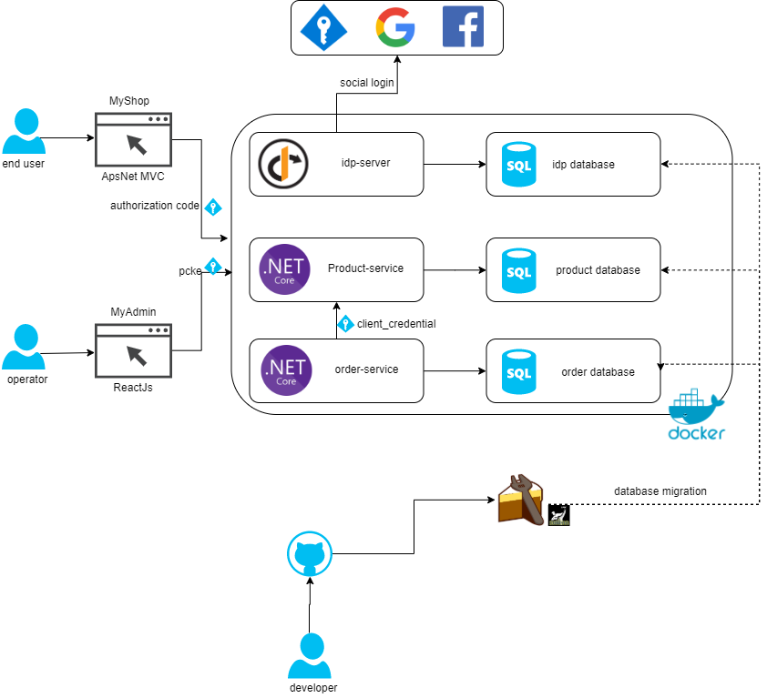
The architecture

Slide 17
Q & A
Source code: https://github.com/hoangthanh28/amazing-shop

Slide 18





Slide 19


Thanks for joining !
https://www.facebook.com/devcafevn

