Slide 1
PING PONG BALL USING AI
GROUP MEMBERS:
P.SATYANARAYANA REDDY – 20BRS1263.
CHAITANYA KAMASANI – 20BRS1037.

Slide 2
Introduction
Pong is one of the earliest arcade video games. It is a table-tennis inspired game featuring simple two dimensional graphics. In it, the player controls the paddle by moving it vertically across the left or the right side of the screen.
Each player earns points when the opponent fails to return the ball. The aim of this project is to create a C# application for Pong using the UNITY HUB SOFTWARE. It also involves creating a few AI models which the user can play against.

Slide 3
SOFTWARE AND PROGRAMMING LANGUAGE USED
UNITY HUB
The Unity Hub is a standalone application that streamlines the way you find, download, and manage your Unity Projects and installations. In addition, you can manually add versions of the Editor that you have already installed on your machine to your Hub.
C#
It is an object-oriented programming language created by Microsoft that runs on the .NET Framework.
C# has roots from the C family, and the language is close to other popular languages like C++ and Java.
The first version was released in year 2002. The latest version, C# 8, was released in September 2019.
C# can be used to create a number of different programs and applications: mobile apps, desktop apps, cloud-based services, websites, enterprise software and games. Lots and lots of games.

Slide 4
PROJECT GOALS

Slide 5
The project was executed with the following goals in mind:
Creation of a GUI so that the user can select options and navigate through the application.
Development of the 2 player interface, that allows 2 players to play the game using the keyboard.
Modifying the 2 player interface to build a player vs AI interface.
Creating AI models for the player vs AI interface using simple algorithms.

Slide 6
IMPLEMENTATION

Slide 7
The AI has a position where it wants to be, and moves towards that position at a constant velocity, using the standard “arrive” behavior (look into steering behaviors for AI - the trick with “arrive” is that you have an arrive radius, and scale your velocity according to it, so that your velocity is maximum at the radius and outside, but becomes zero in the middle).
The desired position is calculated by casting a ray from the current ball position, along its velocity vector, and seeing if it intersects the line where the AI is guarding the goal. If it intersects a wall, it is reflected from there, and tested again. I only calculate one reflection, seeing how a human would also have problems predicting more than one.

Slide 8
When the ball hits something, a delay is started which prevents the AI from immediately recalculating the desired position, for around 200 milliseconds. This simulates reaction time, and is based on actual data about human reaction times (around 215 ms on average).
Later I added an “enrage” mechanic, where when the player scored a goal the AIs speed would be increased a bit and the reaction time reduced a bit. When the AI scored, the opposite would happen. This turned out to be a very good idea, since the AI would automatically scale its difficulty to any player skill level.

Slide 9
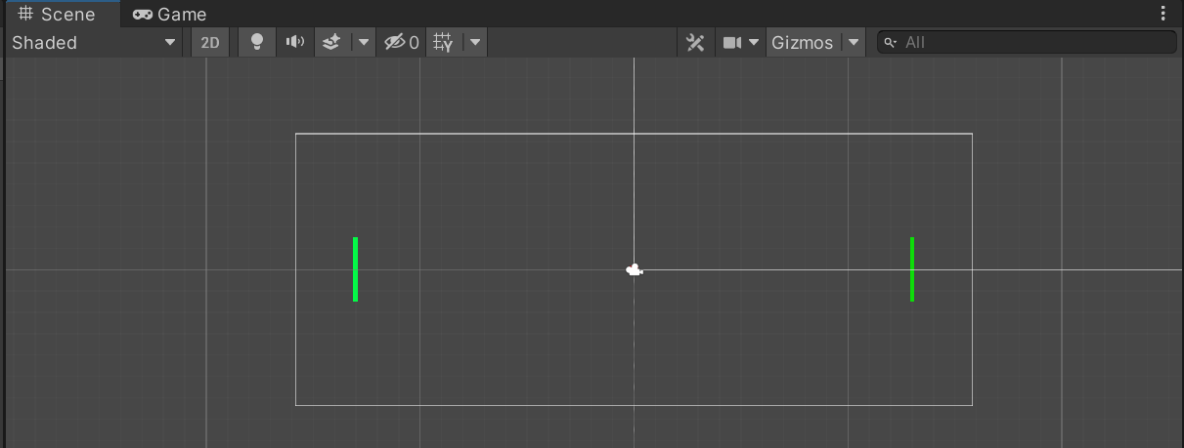
GAME SCENE

Slide 10
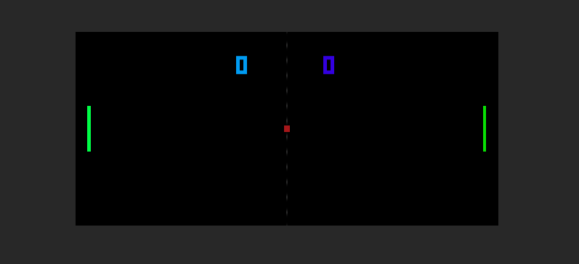
PROJECT MODEL

Slide 11

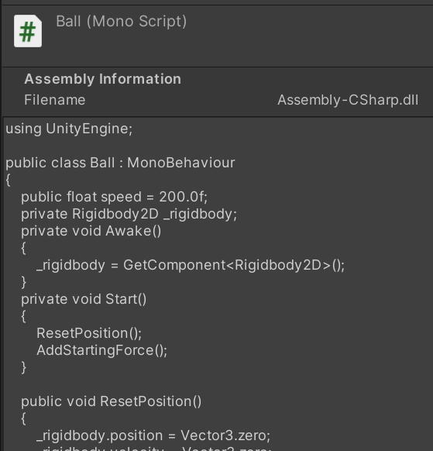
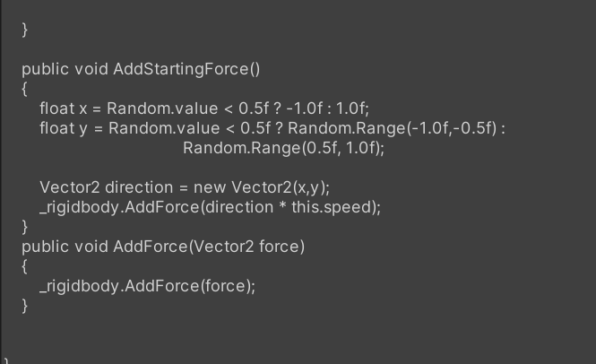

Slide 12
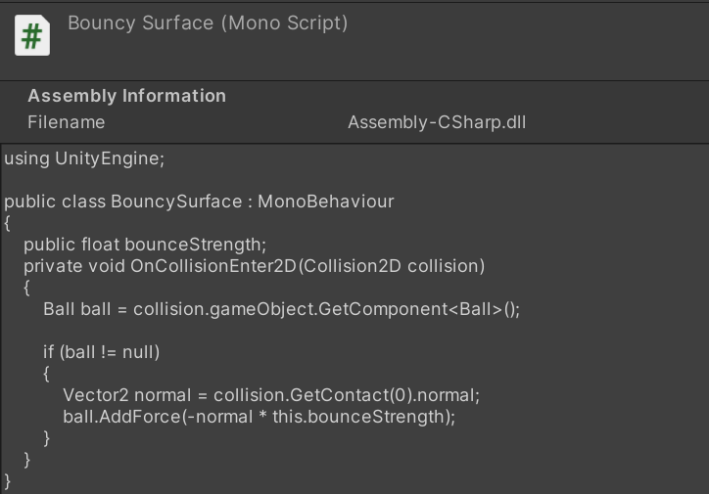

Slide 13
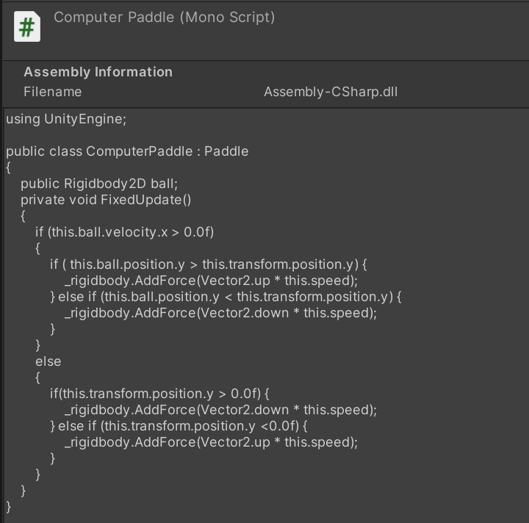

Slide 14

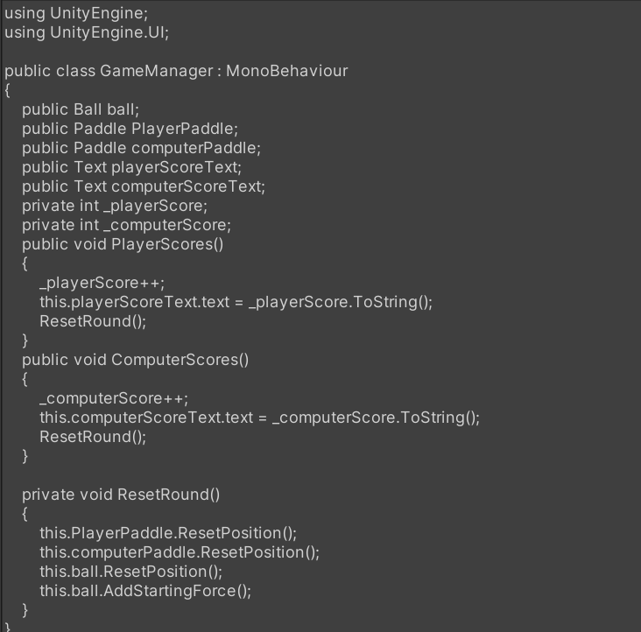

Slide 15
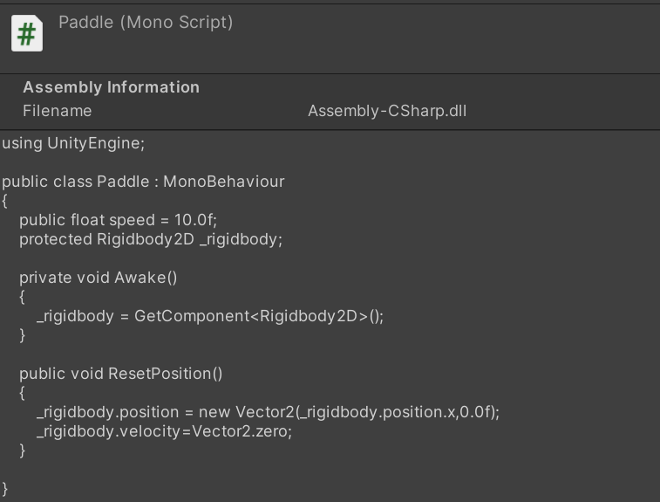

Slide 16
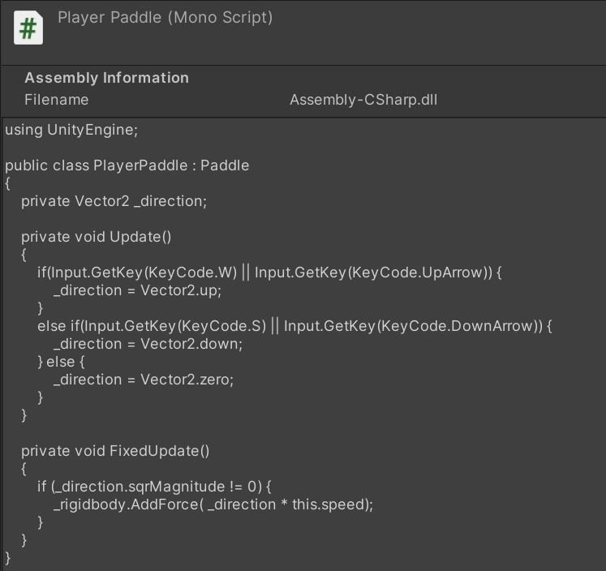

Slide 17
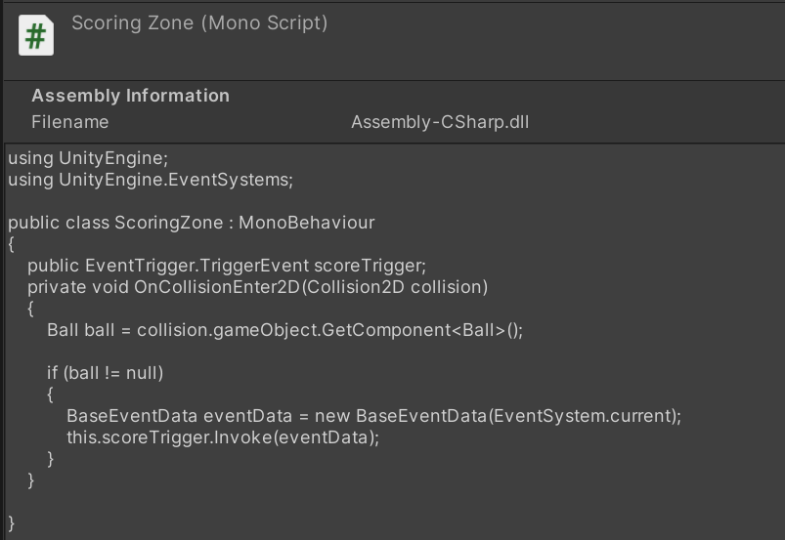

Slide 18
ADVANTAGES AND DISADVANTAGES
Playing improves hand-eye coordination and it stimulates mental alertness, concentration and tactical strategy. ...
Develops mental acuity. ...
Improves reflexes. ...
It's easy on the joints.
Burns calories.
Offers a social outlet.
Keeps your brain sharp.
Improves coordination.
There are absolutely no cons of ping pong. Ping pong is a game of reflexes, agility and flexibility. It improves your reflexes by the most.

Slide 19
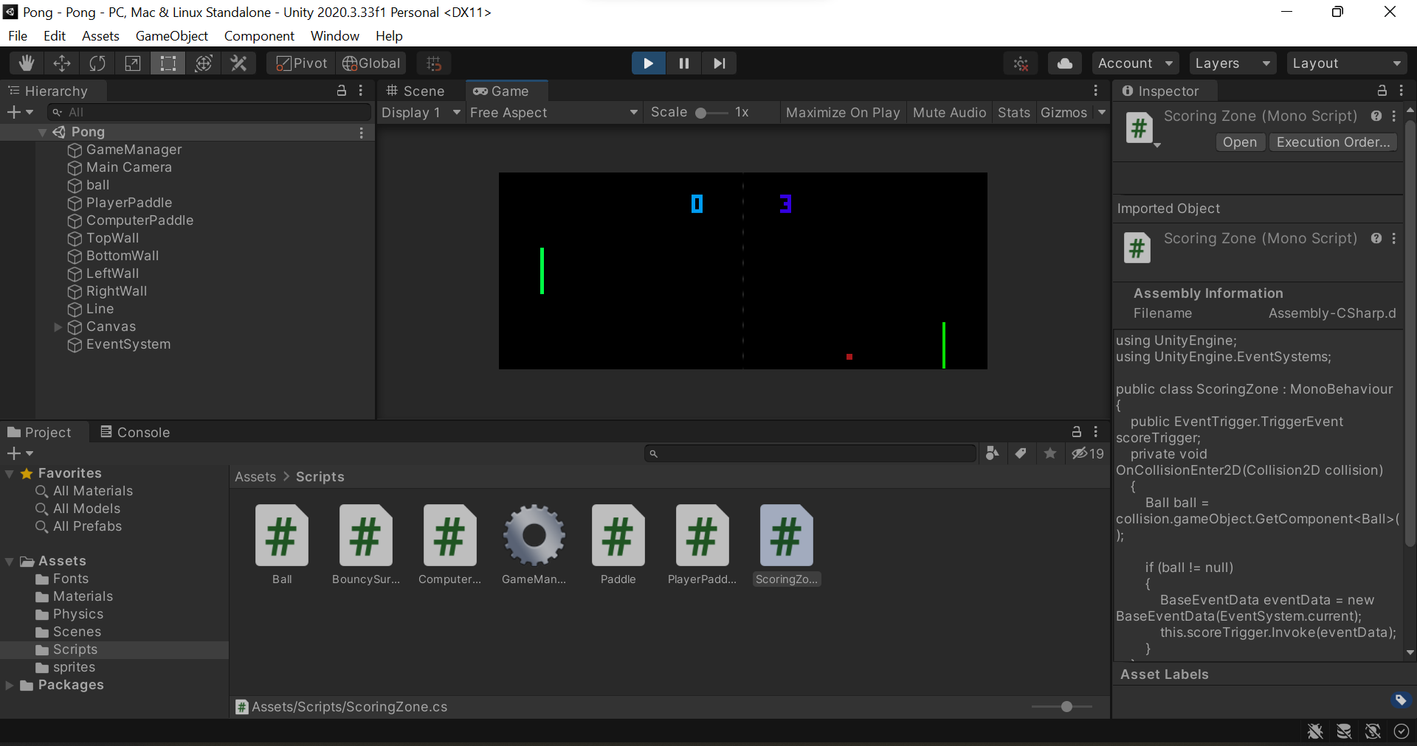
OUTPUT

Slide 20
CONCLUSION
Our project resulted in a working implementation of the game Pong. The game displays the paddles on either side of the screen, with a square ball bouncing between them. The play area on the screen is separated from the rest of the display by lines at the top and bottom. Above the play area, the score is displayed as two bars which fill toward the center of the screen when one player scores a point.

Slide 21
Thanks!

