Slide 1

Food Delivery Performance Dashboard
Created by: Devansh Chauhan
Tool Used: Power BI

Slide 2
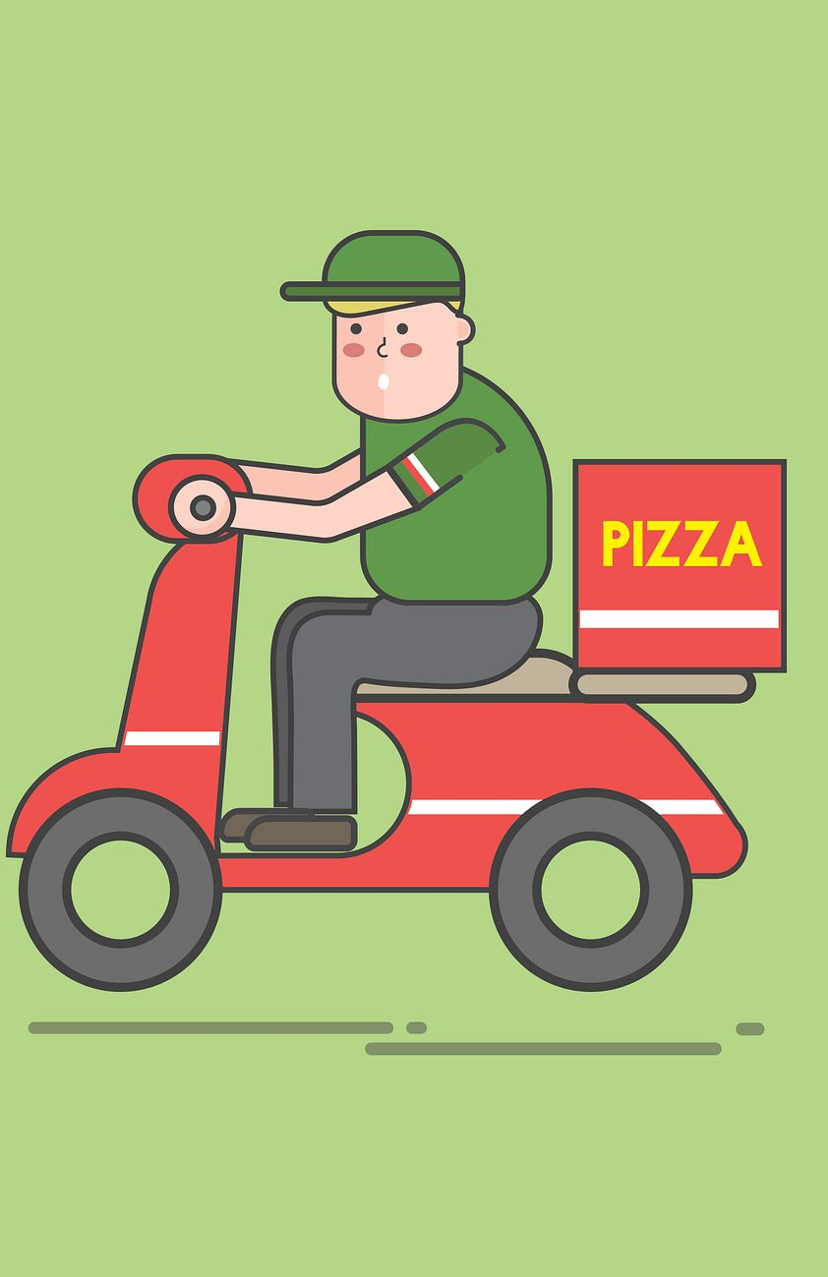
Project overview
Objective
The objective of this dashboard is to analyse food delivery performance and identify factors affecting delivery time and order trends.
Dataset Includes:
Order ID
Delivery Time
Distance
Traffic Level
Weather
Delivery Mode
Restaurant Zone
Customer Zone
Order Time

Slide 3
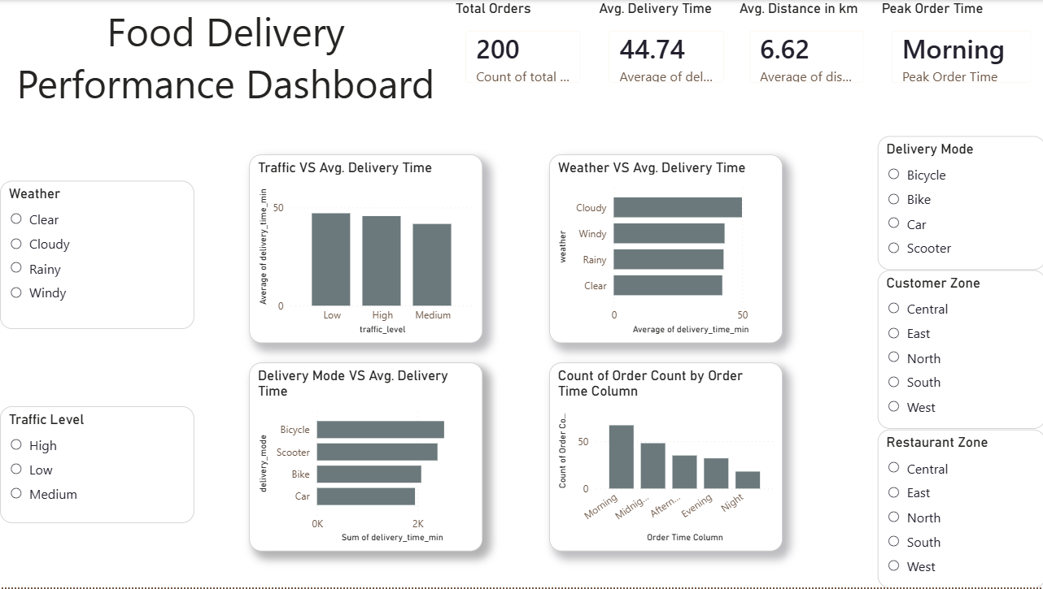
dashboard
Dashboard provides an interactive overview of food delivery performance.
Users can filter data using slicers such as weather, traffic level, delivery mode, customer zone, and restaurant zone.
KPI cards display key performance metrics at a glance.

Slide 4
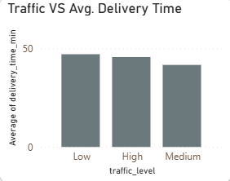
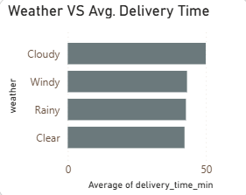
Traffic and weather analysis
Traffic vs Delivery Time
Observation Delivery time increased slightly with increasing traffic levels.
Insight Traffic had only a minor impact on delivery time, with just a small difference between low and high traffic conditions.
Weather vs Delivery Time
Observation Cloudy weather recorded the highest average delivery time.
Insight Cloudy conditions were associated with slower deliveries compared to clear, rainy, and windy weather.

Slide 5
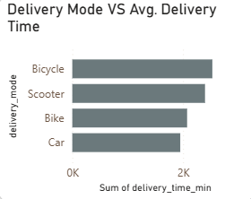
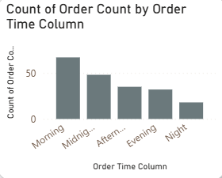
Delivery mode and peak order time analysis
Delivery Mode vs Delivery Time
Observation Cars and bikes delivered orders faster than bicycles.
Insight Motorized delivery modes were more efficient, while bicycles had the longest average delivery time.
Peak Order Time
Observation Morning had the highest number of orders, while night had the fewest.
Insight Customer demand was concentrated during morning hours.

Slide 6

Business recommendations
1. Optimize Delivery Allocation
Assign cars and bikes to time-sensitive and longer-distance deliveries to improve delivery efficiency.
2. Increase Resources During Peak Hours
Deploy more delivery partners during morning hours to handle higher demand.
3. Investigate Cloudy Weather Delays
Analyse operational challenges during cloudy conditions and optimize delivery planning.

Slide 7
conclusion
Conclusion
The dashboard provides valuable insights into delivery performance.
Delivery mode and weather showed a greater impact on delivery time than traffic.
Morning is the busiest order period and requires higher operational capacity.
Interactive filters enable quick analysis across different business scenarios.

