Slide 1

Learn to Code For Women
A Beginners Course
First things First - Class #1

Slide 2
Agenda
Welcome – Who are you and What do you expect ?
Computers are Dumb – How to talk to Computers.
Exercise #1 – Post it Notes Design
Setting up your cloud learning environment
Running your first program.
Next Week Seven Concepts

Slide 3

Welcome – Who are you and What do you expect ?
Tell us about your self.
What is your favorite food ?
What do you expect to learn ?
NOTE: You should know how to type on a computer and use a web browser for this class.

Slide 4
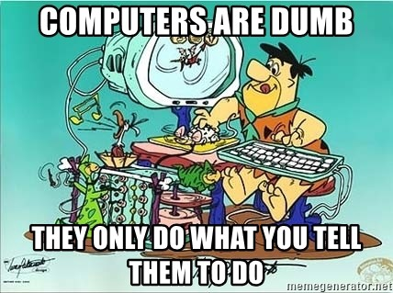
Computers are Dumb

Slide 5

How to talk to Computers
Computers in the beginning could only speak on and off, zeros and ones. Yes, Binary, but that is not how you have to talk to computers today.
Computers have many different languages that they can understand today.
For this class we will learn three different languages, python, html and a little JavaScript.
First we will learn python and understand the basics.

Slide 6

Thinking like a Coder/Programmer Exercise #1 – Post it Notes Design
Your first exercise will be to write out detailed step by step instructions for cooking chili hot dogs on regular buns.
Remember computers are dumb.
Learn to think how to break the process into step by step form, with everything and I mean everything in simple steps.
You need to write each step on one post-it note. You should have between 20 and 30 steps/post-it notes.
Example starting point: 1.) choose recipe, 2. choose store, 3. Check if I can I walk or need to drive to store ? 4.) If drive then do I have a car ? , finish the steps on post-it notes.

Slide 7
Setting up your cloud learning environment – Pre-Reqs
The tools you will need to use to learn to code will all be on the internet or cloud as they say now. All you need is a web browser, like google chrome or firefox.
In your web browser
NOTE: You can create new ones just for class if you want.
Create a Google Gmail at
http://mail.google.com.
Create GitHub Account
https://github.com

Slide 8
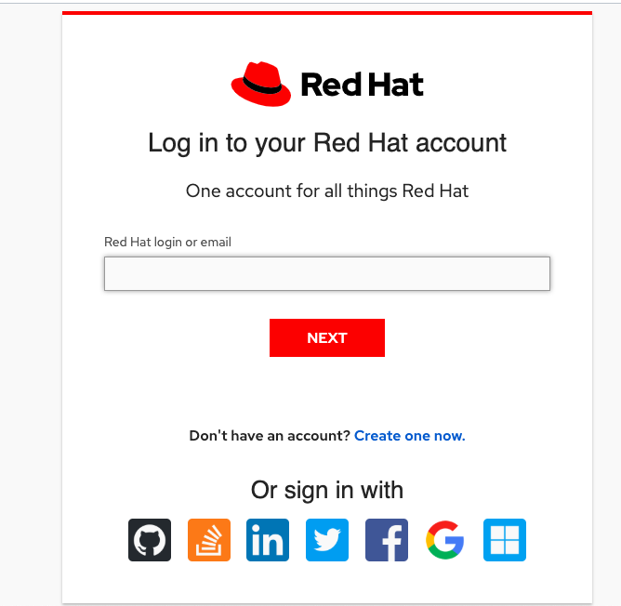
Setting up your cloud learning environment – Eclipse-Che
Next Create Red Hat Account for Eclipse-Che Python Environment
In web browser goto:
https://che.openshift.io
NOTE select click on the cat picture the first icon. See yellow arrow below. This will use up your github account.
You do not have to type in box your email.

Slide 9
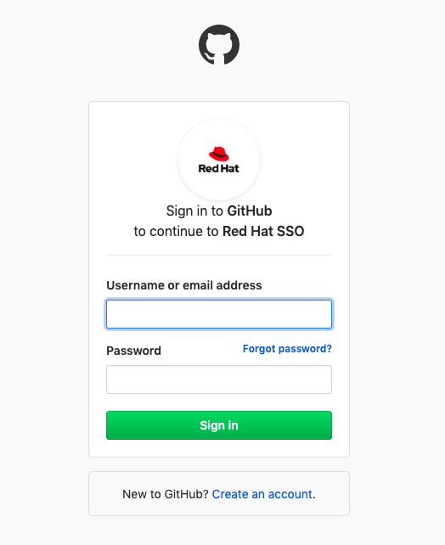
Setting up your cloud learning environment – Login using the Github you created

Slide 10
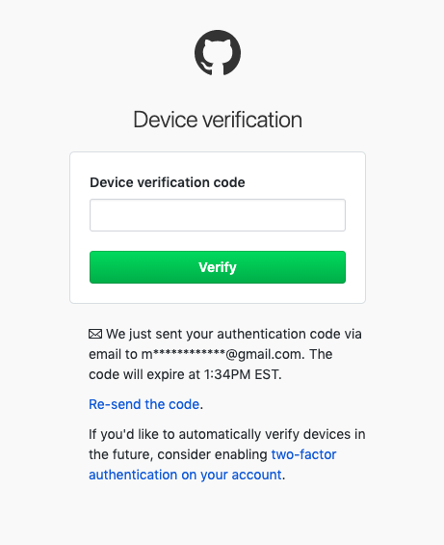
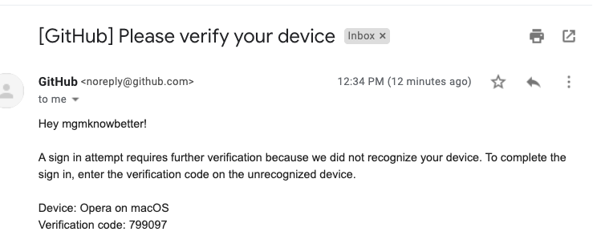
Setting up your cloud learning environment – Goto your Gmail Account and get the code.
Goto your Gmail Email and look for email with this subject and copy the verification code to use on verification form.
Gmail Code Type in box on from last step.

Slide 11
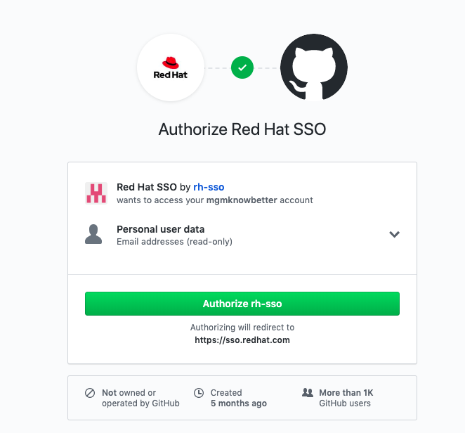
Setting up your cloud learning environment – Login using the Github you created

Slide 12
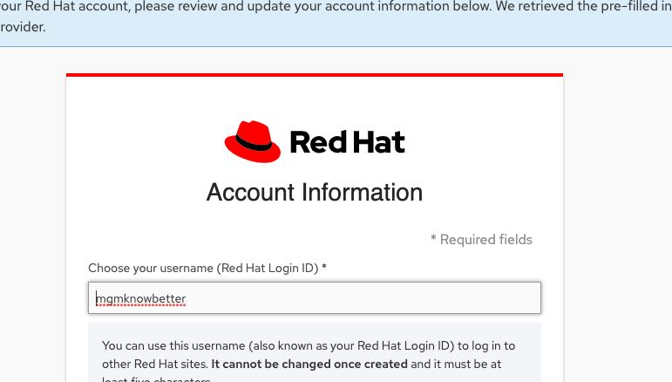
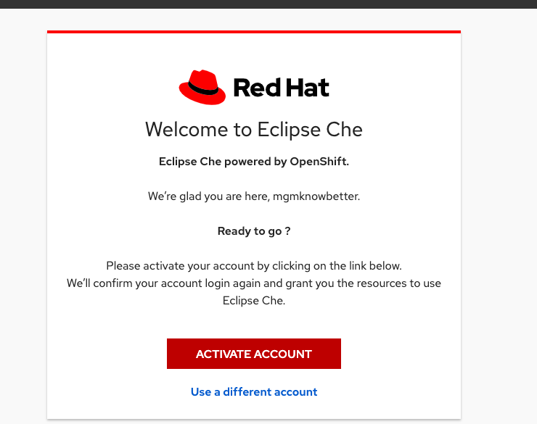
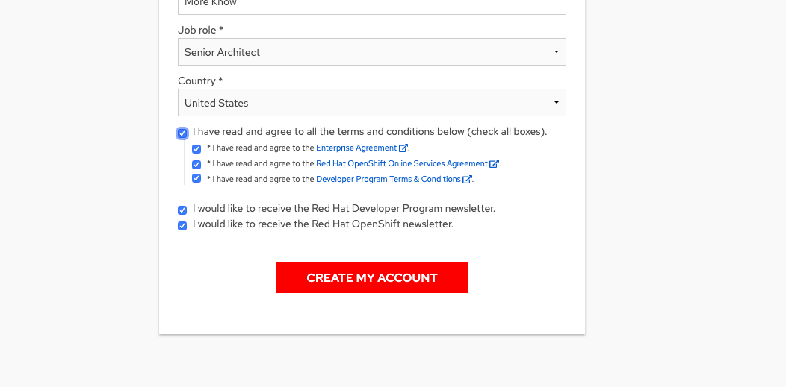
Setting up your cloud learning environment – A few more authoriztion steps follow screens enter info.

Slide 13
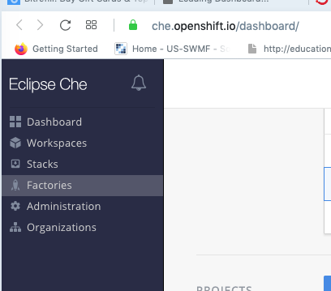
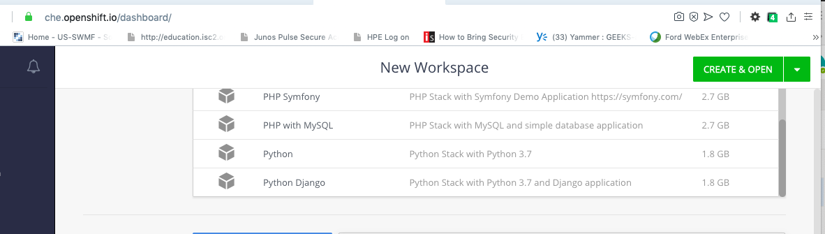
Setting up your cloud learning environment – Final Step Create Python Workspace.

Slide 14
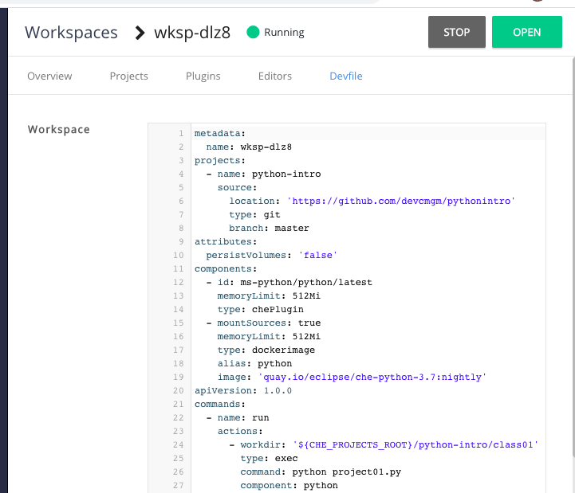
Setting up your cloud learning environment – Final Step Create Python Workspace.

Slide 15
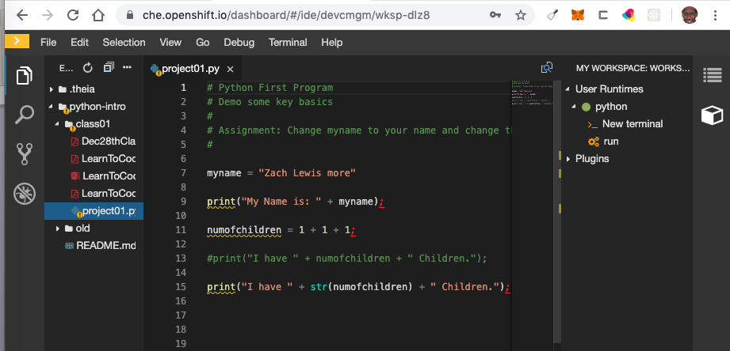
Setting up your cloud learning environment – Final Step Create Python Workspace.

Slide 16
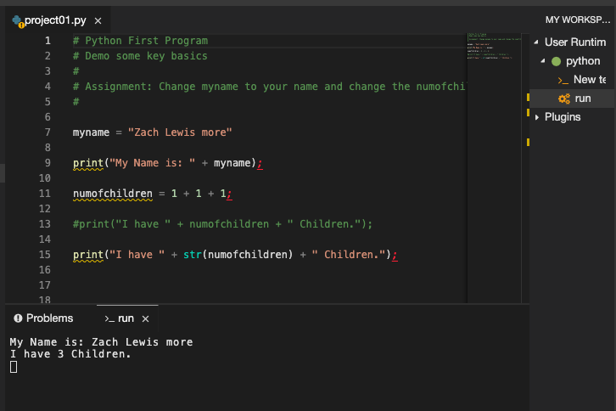
Setting up your cloud learning environment – Final Step Create Python Workspace.

Slide 17
Next Week Seven Concepts
Next Week we will explain the seven key concepts of programming.
Data Storage Variables.
Control - Conditional statements (“if” statements) ...
Control - Looping and iteration. ...
Data Representation - Data types and data structures. ...
Control - Functions.
Statements
Expressions

