Slide 1
MGMWERX’s WERX Wednesday: Elements of Modern Web Development
Yes it is that simple. Fast, Flexible and Free Development

Slide 2
Agenda
Introductions
Demo - Creating/Deploying a Web App in 15 Minutes.
Web and App Development What Has Changed ?
Hands on Demo with Tools for Fast, Flexible and Free App Development
Q/A

Slide 3
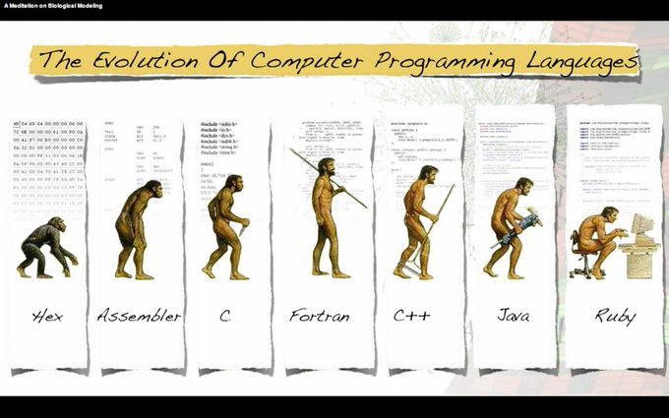


Basic
C
Cobol
Fortran
Pascal
Hex Codes
Assembler
C++
Smalltalk
ProLog
4GL
Java
PHP/Perl
Ruby
ObjC
Python
JavaScript
Swift
NodeJs
Scala
Dapps
Go
Kotlin
Solidity

Slide 4
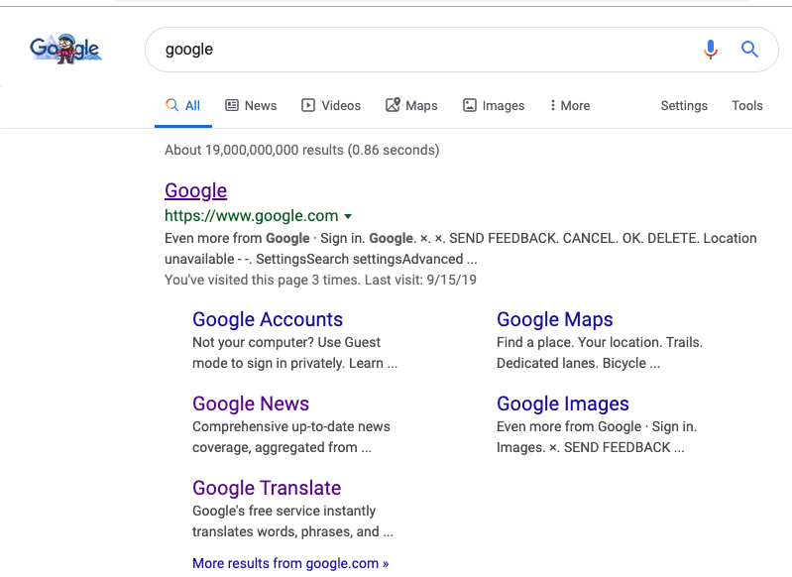
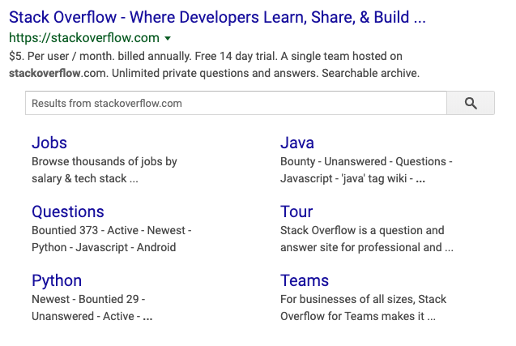
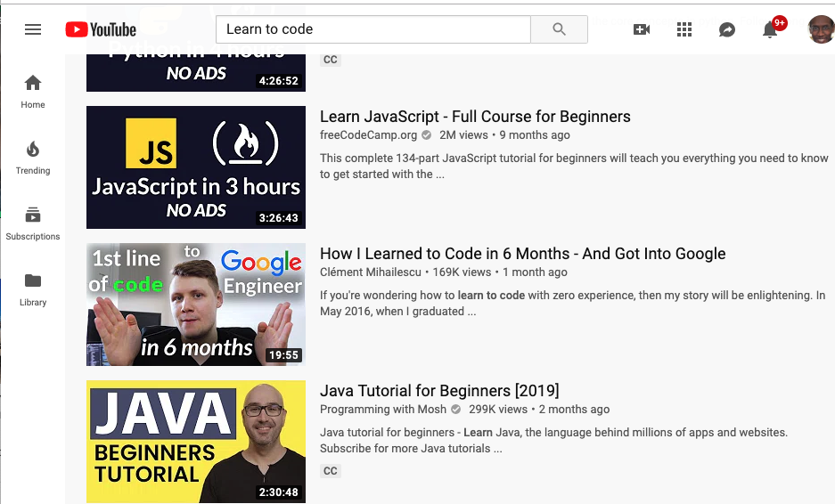
What’s Changed and Changing

Slide 5
Development - What’s Changed and Changing
Now anyone who has basic computer skills and the internet can learn how to build complex apps for FREE. Yes FREE
Complexity of development is reduced by prebuilt frameworks
Development Tools free. VS Code, Node, Atom, CodeSandbox and …
Development Cloud Servers available for free. Heroku, Zeit,, Etc …
Programming App Containers, NodeJs and JavaScript Cloud Platforms. From standard Programing Languages to Javascript and Derivatives like Blockchain’s Solidity

Slide 6
Hiring What’s Changed and Changing
Does the person have people/teamwork skills ?
Can the person handle rapid change ?
Can the person learn fast ?
Does the person understand key concepts ?
Does the person have experience with Open Source tools ? Github, NodeJs, Python, Docker, Kubernetes, Linux, etc…
Do they want to work for us and have a passon for our mission ? NOTE: Memorizing things that you can find on google in one minute is NOT as important.

Slide 7
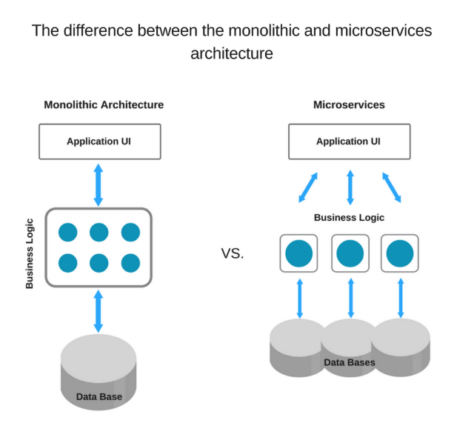
Java
C#/ASP.Net
NodeJs
Scala
Now
it is easier

Slide 8

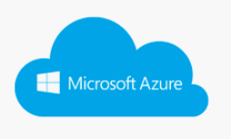



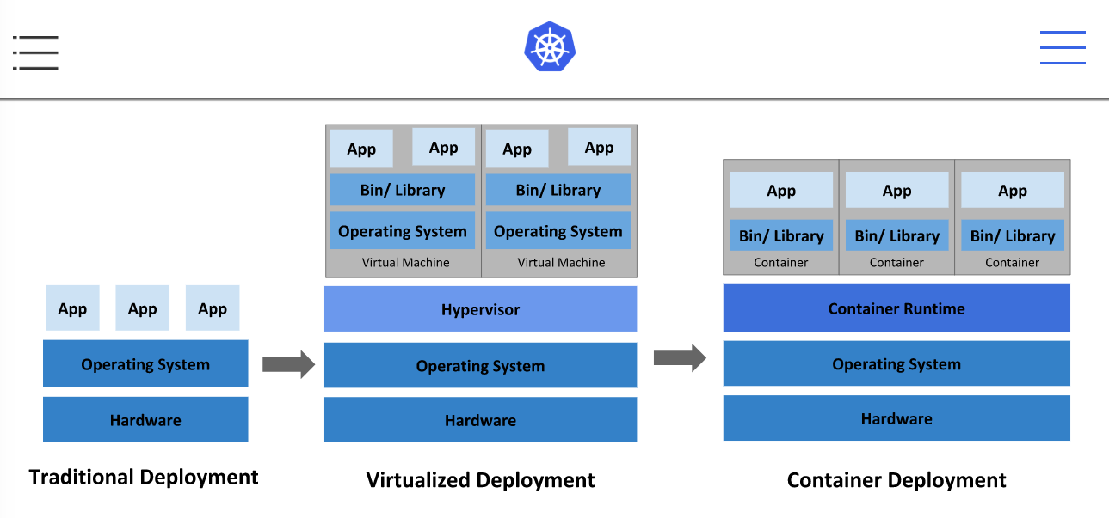

From Servers to Containers

Slide 9
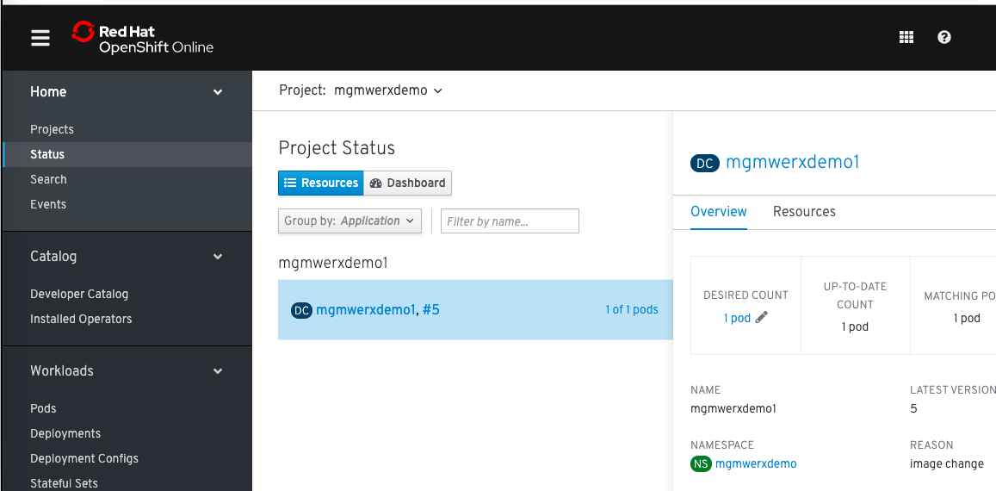
Red Hat Open Shift

Slide 10
Key Features
Management Automation
Self-healing (Resiliency)
Secret and configuration management
Automated rollouts and rollbacks

Slide 11
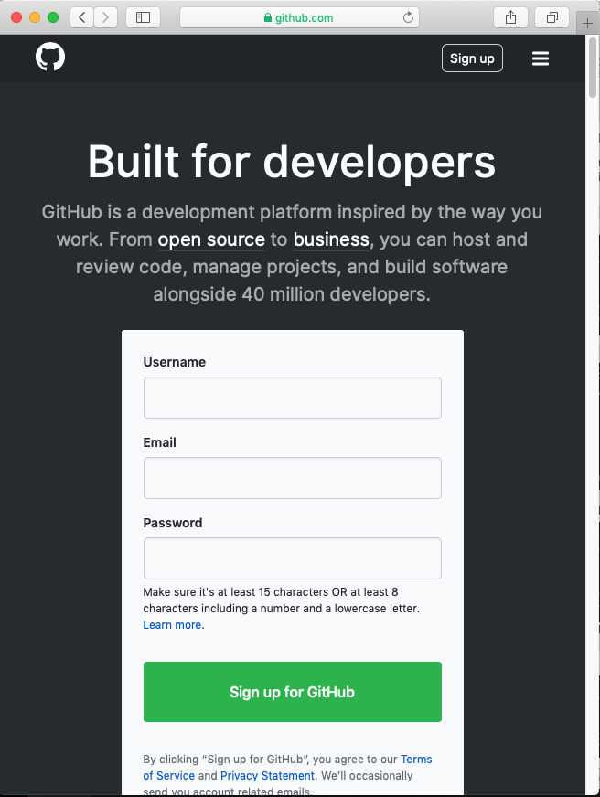
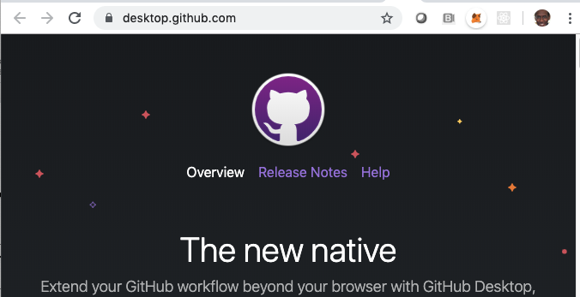
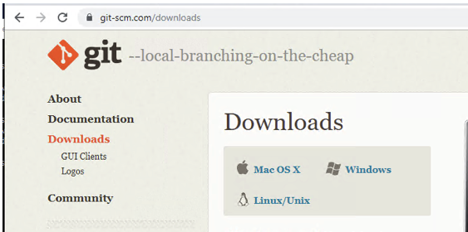
First Things First: --- GitHub.com
NOTE: GitHub provides an account for single sign-on to other service and as a source code repository.
Create a Github Account at
https://github.com
Download Github client or GUI Desktop Tool at:
https://desktop.github.com Or https://git-scm.com/downloads

Slide 12
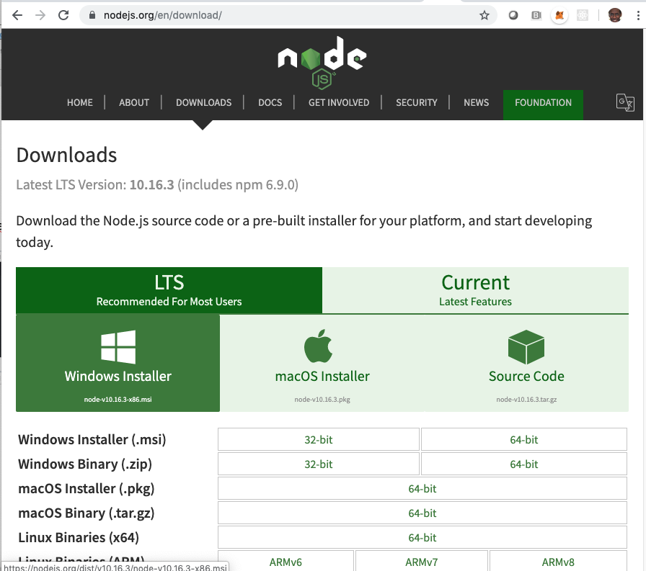
NodeJs
NODEJs is the foundation for Javascript based application development.
https://nodejs.org/en/download

Slide 13
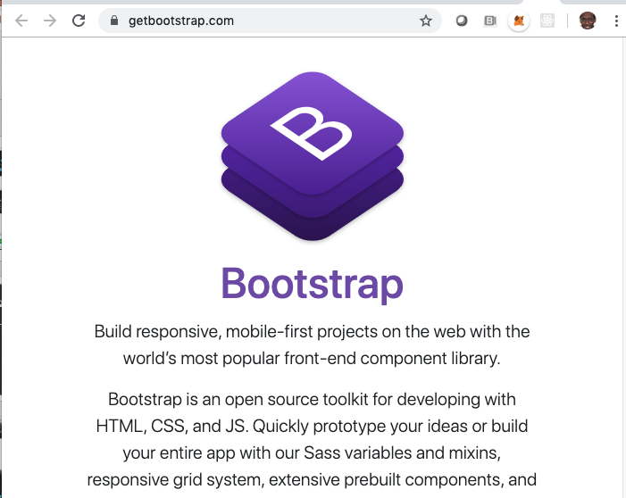
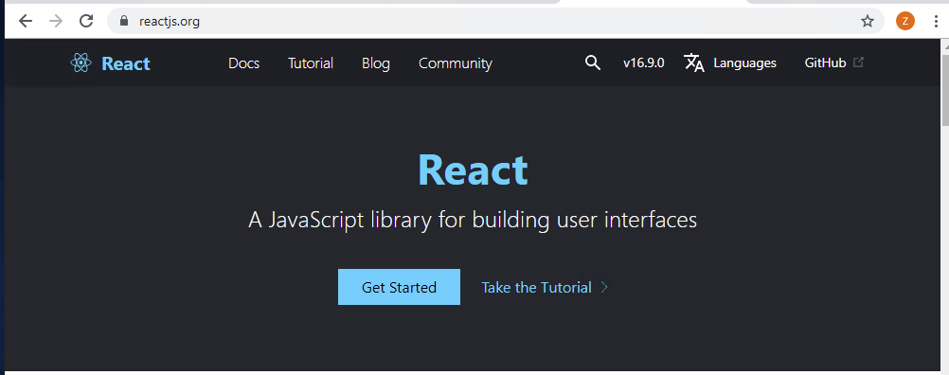
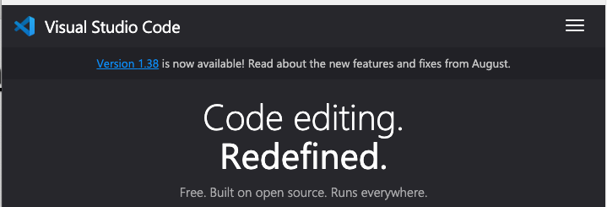
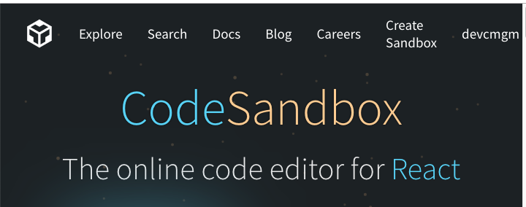
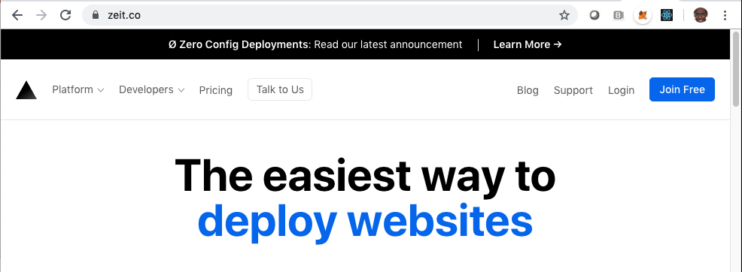
Key Tools used in Development.
Development Tools
https://code.visualstudio.com
https://codesandbox.io

Slide 14
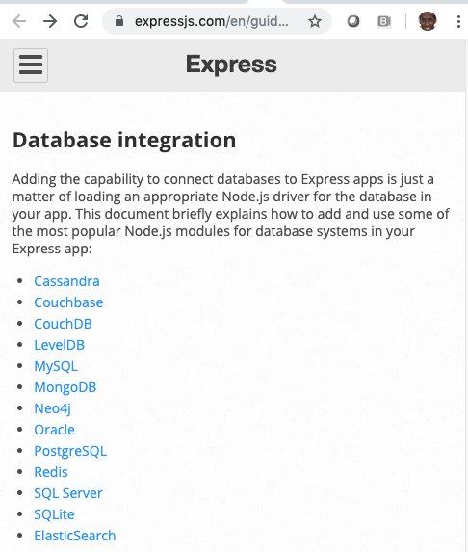
Key Tools used in Development.
JavaScript Libraries:
https://reactjs.org
https://getbootstrap.com/
https://expressjs.com
Development Tools
https://code.visualstudio.com
https://codesandbox.io

Slide 15
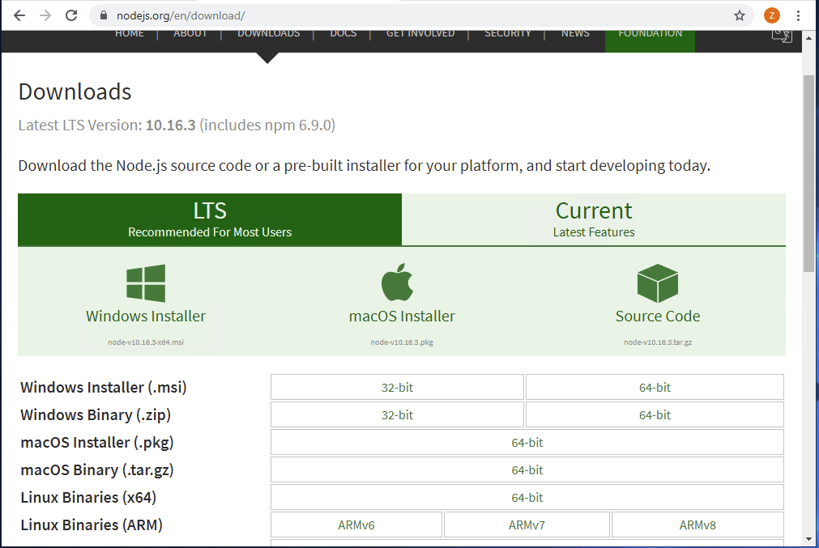
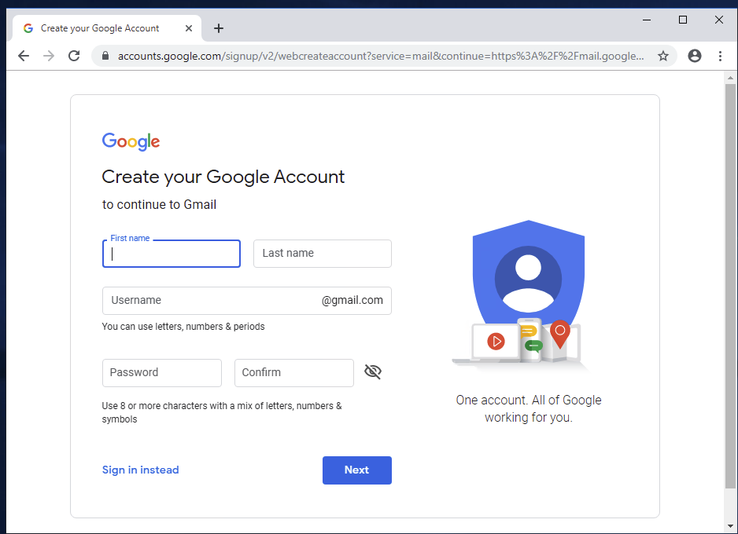
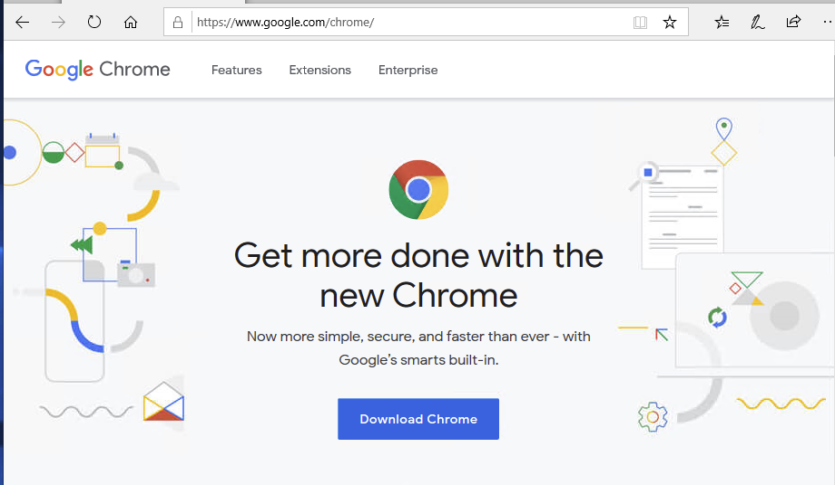
Local Development Tools Basics
Download Chrome, NodeJs, Get Chrome Email
recommended base tools for local development

Slide 16
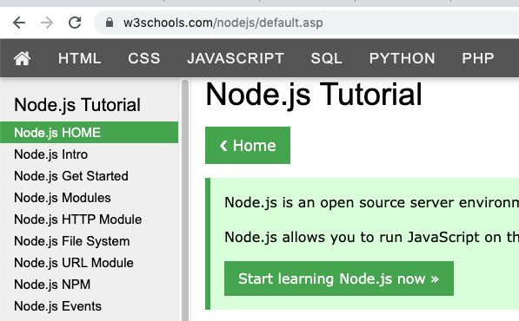
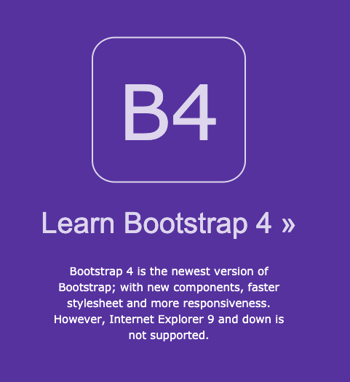
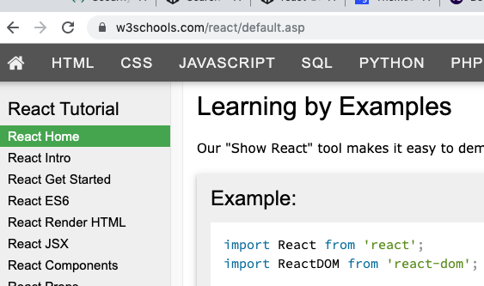
W3Schools is a great place to learn.
Bootstrap -- https://www.w3schools.com/bootstrap
React -- https://www.w3schools.com/react\
NodeJS -- https://www.w3schools.com/nodejs

Slide 17
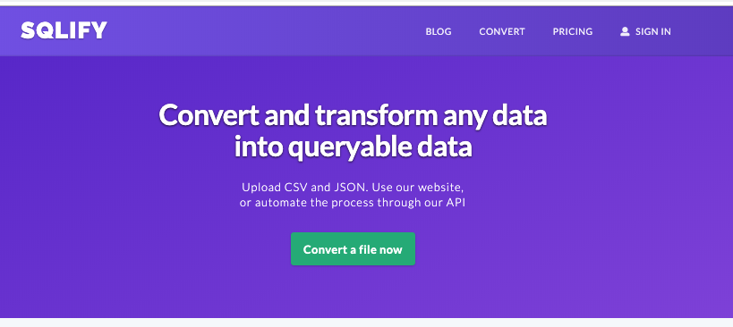
Convert my JSON Messages to SQL
https://sqlify.io/
Example
Data
Transformation

Slide 18
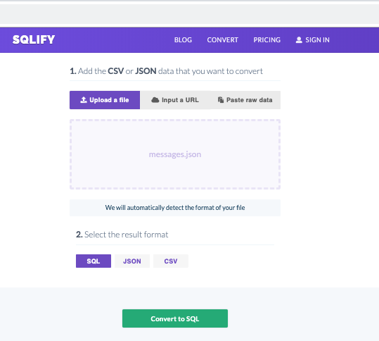
Convert my JSON Messages to SQL
https://sqlify.io/

Slide 19
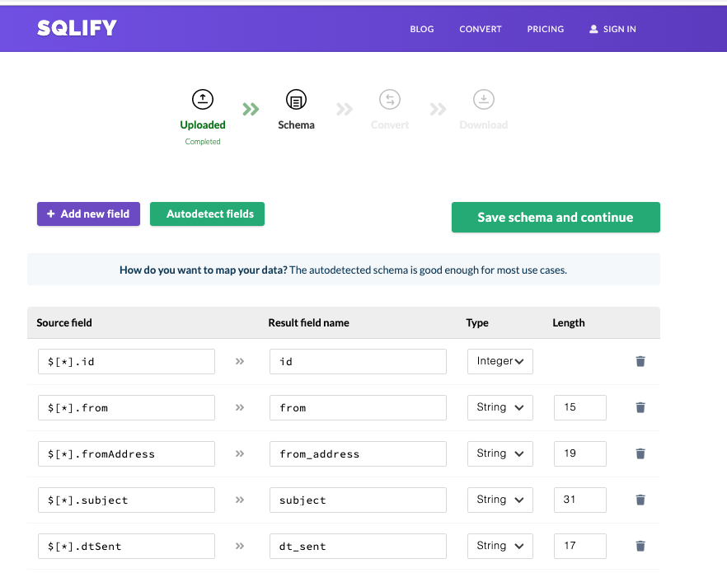
Convert my JSON Messages to SQL
https://sqlify.io/

Slide 20
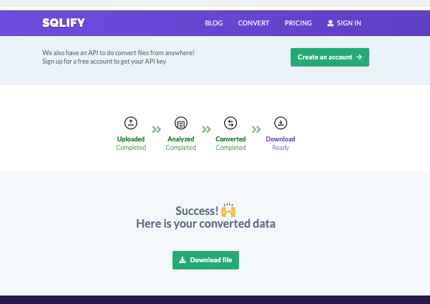
Convert my JSON Messages to SQL
https://sqlify.io/

Slide 21
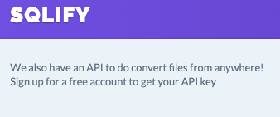
Convert my JSON Messages to SQL
https://sqlify.io/
Example Data Output
CREATE TABLE IF NOT EXISTS data (
id INT NULL,
from VARCHAR(15) NULL,
from_address VARCHAR(19) NULL,
subject VARCHAR(31) NULL,
dt_sent VARCHAR(17) NULL,
body VARCHAR(180) NULL,
priority INT NULL
);
INSERT INTO data VALUES
(1,"Gary Lewis","test@foofoo.com","I saw this posting on the board","Today\, 9:18AM","Hey Mark\,<br><br>I saw your post on the message board and I was wondering if you still had that item available. Can you call me if you still do?<br><br>Thanks\,<br><b>Gary Lewis</b>",NULL),
…

Slide 22


Build and Deploy
Web App
In. 15 Minutes
Live Demo

Slide 23
Demo Building Apps in
https://codesandbox.io
Zeit Now Demo
https://tinyurl.com/y2cnjczf

Slide 24
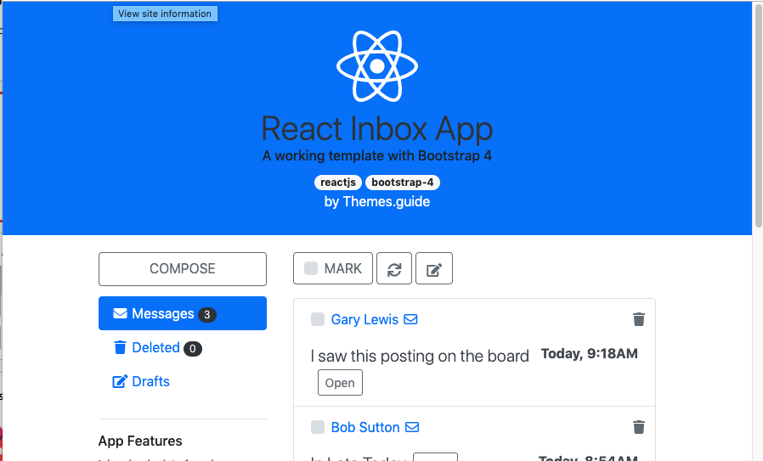
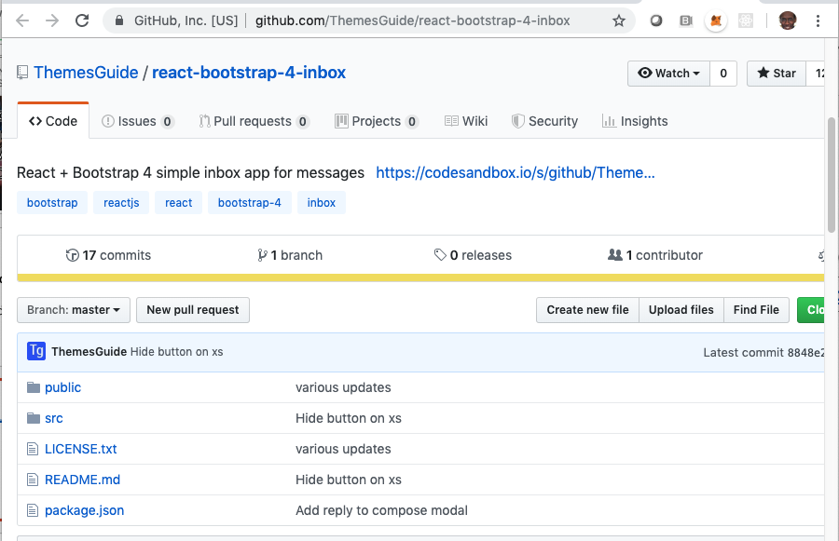
Demo Building Apps Custom Email
NOTE: Suppose you want to create your own messaging app?
Demo Custom Messenging App
https://llzykynvnq.codesandbox.io/
Source Code for Demo Custom Messenging App
https://github.com/ThemesGuide/react-bootstrap-4-inbox

Slide 25
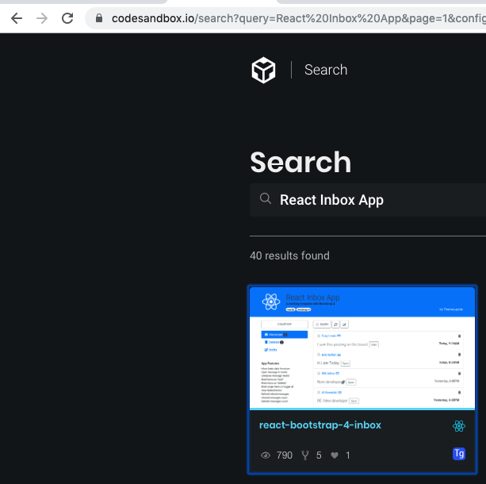
Demo Building Apps Custom Email
https://codesandbox.io/search

Slide 26
CREATE TABLE IF NOT EXISTS data (
id INT NULL,
from VARCHAR(15) NULL,
from_address VARCHAR(19) NULL,
subject VARCHAR(31) NULL,
dt_sent VARCHAR(17) NULL,
body VARCHAR(180) NULL,
priority INT NULL
);
INSERT INTO data VALUES
(1,"Gary Lewis","test@foofoo.com","I saw this posting on the board","Today\, 9:18AM","Hey Mark\,<br><br>I saw your post on the message board and I was wondering if you still had that item available. Can you call me if you still do?<br><br>Thanks\,<br><b>Gary Lewis</b>",NULL),
(2,"Bob Sutton","test@testdomain.com","In Late Today","Today\, 8:54AM","Mark\,<br>I will be in late today due to an appt.<br>v/r Bob",NULL),
(3,"Will Adivo","test@testbar.com","New developer","Yesterday\, 4:48PM","Here is the last resume for the developer position we posted on SO. Please review and let me know your thoughts!",NULL),
(4,"Al Kowalski","test@domain.com","R

Slide 27
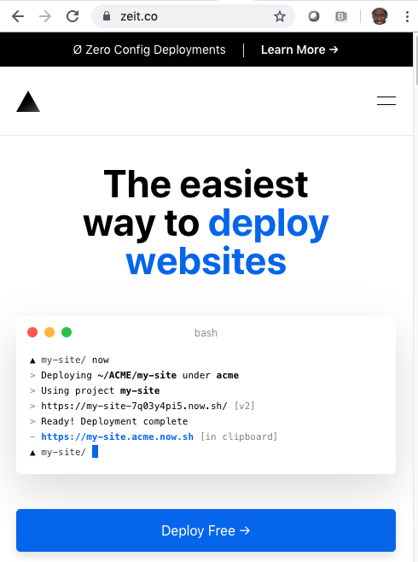
Key Tools used in Deployment.
https://zeit.co

Slide 28
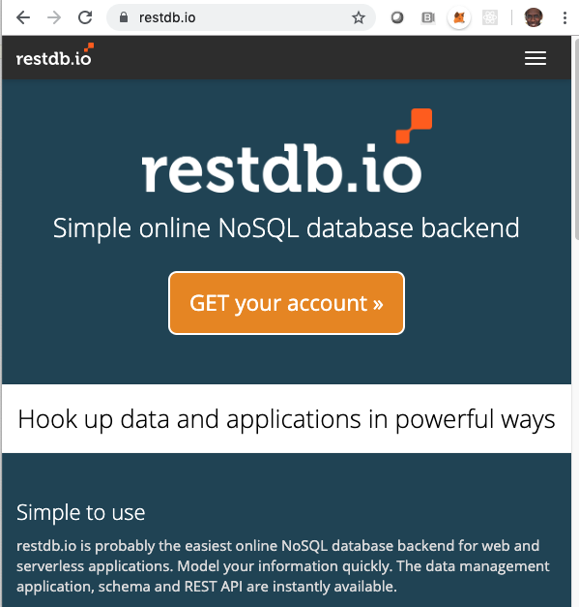
One more thing
Restdb.io is a simple place to test Rest API Code.

Slide 29

Questions and Answers

Slide 30
Demo Web Urls
Zeit Now Demo https://tinyurl.com/y2cnjczf
Red Hat Open Shift Demo https://tinyurl.com/y42eteqc

