Slide 1
50K
15.78%
42.11K
7.89K
Total Users
Churn Rate
Active Users
Churned Users
Churn isn't about engagement…
it's about disappearance.
A data-driven look at what actually makes users leave — Music Streaming Platform, 2026
Behavioral analysis of 50,000 users
Nisha Kumari | Music Streaming Churn Analysis

Slide 2
02 PROBLEM
The Questions I Wanted to Answer
❓
📊
🔮
Why do users churn?
Does engagement really matter?
Can we predict churn early?
Is it behavior, subscription tier, or something less visible?
Or are we measuring the wrong signals entirely?
Before it's too late to retain the user?
Dataset: Music Streaming User Behavior | 50,000 Users | Tools: Excel · SQL · Power BI
Nisha Kumari | Music Streaming Churn Analysis

Slide 3
03 SCOPE
What I Analyzed
📈
Engagement Levels vs Churn
⏭️
Skip Behavior vs Churn
Compared High / Medium / Low engagement against churn rates to see if usage intensity predicts leaving.
Analyzed Low, Medium and High skip groups — does frequently skipping songs signal dissatisfaction?
💤
Inactivity Patterns
🎧
Listening Time
Measured inactive vs active users and their churn probability — this turned out to be the key driver.
Compared listening duration across churned vs active users
Nisha Kumari | Music Streaming Churn Analysis

Slide 4
04 KEY INSIGHTS
What the Data Revealed 🔥
⚡
Inactivity Is the #1 Churn Driver
📉
Engagement Has Minimal Impact
Inactive users churned at a dramatically higher rate than active users — the clearest signal in the data.
High, Medium & Low engagement users showed nearly identical churn rates (~15.75–16.79%). Not predictive.
⏭️
Skip Behavior: Surprisingly Flat
🎧
Listening Time: Almost Identical
Churn rates were near-equal across Low (16.53%), Medium (15.64%) and High (15.79%) skip groups.
Churned and active users had near-identical average daily listening durations. Duration alone doesn't predict churn.
Nisha Kumari | Music Streaming Churn Analysis

Slide 5
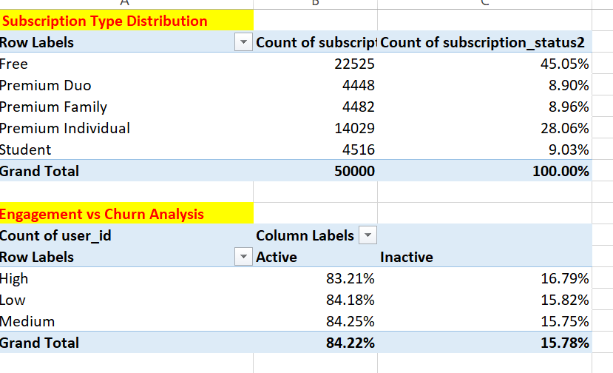
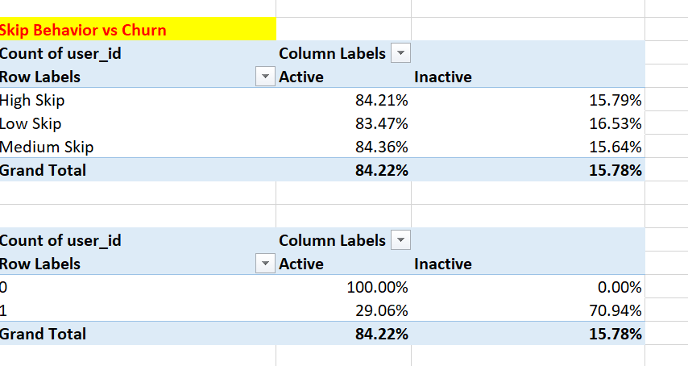
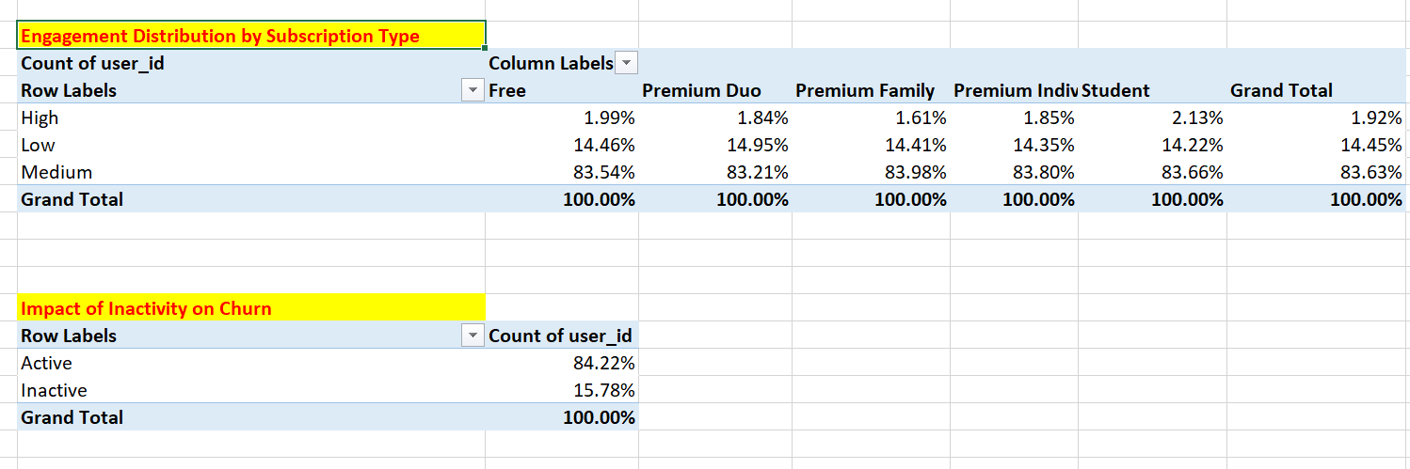
05 EXCEL
Data Preparation (Excel)
Pivot Tables
Cleaned Raw Dataset
01
Nulls handled, data types fixed, columns standardized
02
Created Derived Columns
engagement_level, skip_group, inactivity flags
03
Built Pivot Tables
Churn by subscription, engagement, skip & inactivity
04
Identified Key Patterns
Inactivity emerged as key driver before visualisation
Nisha Kumari | Music Streaming Churn Analysis

Slide 6
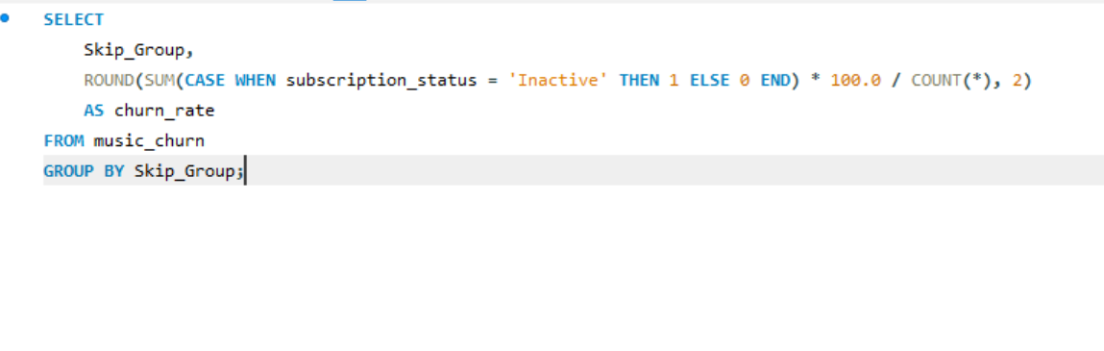
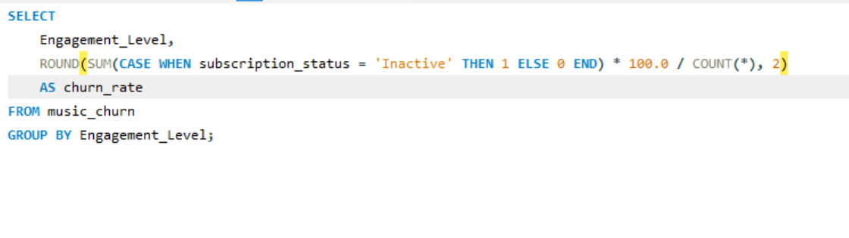
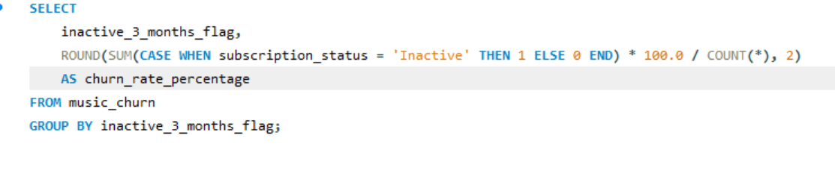
06 SQL
SQL Queries
Data Analysis (SQL)
Extracted Churn Metrics
01
Churn rate, active count, subscription breakdowns
02
Grouped by Behavior
GROUP BY skip_group, engagement_level, inactivity flag
03
Calculated Churn %
Calculated churn % using conditional aggregation
04
Validated Excel Findings
Cross-checked every pivot insight with SQL result sets
Nisha Kumari | Music Streaming Churn Analysis

Slide 7
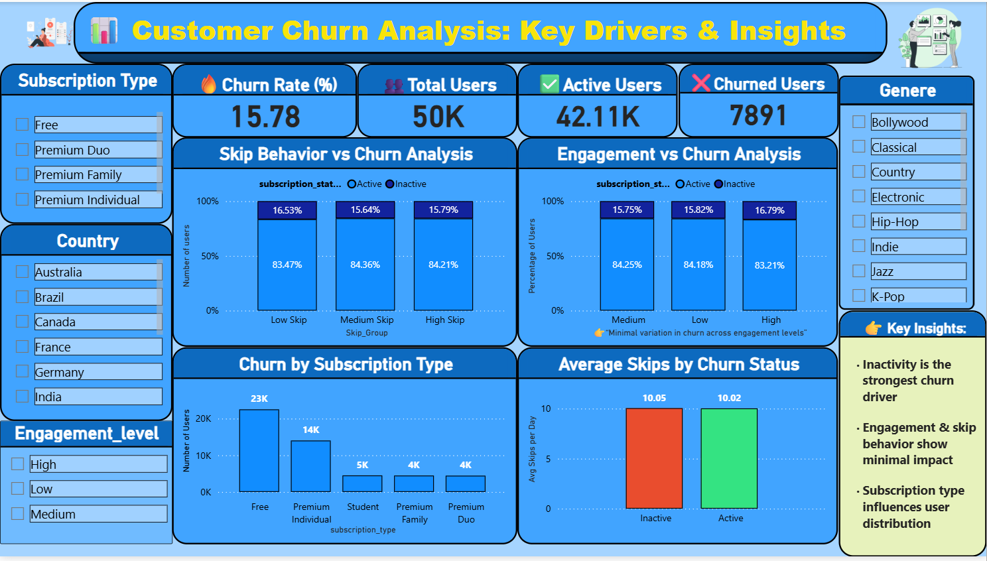
07 POWER BI
Final Dashboard
Interactive Filters
Slice by Genre, Subscription & Engagement level
Churn KPIs
15.78% rate · 50K users · 7.89K churned
4-Chart Layout
Skip, Engagement, Subscription & Inactivity views
Key Finding
Inactivity is the dominant churn signal
Nisha Kumari | Music Streaming Churn Analysis

Slide 8
08 LEARNINGS
What I Learned
Churn Builds Silently
🕰️
Users don't leave suddenly — they drift. Inactivity is the earliest and clearest warning sign available.
Behavior Matters More Than Activity
🧠
What users stop doing reveals far more than what they continue. Absence of action is itself a signal.
Not Every Metric Is Meaningful
🚫
Skip rate and engagement level had almost no predictive power here. Data analysis means knowing what to ignore.
Nisha Kumari | Music Streaming Churn Analysis

Slide 9
09
Think Beyond the Dashboard
The goal isn't dashboards.
It's understanding behavior before it becomes loss.
📊 Excel
🗄️ SQL
📈 Power BI
Nisha Kumari
Data Analyst | Music Streaming Churn Analysis | 2026

