Slide 1
B유형 기말고사 대체
20211224_박광선
20211343_김동현

Slide 2
목차
Data Introduction
Model Introduction
Graph Introduction
Comparison of loss functions

Slide 3

Data Introduction
This data is showing lungs capacity of smokers and non-smokers by age, gender and height.
Here's the meaning of variables:
LungCap: It’s the lung capacity(closing capacity) of the person Age: It’s how old is the person Height: It’s how tall is the person Smoke: If the person smokes or doesn’t smoke Gender: If are male or female
https://www.kaggle.com/datasets/prathibhapradhan/regression-dataset?select=LungCapData2.csv

Slide 4
Model Introduction
SVR, mean_squared_error, PCA from Scikit learn
Pandas, Numpy, matplotlib, seaborn
SVR 모델을 통해 Age, Height, Gender, Smoke 4개의 변수와 Lung Capacity 변수와의 연관성을 학습하고, 추후 학습되지 않은 Age, Height, Gender, Smoke 변수가 입력되었을 때, 추론한 결과를 반환합니다.

Slide 5
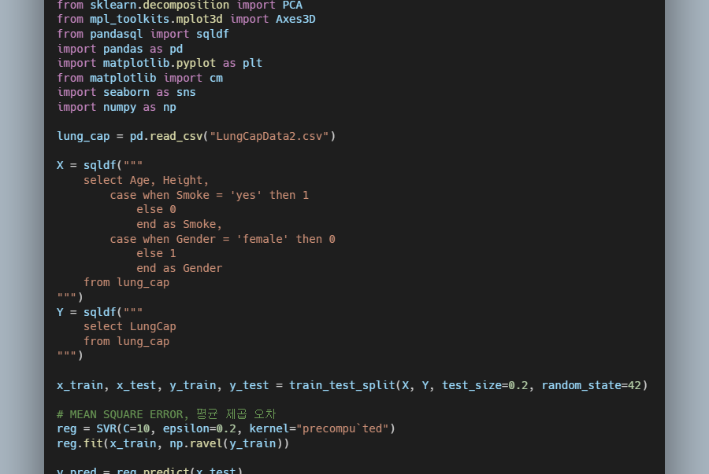
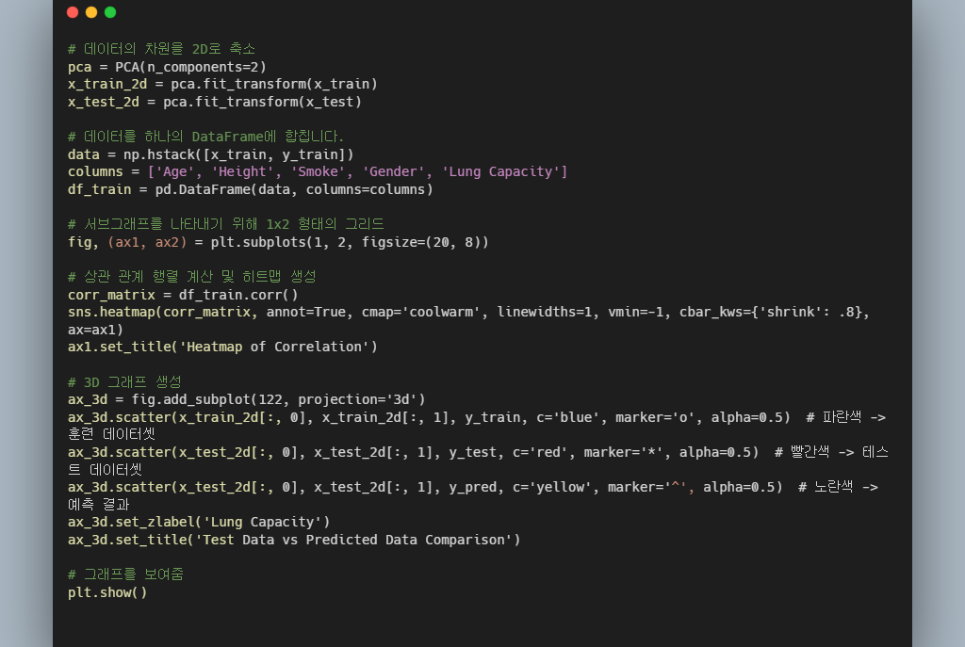
Code Image

Slide 6
Comparison of Kernel functions
Linear
Poly
Rbf
Sigmoid

Slide 7
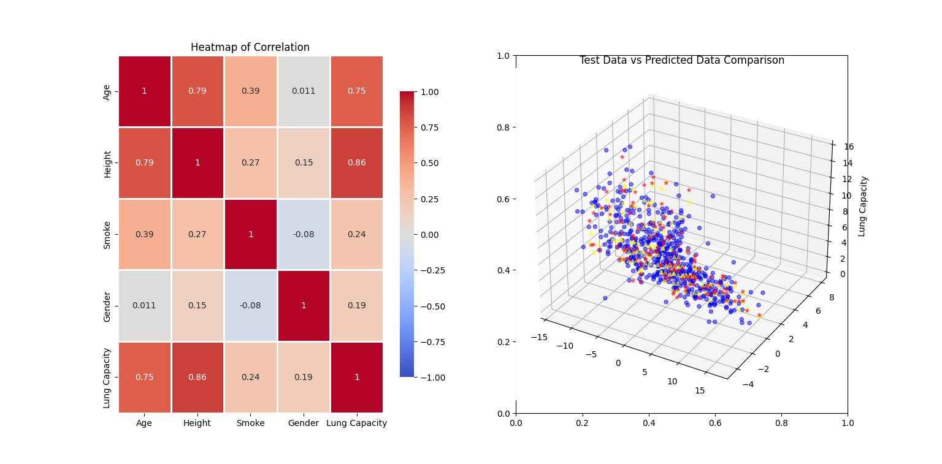
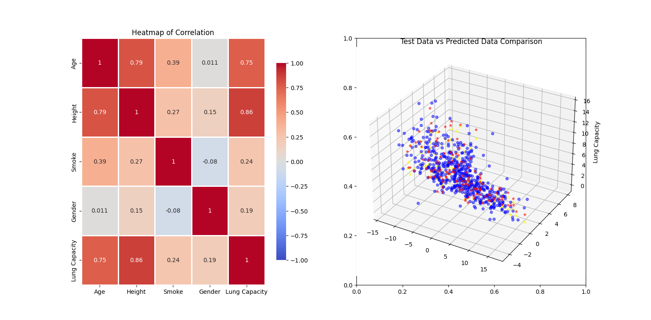
Linear
Poly

Slide 8

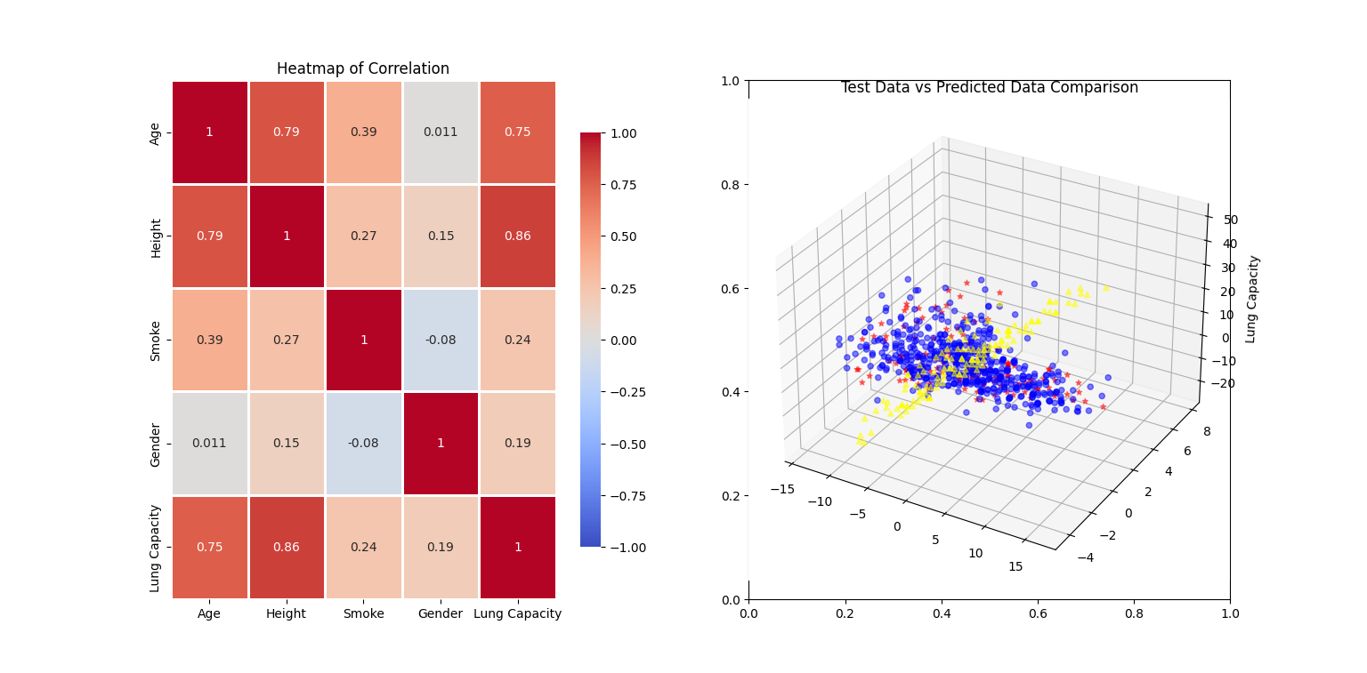
Rbf
Sigmoid

Slide 9
Sigmoid

Slide 10
Comparison of Kernel functions
Sigmoid 그래프는 눈으로 확인할 수 있을 만큼의 오차가 발생함
Poly: MSE: 1.325854804274837
Linear: MSE: 1.5160085323933927
Rbf: MSE: 1.3536453580642638
Sigmoid: MSE: 385.18880833557716

