Slide 1

Container CI using Openshift and Jenkins pipelines
Scott Hebert
Notes:
Welcome to Container CI using Openshift and Jenkins pipelines
My name is Scott Hebert

Slide 2
Agenda
Introduction
Motivation
Use case
Options
Solution
Demo
Questions
Notes:
The agenda for the talk will be:
A quick intro
Discuss the motivation for this talk
Go over a simple use case to demonstrate the topic
Look at other options
Talk about we solved this use case
I will show you a video of it in action
Time for questions

Slide 3

Introduction
About me
Scott Hebert
@ Red Hat for 2 yrs
In the System Engineering organization
From Montreal, Canada (Go Habs Go!)
Jenkins contributor
Notes:
About me
Scott Hebert
@ Red Hat for 2 yrs
In the System Engineering organization
From Montreal, Canada (Go Habs Go!)
Jenkins contributor
Brno story?

Slide 4
Introduction
DevConf CI/CD track (in this room E104)
Delivering a host platform at the speed of light
Container CI with Jenkins and Openshift (This talk)
Minishift: CI/CD in the palm of your hand
Lessons Learned Implementing Builder Containers
Notes:
This talk is part of the DevConf CI/CD track (in this room)
This is part 2 of 4 talks
I highly encourage you to stick around for Rob and Bill’s talks

Slide 5
Motivation
Need to be able to run a change thru a pipeline where the build, package and test steps were all performed within different containers.
Ensure that changes to these build containers would not affect the production flow.
We need CI of our containers!
Notes:
During work on the project A faster moving Atomic Host at Red Hat, we needed to be able to run a change thru a pipeline where the build, package and test steps were all performed within different containers.
These containers were dependent on each other in that inputs to future stages of the pipeline are obtained from outputs from the early stages.
During development of the pipeline, we needed to ensure that changes to these build containers would not affect the production flow.
We needed CI of our containers!

Slide 6
Simplified Use Case
Multiple container images that are dependent on each other.
Test changes to one container image independently while keeping other container images and code/scripts fixed.
Add/update files in a container image for test scenario.
Promote image once tests pass.
Notes:
Our simplified use case consists of the following:
Application with multiple container images that are dependent on each other.
Testing changes to a container image independently while keeping other container images and code/scripts fixed.
Adding/updating files in a container image for testing purposes.
Gathering logs from each.
Once tests pass, image should be promoted.

Slide 7
Options
Trigger a Jenkins job for a change in source control:
Use Jenkins to create a node with Docker pre-installed.
Where do you get your images from?
How do you build the intermediate containers with the change in question?
Where do you put your images after your tests?
Notes:
We looked into what was already being used for this use case:
You could trigger a Jenkins job for a change in source control
Would you then create jenkins node with docker pre-installed?
Where do you get images from?
How do you build intermediate containers for change in question?
Blindly?
Where do you put images after?

Slide 8
Solution
Container CI with Openshift and Jenkins pipelines
Container workload as well as Jenkins instance and nodes provisioned with Openshift Container Platform
Trigger pipeline jobs using GitHub Pull Request Builder plugin
Determine which containers need to be built based on changeset
Jenkins Declarative Pipeline using conditional steps with changesets
Build, Tag and Store these intermediate images
Jenkins Openshift Client plugin
Create pod with intermediate container images using a PodTemplate in Jenkins pipeline
Create Jenkins node using pod and interact with containers using ‘sh’ commands
Jenkins Kubernetes Plugin
Promote new container images automatically when PR is merge
Notes:
Our solution for Container CI is as follows:
Our Container workload is handled by Openshift Container Platform
Pipeline jobs triggered using GitHub Pull Request Builder plugin
New PR or PR updated
Determine which containers need to be built based on changeset
This is done using the Jenkins Declarative Pipeline which provides conditional steps with changesets
We need to Build, Tag and Store our intermediate images
Accomplished using Jenkins Openshift Client plugin
Create pod with intermediate container images using a PodTemplate in Jenkins pipeline
Create Jenkins node using our newly provisioned pod and interact with the pod’s containers using standard pipeline ‘sh’ commands
Accomplished using Jenkins Kubernetes Plugin
Promote new container images automatically when PR is merged

Slide 9

Openshift Container Platform
OpenShift Container Platform is Red Hat's on-premises private platform as a service product, built around a core of application containers powered by Docker, with orchestration and management provided by Kubernetes, on a foundation of Red Hat Enterprise Linux.
Notes:
I will now go over some of the technology in the solution
For our container workloads, we use Openshift container platform
For those that do not know Openshift, it is a great product
It is built around a core of containers powered by Docker with orchestration by Kubernetes
Allows you to build containers from source
Allows you to orchestrate the creation and operation of pods

Slide 10


Jenkins Node
Pod
Connection between jenkins container and master
Jenkins node container
component1 container
Shared Jenkins Workspace
component2 container
Notes:
This is an image of how our Jenkins node is composed in Openshift
Pod with:
Jenkins node container
Handles the connection to jenkins master
Each component container
All container share the same workspace

Slide 11
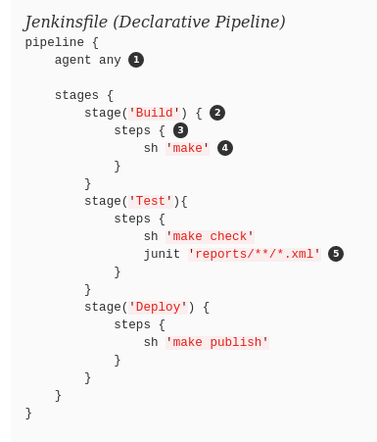
Jenkins Pipelines
Jenkins Pipeline is a suite of plugins which supports implementing and integrating continuous delivery pipelines in Jenkins.
Allow you to programmatically drive the execution of build steps via DSL.
Notes:
Jenkins pipelines
This is a suite of plugins which supports continuous delivery pipelines in Jenkins.
Allow you to programmatically drive the execution of build steps via DSL.

Slide 12
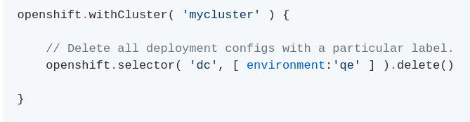
Jenkins Openshift Client Plugin
A Jenkins plugin that provides a readable, concise, comprehensive, and fluent Jenkins Pipeline syntax for rich interactions with an OpenShift API Server.
Provides convenient methods to interact with Openshift
Notes:
Jenkins Openshift Client Plugin
This is a plugin that provides Jenkins Pipeline syntax for interactions with OpenShift.
Provides convenient methods to interact with Openshift
build()
describe()
tag()
delete()

Slide 13
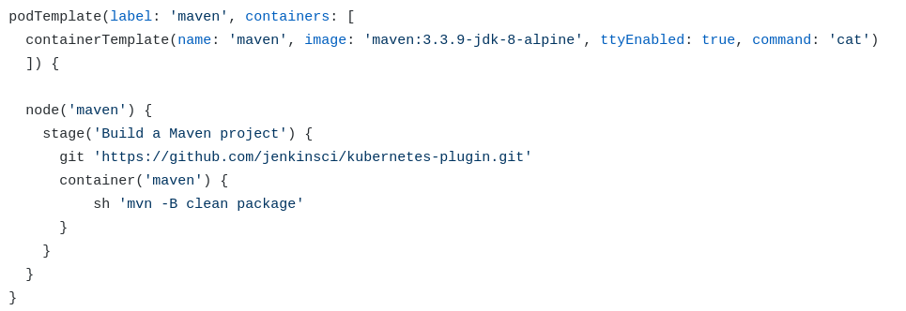
Jenkins Kubernetes Plugin
Jenkins plugin to run dynamic agents in a Kubernetes cluster.
Notes:
Jenkins Kubernetes Plugin
This is a plugin to run dynamic Jenkins agents/nodes in a Kubernetes cluster.
Allows you to:
Define and create Pod Templates based on container templates and use the resulting pods as Jenkins node.
Use convenient pipeline methods to create Pod Templates within a pipeline.
Share workspace between all containers automatically.

Slide 14
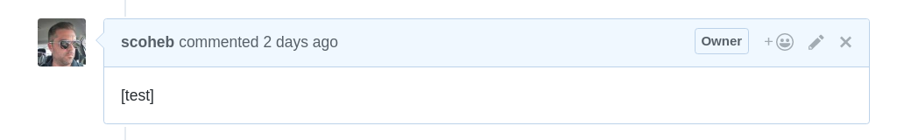
GitHub Pull Request Builder Plugin
Jenkins plugin builds pull requests from GitHub and will report the results directly to the pull request via the GitHub Commit Status API
A new build can also be started with a comment: [test]
Notes:
GitHub Pull Request Builder Plugin
This a Jenkins plugin that builds pull requests from GitHub and reports the results directly to the pull request via the GitHub Commit Status API
A new build can also be started with a comment: [test]

Slide 15
Putting all together!
All code is stored here: https://github.com/scoheb/containerCIDemo
4 Pieces to the puzzle
Openshift setup
Application Test pipeline
Verification pipeline
Merge pipeline
Notes:
Putting it all together
All code stored in github
There are 4 pieces to puzzle:
Openshift setup
Application Test pipeline
Verification pipeline
Merge pipeline

Slide 16
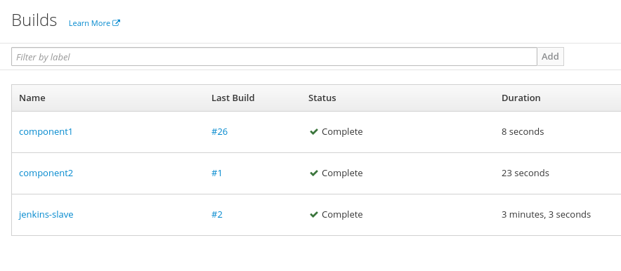
Openshift Setup
Populate Build Configurations
The build configurations specify the location of the source and the relative path of the Dockerfile.
Notes:
Openshift Setup
The Openshift instance needs to be populated with the Build Configurations that will be responsible for the creation of images
The build configurations specify the location of the source and the relative path of the Dockerfile.

Slide 17
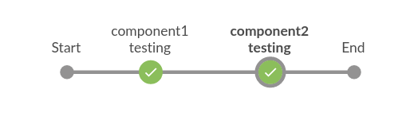
Application Test Pipeline
Pod started with 2 containers
Test scripts needs to be executed in each container.
Notes:
This is the Application Test Pipeline
It models our use case
A pod is created with 3 containers
jenkins-slave
component1
component2
Each stage represents test scripts being executed in each container.

Slide 18
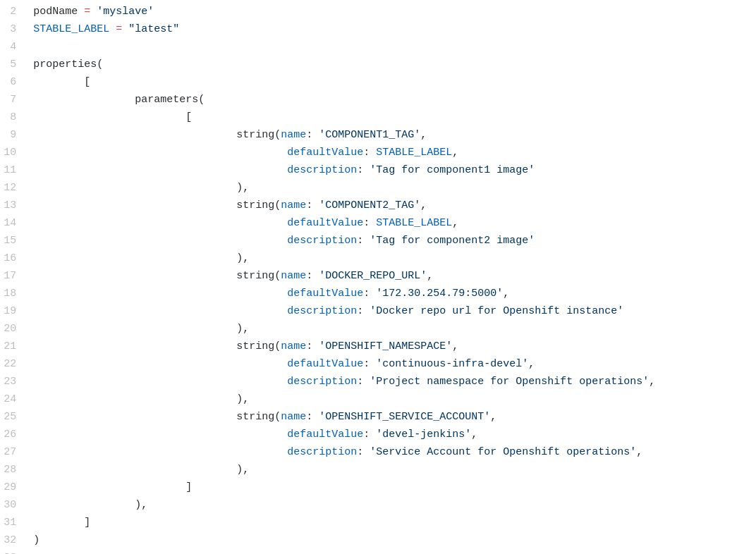
1
Notes:
In the Application Test Pipeline, we need parameters to specify:
Tags to use for each component image
This will allows us to override default value

Slide 19
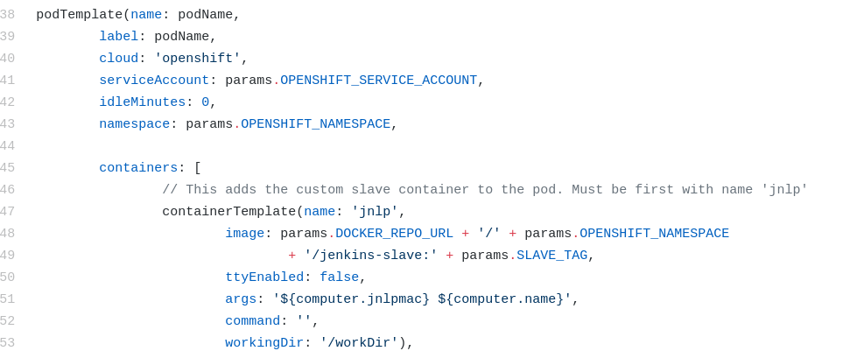
1
2
Notes:
In this image, we specify the pod Template that will allow us to create our Jenkins node
Defines our containers using:
Jenkins slave image
Component 1 and 2 images

Slide 20
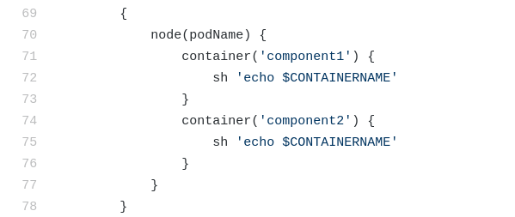
1
2
Notes:
Will want to use our newly provisioned node in our pipeline
We then wrap our scripts within the container they need to be executed in.

Slide 21
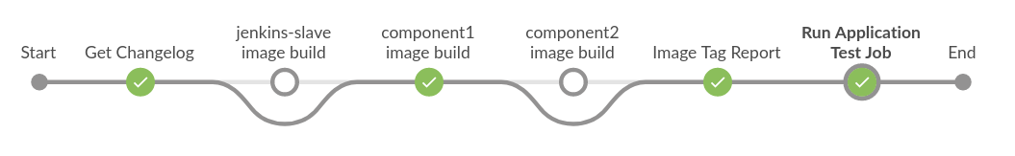
Verification Pipeline
Verify our Application Test Pipeline
How?
Triggered by GitHub event
Containers are built if required.
Application Test Pipeline triggered using new container images built above.
Notes:
This is our Verification Pipeline
We use this to verify our Application Test Pipeline
How?
Started by a GitHub event
New or updated PR OR a comment with ‘[test]’
Images for jenkins-slave, component1 and component2 are built if required.
Application Test Pipeline triggered using new container images built above.

Slide 22
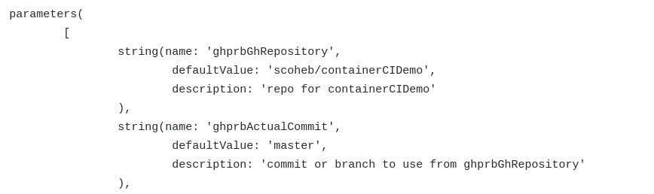
1
Notes:
Taking a closer look at the Verification Pipeline:
We first need to specify Ghprb plugin parameters that will be overridden by PR values

Slide 23
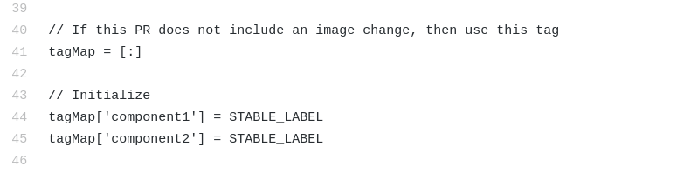
1
Notes:
Our pipeline will determine which tag we need to use based on whether we have rebuilt an image.
We have to first set it to a stable/production value

Slide 24
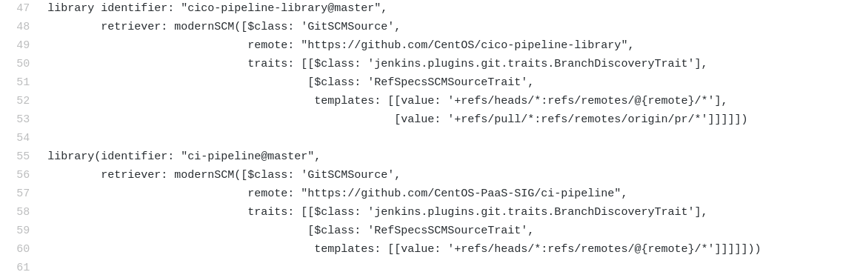
1
Notes:
We make use of Shared Libraries in the Jenkinsfile
Rob Nester will be explaining this in detail in a talk later on.
This step will pull in methods we need for pipeline utilities.

Slide 25
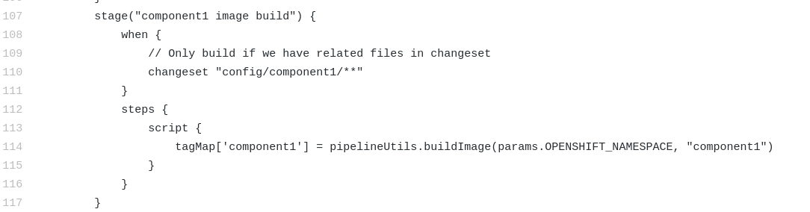
1
2
Notes:
In this image we are seeing the Declarative pipeline syntax
We conditionally execute our build steps
A Conditional based on presence of an affected path in the changeset
We then use a pipeline shared library method of building our image and record its tag for later on.

Slide 26
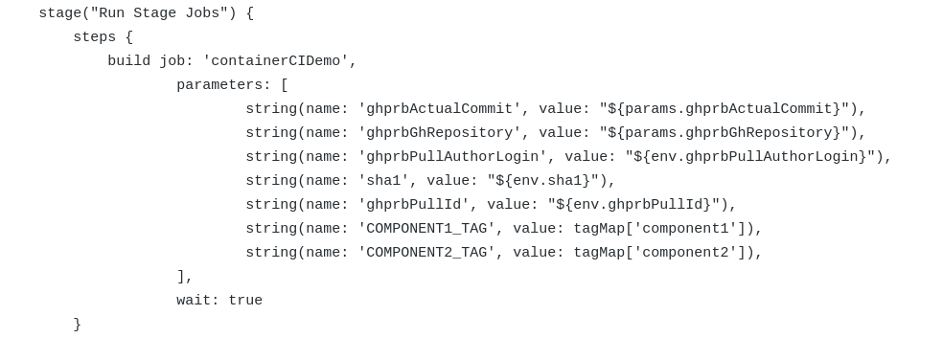
1
2
Notes:
This image shows the same parameters as in Application Pipeline
We use the recorded tags from previous steps.
This is what allows us to make use of previously build PR images

Slide 27
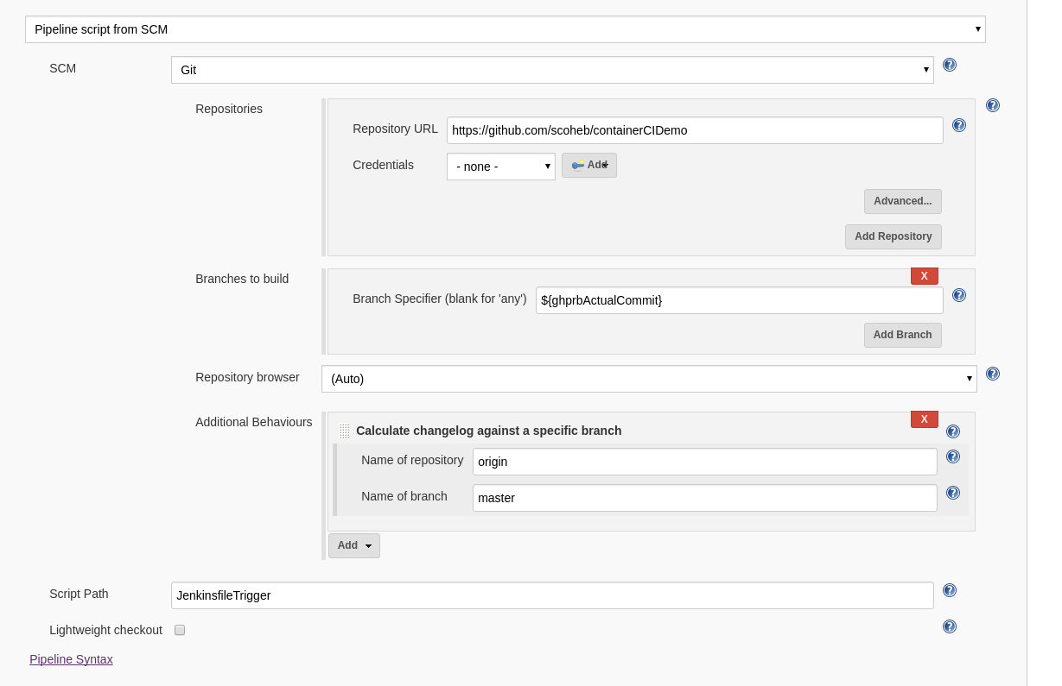
1
Notes:
Important to note that for declarative pipeline to work with conditional steps we need some help from the git plugin
It needs to be told to compute changelogs based on the master branch to always get all changes for PR not just latest commit.

Slide 28
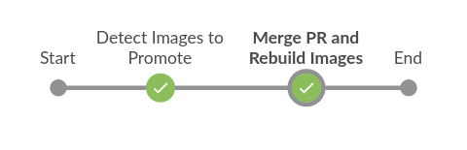
Merge Pipeline
Code Review has been completed
Tests in Verification Pipeline are successful
Trigger a merge by entering “[merge]” as a comment in Github
Notes:
This is our Merge Pipeline
Code Review has been completed
Tests in Verification Pipeline are successful
Trigger a merge by entering “[merge]” as a comment in Github
Our Pipeline starts

Slide 29
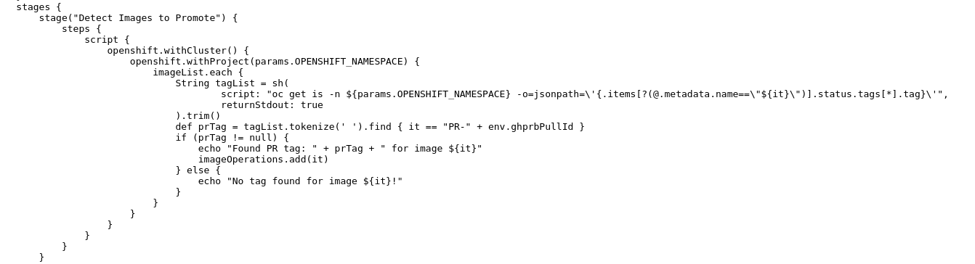
1
2
Notes:
We need to query tags to see if there is a PR tag and record it

Slide 30
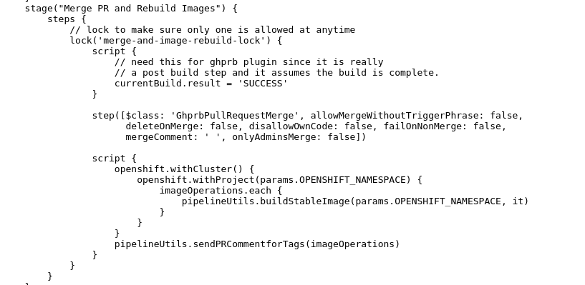
1
2
3
Notes:
Tell GHPRB to merge the PR
Build each image that has been affected by the PR
Update PR with info about promotion

Slide 31
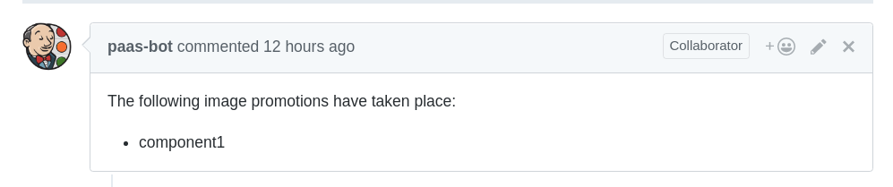
End Result
Notes:
This is our end result
Container tested and validated
PR merged by bot
Container promoted to production
PR comment notification

Slide 32
Demo
See https://www.youtube.com/watch?v=JcvhDPeqBMY

Slide 33
Questions?

Slide 34
Thank you!

Slide 35
References
https://www.openshift.com/container-platform/index.html
https://jenkins.io/doc/book/pipeline/
https://github.com/CentOS-PaaS-SIG/ci-pipeline
https://github.com/scoheb/containerCIDemo
https://github.com/openshift/jenkins-client-plugin
https://github.com/jenkinsci/kubernetes-plugin
https://github.com/jenkinsci/ghprb-plugin

