Slide 1

Please sit back and relax while the presentation is preparing
THANK YOU

Slide 2
500 commits journey to Kubernetes
November 3, 2022
Vasyl Kaigorodov, Senior Engineering Manager
Notes:
Hi, my name is Vasyl, I work as Senior Engineering Manager, leading a team of DevOps engineers at Zeta Global.
Zeta is empowering its’ customers to target, connect and engage consumers through software that delivers personalized marketing across all addressable channels, including email, social media, web, chat, connected TV, and video, among others.
Today I‘m going to speak about how we run and maintain our Kubernetes clusters.

Slide 3
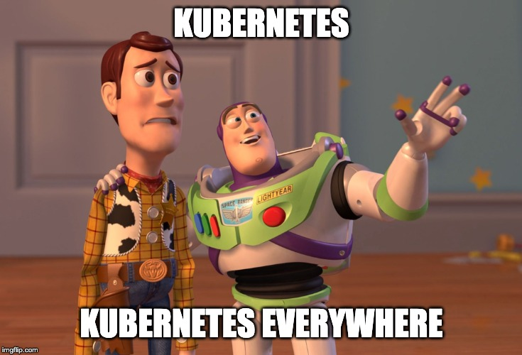
Notes:
We will talk about the cluster architecture, what components we‘re using, and what future enhancements we’re planning to implement in our clusters.

Slide 4
Kubernetes evolution at Zeta
2019
2020
2021
2022
--->
BEGINNING
Scripts and manual work
PRODUCTION
First production workloads; k8s in all DCs
THE FUTURE
Security best practices; clusters recovery process
TESTING PHASE
Some of the internal workloads migrated to Kubernetes
SCALING
More prod workloads migrated; CI workers in k8s; bare-metal clusters
Notes:
We started to look into Kubernetes in 2019; we went a long way from manual cluster deployments in single datacenter to automated management solution based on Kubespray (for cluster management), and GitOps Toolkit (for cluster components and workloads management).

Slide 5
Basic components
3x small VMs for control-plane nodes
3x medium VMs for etcd
Nx 16 CPU / 24 Gb of RAM for worker nodes (*)
Kubespray for bare-bones cluster deployment
MetalLB for `LoadBalancer`
Haproxy (default) and NGINX controllers for `Ingress`
Dex for authentication through LDAP
Separate CoreDNS + ExternalDNS for, well, external DNS
vSphere in-tree storage driver for `PersistentVolume`
Notes:
Let’s talk about the cluster layout, and basic components we’re using.
It’s really nothing special, and follows usual deployment models.
We’re using Vmware to host the entire thing; it’s 3 VMs for control-plane nodes, then we have 3 more nodes for etcd, and then countless number of worker nodes.
You can notice our worker nodes are not that powerful – this limitation comes from Vmware, the Vmotion feature (which is just a fancy name for virtual machines live migration) does not work very well if we bump up the RAM or number of CPUs. Since we have workloads that require more compute power than current clusters are able to provide – we’re looking into having bare-metal clusters to overcome this limitation.
As for the cluster components (on the right side of the slide) it’s pretty standard too, I’m not going to dive deep into too much details there, will just mention that we use two Ingress controllers for convenience – some of our engineers were requesting nginx controller to do some fancy URL rewriting, so here we are; default is haproxy though.
For persistent volumes support we use deprected in-tree vSphere storage driver; we’re waiting for underlying Vmware infrastructure upgrade to switch to vSphere Cloud Storage Interface.

Slide 6
Other components
GitOps Toolkit controllers (controls the cluster state)
SealedSecrets controller (to store encrypted secrets in Git)
Prometheus Operator (cluster and workloads monitoring)
Notes:
Other, more interesting components include the GitOps toolkit, SealedSecrets controller from Bitnami and Prometheus Operator.
SealedSecrects controller allow us to store Secret resources encrypted in Git, Prometheus Operator is used to deploy ServiceMonitors and PodMonitors for cluster monitoring.
The GitOps toolkit is our bread and butter, let’s talk about it in more details.

Slide 7
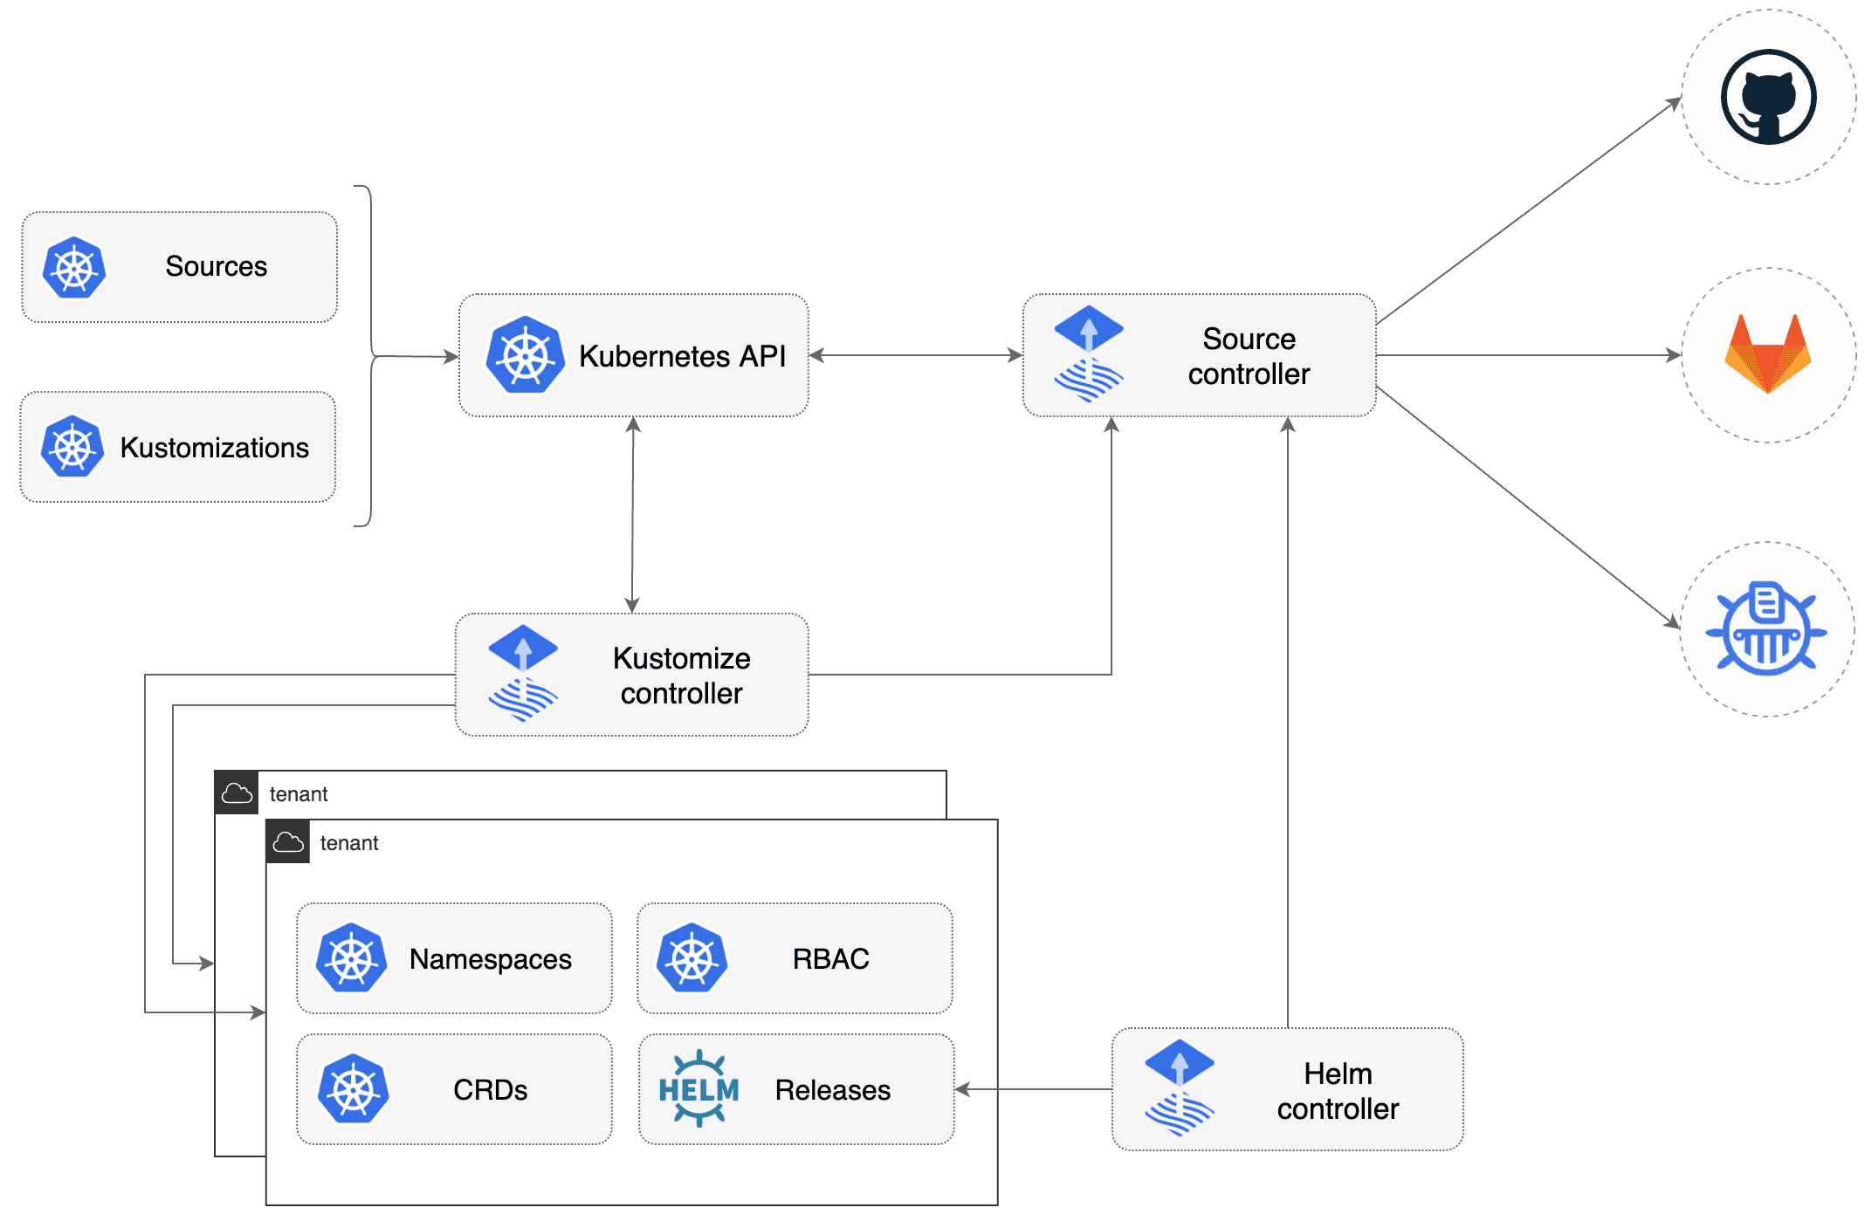
GitOps toolkit basics
Notes:
GitOps toolkit, also known as FluxCD, or simply – Flux is a set of controllers that provide you an API to manage your cluster from a git repository (or from a number of git repositories, there’s no hard requirement to store all manifests in one single repo).
Installing Flux in the cluster adds support for several Custom Resources which define where your manifests are located, how to install your Helm charts, how to handle updates and so on. Flux also allows you to automatically update your deployments and statefulsets with the new versions of application, there is a special API provided for this as well.
The very basic concept is that you create a Git repo which stores your manifests and the description of helm releases, install Flux pointing to that Git repository into clusterand bam - your stuff is up and running without other manual interventions, and is always in a state you’d expect – Flux is watching cluster state and rolls back the manual changes applied to the resources that are under Flux control to the state stored in Git.

Slide 8
Flux custom resources
Source controller - GitRepository
Kustomize controller - Kustomization
Helm controller - HelmRelease
Notes:
Here are the main GitOps Toolkit custom resources we’re using.
GitRepository resource describes, well, the Git repository – it’s URL, credentials, which branch and how often a repository should be queried for new changes.
Kustomization resource tells Flux where to find manifests within the repository.
HelmRelease resource tells Flux how to install a Helm chart, and provides chart values.
We also use Flux Notification controller and Image Update Automation controllers, but I won’t talk about those today.
Before we talk about how those resources work – let me show you our repository layout.

Slide 9
Repository layout
cluster.local-flux/
├── app01-qa
│ ├── admin-rb.yaml
│ ├── app01-helmrelease.yaml
│ ├── kustomization.yaml
│ └── namespace.yaml
├── app01-dev
│ ├── admin-rb.yaml
│ ├── app01-helmrelease.yaml
│ ├── kustomization.yaml
│ └── namespace.yaml
├── app01-prod
│ ├── admin-rb.yaml
│ ├── app01-helmrelease.yaml
│ ├── kustomization.yaml
│ └── namespace.yaml
└── flux-system
└── ...
Notes:
We follow the multi-tenant concept - every application gets 3 namespaces, equals to number of environments an application is needed. The namespaces are defined from the root of the Git repository as sub-directories, which contain all the YAMLs needed to deploy an application.
On the slide you see our usual repo - 3 namespaces for an application and flux-system namespace which holds flux-related manifests. Other system components, such as MetalLB or Ingress controllers each get one namespace - everything is managed from one repository. You don't see them because the screen space is limited.
We do have certain namespaces where engineers prefer to manage their manifests from their own repositories – we delegate this to them by creating a separate GitRepository definition that points to their own repo, and Kustomization that works off their repository.
Time to talk about the Flux custom resources.

Slide 10
gitrepository.yaml
---
apiVersion: source.toolkit.fluxcd.io/v1beta1
kind: GitRepository
metadata:
name: flux-system
namespace: flux-system
spec:
interval: 1m0s
ref:
branch: main
secretRef:
name: flux-system
url: ssh://git@gitrepo.domain.local/cluster.local-flux
Notes:
This is the usual GitREpository resource definition. This tells Flux Source Controller to fetch branch main from the specific URL every minute.
Flux does not care about what's in the repository at this point - this part just clones the repository and then fetches new changes periodically.

Slide 11
kustomization.yaml
---
apiVersion: kustomize.toolkit.fluxcd.io/v1beta1
kind: Kustomization
metadata:
name: app01-prod
namespace: app01-prod
spec:
interval: 10m0s
path: ./app01-prod
prune: true
sourceRef:
kind: GitRepository
name: flux-system
namespace: flux-system
validation: client
Notes:
Here is the Kustomization definition, which is processed by Kustomization Controller. This guy already care about the actual content.
In the spec section we see that every 10 minutes the contents of ./app01-prod directory will be applied to the cluster; the git repository that contains the app01-prod directory is defined in flux-system namespace under the same name - flux-system. We just saw it on previous slide.
Kustomization will ignore non-yaml files (so it's totally fine to store READMEs in the corresponding directories), but will fail if it encounters a poorly written kubernetes manifest.
You can have any number of kustomizations watching different git repositories for manifests for you. In our setup, it’s an organization agreement that we always have a git repository named flux-system in the flux-system namespace, and anyone can create a Merge Request to that repo to add their resources. If it passes our review – the resource gets created in the cluster when a change is merged.
Until now we saw how Flux handles plain manifests – but what about Helm charts? Well, there is Helm Controller in Flux that adds support for HelmRelase resource

Slide 12
helmrelease.yaml
---
apiVersion: helm.toolkit.fluxcd.io/v2beta1
kind: HelmRelease
metadata:
name: sealed-secrets
namespace: flux-system
spec:
chart:
spec:
chart: sealed-secrets
sourceRef:
kind: HelmRepository
name: sealed-secrets
version: '2.4.0'
interval: 1h0m0s
releaseName: sealed-secrets
targetNamespace: flux-system
values: { ... }
Notes:
Here it is on the screen.
Again, nothing special, and if you’re familiar with Helm command line tool – you should understand what all the parameters are.
We can see a new resource name reference in sourceRef dictionary – HelmRepository. HelmRepository lets’ Flux know where to find your Helm charts, it looks similar to GitRepository definitiion and can contain usual Helm repository URL that you feed into helm repo add command, or a GitRepository resource refrence.
The HelmRelease on the slide will check the state of the installed Helm release in cluster every hour, and run “helm upgrade” command against it if differences were found (like, value has changed or whatnot).
The values can be stored in the same file as you see on the slide, or you can reference a remote values file. We store values in the HelmRelease definitions directly, for convenience.

Slide 13
Repository layout
cluster.local-flux/
├── app01-qa
│ ├── admin-rb.yaml
│ ├── app01-helmrelease.yaml
│ ├── kustomization.yaml
│ └── namespace.yaml
├── app01-dev
│ ├── admin-rb.yaml
│ ├── app01-helmrelease.yaml
│ ├── kustomization.yaml
│ └── namespace.yaml
├── app01-prod
│ ├── admin-rb.yaml
│ ├── app01-helmrelease.yaml
│ ├── kustomization.yaml
│ └── namespace.yaml
└── flux-system
└── ...
Notes:
Now, getting back to our git repository layout – you could ask ”how does Flux knows which directories to process? The answer is simple – when a new application is created in the repository, someone needs to manully run kubectl apply and create namespace, and the kustomization. From that point Flux will pick up the rest of the manifests on the next repository sync cycle and create all the resources.
There’s a default setup, where there’s only one kustomization is created which is watching whole repository for changes – such setup would pick up all new resources added to the repository automatically; we went “one namespace – one kustomization” way to make our lives easier, let me explain.
Any Flux object can be suspended. Suspending Kustomization means that Flux will not process manifests that are seen by kustomization, even if there are new changes. This simplifies the development of new manifests and troubleshooting – pausing one namespace kustomization does not affect the rest of namespaces in the cluster.
We had an issue with this - people were forgetting to resume suspended kustomizations, and then were wondering why the changes they make to Git repository are not reflected in the cluster.
We solved this by firing an alert to our work chat when there’s a kustomization that’s suspended for more than 8 hours.

Slide 14
Future work/known issues
Circular dependencies:
Prometheus Operator:
provides: ServiceMonitor
is using SealedSecret resources
SealedSecret controller:
is using: ServiceMonitor
provides: SealedSecret
Storage driver deprecated
Security – custom GitRepository definition can access unintended resources
https://fluxcd.io/flux/security/best-practices/
Notes:
We also have other known issues with our setup:
Circular dependencies. There’re workloads that provide resources to other workloads, and at the same time are using resources provided by those other workloads. For example, Prometheus Operator provides the ServiceMonitor custom resource definition (among other things), and is using SealedSecret resources to decrypt its’ secrets. SealedSecrets controller is using ServiceMonitor resources, and provides SealedSecret custom resource definition. Both are controlled by different Kustomization, which fail if applied “as is” to a freshly installed cluster. We don’t have a good solution to this yet – for now we actually remove the ServiceMonitor resources manifests from SealedSecret controller kustomization, apply the manifests, and then put the ServiceMonitor resources back.
Second issue is security-related. As was previously mentioned, you can have any number of GitRepositories added to cluster, and Flux will apply whatever a Kustomization tells it to apply. Since we don’t actively monitor those repositories and are not even part of code review in these repositories – we can’t be sure that someone does not push some evil manifest to the cluster, creating objects in a namespace that normally is managed by another kustomization. Solution to this is to disable cross-namespace reference for Flux, and assign it a separate ServiceAccount, but this breaks some of our deployments that legitimately need to reference objects in different namespaces – we’re working on figuring the best way out here.
Last but not least, we’re using deprecated storage driver to provide persistent volumes support in our clusters; this eventually will prevent us from upgrading Kubernetes, so we’re waiting for Vmware upgrade which is handled by different team, so we could switch to recent vsphere cloud storage interface.

Slide 15
Resources
Kubespray: https://kubespray.io/#/docs/getting-started
GitOps Toolkit concepts: https://fluxcd.io/flux/concepts/
GitOps Toolkit components: https://fluxcd.io/flux/components/
GitOps Toolkit Image Update Automation: https://fluxcd.io/flux/components/image/
Notes:
All in all, after working with this setup for 2 years, I consider GitOps toolkit a very convenient way to manage Kubernetes clusters; it provides flexibility in managing changes in the cluster, and ensures your workloads are always in the shape you expect them to be.

Slide 16
Thank You
THANK YOU
Notes:
That is it for today, thank you for your time. Hope this information was useful.
if you have any questions – now is good time to ask those, we still have X minutes left.

