Slide 1
Kubevirt Tekton tasks
“Easy automated Management of Virtual Machine with OpenShift Pipelines”
Karel Simon
Senior Software Engineer, Red Hat
ksimon@redhat.com

Slide 2
Agenda
OpenShift Virtualization
OpenShift Pipelines
Kubevirt Tekton tasks
Kubevirt Tekton tasks operator
Example pipelines

Slide 3
OpenShift Virtualization
Allow run and management of VMs with containers
Supports Linux and Windows VM
Support for VM Import, LiveMigration, Snapshot/Restore and Monitoring…
Templates for most of the operating systems (Common - templates)

Slide 4
OpenShift Pipelines
OpenShift Pipelines is a cloud-native, continuous integration and continuous delivery (CI/CD) solution based on Kubernetes resources
It uses Tekton building blocks to automate deployments across multiple platforms by abstracting away the underlying implementation details
Tekton introduces a number of standard custom resource definitions (CRDs) for defining CI/CD pipelines that are portable across Kubernetes distributions.

Slide 5
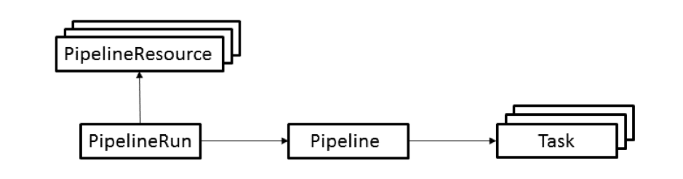
How does Tekton works?
Task: Defines a set of build steps, such as compiling code, running tests, and building and deploying images.
Pipeline: Defines the set of tasks that compose a pipeline.
PipelineResource: Defines an object that is an input (such as a Git repository) or an output (such as a Docker image) of the pipeline.
PipelineRun: Instantiates a Pipeline for execution with specific inputs, outputs, and execution parameters.

Slide 6
Kubevirt Tekton tasks
KubeVirt Tekton tasks provide OpenShift Virtualization - specific Tekton tasks, which focus on:
  Creating, updating and managing resources of KubeVirt (VMs, DataVolumes, Templates)
  Manipulating disk images with libguestfs tools
https://github.com/kubevirt/kubevirt-tekton-tasks

Slide 7
Kubevirt Tekton tasks
Create Virtual Machines
  create-vm-from-manifest - create VM from yaml manifest
  create-vm-from-template - create VM from template
Utilize Templates
  copy-template - copy template
  modify-vm-template - update template metadata
Create DataVolumes/DataSources
  create-datavolume-from-manifest (4.11) - create dataVolume
  modify-data-object (>= 4.12) - create/delete dataVolume/dataSource
Generate SSH Keys
  generate-ssh-keys - generate SSH keys and store them in cluster
Execute Commands in Virtual Machines
  execute-in-vm: execute commands over SSH
  cleanup-vm: execute commands and/or stop/delete VMs
Manipulate PVCs with libguestfs tools
  disk-virt-customize: execute virt-customize commands in PVCs
  disk-virt-sysprep: execute virt-sysprep commands in PVCs
Wait for Virtual Machine Instance Status
  wait-for-vmi-status - wait for VM status

Slide 8
Tekton Task operator
The Tekton Tasks Operator (TTO) is a operator that takes care of deploying Kubevirt tasks and example pipelines.
Starting from OpenShift Virtualization 4.11, TTO and Kubevirt tasks are marked as a dev preview, so they have neither documentation nor test coverage.
Starting from OpenShift Virtualization 4.11, TTO is deployed by default, but does not deploy any resources until explicitly enabled.
To enable resource creation - spec.featureGates.deployTektonTaskResources needs to be updated in the TTO CR / HCO CR:
oc patch hco kubevirt-hyperconverged --type=merge -p '{"spec":{"featureGates": {"deployTektonTaskResources": true}}}'
https://github.com/kubevirt/tekton-tasks-operator

Slide 9
Example pipelines - Motivation
Prepare golden image for Windows 10
Automate installation of windows
Allow to modify windows disks in cluster

Slide 10
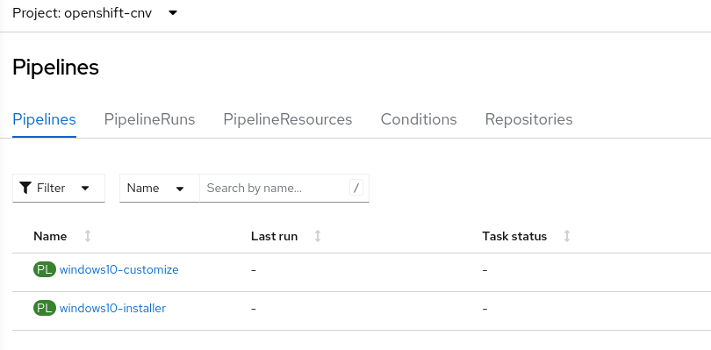
Tekton Task operator - Example pipelines
windows10-installer - Populates golden windows 10 image in openshift-virtualization-os-images namespace
windows10-customize - Installs sql server in golden windows image and creates new image and template

Slide 11
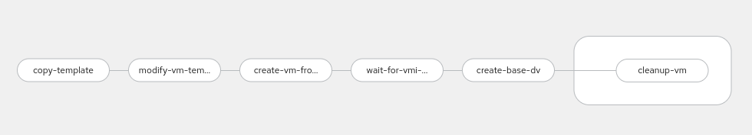
Example pipelines - windows10-installer
Populates golden windows image in kubevirt-os-images namespace
Installs virtio drivers
The minimal required input is the URL to the Windows 10 ISO
The default Windows 10 template will detect the golden image as default disk image automatically
Upstream pipeline definition: https://github.com/kubevirt/tekton-tasks-operator/blob/main/data/tekton-pipelines/okd/windows10-installer.yaml

Slide 12
windows10-installer - Important parameters
Name | Default value | Description
winImageDownloadURL |  | Download URL to Windows 10 installation ISO (Example sysprep requires English United States x64 version).
autounattendConfigMapName | windows10-autounattend | Name of the ConfigMap containing the sysprep configuration files (autounattend.xml, etc.).
sourceTemplateName | windows10-desktop-large | Name of the Template which is used to create the installer Template.
baseDvName | win10 | Name of the base DataVolume which is created. Pre-installed Windows VMs can be created from this DataVolume.

Slide 13
windows10-installer - tasks
Pipeline task | Explanation | Objects lifeline
copy-template | Creates a VM template | Template created or replaced
modify-vm-template | Adjust the template to boot from the Windows ISO
create-vm-from-template | Boot a temporary VM instance created from the template. This way the Windows ISO is booted, Windows is installed, generalized (syspreped) and shut down in an unattended way. | VM with disk, Windows ISO and sysprep ISO created
wait-for-vmi-status | Waits until the shutdown is done.
create-base-dv | Creates a DataVolume from the disk image of the temporary VM | DataVolume with PVC created
cleanup-vm | Deletes the temporary VM | VM including Windows ISO and disk image deleted

Slide 14
Example pipelines - windows10-installer demo

Slide 15
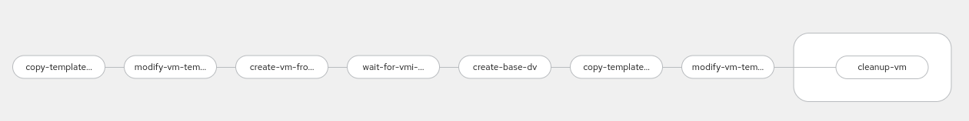
Example pipelines - windows10-customize
Creates golden images with customizations applied
on top of a basic Windows installation
Uses image created by windows10-installer pipeline
Example pipeline installs sql server in windows 10

Slide 16
windows10-customize - Important parameters
Name | Default value | Description
sourceTemplateName | windows10-desktop-large | Name of the Template which is used to customize Windows 10 and create a golden Template
customizeConfigMapName | windows10-sqlserver | Name of the ConfigMap containing the customization and sysprep configuration files (unattend.xml, etc.).
goldenTemplateName | windows10-desktop-large-golden-sqlserver | Name of the golden Template which is created. Pre-installed Windows VMs can be created from this template.

Slide 17
windows10-customize - tasks
Pipeline task | Explanation | Objects lifeline
copy-template | Creates a VM template. | Template created or replaced
modify-vm-template | Adjust the template to boot from the win10 datavolume.
create-vm-from-template | Boot a temporary VM instance created from the template. This way the Windows is generalized and shut down in an unattended way. | VM with disk, Windows ISO and sysprep ISO created
wait-for-vmi-status | Waits until the shutdown is done.
create-base-dv | Creates a DataVolume from the disk image of the temporary VM. | DataVolume with PVC created
copy-template-golden | Creates a golden VM template, which uses customized DataVolume. | Template created or replaced
modify-vm-template | Adjust the template to boot from the customized win10 datavolume.

Slide 18
Example pipelines - windows10-customize

Slide 19
Thank you
QA?
ksimon@redhat.com

