Slide 1

Rapid prototyping with JBoss Forge
> Rory Preddy

Slide 2





Agenda
A “little” bit about me
Prototyping and Scaffolding
Forge
Forge 101
Building a basic app
Getting Fancy
Angular
Swagger
Face-Mash Demo

Slide 3

A “little” bit about me
Java Evangelist at BBD
Trained 150 developers last year
Organizer for the Jozi-JUG
www.meetup.com/Jozi-Jug

Slide 4
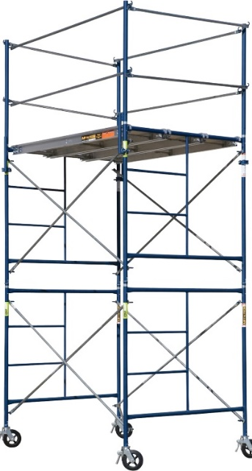
A “little” bit about me
Prototyping and Scaffolding
Forge
Forge 101
Building a basic app
Getting Fancy
Angular
Swagger
Face-Mash Demo

Slide 5






History
1960
Ada prototyping
1970/1980
”Mythical Man-Month” and “No Silver Bullet” books
1990
RAD
2006/2007
Ruby-on-Rails 2
Seam-Gen
ASP.NET Dynamic Data
2009
Spring Roo
2012
Yeoman (Node.Js)
Forge 1.0
2016
Forge 3.0
Notes:
seam-gen was oriented at Seam 2; Forge at standard Java EE 6 and Java SE projects.
seam-gen is a batch process built over Ant; Forge is an interactive shell built over Maven.
seam-gen is a one-time generation; Forge allows you to add new Entities, fields within them, and so on, at any time.
“no silver bullet” - http://www.cs.nott.ac.uk/~pszcah/G51ISS/Documents/NoSilverBullet.html

Slide 6
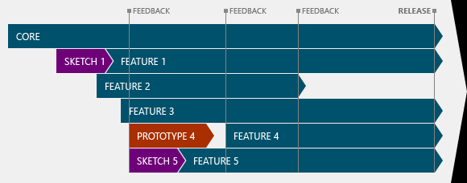
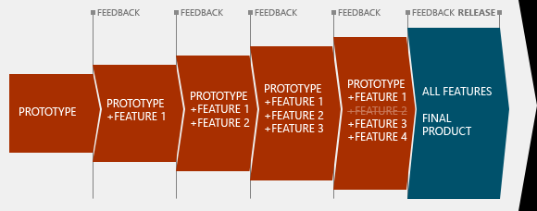
Prototyping
Throwaway
Evolutionary
Notes:
Evolutionary prototyping is different from Agile methodologies too. Agile is about iterations and frequent milestones where a fully functional product can be released to manufacturing. If you have a working product every Thursday, you're doing Agile. In evolutionary prototyping, you expand the prototype, but nothing forces you to have a fully-functional product regularly. You can spend two months creating the first prototype, than expand it with a few features in respectively two and three days, and then spend three months on another feature. You can't have this sort of irregular patterns in Agile.

Slide 7

Advantages
Business now
Understand us
We don’t pretend to understand them
They can even code!
Work with us
Don’t scream at us
They see delivery!
Trust!

Slide 8
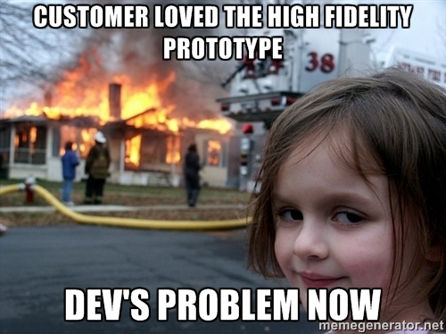

Slide 9

Disadvantages
Code-and-Repair
Scope creep
Do we have to maintain it also?
Loyalty to the throw-away
Over-zealous-just-been-on-training” Anti-pattern
Notes:
I went on JBoss training in 2013. Discovered Forge and have tried to incorporate it into development ever since

Slide 10


Scaffolding
Ruby on Rails - 2007
Popularized
inbuilt ORM
CRUD scaffolding
simple CLI commands
Started the Hipster IT movement
“Inventors or first adopters of novelties”
Shipped with Mac OS X v10.5
> ruby script/generate scaffold Movie title:string

Slide 11


Slide 12
A “little” bit about me
Prototyping and Scaffolding
Forge
Forge 101
Building a basic app
Getting Fancy
Angular
Swagger
Face-Mash Demo

Slide 13
My Forge Journey
In 2013 I started to teach
EJB/JPA/JSF
Angular/REST
A JBoss course introduced me to Forge
“Over-zealous-just-been-on-training” Anti-pattern
Recently, at one of the Big 4 Banks
Used forge to prototype an invoice processing system
With a team of 8 high school grads
They had NO prior Enterprise experience

Slide 14
Forge 101
Similar to Rails:
Scaffolding for Java EE
JPA (e.g. Hibernate) as ORM
CLI commands - REPL
Takes care of JEE integration
Includes Wizards for your favourite IDE

Slide 15
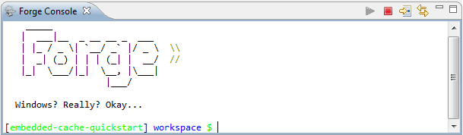
Forge 101 - Installation
Unzip Forge installation and run Forge.bat
or
Red Hat Eclipse IDE (Preferred)
or
Plugins
Eclipse
IntelliJ
Netbeans

Slide 16
Forge 101 - add-ons
Core
JPA
Scaffold
Maven
REST
Angular
Community
OAuth
Twitter
Camel
Confluence/JIRA
Wildfly-Swarm
Docker
Portlets
Swagger
> addon-install-from-git --url https://github.com/rmpestano/swagger-addon.git

Slide 17
Forge 101 - Tasks
Core Tasks
Add JPA entities
Scaffold a view layer
Pure JSF
or
Angular reverse-engineered from REST Layer
Deploy to an application server

Slide 18
Building a Basic App
project-new --named shoppinglist --topLevelPackage com.bbd;
jpa-new-entity --named shopping;
jpa-new-field --named item;
scaffold-setup --provider Faces;
scaffold-generate --provider Faces --targets com.bbd.model.*;
build;
Copy to server or Right click “run as server”
http://localhost:8080/shoppinglist
Notes:
project-new --named shoppinglist --topLevelPackage com.bbd;
jpa-new-entity --named shopping;
jpa-new-field --named item;
scaffold-setup --provider Faces;
scaffold-generate --provider Faces --targets com.bbd.model.*;
build;

Slide 19


A “little” bit about me
Prototyping and Scaffolding
Forge
Forge 101
Building a basic app
Getting Fancy
Angular
Swagger
Face-Mash Demo

Slide 20
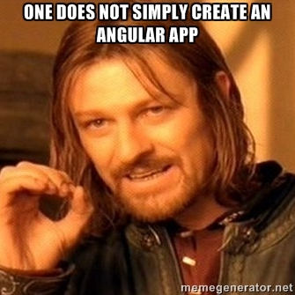

Slide 21
Angular
Create a conference project
Add Entites “Speaker”, “Talk”, “Book”
Add REST layer
Generate Angular Scaffold
http://localhost:8080/conferenceang
(mobile ready)
Notes:
project-new --named conferenceang --topLevelPackage org.example --type war --finalName conferenceang;
jpa-setup --provider Hibernate --container WILDFLY;
jpa-new-entity --named Speaker --targetPackage org.example.model;
jpa-new-field --named firstname;
jpa-new-field --named surname;
jpa-new-field --named bio --length 2000;
jpa-new-field --named twitter;
constraint-add --onProperty firstname --constraint NotNull;
constraint-add --onProperty surname --constraint NotNull;
constraint-add --onProperty bio --constraint Size --max 2000;
jpa-new-entity --named Talk --targetPackage org.example.model;
jpa-new-field --named title;
jpa-new-field --named description --length 2000;
jpa-new-field --named room;
jpa-new-field --named date --type java.util.Date --temporalType DATE;
jpa-new-field --named speakers --type org.example.model.Speaker --relationshipType One-to-Many;
constraint-add --onProperty title --constraint NotNull;
constraint-add --onProperty room --constraint NotNull;
constraint-add --onProperty description --constraint Size --max 2000;
java-new-enum --named Language --targetPackage org.example.model;
java-new-enum-const ENGLISH;
java-new-enum-const FRENCH;
jpa-new-entity --named Book --targetPackage org.example.model;
jpa-new-field --named isbn;
jpa-new-field --named title;
jpa-new-field --named author;
jpa-new-field --named description --length 2000;
jpa-new-field --named price --type java.lang.Float;
jpa-new-field --named nbOfPages --type java.lang.Integer;
jpa-new-field --named publicationDate --typeName java.util.Date --temporalType DATE;
jpa-new-field --named language --type org.example.model.Language;
cd ..;
rest-setup;
rest-generate-endpoints-from-entities --targets org.example.model.*;
scaffold-setup --provider AngularJS ;
scaffold-generate --provider AngularJS --targets org.example.model.*;
swagger-setup;
swagger-generate;
cd ~~;
build;

Slide 22
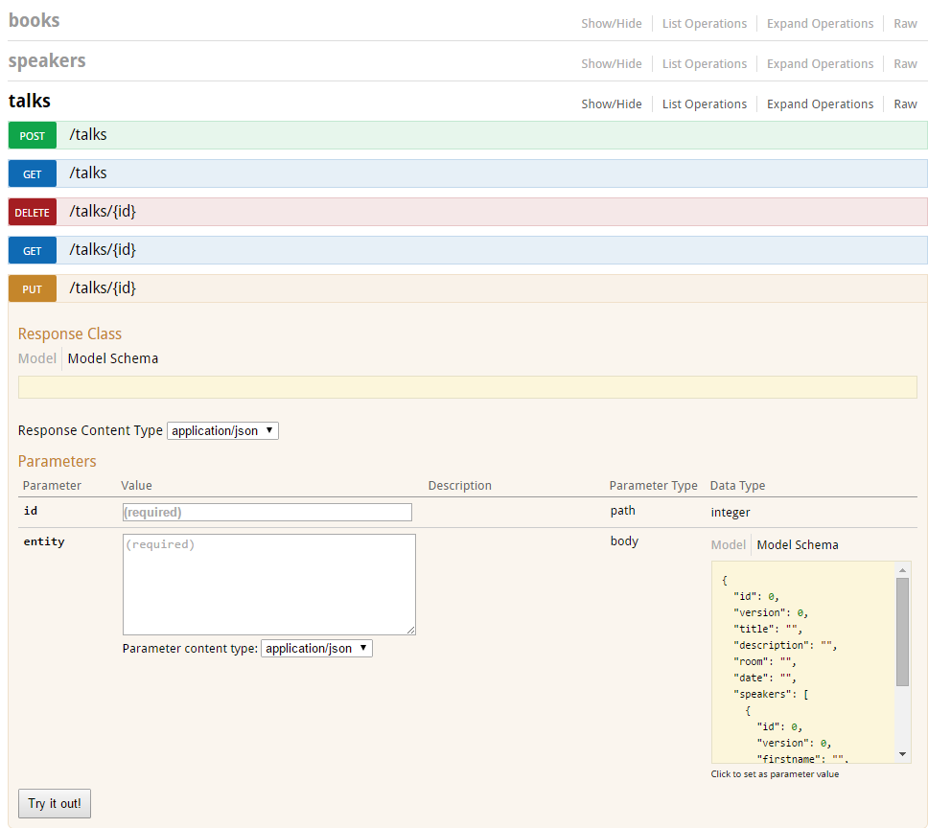
Swagger
Interactive Documentation
Client SDK Generation
Discoverability
http://localhost:8080/conferenceang/apidocs/index.html

Slide 23

A “little” bit about me
Prototyping and Scaffolding
Forge
Forge 101
Building a basic app
Getting Fancy
Angular
Swagger
Face-Mash Demo

Slide 24

Face-Mash
Vote for Cars and Celebrities
Using Forge IDE Wizards

Slide 25
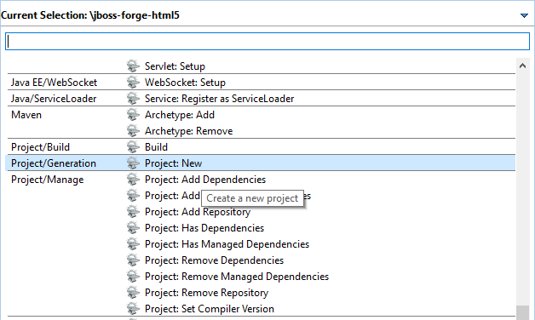
How-to with IDE Forge Wizards
Eclipse - CTRL+4
Netbeans – CTRL+I
IntelliJ – CTRL+ALT+4
Create a project
Add Enums
Add an Entity
With some fields
Generate Scaffold
Deploy to Server
Notes:
project-new --named facemash --topLevelPackage org.example --type war --finalName facemash;
java-new-enum --named Category --targetPackage org.example.model;
java-new-enum-const celebrity;
java-new-enum-const car;
jpa-setup --provider Hibernate --container WILDFLY;
jpa-new-entity --named Item --targetPackage org.example.model;
jpa-new-field --named name;
jpa-new-field --named category --type org.example.model.Category;
jpa-new-field --named hot --type java.lang.Boolean;
constraint-add --onProperty name --constraint NotNull;
constraint-add --onProperty category --constraint NotNull;
cd ..;
rest-setup;
rest-generate-endpoints-from-entities --targets org.example.model.*;
scaffold-setup --provider AngularJS ;
scaffold-generate --provider AngularJS --targets org.example.model.*;
cd ~~;
build;

Slide 26

Summary
Forge is the Fastest way to build Maven-based Java EE projects
Enterprise Java can be prototyped!
Use CLI or IDE wizards
Is this as close to Hipster that Java can get?
Java 9 REPL?

Slide 27

Questions?
> Rory Preddy

