Slide 1

Persistence
Badi Sudhakaran
Rapidly fire up apps with Firebase – Google’s NoSQL cloud database

Slide 2
Agenda
Introduction to Firebase
Coding example

Slide 3
Building an App
Users
Tasks
Data
Notes:
We think the trend of developers being able to do more with less will continue.
Specifically, in the future developers will be spend more time on high level concepts like users, data, and tasks, rather than underlying infrastructure.
Today we’re going to look at how Google helps developers focus on those high level tasks.

Slide 4

Building an App
Deployment
Infrastructure
Scaling
Notes:
Next once the app is ready for use, we start to think of infrastructure, scalability and deployment etc…
We live in the future. We shouldn’t be thinking of these things anymore.

Slide 5

A powerful platform for mobile and web apps
Notes:
Which brings us to Firebase.
For those of you who aren’t yet familiar with Firebase, lets start with a quick overview.
Firebase is a platform that help developers rapidly build mobile and web apps.
One of the first things you do when building an app is choose how to build it’s backend.
Backend as a Service (BaaS)
1. Cloud platform, 2. NoSQL, with one JSON object, 3. REST API – every piece of data has its own URL, 5. Straight from the client

Slide 6



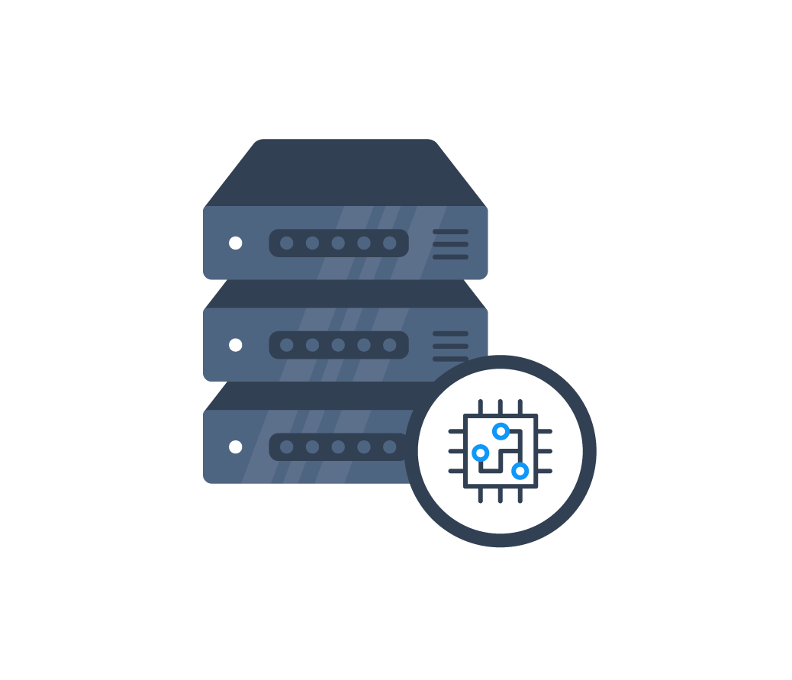
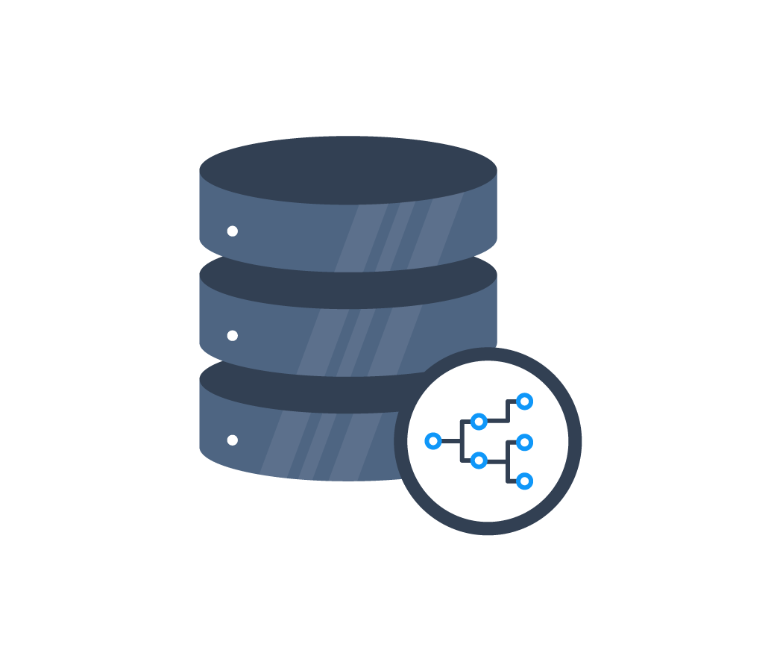
2-Tier Architecture
x
device
Firebase
device
application server
database
Notes:
With Firebase you can connect to the database Straight from the client
You won’t need the application server to fetch data back and forth from and to the database like the the 3-tier architecture shown here

Slide 7










Client SDKs
Web Framework Integrations
Server Side Access
Notes:
Firebase has client SDKs for iOS, Android and the Web.
We have tight integrations with these great front-end web frameworks,
and with our REST API and specific REST-wrappers you can access Firebase from a server if you need to as well.
Firebase lets you build great applications, for your favorite platform, in a fraction of the time it used to take.

Slide 8






Realtime Database
Offline Support
User Authentication
Static Hosting
Notes:
Firebase provides a set of services: user authentication, a realtime database, and static asset hosting, that lets you build apps without needing to spin up servers or manage complex infrastructure.
This saves you an immense amount of time, but more importantly it lets you focus on creating a great user experience.
Your users don’t care how elegant the code to shard your database is.
What they care about is if you’re elegantly solving their problem.
Realtime
User Auth
Offline support
Deployment

Slide 9
Realtime Data Synchronization

Slide 10
> npm install firebase --save
...
var Firebase = require(‘firebase’);
var ref = new Firebase(‘https://your-app.firebaseio.com’);
Notes:
To get started all you have to do to get started is npm install firebase and then require Firebase in your project and you’re off to the races.
We can’t wait to see what you built.

Slide 11
App Showcase & Deep Dive
bit.do/devconf

Slide 12
Firebase promo code
devbase3

Slide 13

Thank you!
Badi Sudhakaran
IQ Business
bkumar@iqbusiness.net
@badikumar
https://github.com/badikumar/
http://www.devconf.co.za/rate

