Slide 1
Draw me a story
A.Y. 2019 - 2020
Creative Programming and Computing
Olivieri Marco – Simeon Federico – Vassena Mattia – Acerbi Matteo

Slide 2






What is it?
Emotional experience for children
Creative interaction with a generative story
Free online browser Chrome http://drawmeastory.surge.sh
No download required
1
/6
Notes:
Our purpose was to develop …

Slide 3
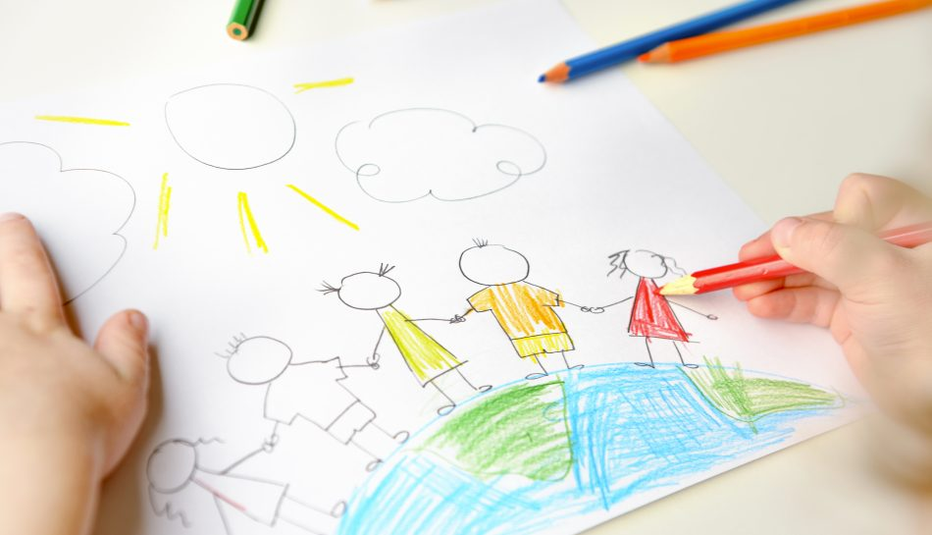

Pedagogy overview: children
Story telling
Drawing
Fantasy
Surprise
2
/6

Slide 4


Goals
Emotional experience
Choose the story
Draw elements of the story
Surprise from generative drawing
Indirect developement of creativity
3
/6

Slide 5


Implementation: idea
Story
Draw
RNN
4
/6

Slide 6
Implementation: libraries
Library | Author | Our usage | License
TensorFlow.js | Open community | Library for machine learning in java | Apache License 2.0
Magenta.js | Open community | Machine learning API | Apache License 2.0
jQuery | John Resig | JavaScript semplification | MIT License
NN model | Author | Our usage | License
Sketch-rnn | Open community | RNN model to draw | Apache License 2.0
5
/6

Slide 7
Final release features
Choose different story-scenarios
Explore them in original and detailed ways
Choose different drawing tools (marker, pencil, …)
Train the NN for new drawing
Improve the current NN model
6
/6
Notes:
we discuss about some ..

Slide 8


Draw me a story
December ${20}^{th}$, 2019

