Slide 1

How to create LinkedIn App for web applications
powered by:

Slide 2
Login to LinkedIn developers site.
https://www.linkedin.com/secure/developer/

Slide 3
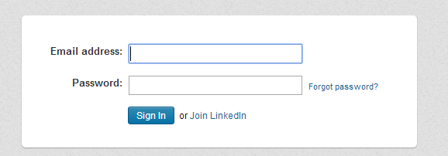
Login with your LinkedIn account

Slide 4
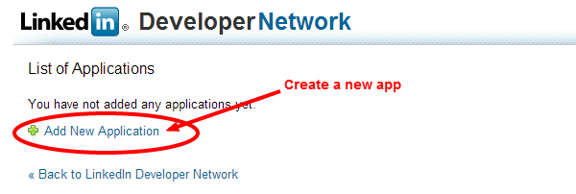
Click on Add new application link to create a new application.

Slide 5
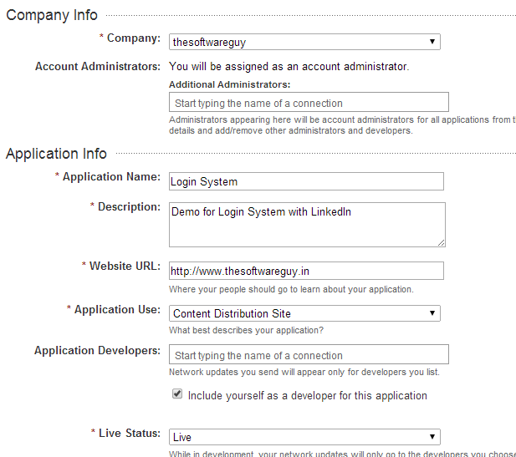
You have to fill up all the required fields

Slide 6
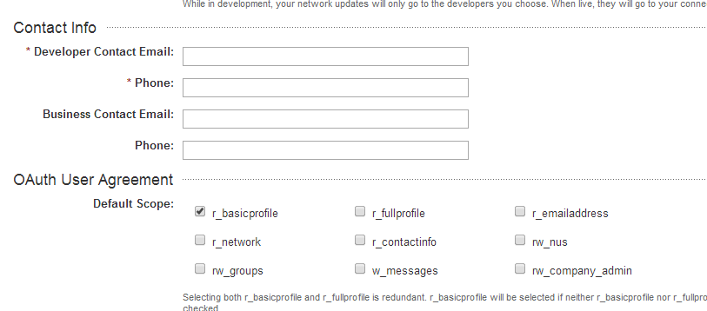
Give your contact details. Just set the default scope to r_basicprofile. You can change scope using PHP code.

Slide 7
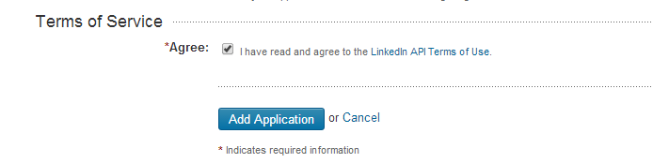
Finally Agree with their terms of service and hit the add application button.

Slide 8
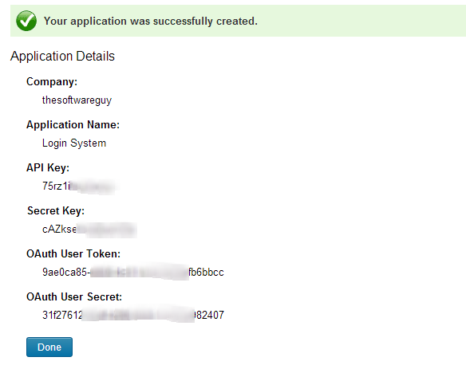
You will get all your credentials.

Slide 9
Connect with us
website: www.thesoftwareguy.in
facebook: www.facebook.com/Thesoftwareguy7
twitter: www.twitter.com/thesoftwareguy7
google plus: www.plus.google.com/+ThesoftwareguyIn

