Slide 1
STEGANOGRAPHY IN IMAGES
- annie calpe

Slide 2
OVERVIEW
Steganography Defined
Examples in History
Digital Approaches
Reasons For Using Digital Images
Image Attributes
Popular Techniques That Use Images

Slide 3
STEGANOGRAPHY DEFINED
Greek for “covered writing”
“The art and science of writing hidden messages in such a way that no one apart from the intended recipient even knows that a message has been sent.”

Slide 4
EXAMPLES IN HISTORY
Tattoos on shaved heads
Wax-covered tablets
Microdots – shrunken pictures
Invisible Inks - milk, fruit juice, urine

Slide 5
DIGITAL APPROACHES
Today, it often exists within digital formats
It makes use of seemingly innocent cover files such as text, audio, and image files
The embedded message may be anything that can be encoded in binary

Slide 6
REASONS FOR USING DIGITAL IMAGES
It is the most widely used medium being used today
Takes advantage of our limited visual perception of colors
This field is expected to continually grow as computer graphics power also grows
Many programs are available to apply steganography

Slide 7
IMAGE ATTRIBUTES
Digital images are made up of pixels
The arrangement of pixels make up the image’s “raster data”
8-bit and 24-bit images are common
The larger the image size, the more information you can hide. However, larger images may require compression to avoid detection

Slide 8
IMAGE-BASED TECHNIQUES
Least Significant Bit Insertion
Masking and Filtering

Slide 9
LSB INSERTION
Replaces least significant bits with the message to be encoded
Most popular technique when dealing with images
Simple, but susceptible to lossy compression and image manipulation

Slide 10
LSB - Example
A sample raster data for 3 pixels (9 bytes)
may be:
Inserting
the binary
value for
A
(10000001)
changes
4 bits
00100111 11101001 11001000
00100111 11001000 11101001
11001000 00100111 11101011
00100111 11101000 11001000
00100110 11001000 11101000
11001001 00100111 11101011

Slide 11
LSB Continued…
Best to use a grayscale palette or one with gradual changes in shades
Otherwise, it is best to use images with “noisy areas” – areas with ample color variation and without large areas of solid color

Slide 12
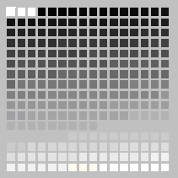
GRAYSCALE PALETTE

Slide 13
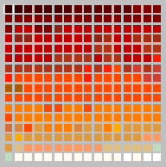
NEBULA PALETTE

Slide 14
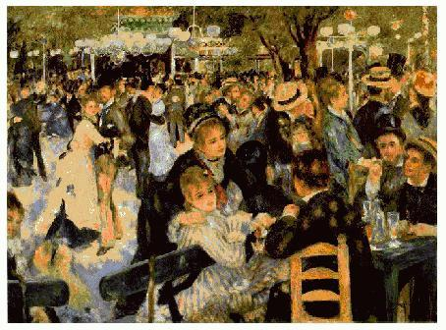
“NOISY AREAS” - Example
Renoir painting

Slide 15
LSB - Uses
Storing passwords and/or other confidential information
Covert communication of sensitive data
Speculated uses in terrorist activities
Being widely used to hide and/or transfer illegal content

Slide 16
MASKING & FILTERING
Masks secret data over the original data by changing the luminance of particular areas
During masking, it embed the message within significant bits of the cover image
Not susceptible to lossy techniques because image manipulation does not affect the secret message

Slide 17
MASKING & FILTERING - Uses
Digital Watermarking – provides identification pertaining to the owner; i.e. license or copyright information
- Invisible vs Visible
Fingerprinting – provides identification of the user; used to identify and track illegal use of content

Slide 18
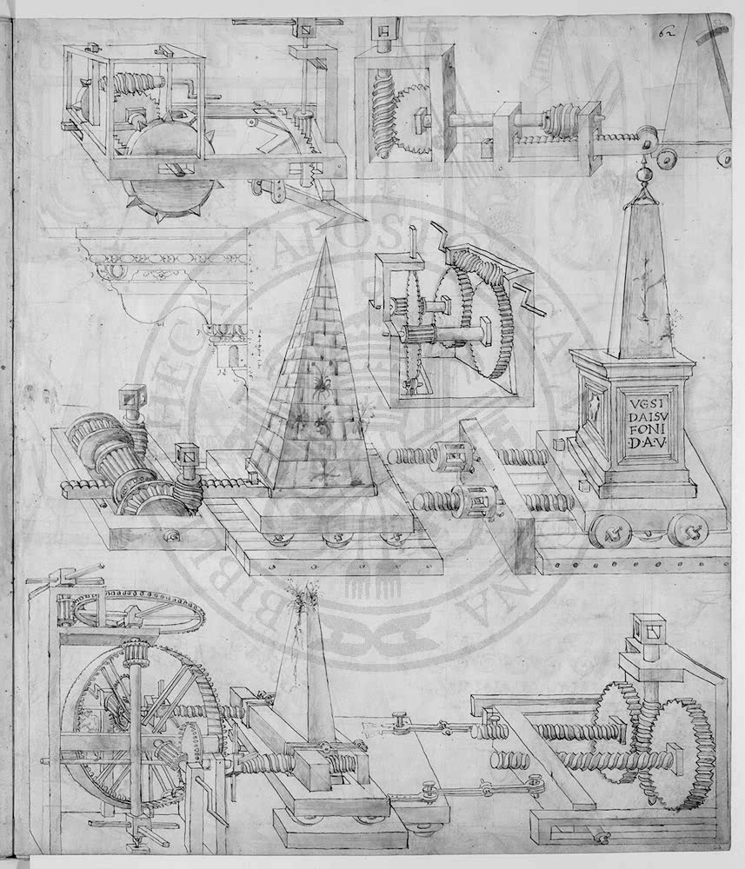
Visible Watermark - Example

Slide 19
SUMMARY
Steganography as a whole has existed in many forms throughout much of history.
Lossless compression of images with a great deal of color variation work best as a cover image to embed a message.
Steganography can be used as benefitial tool for privacy.

Slide 20
REFERENCES
Wikipedia
Exploring Steganography: Seeing the Unseen – N. Johnson & S. Jajodia
www.jjtc.com/stegdoc/steg1995.html
Information Hiding: Techniques for Steganography and Digital Watermarking” – S. Katzenbeisser, F. Petitcolas
Digital Watermarking – H. Bergel, L. O’Gorman

