Slide 1

Smart Home Automation Project
By Team Freemasons

Slide 2

Hardware Components
ESP32 Board
The ESP32 board forms the backbone of the smart home automation project, serving as the primary microcontroller for data processing and control of various connected devices. Its dual-core, low-power 32-bit CPU helps in efficiently managing tasks and communication with other components.
Sensors
The DHT22 sensor monitors temperature and humidity, enhancing comfort and energy efficiency. The MQ135 sensor measures air quality, providing vital information for healthy living spaces. Other sensors like the flame sensor, LDR sensor, IR sensor, and buzzer enable real-time detection and response to environmental changes, enhancing safety and security.
Servo Motor
The servo motor facilitates automated control of blinds, gates, and other movable fixtures, adding convenience and efficiency to the smart home system.
Photos provided by Pexels

Slide 3
Sensor Applications
Emergency Alerts
Environmental Control
Safety and Security
Upon sensing hazardous environmental conditions or security breaches, the system triggers emergency alerts through various means, ensuring timely response and preventive actions, thereby enhancing the safety and well-being of the occupants.
The temperature and humidity sensors regulate the climate, ensuring optimal comfort and energy efficiency. Air quality monitoring through the MQ135 sensor allows for the detection of harmful gases, enabling air purification and ventilation systems to safeguard inhabitants' well-being.
The flame sensor and intruder detection capabilities contribute to early fire warning, enabling rapid response and evacuation strategies. Additionally, light intensity-based lighting control and automated blinds/gates facilitate security by creating an illusion of occupancy, deterring potential intruders.

Slide 4

Google Firebase Integration
Real-time Data Storage
Google Firebase provides a robust platform for storing and retrieving real-time sensor data, enabling seamless and reliable access to historical and current environmental metrics, enhancing user experience and system control.
User Interface and Control
The integration of Google Firebase enables the development of an intuitive user interface for personalized smart home control, empowering users to manage and monitor their living space efficiently through a user-friendly interface accessible from various devices.
Push Notifications and Alerts
Firebase's push notification capabilities enhance the system's responsiveness by delivering immediate alerts to users, thereby ensuring timely preventive measures and actions in response to critical events such as environmental anomalies or security breaches.
Photos provided by Pexels

Slide 5

AI/ML Processing
Data Processing and Analysis
Real-time Decision Making
AI and ML algorithms preprocess and analyze sensor data, providing valuable insights into environmental trends and occupant behaviors, facilitating informed decision-making for optimizing comfort, safety, and energy efficiency within the smart home.
The integration of AI and ML enables the system to make real-time decisions based on the analyzed data, improving responsiveness and adaptability to dynamic environmental conditions, thereby ensuring a seamless and intelligent living space for the occupants.
Model Evaluation and Optimization
AI and ML algorithms continuously evaluate and optimize predictive models, enhancing the system's performance in adapting to changing environmental dynamics and occupant preferences, ultimately ensuring a personalized and efficient living experience.

Slide 6
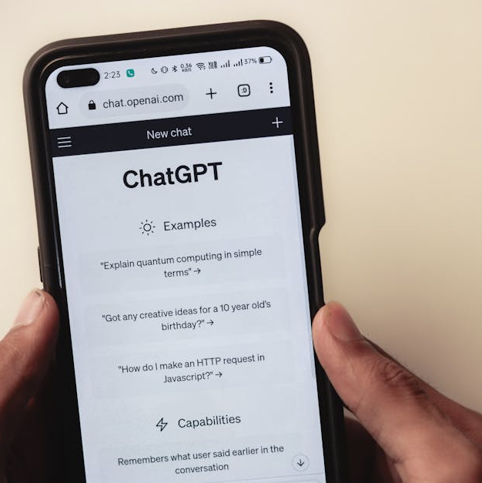
AI/ML Integration
Cloud-based Services
Leveraging cloud-based AI and ML services enables the smart home automation system to access advanced computational resources, empowering it to handle complex data processing and decision-making tasks, enhancing the system's adaptability and functionality.
Edge AI for Local Processing
Local AI processing at the edge devices enhances system efficiency by enabling quick responses to real-time environmental changes without relying solely on cloud services, ensuring a responsive and reliable smart home experience for the occupants.
Real-time Data Processing using AI/ML Algorithms
The integration of AI and ML algorithms allows for real-time data processing, enabling the system to respond intelligently and adaptively to environmental changes and occupant preferences, resulting in a personalized and seamless living experience.
Photos provided by Pexels

Slide 7
AI/ML Applications
Security and Emergency Response
Predictive Maintenance
Energy Management and Conservation
AI and ML enable real-time security monitoring and response, facilitating proactive intrusion detection and emergency response strategies, ensuring the safety and well-being of the occupants within the smart home environment.
AI and ML algorithms predict equipment maintenance needs based on usage patterns and environmental conditions, enabling proactive maintenance strategies to ensure the longevity and efficiency of the smart home automation system.
AI and ML algorithms optimize energy usage based on occupancy patterns and environmental metrics, enabling the system to efficiently manage energy resources and reduce environmental impact while maintaining occupant comfort.

Slide 8

Future Directions
Integration with Smart Devices and Appliances
Expanding integration with various smart devices and appliances, such as thermostats, lights, and security systems, to create a unified and automated living experience.
Voice-based Control and Interaction
Further development of voice-based control capabilities to enable hands-free operation and seamless interaction with the smart home system.
Advanced AI/ML Algorithms for Decision Making
Advancements in AI/ML algorithms to enhance decision-making capabilities, including personalized suggestions and predictive analytics for optimizing home automation.
Photos provided by Pexels

Slide 9
Conclusion
Impact and Value Proposition
Summary of the Smart Home Automation Project
Key Contributions and Innovations
Examining the direct and indirect impact of the smart home automation system on enhancing convenience, comfort, energy efficiency, and overall quality of life for users.
A comprehensive overview of the project's objectives, achievements, and its transformative impact on enhancing everyday living through automation and intelligent decision-making.
Highlighting the key contributions and innovative elements that have shaped the smart home automation project, driving advancements in connectivity, efficiency, and user experience.

Slide 10

References
Relevant Research Papers and Articles
References to the latest research papers, articles, and scholarly works that have contributed to the understanding and advancements in smart home automation technologies.
Technical Documentation and Guides
Access to technical documentation, user guides, and comprehensive resources that provide insights into the implementation and utilization of smart home automation systems.
Industry Reports and Trends
Insights from industry reports and trend analyses that delineate the current state and anticipated developments in smart home automation, encompassing market dynamics and consumer preferences.
Photos provided by Pexels

Slide 11
Future Prospects
Open Floor for Questions and Discussion
Clarification of Concepts and Ideas
Engage with the audience for inquiries, discussions, and feedback to gain insights and perspectives on the smart home automation presentation, fostering interactive dialogue.
Addressing queries and providing clarity on concepts and ideas presented, ensuring a thorough understanding and comprehension among the audience.
Feedback and Suggestions
Encouraging feedback and suggestions from the audience to gather diverse viewpoints and recommendations for further refinement and enhancement of the smart home automation system.

