Slide 1

Chicago Crime (2015–2020)
IS-2053-001 | Dev Desai & Ziyad Rashid
Professor: Dorde Klisura

Slide 2
Dataset Overview
• Source: Kaggle
• Contains detailed crime incident reports
• Key columns: date, primary_type, arrest, latitude, longitude, description
• Time period: 2015–2020
Why this dataset?
• Large real-world dataset
• Ideal for discovering meaningful crime patterns
• Helps support public safety decisions

Slide 3
Business Problem
Chicago reports thousands of crimes every year.
City officials want to:
• Understand crime trends over time
• Identify locations with high crime activity
• Recognize time-of-day crime patterns
• Improve safety planning and resource allocation
Main Question:
“How did crime change from 2015–2020, and what patterns can help improve public safety?”

Slide 4
Key Research Questions
This project explores:
• How did total crime change year to year?
• What are the most common crime types?
• At what time of day do crimes occur most often?
• How do crime levels vary by month?
• What percentage of crimes result in arrests?

Slide 5
Methodology
Steps performed:
• Imported and cleaned the dataset
• Extracted time features (year, month, hour) from the date column
• Conducted trend analysis over the 2015–2020 period
• Visualized crime types, time-of-day, and monthly patterns
• Calculated overall arrest rates
Tools Used:
Python, Pandas, Matplotlib, Seaborn

Slide 6
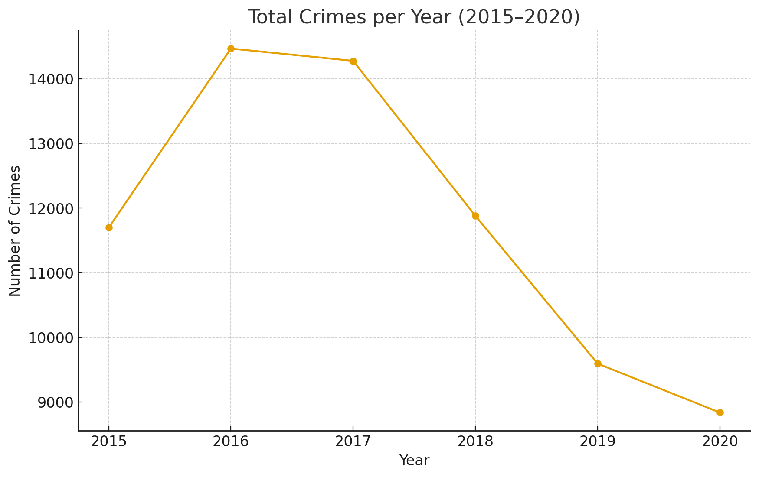
Crimes per Year (2015–2020)

Slide 7
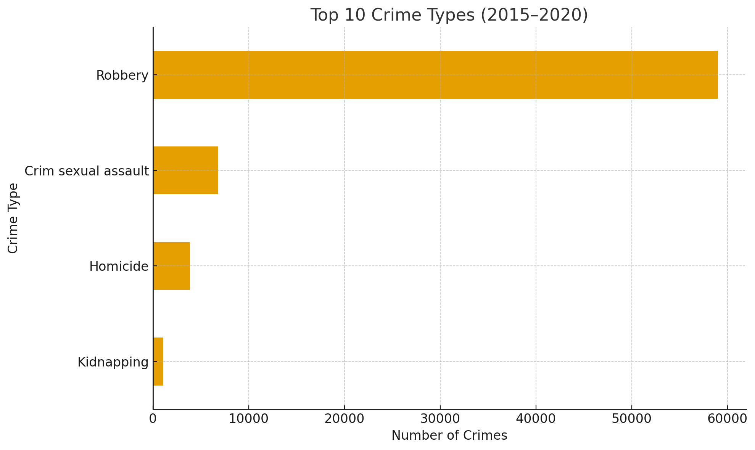
Top 10 Crime Types

Slide 8
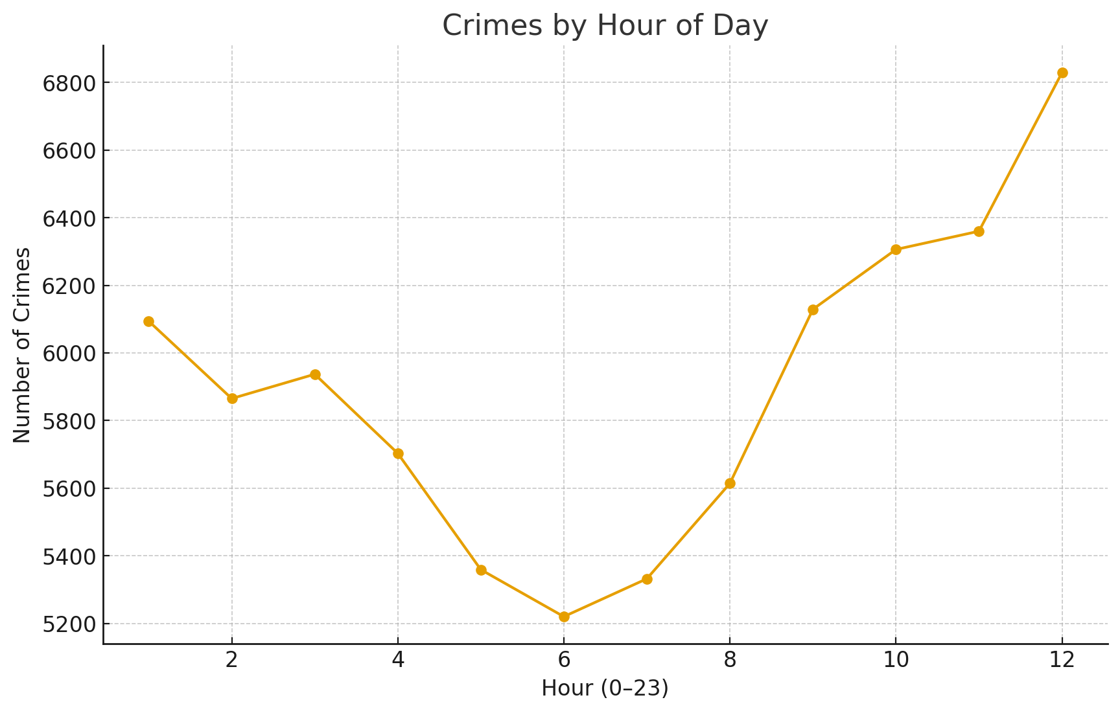
Crimes by Hour of Day

Slide 9
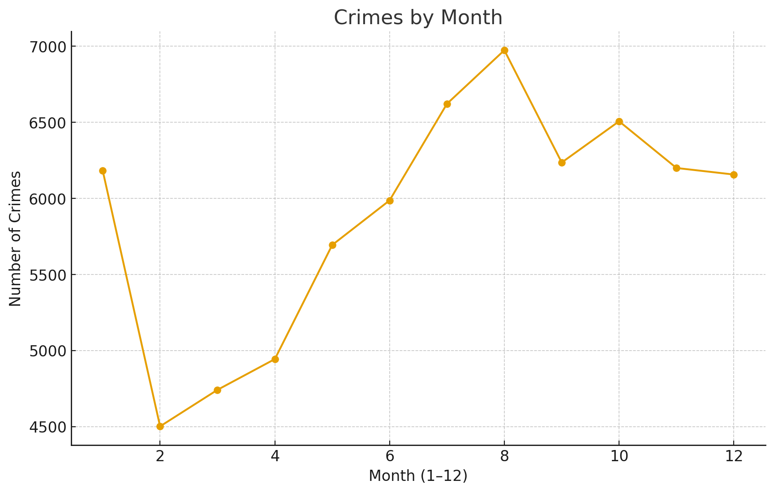
Crimes by Month

Slide 10
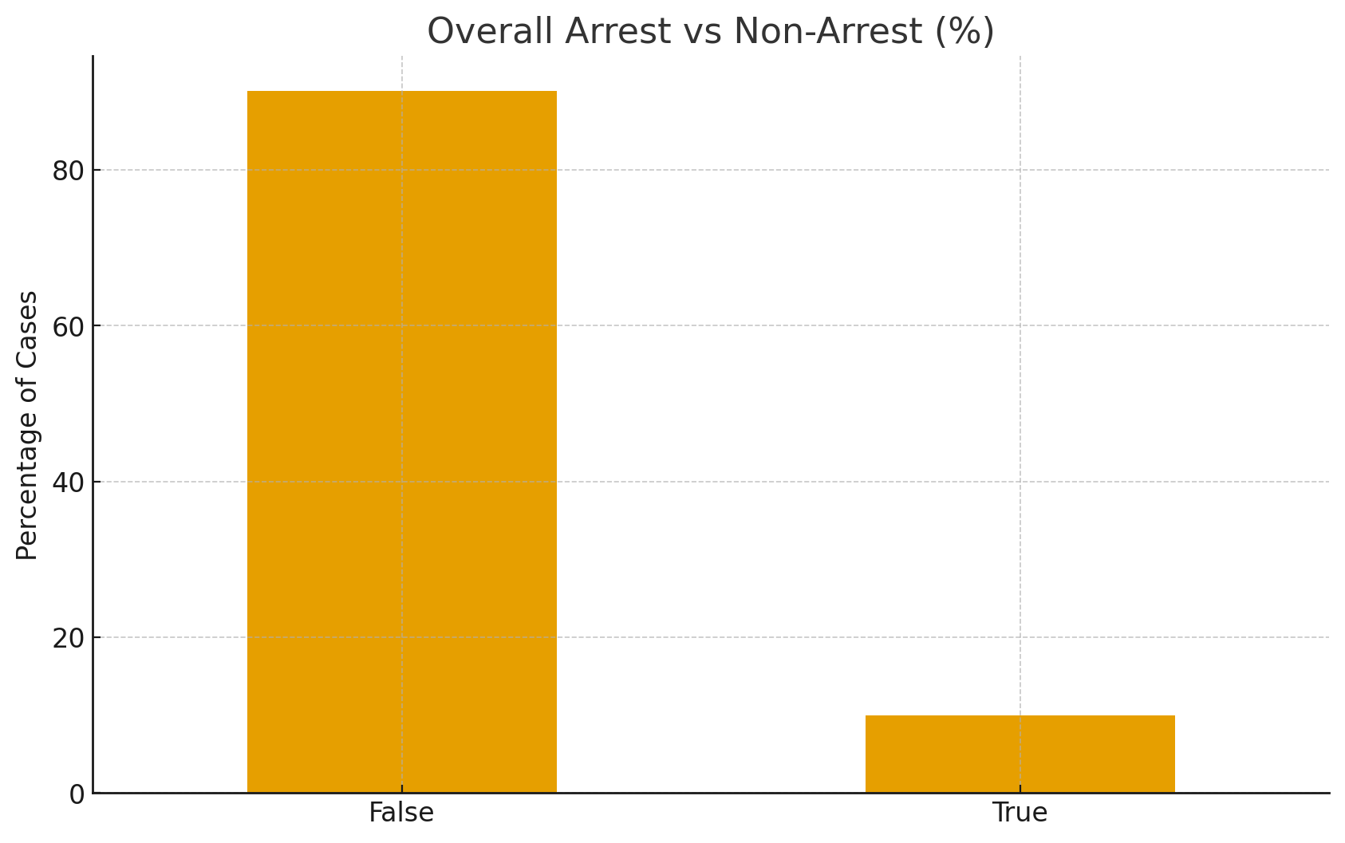
Overall Arrest vs Non-Arrest Rate

Slide 11
Summary of Insights
• Crime levels vary across the years 2015–2020
• Certain crime types (such as theft and assault-related offenses) appear frequently
• Crimes tend to peak during specific hours of the day
• Monthly patterns show fluctuations in crime activity throughout the year
• Only a portion of reported crimes result in arrests
These patterns provide a high-level picture of how crime evolves over time in Chicago.

Slide 12
Recommendations
Based on the analysis, the city could:
• Allocate more patrol resources during peak crime hours
• Focus prevention programs in areas and times with repeated high activity
• Monitor high-frequency crime types more closely
• Use year-over-year trends to evaluate policy effectiveness
• Encourage better reporting and follow-up to improve arrest outcomes

Slide 13
Project & Repository
GitHub Repository:
[Insert your GitHub link here]
Contents:
• Jupyter Notebook (analysis and visualizations)
• Dataset reference
• Presentation slides
• README with project overview and findings

