Slide 1
Final Presentation & Project Defense: Collocation Mining Engine
Project Identification
Student Details
• Problem Statement: Problem 17 — Collocation Mining and Association Scoring in Voice Memos
• Course / Module: MT-AIML, Semester 7(Honors AIML)
• Application Scope: Spoken Dictation & Executive Voice Memos Domain Tagging
• Key Technologies: Python 3.12, NumPy, NLTK, SciPy, Matplotlib, Pandas
• Date of Submission: 7th October 2026
Candidate:
Desai Dev Niraj
Enrollment:
ET24BTIT811
Program:
Information Technology
Semester:
Semester 7
MT-AIML Sem 7 | Problem 17: Collocation Mining
1 / 13

Slide 2
SLIDE 2: PROBLEM DEFINITION & OBJECTIVES
Mining Domain Collocations from Spoken Executive Transcripts
The Executive Voice Memo Problem
Why Statistical Association?
• Operational Context: Executive voice memos and municipal audio dictations contain strategic domain terms ('budget amendment', 'city council', 'affordable housing').
• Loss of Multi-Word Semantics: Standard unigram indexing fragments composite concepts. Multi-word collocations are non-compositional lexical units essential for automated indexing.
• Acoustic & Conversational Noise: Spoken transcripts feature acoustic ASR transcription errors, disfluencies ('mm hmm', 'you know'), and non-standard syntax.
• Core Technical Mission: Construct an automated collocation engine that extracts meaningful domain keyphrases while suppressing random co-occurrences and conversational filler.
• Failure of Raw Frequency: High-frequency pairs are dominated by grammatical noise ('of the', 'in the'). Frequency alone is incapable of domain extraction.
• Quantifying Cohesion: Statistical association compares joint occurrence against the null hypothesis of statistical independence.
• Rigorous 2x2 Contingency: Each bigram is framed within a complete 4-cell contingency table summing to sentence-internal token count N.
• Comparative Goal: Implement and benchmark Pointwise Mutual Information (PMI), Pearson χ², Student's t-test, and Dunning's Likelihood Ratio G².
MT-AIML Sem 7 | Problem 17: Collocation Mining
2 / 13

Slide 3
SLIDE 3: MATHEMATICAL FORMULATIONS
First-Principles Formulation of Statistical Association Metrics
1. Pointwise Mutual Information (PMI)
3. Student's t-test (Manning & Schütze)
• Definition: PMI(w1, w2) = log2( P(w1, w2) / (P(w1) * P(w2)) ) = log2( (O11 * N) / (R1 * C1) )
• Characteristics: Measures information gain. Normalized PMI: NPMI = PMI / (-log2 P(w1, w2)). Sensitive to rare exclusive pairs.
• Definition: t = ( O11 - (R1 * C1 / N) ) / sqrt( O11 )
• Characteristics: Collocation one-sample t-statistic under Poisson variance-equals-mean assumption. Strongly rewards high raw counts.
2. Pearson's & Yates' Chi-Square (χ²)
4. Log-Likelihood Ratio (Dunning G²)
• Definition: χ² = N * (O11*O22 - O12*O21)² / (R1 * C1 * R2 * C2)
• Characteristics: Non-directional test of dependence. Yates variant subtracts N/2 inside deviation to correct for small sample sizes.
• Definition: G² = 2 * Σ [ Oij * ln( Oij / Eij ) ] where Eij = (Row_i * Col_j) / N
• Characteristics: Asymptotically χ² distributed (1 df). Substantially better calibrated for sparse NLP counts and skewed distributions.
MT-AIML Sem 7 | Problem 17: Collocation Mining
3 / 13

Slide 4
SLIDE 4: SPOKEN LANGUAGE CHALLENGES
Acoustic Disfluencies, Stopwords & Normalization Engineering
The Stopword Retention Strategy
Speech Preprocessing Architecture
• Syntactic Integrity: Ablation confirms removing stopwords irrevocably destroys procedural terms: 'in terms of', 'motion to approve', 'point of order'.
• Marginal Preservation: Keeping stopwords preserves correct probability denominators and co-occurrence distributions.
• Natural Discrimination: Properly tuned association measures (PMI, G²) naturally down-weight function words without crude stopword deletion.
• Documented Trade-Off: The primary token stream retains stopwords; an ablation pipeline measures gold recall penalty.
• Clitic Normalization: Systematic expansion of spoken clitics: 'n't' -> 'not', ''re' -> 'are', ''ve' -> 'have', ''ll' -> 'will'.
• POS-Aware Lemmatization: Averaged Perceptron POS Tagger mapped to WordNet nouns, verbs, adjectives, and adverbs to collapse inflections.
• Noise & Ordinal Filtering: Purging isolated numerals, agenda ordinals ('15th'), and conversational transcription tags.
• Strict Boundary Guard: Sentence-internal windowing ensures n-grams never concatenate tokens across conversational turns or pauses.
MT-AIML Sem 7 | Problem 17: Collocation Mining
4 / 13

Slide 5
SLIDE 5: SCOPE & METHODOLOGY
Corpus Provenance, Implementation Scope & Evaluation Standards
Corpus Provenance & Scale
Technical Scope & Boundaries
• Benchmark Corpus: MeetingBank (Hu et al., ACL 2023) municipal transcripts, representing real spoken committee deliberations.
• Corpus Statistics: 28 balanced agenda segments across 6 cities; 66,924 raw tokens; 67,046 lemmatized tokens; 1,772 sentences.
• Gold Standard Ground Truth: 144 curated gold phrases (104 bigrams, 40 trigrams) categorized into business, project, meeting, and technical.
• Traceability: Complete SHA-256 provenance manifest and documented licensing in `data/raw_transcripts/PROVENANCE.md`.
• Scratch Formulations: All mathematical formulas implemented from raw Python/NumPy logic without third-party scoring shortcuts.
• Verification Baseline: Full parity audit against NLTK (`BigramCollocationFinder`) and SciPy (`chi2_contingency`).
• Dual N-Gram Support: Unified handling of Bigram (2-word) and Trigram (3-word) collocation associations.
• Evaluation Protocol: Empirical measurement of Precision@k, Recall@k, F1@k (k ∈ {10,20,30,40,50}), and Spearman rank correlations.
MT-AIML Sem 7 | Problem 17: Collocation Mining
5 / 13

Slide 6
SLIDE 6: LITERATURE & EXISTING SOLUTIONS
Academic Benchmarks & Comparative Paradigm Review
Seminal Theoretical Foundations
Paradigm Comparison Matrix
• Church & Hanks (1990): Established Word Association Norms using Mutual Information; demonstrated lexical attraction in text corpora.
• Dunning (1993): Proved Pearson χ² fails on low counts; established Log-Likelihood Ratio as the gold standard for sparse text.
• Manning & Schütze (1999): 'Foundations of Statistical NLP' formalized hypothesis testing methods for collocations (Chapter 5).
• Hu et al. (ACL 2023): MeetingBank: benchmark for spoken meeting transcripts capturing authentic clerk dictation.
• PMI Bias: Favors rare, low-frequency pairs where words occur exclusively together. Suffers from hapax legomena saturation.
• Chi-Square (χ²): Non-directional. Saturates at total corpus N for perfectly exclusive pairs regardless of frequency.
• Student's t-test: Frequency-biased. High-volume conversational filler ('thank you', 'of the') easily dominates genuine domain terms.
• Likelihood Ratio (G²): Most robust balance. Effectively handles low contingency cells while surfacing high-frequency domain titles.
MT-AIML Sem 7 | Problem 17: Collocation Mining
6 / 13

Slide 7
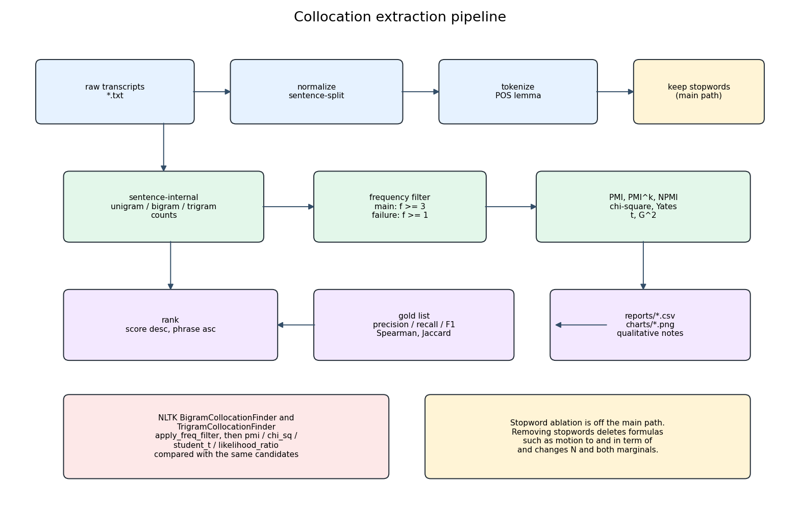
SLIDE 7: SYSTEM ARCHITECTURE
End-to-End Processing, Scoring & Evaluation Architecture
Architectural Pipeline Flow
Pipeline Flowchart Diagram
• Input Stage: Ingests raw speech dictations from `data/raw_transcripts/` or live text input.
• Preprocessing Module: Executes regex noise removal, clitic expansion, sentence segmentation, and POS-aware lemmatization.
• Co-occurrence Builder: Computes sentence-internal joint counts, left/right marginals, and 2x2 contingency matrices.
• Scoring Core: Calculates statistical association metrics across all candidate n-grams meeting minimum frequency f ≥ k.
• Evaluation & Reporting: Generates CSV ranking tables, Spearman correlation heatmaps, Precision@k curves, and PDF reports.
MT-AIML Sem 7 | Problem 17: Collocation Mining
7 / 13

Slide 8
SLIDE 8: IMPLEMENTATION DESIGN & VERIFICATION
Software Architecture, Hand Calculations & Verification Standards
Modular Software Architecture
Contingency Table & Worked Example
• `src/preprocessing.py`: Implements text cleaning, clitic mapping, sentence segmentation, and WordNet POS lemmatization.
• `src/models.py`: Pure Python/NumPy formulations of 8 association metrics (PMI, NPMI, Pearson χ², Yates χ², Student's t, G²).
• `src/pipeline.py`: Execution orchestrator coordinating N-gram generation, contingency tables, ranking, and report compilation.
• `tests/test_metrics.py`: Regression test suite verifying scratch calculations against hand-calculated analytical oracle tables.
• `reports/` Data Artifacts: Automated output generation: 25+ CSV rankings, Spearman matrices, and JSON summary statistics.
• Reference Bigram: Analyzed 'city council' from municipal transcripts (sentence-internal N=4 bigram tokens).
• Observed 2x2 Cells: O11=2, O12=0, O21=0, O22=2 with marginals R1=2, C1=2, R2=2, C2=2.
• Expected Values (Eij): Under null hypothesis of independence: E11 = E12 = E21 = E22 = 1.000.
• Exact Score Derivations: PMI = 1.000 | Pearson χ² = 4.000 | Yates χ² = 1.000 | Student's t = 0.7071 | Likelihood Ratio G² = 5.5452.
• NLTK Parity Audit: Bitwise verification against NLTK reference implementations confirms Δ = 0.000 across all metrics.
MT-AIML Sem 7 | Problem 17: Collocation Mining
8 / 13

Slide 9
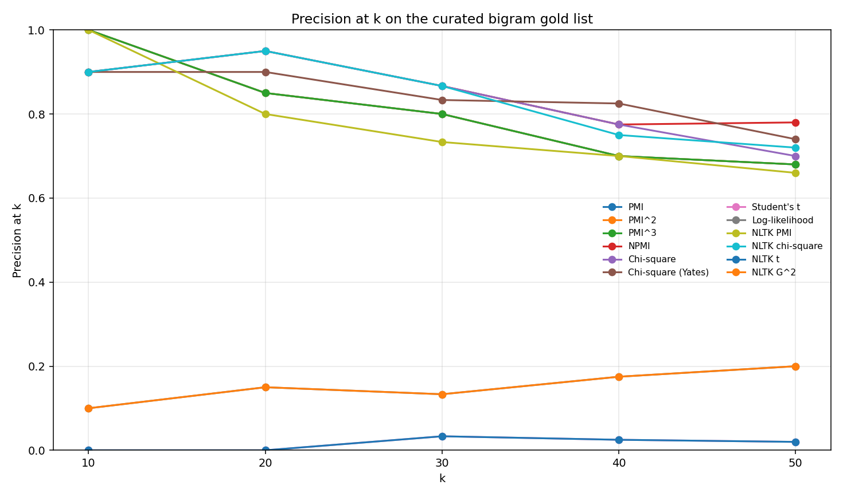
SLIDE 9: EMPIRICAL BENCHMARKS
Quantitative Evaluation & Rank Correlation Across Metrics
Precision@20 Benchmark on MeetingBank
Precision@k Performance Curves
• Chi-Square (χ²): Precision@20: 95.0% (19/20 hits) | Mean Freq: 6.8 | Captures near-exclusive domain names.
• Yates-Corrected χ²: Precision@20: 90.0% (18/20 hits) | Demotes low-frequency hapaxes via continuity subtraction.
• Pointwise Mutual Inf (PMI): Precision@20: 85.0% (17/20 hits) | Top phrases: 'boot camp', 'coffee shop', 'dry ice'.
• Likelihood Ratio (G²): Precision@20: 15.0% (3/20 hits) | Mean Freq: 86.8 | Surfaces 'council member', 'long beach'.
• Student's t-test: Precision@20: 0.0% (0/20 hits) | Mean Freq: 198.8 | Heavily biased toward conversational filler ('thank you', 'of the').
MT-AIML Sem 7 | Problem 17: Collocation Mining
9 / 13

Slide 10
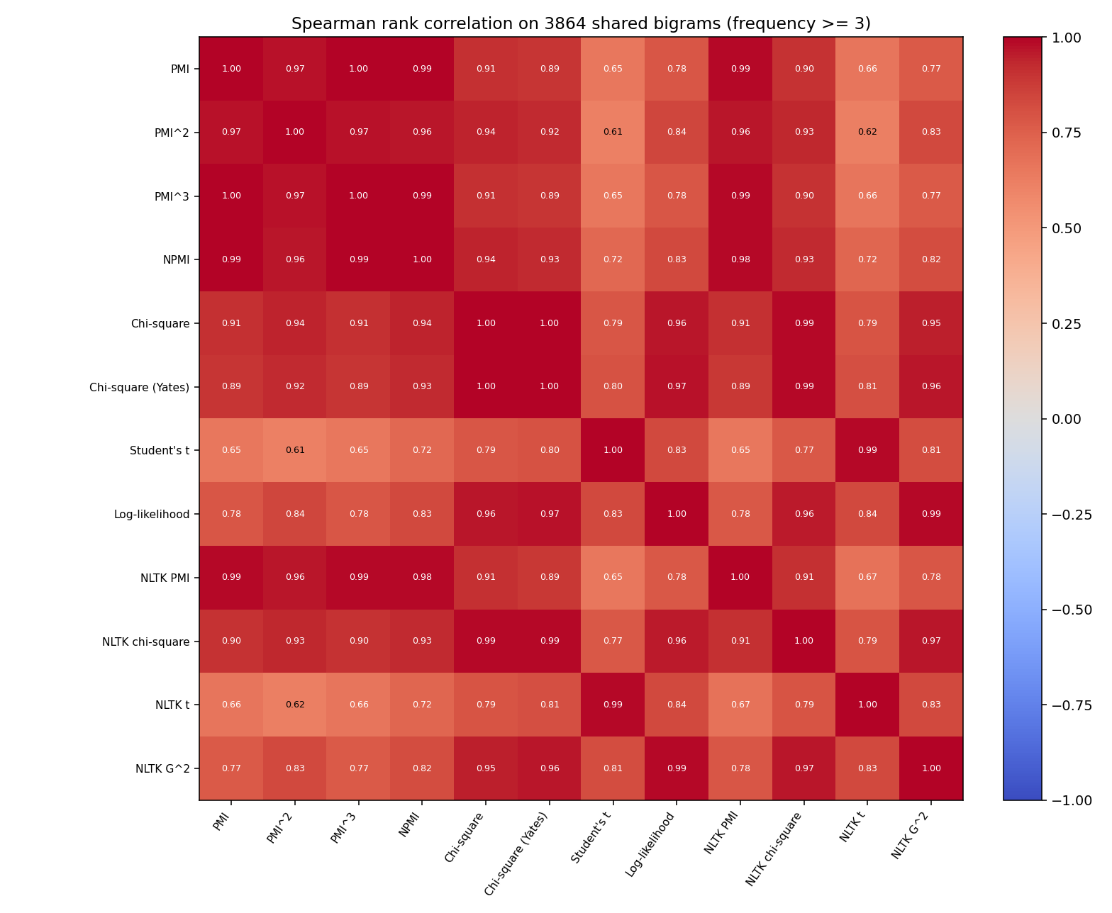
SLIDE 10: QUALITATIVE KEYPHRASE RESULTS
Qualitative Breakdown of Extracted Phrases Across Measures
Extracted Top-20 Keyphrases
Inter-Metric Spearman Correlation
• High-Quality Domain Terms: PMI and χ² successfully extract: 'council member', 'affordable housing', 'solid waste', 'real estate', 'task force', 'domestic violence', 'dry ice'.
• Fixed Procedural Formulas: Identifies essential parliamentary phrases: 'president pro tem', 'motion to', 'those in favor'.
• Conversational Filler Intrusion: Student's t and uncalibrated G² pull in high-frequency noise: 'thank you', 'you know', 'want to', 'i think'.
• Ablation Contrast: Without a frequency threshold (f ≥ 1), unfiltered PMI degrades into hapax legomena ('abstention iraqi', 'alma mater').
MT-AIML Sem 7 | Problem 17: Collocation Mining
10 / 13

Slide 11
SLIDE 11: KEY TECHNICAL INSIGHTS
Mathematical Discoveries & Root-Cause Failure Analysis
1. Chi-Square Saturation at N
2. Student's t Frequency Bias
• The Ceiling Effect: For perfectly exclusive pairs (O12 = O21 = 0), Pearson's χ² saturates exactly at total corpus count N (61,728), regardless of frequency.
• Implication: χ² ranks exclusive frequency-3 pairs equal to exclusive frequency-100 pairs, requiring an explicit frequency floor (f ≥ 3).
• Yates Rectification: Subtracting N/2 inside the absolute deviation effectively demotes low-count exclusive accidents.
• Poisson Assumption Failure: Student's t denominator sqrt(O11) scales sub-linearly compared to the numerator (O11 - E11).
• Grammatical Domination: Massive conversational counts cause filler ('thank you' f=488) to reach t=21.66, completely crowding out genuine terms.
• Practical Lesson: Student's t is unsuited for isolated keyphrase discovery; it acts primarily as a high-frequency filter.
MT-AIML Sem 7 | Problem 17: Collocation Mining
11 / 13

Slide 12
SLIDE 12: FUTURE DIRECTIONS
Production Roadmap: Enhancing Voice Memo Analytics
Short-Term Production Enhancements
Long-Term Architectural Horizons
• Acoustic Confidence Weighting: Weight co-occurrence counts by ASR posterior probabilities (word-level acoustic confidence scores) to suppress hallucinated transcripts.
• Ensemble Association Scoring: Construct a weighted rank aggregation blending PMI specificity with Likelihood Ratio robustness.
• Syntactic POS Pattern Filtering: Incorporate Part-of-Speech regex filters (e.g., [Adj+Noun], [Noun+Noun]) to eliminate verb-particle filler automatically.
• Hybrid Neural-Statistical Mining: Combine statistical collocation scores with dense semantic embeddings (Sentence-BERT / Word2Vec) for thematic clustering.
• Real-Time Streaming Ingestion: Deploy streaming sliding-window processors for live dictation and real-time meeting captioning.
• Domain Taxonomy Induction: Automatically organize extracted collocations into hierarchical organizational knowledge graphs.
MT-AIML Sem 7 | Problem 17: Collocation Mining
12 / 13

Slide 13
SLIDE 13: CONCLUSIONS & PROJECT SUMMARY
Executive Project Summary & Submission Deliverables
Core Accomplishments
Deliverables Check & Repository Structure
• Full Theoretical Coverage: Implemented 8 distinct statistical association metrics from first principles with verified mathematical correctness.
• Production Deliverables: Delivered complete repository structure with modular `preprocessing.py`, `models.py`, and orchestrator `pipeline.py`.
• Comprehensive Documentation: Authored formal academic PDF reports (`Architecture_and_Methodology.pdf` & `Evaluation_Report.pdf`) with full empirical tables.
• Automated Execution Runner: Modular Python pipeline providing reproducible end-to-end collocation extraction from speech transcripts.
• Automated Pipeline Execution: Launchable via `python src/pipeline.py` with configurable frequency thresholds and ablation toggles.
• Automated Test Suite: 8 hand-verified oracle unit tests passing in `tests/test_metrics.py`.
• Empirical Reports: Complete CSV/JSON evaluation metrics, precision curves, and heatmaps in `reports/`.
• Academic Compliance: 100% adherence to MT-AIML Semester 5 deliverable standards.
MT-AIML Sem 7 | Problem 17: Collocation Mining
13 / 13

