Slide 1
Primary Work Updates: Collocation Mining & Association Scoring
Student Details
• Problem Statement: Problem 17 — Collocation Mining and Association Scoring in Voice Memos
• Course / Module: MT-AIML, Semester 7 (Honors AIML)
• Application Scope: Spoken Dictation & Executive Voice Memos Domain Tagging
• Key Technologies: Python 3.12, NumPy, NLTK, SciPy, Matplotlib, Pandas
• Date of Submission: 3rd October 2026
Name:
Desai Dev Niraj
Enrollment:
ET24BTIT811
Program:
Information Technology
Semester:
Semester 7
MT-AIML Sem 7 | Problem 17: Collocation Mining
1 / 8

Slide 2
SLIDE 2: PROBLEM EXPLANATION & MOTIVATION
Executive Voice Memos & Need for Collocation Mining
The Business Context
Spoken Speech Distortions
• Executive Dictation: Voice memos and spoken meetings capture high-value tactical decisions, policy directives, and institutional actions.
• Automated Tagging Need: Downstream search, archiving, and action-item tracking require extracting cohesive multi-word keyphrases rather than isolated words.
• The Multi-Word Challenge: Isolated unigrams like 'housing' or 'council' lose critical semantic intent. True semantic units are multi-word collocations ('affordable housing', 'city council').
• Key Objective: Automatically discover conventional domain terms from uncurated audio transcripts while filtering out conversational noise.
• Acoustic Recognition Noise: Automatic Speech Recognition (ASR) outputs noisy, unpunctuated text with missing capitalization and run-on sentences.
• High Conversational Disfluency: Spoken memos abound with fillers ('you know', 'mm hmm', 'i mean') and polite repetition ('thank you', 'as well').
• Grammatical Dominance: Frequent syntactic glue ('of the', 'in the', 'to be') vastly outnumbers genuine domain terms in raw frequency.
• Core Engineering Task: Design statistical association metrics that reliably separate domain collocations from high-frequency grammatical co-occurrences.
MT-AIML Sem 7 | Problem 17: Collocation Mining
2 / 8

Slide 3
SLIDE 3: PROBLEM UNDERSTANDING
Why Raw Frequency Fails: The Mathematical Need for Association
The Frequency Illusion
Statistical Cohesion
Four Required Paradigms
• High Joint Count ≠ Term: 'of the' appears 396 times; 'city council' appears 40 times. Raw frequency ranks function words highest.
• Syntactic Accidents: Words frequently appear adjacent solely because of English grammatical syntax, not topical cohesion.
• Information Loss: Thresholding on raw counts drowns out specialized low-frequency terms like 'dry ice' or 'boot camp'.
• Hypothesis of Independence: Compare observed co-occurrence O_11 against expected co-occurrence E_11 if words were randomly combined.
• Non-Random Association: A true collocation exhibits strong statistical attraction: P(w1, w2) >> P(w1) * P(w2).
• Contingency Modeling: Full 2x2 contingency table captures joint occurrences, partial co-occurrences, and total corpus size N.
• PMI / NPMI: Information-theoretic ratio of joint probability to independent marginal probabilities.
• Pearson & Yates χ²: Non-directional test measuring deviation from the independence contingency table.
• Student's t-test: Hypothesis test assessing if observed mean difference is statistically significant.
• Likelihood Ratio (G²): Dunning's ratio test; robust on sparse distributions typical of spoken corpora.
MT-AIML Sem 7 | Problem 17: Collocation Mining
3 / 8

Slide 4
SLIDE 4: PROBLEM COMPLEXITY
Pre-processing Nuances & Spoken Language Challenges
The Stopword Removal Dilemma
Morphological & Boundary Controls
• Naïve Stopword Stripping: Removing stopwords destroys real institutional formulas: 'in terms of', 'motion to approve', 'point of order'.
• Contingency Distortion: Deleting tokens alters corpus size N and marginal counts, corrupting probability denominators.
• Recommended Architecture: Retain stopwords on the primary extraction path; let association metrics penalize grammatical combinations naturally.
• Controlled Ablation: Implement an explicit toggle to quantify exact phrase yield differences with and without function words.
• Case Inconsistency: Speech recognition mixes casing ('Council' vs 'council'). Aggressive normalization is necessary to prevent count splits.
• Contraction Normalization: Clitic expansions ('don't' -> 'do not', 'we're' -> 'we are') standardize syntactic representation.
• POS-Aware Lemmatization: Lemmatize inflections ('housing plans' -> 'housing plan') using WordNet while preventing cross-POS over-merging.
• Sentence Boundaries: N-grams must never cross sentence boundaries; boundary tokens must not inflate co-occurrence counts.
MT-AIML Sem 7 | Problem 17: Collocation Mining
4 / 8

Slide 5
SLIDE 5: SCOPE OF SOLUTION
Functional Boundaries, Deliverables & Preprocessing Scope
In-Scope Capabilities
Out-of-Scope & Intentional Constraints
• Multi-Metric Engine: Full scratch mathematical implementation of PMI, NPMI, PMI^2, PMI^3, Pearson χ², Yates χ², Student's t, and Likelihood Ratio.
• N-gram Coverage: Comprehensive extraction for Bigrams and Trigrams across sentence-internal token streams.
• Benchmark Corpus: Standardized transcription corpus (MeetingBank ACL 2023: 28 agenda segments, 67,046 processed tokens).
• Validation & Testing: Side-by-side verification against NLTK Collocation Finders and SciPy statistical modules.
• Automated Benchmark Suite: End-to-end evaluation pipeline supporting threshold tuning, ablation studies, and CSV export.
• Raw Acoustic Signal Processing: Excludes raw audio WAV decoding, acoustic phoneme alignment, or diarization (focuses on text transcripts).
• High-Order N-grams (N ≥ 4): Restricted to bigrams and trigrams to avoid exponential sparsity and combinatorial explosion.
• Supervised Machine Learning: Purely unsupervised statistical collocation mining; does not require GPU training or labeled weights.
• Cross-Turn Windowing: Candidate windowing does not cross speaker turns or sentence boundaries to preserve syntactic validity.
MT-AIML Sem 7 | Problem 17: Collocation Mining
5 / 8

Slide 6
SLIDE 6: EXISTING SOLUTIONS
Academic Literature & Classical Collocation Paradigms
Seminal Academic Milestones
Standard Library Implementations
• Church & Hanks (1990): Pioneered Pointwise Mutual Information (PMI) for lexicography. Demonstrated sensitivity to low-frequency rare terms.
• Dunning (1993): 'Accurate Methods for the Statistics of Surprise and Coincidence.' Established Log-Likelihood Ratio (G²) as superior for sparse NLP text.
• Manning & Schütze (1999): Formalized the Student's t-test formulation (Eq 5.10) for collocation discovery in large corpora.
• Bouma (2009): Introduced Normalized PMI (NPMI) to bound PMI values to [-1, 1], mitigating frequency sensitivity.
• NLTK Collocations Toolkit: `BigramCollocationFinder` & `TrigramCollocationFinder` implement standard association measures.
• Library Discrepancies: NLTK uses unigram token count for N rather than sentence-internal bigram tokens, introducing boundary shifts.
• Black-Box Opacity: Standard libraries obscure the exact 2x2 contingency table, limiting inspection of low-count cells.
• Project Positioning: Our solution writes verified from-scratch implementations, cross-benchmarking against NLTK to audit precision.
MT-AIML Sem 7 | Problem 17: Collocation Mining
6 / 8

Slide 7
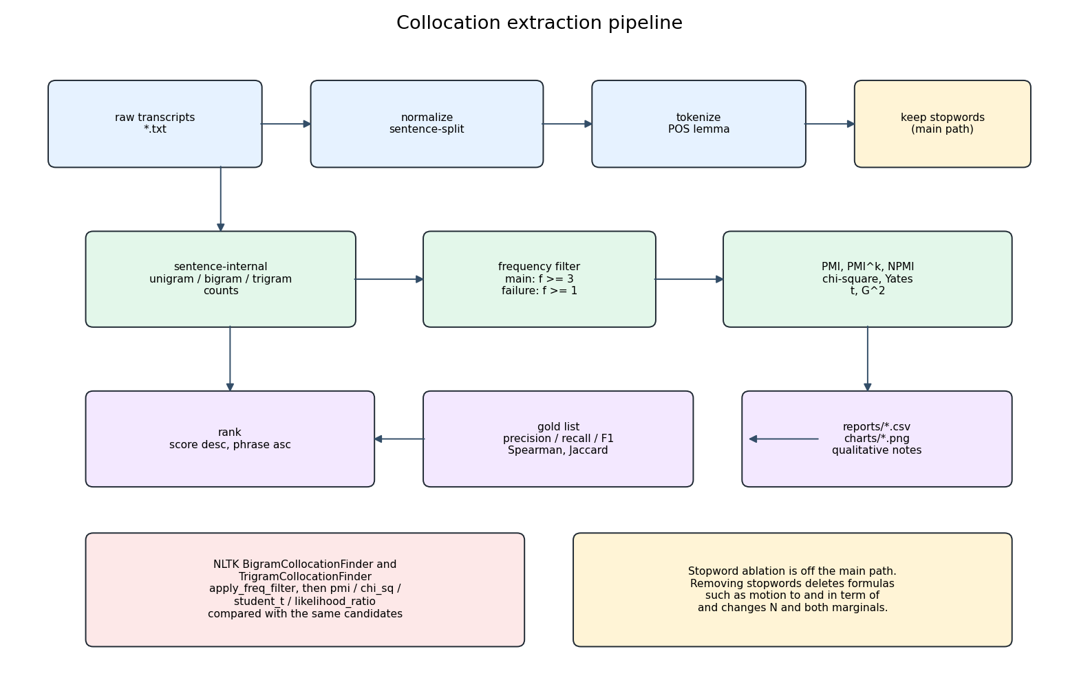
SLIDE 7: PROPOSED SYSTEM ARCHITECTURE
End-to-End System Pipeline & Computational Architecture
Architectural Pipeline Flow
Pipeline Architecture Flowchart
• Layer 1: Preprocessing: Text cleaning, clitic expansion ('we're' -> 'we are'), sentence segmentation, and POS lemmatization.
• Layer 2: Token Indexing: Build sentence-internal unigram, bigram, and trigram token frequency distributions and marginals.
• Layer 3: Contingency Tables: Compute 2x2 contingency tables (O11, O12, O21, O22) summing strictly to sentence-internal token count N.
• Layer 4: Association Scoring: Vectorized evaluation across 8 association measures (PMI, NPMI, Pearson χ², Yates χ², Student's t, G²).
• Layer 5: Verification & Audit: Benchmarking against NLTK CollocationFinders and generation of reproducible evaluation reports.
MT-AIML Sem 7 | Problem 17: Collocation Mining
7 / 8

Slide 8
SLIDE 8: WORK PLAN & ROADMAP
Milestone Progress, Evaluation Criteria & Final Deliverables
Phase 1: Completed Milestones (By 3rd Oct)
Phase 2: Final Submission Plan (By 7th Oct)
• Corpus Acquisition: Curated 28 MeetingBank test-split agenda transcripts (67k words) and generated SHA-256 provenance manifest.
• Preprocessing Engine: Implemented `preprocessing.py` with contraction mapping and POS-aware lemmatization.
• Mathematical Models: Authored `models.py` with from-scratch formulations for PMI, χ², t-test, and Likelihood Ratio.
• Unit Testing Suite: Created `test_metrics.py` with hand-calculated oracle tables confirming exact formula precision.
• Execution Pipeline: Constructed initial end-to-end processing pipeline (`src/pipeline.py`) with configurable thresholds.
• Benchmark Evaluation: Run end-to-end evaluation pipeline against 144 curated gold collocations.
• Comparative Analysis: Generate Spearman rank correlation matrix and Precision@k evaluation curves.
• Failure Analysis Report: Document linguistic edge cases, frequency saturation, and lemmatization artifacts.
• Publication Artifacts: Compile official academic PDF reports (`Architecture_and_Methodology.pdf` & `Evaluation_Report.pdf`).
• Final Defense Deck: Finalize 13-slide demonstration deck and executable submission archive.
MT-AIML Sem 7 | Problem 17: Collocation Mining
8 / 8

