Slide 1
Installing Aplexaruss
How to get this damn app working…hopefully
1/17/2017
Twitter: @russ152

Slide 2
Disclaimer
This took me 2 weeks to get going.
Granted, I didn’t know how-to-Node prior to starting, and I had to update the code to support changes to the plex api, niether which you have to do now, but still...
Expect this to take a few hours to get working
The biggest hurdle was a lack of documentation, thus this ppt, sooooo if you can’t get it to work with all of this... This might not be a project for you to do solo. Call a buddy, someone who is REALLY good at troubleshooting
Good luck!

Slide 3
Capabilities & Limitations
Capabilities
Enable Alexa to play KNOWN movies and tv episodes with commands like
Play Episode 1 Season 2 of The Office
Play the movie Godzilla 2000
Play a good episode of The Walking Dead
Limitations
Launches only one default client, in our case a Roku
Can’t dynamically see new content, new series/movies must be listed in the Alexa Skill’s list of valid show/movie names
Only one server and does not play content of shared servers

Slide 4
Required Services
This application requires 3 separate services, all of which reside in the AWS ecosystem. For personal/low use like this, it shouldn’t cost you anything
Alexa Skills Kit
Used to create a skill that you install on your Amazon Echo (dot)
Lambda
This will run our Node.js app, and will be the end point for our Alexa Skill
DynamoDB
This is used by our Node.js to store information about our server and connections

Slide 5
Plan of attack
Setup our AWS Services
Enable our workstation to deploy our services and app
Configure our app
Deploy our app
Configure our network to allow Lambda to talk to our client

Slide 6
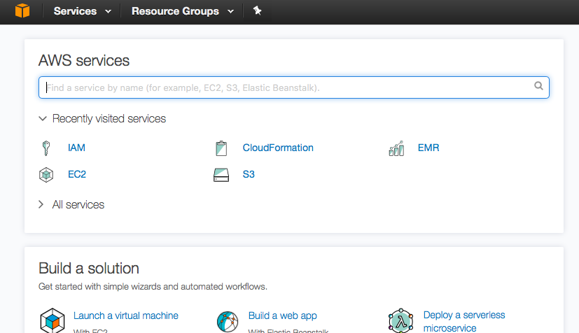
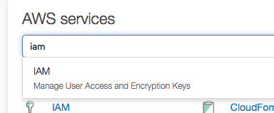
Setting Stuff Up
Create an AWS account
Afterwards you’ll have access to the console, pictured right
Type ‘IAM’ in the services box
We need to our user keys for the next step

Slide 7
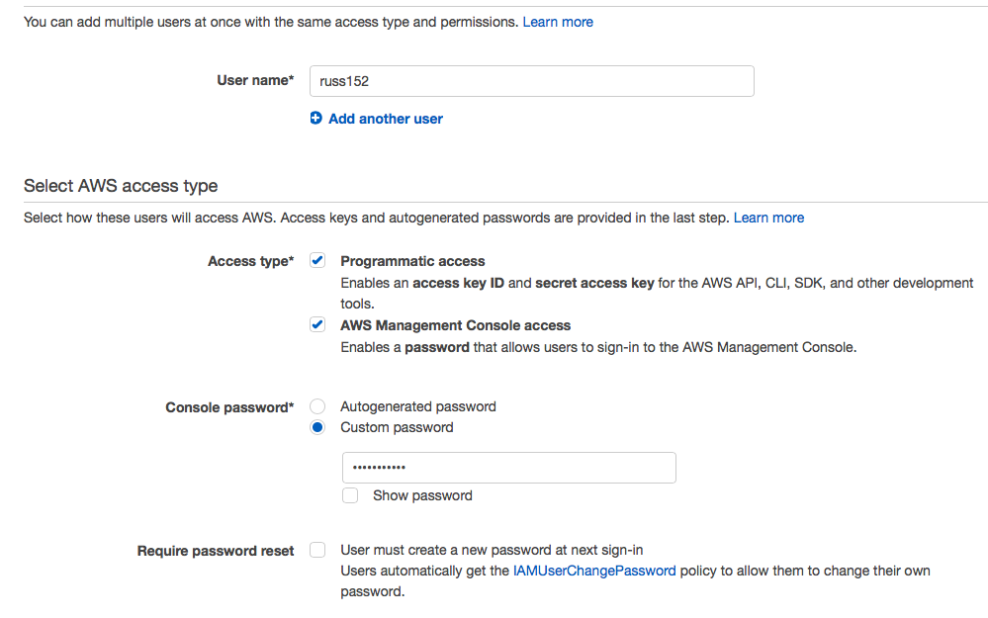
Create a User
On the left, click create user
Then At the top, Add user
Fill in the prompts, make sure programmatic access is checked
Add a password, uncheck reset requirement
Click next

Slide 8
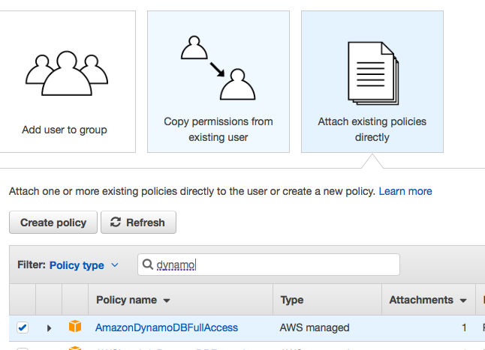
Permissions
Next you can create a group, or you can just give the user the following permissions by clicking ‘Attach existing policies directly’
AWSLambdaFullAccess
AmazonDynamoDBFullAccess
Click next, then create user
On the next screen click download csv
We’re now ready to setup the CLI
But first, let’s setup the other services

Slide 9
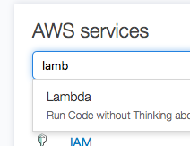
AWS Lambda
AWS Lambda lets us run code, without running a server. When we deploy our app, it will look for an existing AWS function to attach to, so we need to create a blank one
Go back to the console and type lambda
It might say ‘Get Started’ or Create Function, regardless, click that

Slide 10
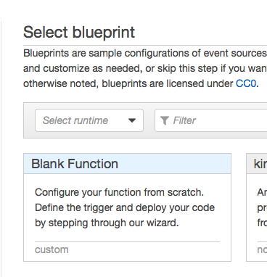
Create a Blank function
Use the blank blueprint

Slide 11
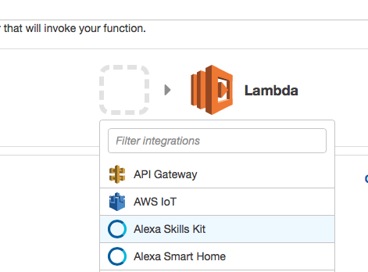
Set Triggers
Click on the dotted-line box and select Alexa Skills Kit
(Not Smart Home)
Click next

Slide 12
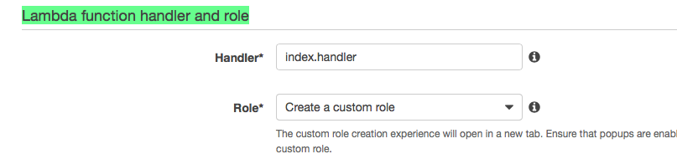
Name and Role
The Lambda function needs access to our DynamoDB (not created yet), so to do that we need to create a role.
On the next screen, give the EXACT name:
alexa-plex
Then scroll down to Lambda function handler and role section and select ‘Create a Custom Role’

Slide 13
Creating A Role
This will open another tab, give the role a name
Click edit and paste the contents of docs/dynamoDB_role.txt inside the box
Click Apply Role and you’ll be taken back to the prior tab
Click done, resolve any errors that come up
So long as the name is alexa-plex, the role has DynamoDB access, and runtime is set to node.js, nothing else should really matter what the other settings are, especially the code, that will get overwritten completely

Slide 14
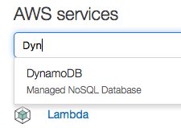
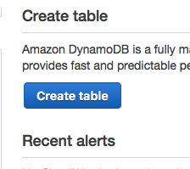
Setup DynamoDB
Now we need to setup DynamoDB
Type in Dynamo into the service box like before and select it
Click either ‘Get Started’ or ‘Create Tables’

Slide 15
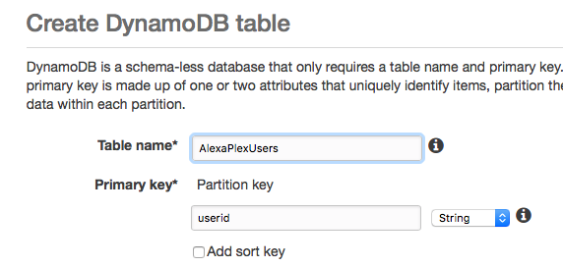
Create Table
Fill in the prompts with
Table Name: AlexaPlexUsers
Primary Key: userid
These have to be exact, the app will look for them by name
Click create

Slide 16
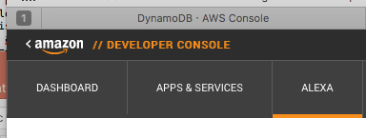
Alexa Skill
It’s time to create our Alexa Skill, this is what we will install on our Echo.
Sign into the devloper console and click ‘Alexa’

Slide 17
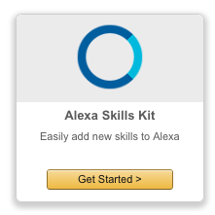
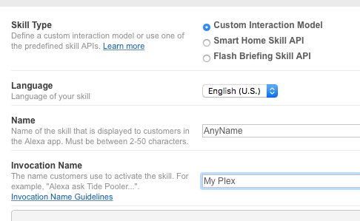
Alexa Skill Kit
Click Alexa Skills Kit
Then Add New skill
Give your skill any name
And for Invocation Name, use something that’s easy to say
’My Plex’ here will mean my commands are:
“Alexa, ask My Plex to play the movie Gone with the Wind”
Click next

Slide 18
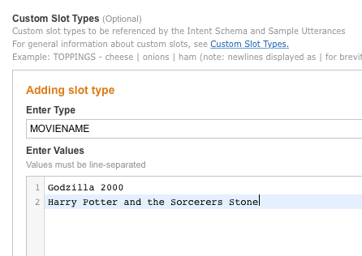
Configure Skill
For each prompt in the next screen, there is a corresponding file in the /ask_configuration folder
Paste the intent-schema.json file into the first prompt
Click the ‘create slot’ and enter slot name SHOWNAME, then paste in the list of shows you want alexa to be able to launch. SHOWNAME.txt is an example (note, there are no commas, each show is on a separate line)
Repeat this process for MOVIENAME
I used plex2csv plex plugin to export my shows and movies, I’d suggest just typing in one show and movie getting it working with that one first
Paste in sample-utterances.txt into the last prompt

Slide 19
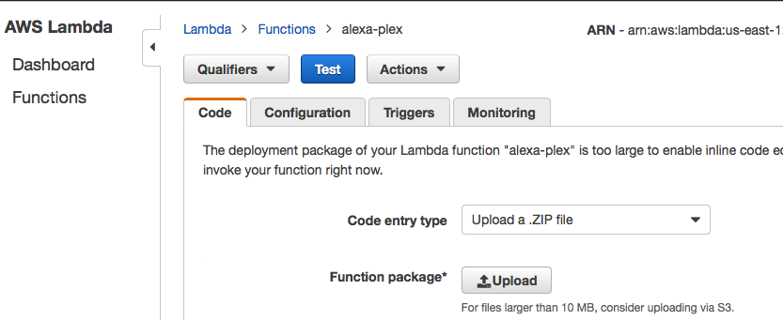
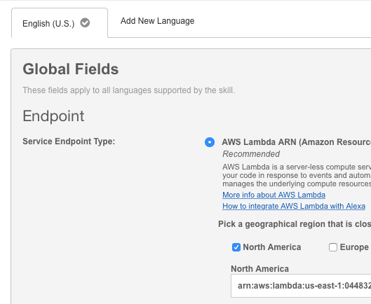
Link to Lambda ARN
In the next screen we need to paste the ARN of our lambda function
Go back to the lambda panel and click on our alexa-plex function
In the top right corner you’ll see the ARN, copy the whole thing from arn:… to function:alexa-plex
Paste this in to the Endpoint prompt

Slide 20
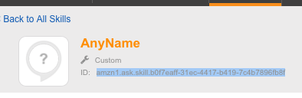
Get the Skill ID
At the top of this page, you should see your Alexa skill id
Copy this out, we’ll need it for the next step, configuring the .env file

Slide 21
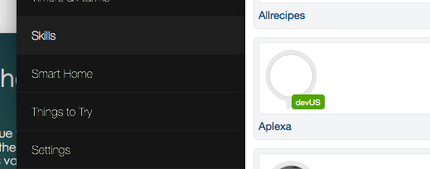
Finish the Skill setup
Continue through the prompts, giving the minimum required to pass validations, at publishing prompt, click ‘SAVE’ not ‘SUBMIT for Certification’
On the last page just click Save
Your skill should now show up in your Skill list of your Alexa app
We can’t test yet though, because our lambda function doesn't’t do anything yet

Slide 22
Install 7zip and configure .env
You need to have 7zip installed and added to your path (check the box during installation) for the included deploy scripts to work
Open the sample.env and edit the last 4 variables listed
APP_IDENTIFIER: This is just a random key you create so that plex doesn’t spawn off a new app ever time you make a request
ALEXA_APP_ID: the id of the alexa skills app we created in the last step
AWS_ACCESS_KEY_ID and AWS_SECRET_ACCESS_KEY: downloaded in slide 8
Save the edited file as just ’.env’ with no prefix name (take off ‘sample’ if your on mac, this might make the file hidden in finder

Slide 23
Setup your network
Ok, before we can have our node function work, we need to have an endpoint for it to talk to
The alexa-plex used to be able to initiate communication with the server and take over from there, but based on my research, plex changed the way you issue commands to clients, and now you have to talk to the client directly, so this is the work around I chose.
Alternative: run the node app on your own home computer/server and point the Alexa skill to it, then your node app can use local ip address

Slide 24
Getting your client information
Sign into plex.tv
Navigate to https://plex.tv/devices.xml
This will show you all the devices you have configured, your public ip, your clients ip, ports, etc
All we need is the publicAddress and connection.uri of the client we want
Notice it probably has a local address (10.0.1.16 in this example)
What we want is the port (8324) in this case

Slide 25
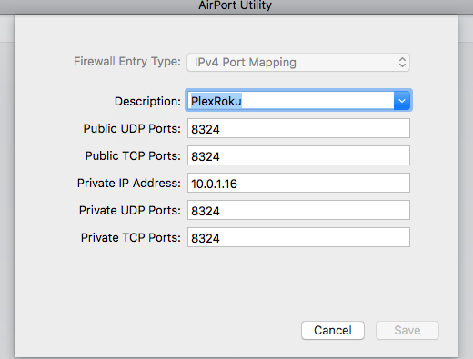
Setup your router
What we want to be able to is take our publicAddress, add our port, and see the client information
However by default, your router doesn’t know we want this
Google ‘how to port forward <router name>’ and follow the instructions
In the example here, I would port forward my Airport Extreme’s public port 8324 to private address 10.0.1.16 and private port 8234

Slide 26
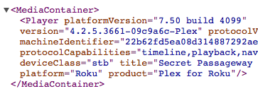
Save and Test
Verify your forwarding is working by navigating to
http://<your_public_ip>:<your_clients_port>/resources.xml
If you see xml like the following, your good to go, but keep your IP and client port handy, we need to tell our app those values

Slide 27
Tell the app where our client is
Get your IP address from google
Alternatively, create an A record for a subdomain on a website and point it to your ip address, like ’myhouse.mywebsite.com’
Update the file /lib/plexutils.js and set the two variables at the top
var clientIP = '123.12.12.123';
var forwardedPort = '8234';
For clientIP, this is your home ip
For portfoward, pop in the port we just tested

Slide 28
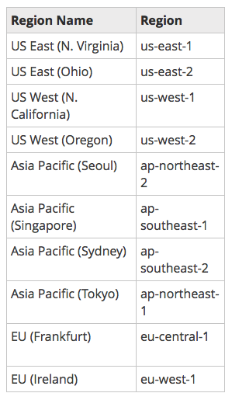
Now we can setup our CLI
Setup the CLI for windows or mac following these instructions:
http://docs.aws.amazon.com/cli/latest/userguide/installing.html#choosing-an-installation-method
Once done, run in terminal/cmd
aws configure
Paste in the Access Key and Secret found in the downloaded csv from slide 8
For default region, use the closest to you in the list here. Someone in Florida would use us-east-1
Leave the output format empty, just hit enter

Slide 29
Install node and npm
In order to deploy our app, we need Node.js on our workstation and NPM (the node package manager)
On mac, you can just use homebrew for both
Brew install node
Brew install npm
Everything else, even mac, can use the following link
https://nodejs.org/en/download/

Slide 30
Ready to deploy
29 slides later, 1+ hour(s), and 3 headaches later, and we should now be able to deploy our alexa plex application
The include bash scripts has been tested to work on my mac and, but you might have to tweak it in some way, and I haven’t extensively tested the windows batch file
Ultimately, the files will build us a node package (hence why we have to install node/npm) and create a zip file, then the script will auto upload the file to our lambda function.
Alternatively, we can just upload the dist.zip file (after you’ve built it via npm) in the web UI, but where’s the fun in that :P
Run deploy_mac.sh if your on mac, or deploy.bat if you’re on windows

Slide 31
Errors
If you get errors here, read them. Either AWS sdk isn’t working, or node can’t compile the script, or the zip file isn’t where it should be, or god just hates you. Scripts suck. Get the code compiled and move it to lambda, this doc assumes you can figure that out and we move onto the next step
You might have to run it with sudo
Try running the commands one at a time and see where it goes wrong
These scripts didn’t work for me out of the box, I’ve saved the changes necessary to get the running for Mr. Mee-agi-only

Slide 32
Sorry, I offer no support
Seriously, from here on out all sorts of things might go wrong, we’ve setup several services, and this requires all of them to be setup correctly for it to work at all
I do have some testing options for you though

Slide 33
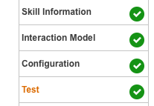
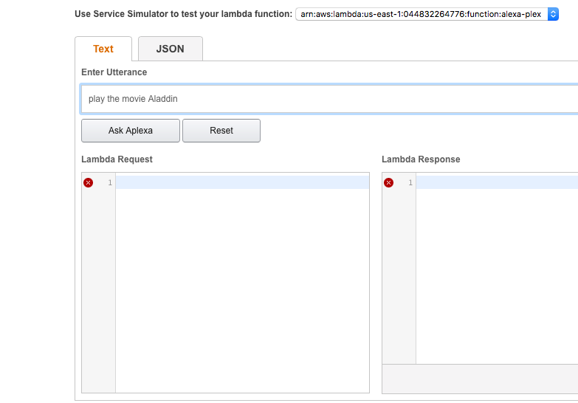
Alexa Skills Test Screen
In the alexa skill, there is a Test screen
Scroll down and you can type in the alexa commands, follow the speech formats in the utterances file
Press ‘ask alexa’ and this will build out the request alexa sends, and it will retun the lambda result, which will likely be ‘something went wrong’
Useless, right?

Slide 34
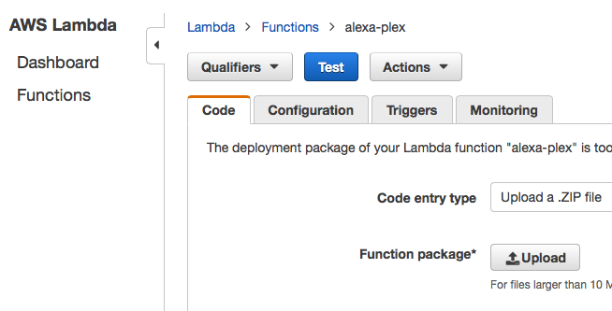
But that’s not all!
Copy the json from the left side, and go to the Lambda test screen!
Click the lambda function and you’ll see the dashboard
Click ‘Actions’ and ‘Configure new test event
Paste your json text
Press save and test

Slide 35
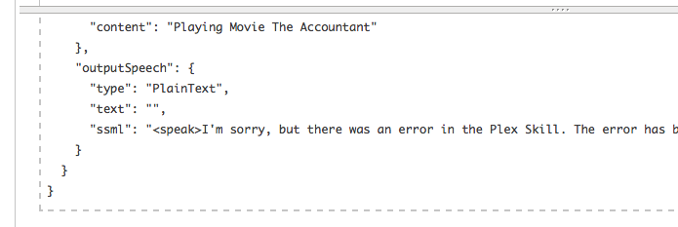
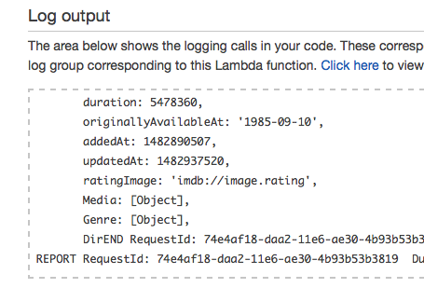
Log Output
Your node function will output some info near the middle of the page
This is the same response sent back to alexa
If you look in the bottom right, you’ll see the actual log file
This is still only a subset, click the ‘Click here’ link above it for even more, stored in cloudwatch!

Slide 36
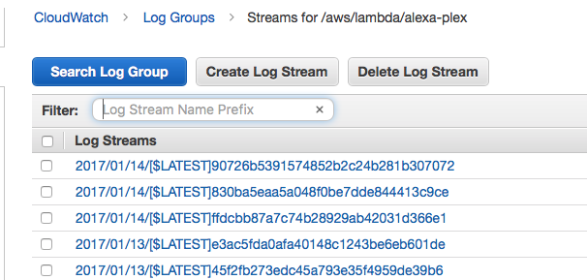
Cloud Watch
The next screen shows the log files generated
Click the top one, it’s the most recent
Now you can see each line, scroll to the bottom for the error and see what you need to fix
I did this for 12 days before it worked so good luck!

Slide 37
That’s it!
Easy as pie…

