Slide 1
CUDA Programming

Slide 2
Outline
GPU
CUDA Introduction
  What is CUDA
  CUDA Programming Model
  CUDA Library
  Advantages & Limitations
CUDA Programming

Slide 3
GPU
GPUs are massively multithreaded many core chips
  Hundreds of scalar processors
  Tens of thousands of concurrent threads
  1 TFLOP peak performance
  Fine-grained data-parallel computation
Users across science & engineering disciplines are achieving tenfold and higher speedups on GPU

Slide 4
Outline
GPU
CUDA Introduction
  What is CUDA
  CUDA Programming Model
  CUDA Library
  Advantages & Limitations
CUDA Programming
Future Work

Slide 5
What is CUDA?
CUDA is the acronym for Compute Unified Device Architecture.
  A parallel computing architecture developed by NVIDIA.
  The computing engine in GPU.
  CUDA can be accessible to software developers through industry standard programming languages.
CUDA gives developers access to the instruction set and memory of the parallel computation elements in GPUs.

Slide 6
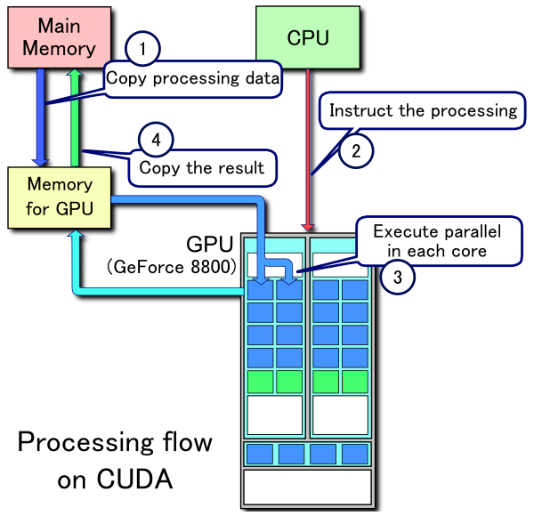
Processing Flow
Processing Flow of CUDA:
  Copy data from main mem to GPU mem.
  CPU instructs the process to GPU.
  GPU execute parallel in each core.
  Copy the result from GPU mem to main mem.

Slide 7
Outline
GPU
CUDA Introduction
  What is CUDA
  CUDA Programming Model
  CUDA Library
  Advantages & Limitations
CUDA Programming
Future Work

Slide 8
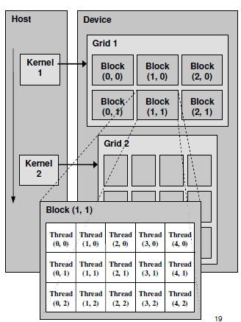
CUDA Programming Model
Definitions:
Device = GPU
Host = CPU
Kernel = function that runs on the device

Slide 9
CUDA Programming Model
A kernel is executed by a grid of thread blocks
A thread block is a batch of threads that can cooperate with each other by:
  Sharing data through shared memory
  Synchronizing their execution
Threads from different blocks cannot cooperate

Slide 10
CUDA Kernels and Threads
Parallel portions of an application are executed on the device as kernels
  One kernel is executed at a time
  Many threads execute each kernel
Differences between CUDA and CPU threads
  CUDA threads are extremely lightweight
    Very little creation overhead
    Instant switching
  CUDA uses 1000s of threads to achieve efficiency
    Multi-core CPUs can use only a few

Slide 11
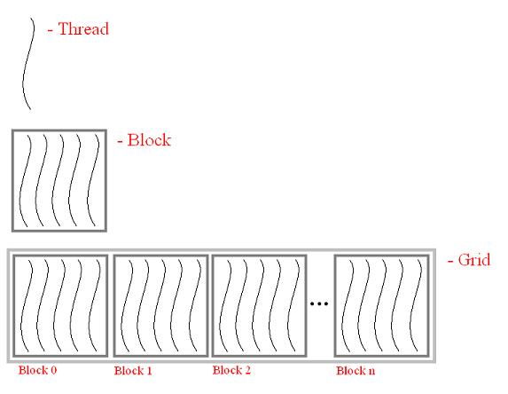
Thread Hierarchy
      Thread – Distributed by the CUDA runtime
      (identified by threadIdx)
      Warp – A scheduling unit of up to 32 threads
      Block – A user defined group of 1 to 512 threads.
      (identified by blockIdx)
      Grid – A group of one or more blocks. A grid is created for each CUDA kernel function

Slide 12
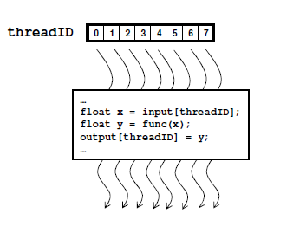
Arrays of Parallel Threads
A CUDA kernel is executed by an array of threads
  All threads run the same code
  Each thread has an ID that it uses to compute memory addresses and make control decisions

Slide 13
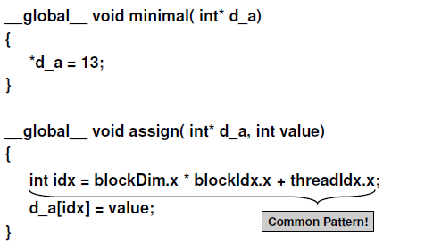
Minimal Kernels

Slide 14
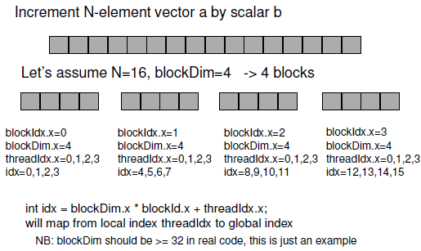
Example: Increment Array Elements

Slide 15
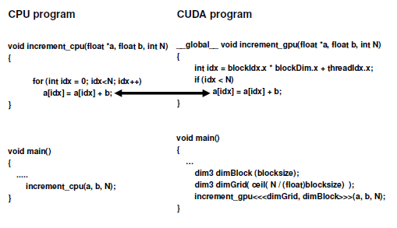
Example: Increment Array Elements

Slide 16
Thread Cooperation
The Missing Piece: threads may need to cooperate
Thread cooperation is valuable
  Share results to avoid redundant computation
  Share memory accesses
    Drastic bandwidth reduction
Thread cooperation is a powerful feature of CUDA

Slide 17
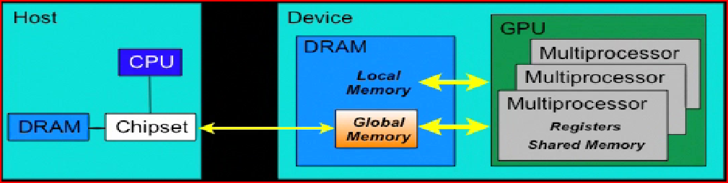
Manage memory

Slide 18
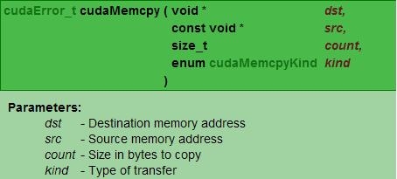
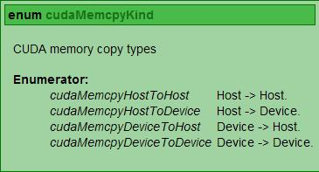
Moving Data…
CUDA allows us to copy data from one memory type to another.
This includes dereferencing pointers, even in the host’s memory (main system RAM)
To facilitate this data movement CUDA provides cudaMemcpy()

Slide 19
Advantages of CUDA
CUDA has several advantages over traditional general purpose computation on GPUs:
  Scattered reads – code can read from arbitrary addresses in memory.
  Shared memory - CUDA exposes a fast shared memory region (16KB in size) that can be shared amongst threads.

Slide 20
Limitations of CUDA
CUDA has several limitations over traditional general purpose computation on GPUs:
  A single process must run spread across multiple disjoint memory spaces, unlike other C language runtime environments.
  The bus bandwidth and latency between the CPU and the GPU may be a bottleneck.
  CUDA-enabled GPUs are only available from NVIDIA.

Slide 21
Cuda Programming
Cuda Specifications
  Function Qualifiers
  CUDA Built-in Device Variables
  Variable Qualifiers
Cuda Programming and Examples
  Compile procedure
  Examples

Slide 22
Function Qualifiers
_global__ : invoked from within host (CPU) code,
  cannot be called from device (GPU) code
  must return void
__device__ : called from other GPU functions,
  cannot be called from host (CPU) code
__host__ : can only be executed by CPU, called from host
__host__ and __device__ qualifiers can be combined
  Sample use: overloading operators
  Compiler will generate both CPU and GPU code

Slide 23
CUDA Built-in Device Variables
All __global__ and __device__ functions have
access to these automatically defined variables
dim3 gridDim;
  Dimensions of the grid in blocks (at most 2D)
dim3 blockDim;
  Dimensions of the block in threads
dim3 blockIdx;
  Block index within the grid
dim3 threadIdx;
  Thread index within the block

Slide 24
Variable Qualifiers (GPU code)
__device__
  Stored in device memory (large, high latency, no cache)
  Allocated with cudaMalloc (__device__ qualifier implied)
  Accessible by all threads
  Lifetime: application
__shared__
  Stored in on-chip shared memory (very low latency)
  Allocated by execution configuration or at compile time
  Accessible by all threads in the same thread block
  Lifetime: kernel execution
Unqualified variables:
  Scalars and built-in vector types are stored in registers
  Arrays of more than 4 elements stored in device memory

Slide 25
Cuda Programming
Kernels are C functions with some restrictions
  Can only access GPU memory
  Must have void return type
  No variable number of arguments (“varargs”)
  Not recursive
  No static variables
Function arguments automatically copied from CPUto GPU memory

Slide 26
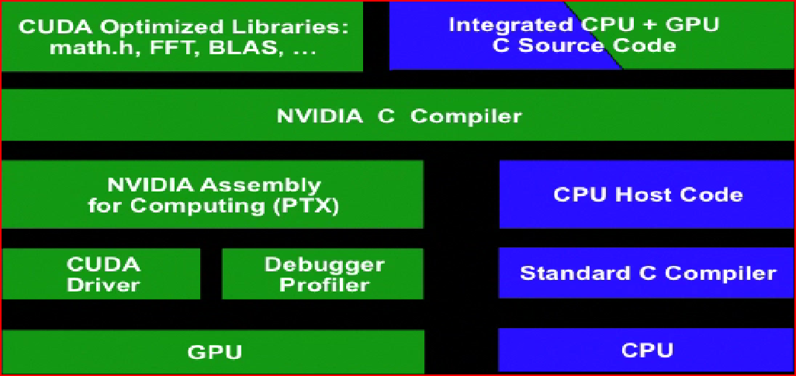
Cuda Compile

Slide 27
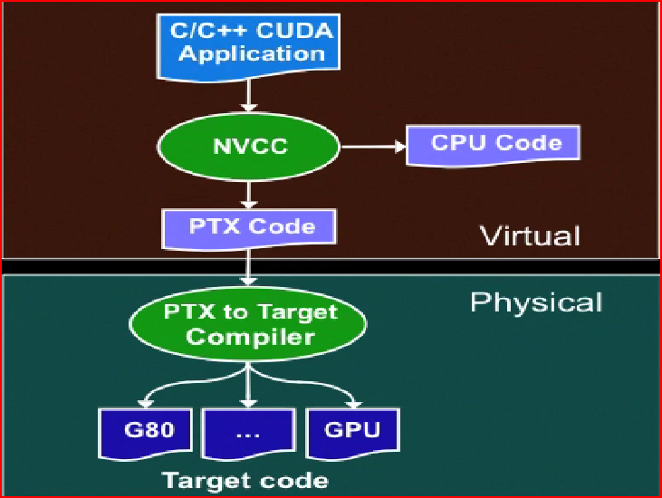
Cuda Compile_cont

Slide 28
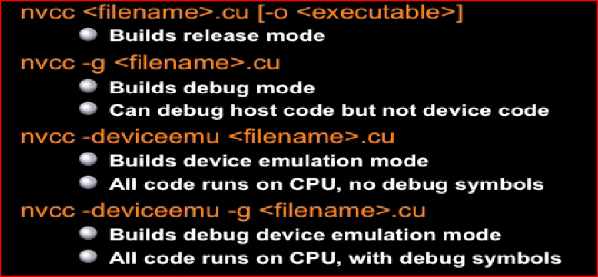
Cuda Compile_cont

