Slide 1

Group 6 DBMS Presentation
Anthony Fattal, Dev Patel, Carter Gluck, Kel Timbrook

Slide 2
How the work was divided
Page | HTML | CSS | PHP | MYSQL
Add Customer | Kel/Dev | Carter | Kel/Dev | Kel/Dev
Edit Customer | Dev | Carter | Dev | Dev
View Customers | Dev | Carter | Dev | Dev
Add Employees | Dev | Carter | Dev | Dev
Edit Employees | Carter | Carter | Carter | Carter
View Employees | Dev | Carter | Dev | Dev
Add Product | Anthony | Carter | Anthony | Anthony
Edit Product | Anthony | Carter | Anthony | Anthony
View Products | Anthony | Carter | Anthony | Anthony
View Order | Anthony/Carter | Carter | Anthony/Carter | Anthony
Place Order | Anthony | Carter | Anthony | Anthony
Homepage | Carter | Carter | Kel | Kel

Slide 3
Summary & Motivation
For our project we created a relational database administration tool for a clothing store with an online shop and physical stores. The database keeps track of information about the customers, employees, orders, products, and suppliers in separate tables. Data can be easily inserted, updated, and deleted from the databases through simple forms. The product database can be queried by product category and supplier and can update item quantity and price. This tool essentially makes it easy for anybody to manage company records without a technology background. Keeping up with day-to-day operations would be centralized in one web-based tool, and expansion of this tool into other record-keeping for the store would be easy to implement.

Slide 4
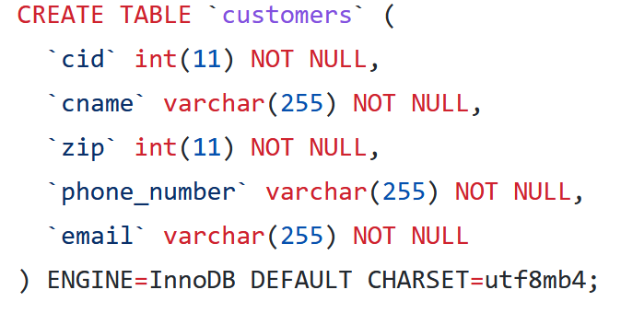
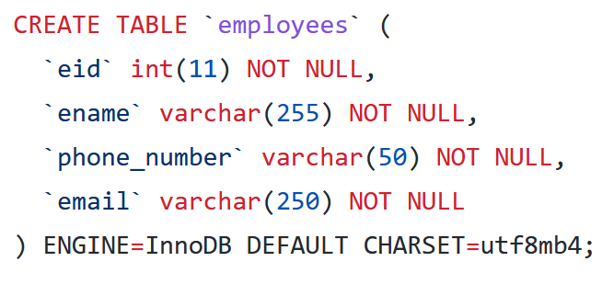
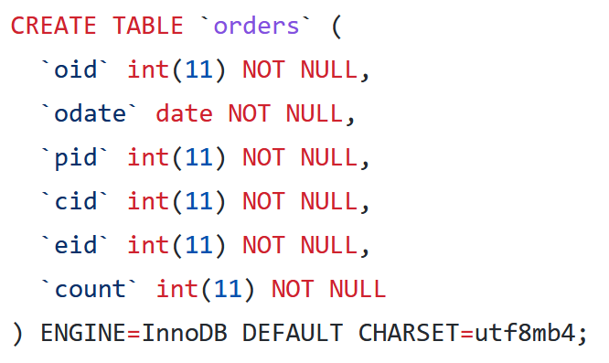
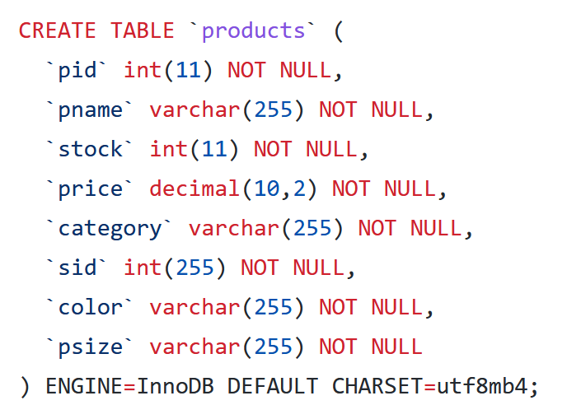
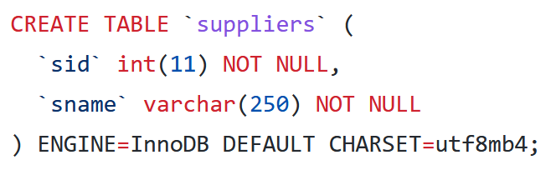
Table Structure
Notes:
This does not have the auto increments or the keys but we do have these in the final product

Slide 5
Use Case Diagram
Fulfills orders
Store Manager
Warehouse
Manages employee records
Adds new in-store purchases
Store Employee
Adds new customers
Supplier
Database Administrator
Add/remove products
Payment Service
Processes Order Total

Slide 6
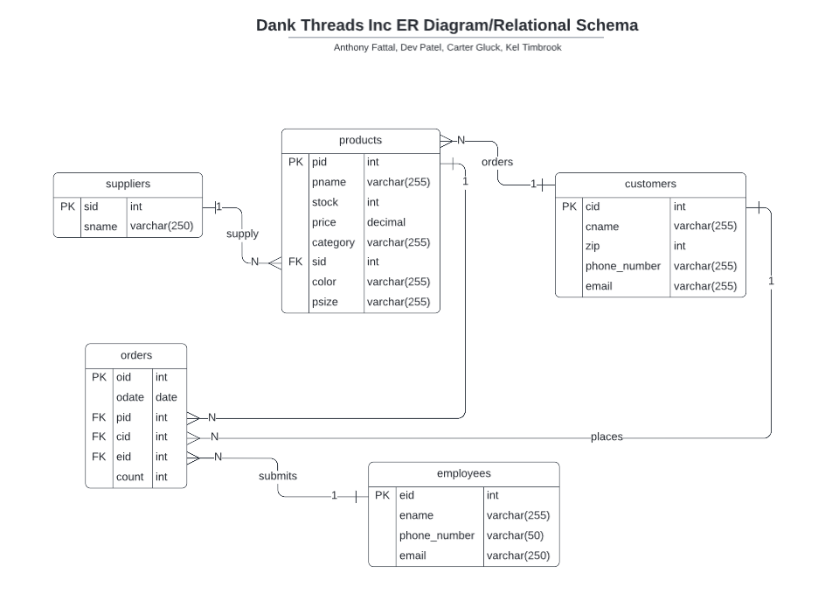
ER Diagram

Slide 7
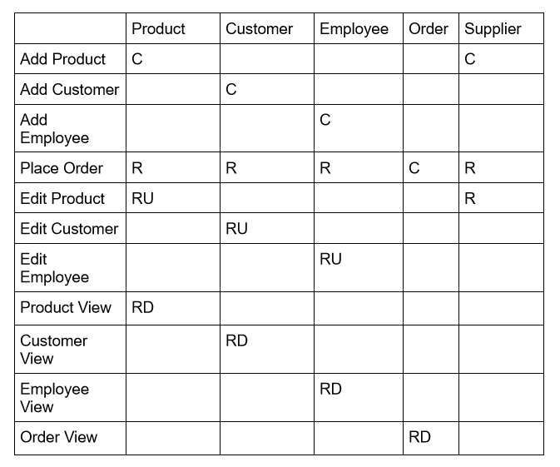
CRUD Matrix

Slide 8
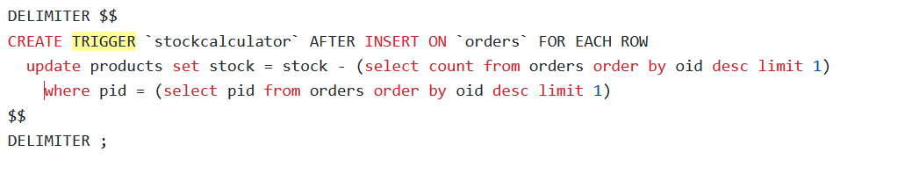
Triggers
Trigger subtracts stock when order is placed

Slide 9



Problems encountered and solutions
Trouble figuring out php syntax when writing queries (fixed through trial and error)
Collaborating on our DBMS project online proved to be difficult at first until we started using github/groupme/zoom to navigate through our work.

Slide 10
Results (next steps)
Integrating further online (online orders e.g.)
Automatically updating/uploading orders to the DB
Adding admin logins, customer logins, and ways to manage passwords / data about admins and users
Expand on Suppliers, Implement view pages and include contact.

Slide 11
Our demo/source code ->

