Slide 1
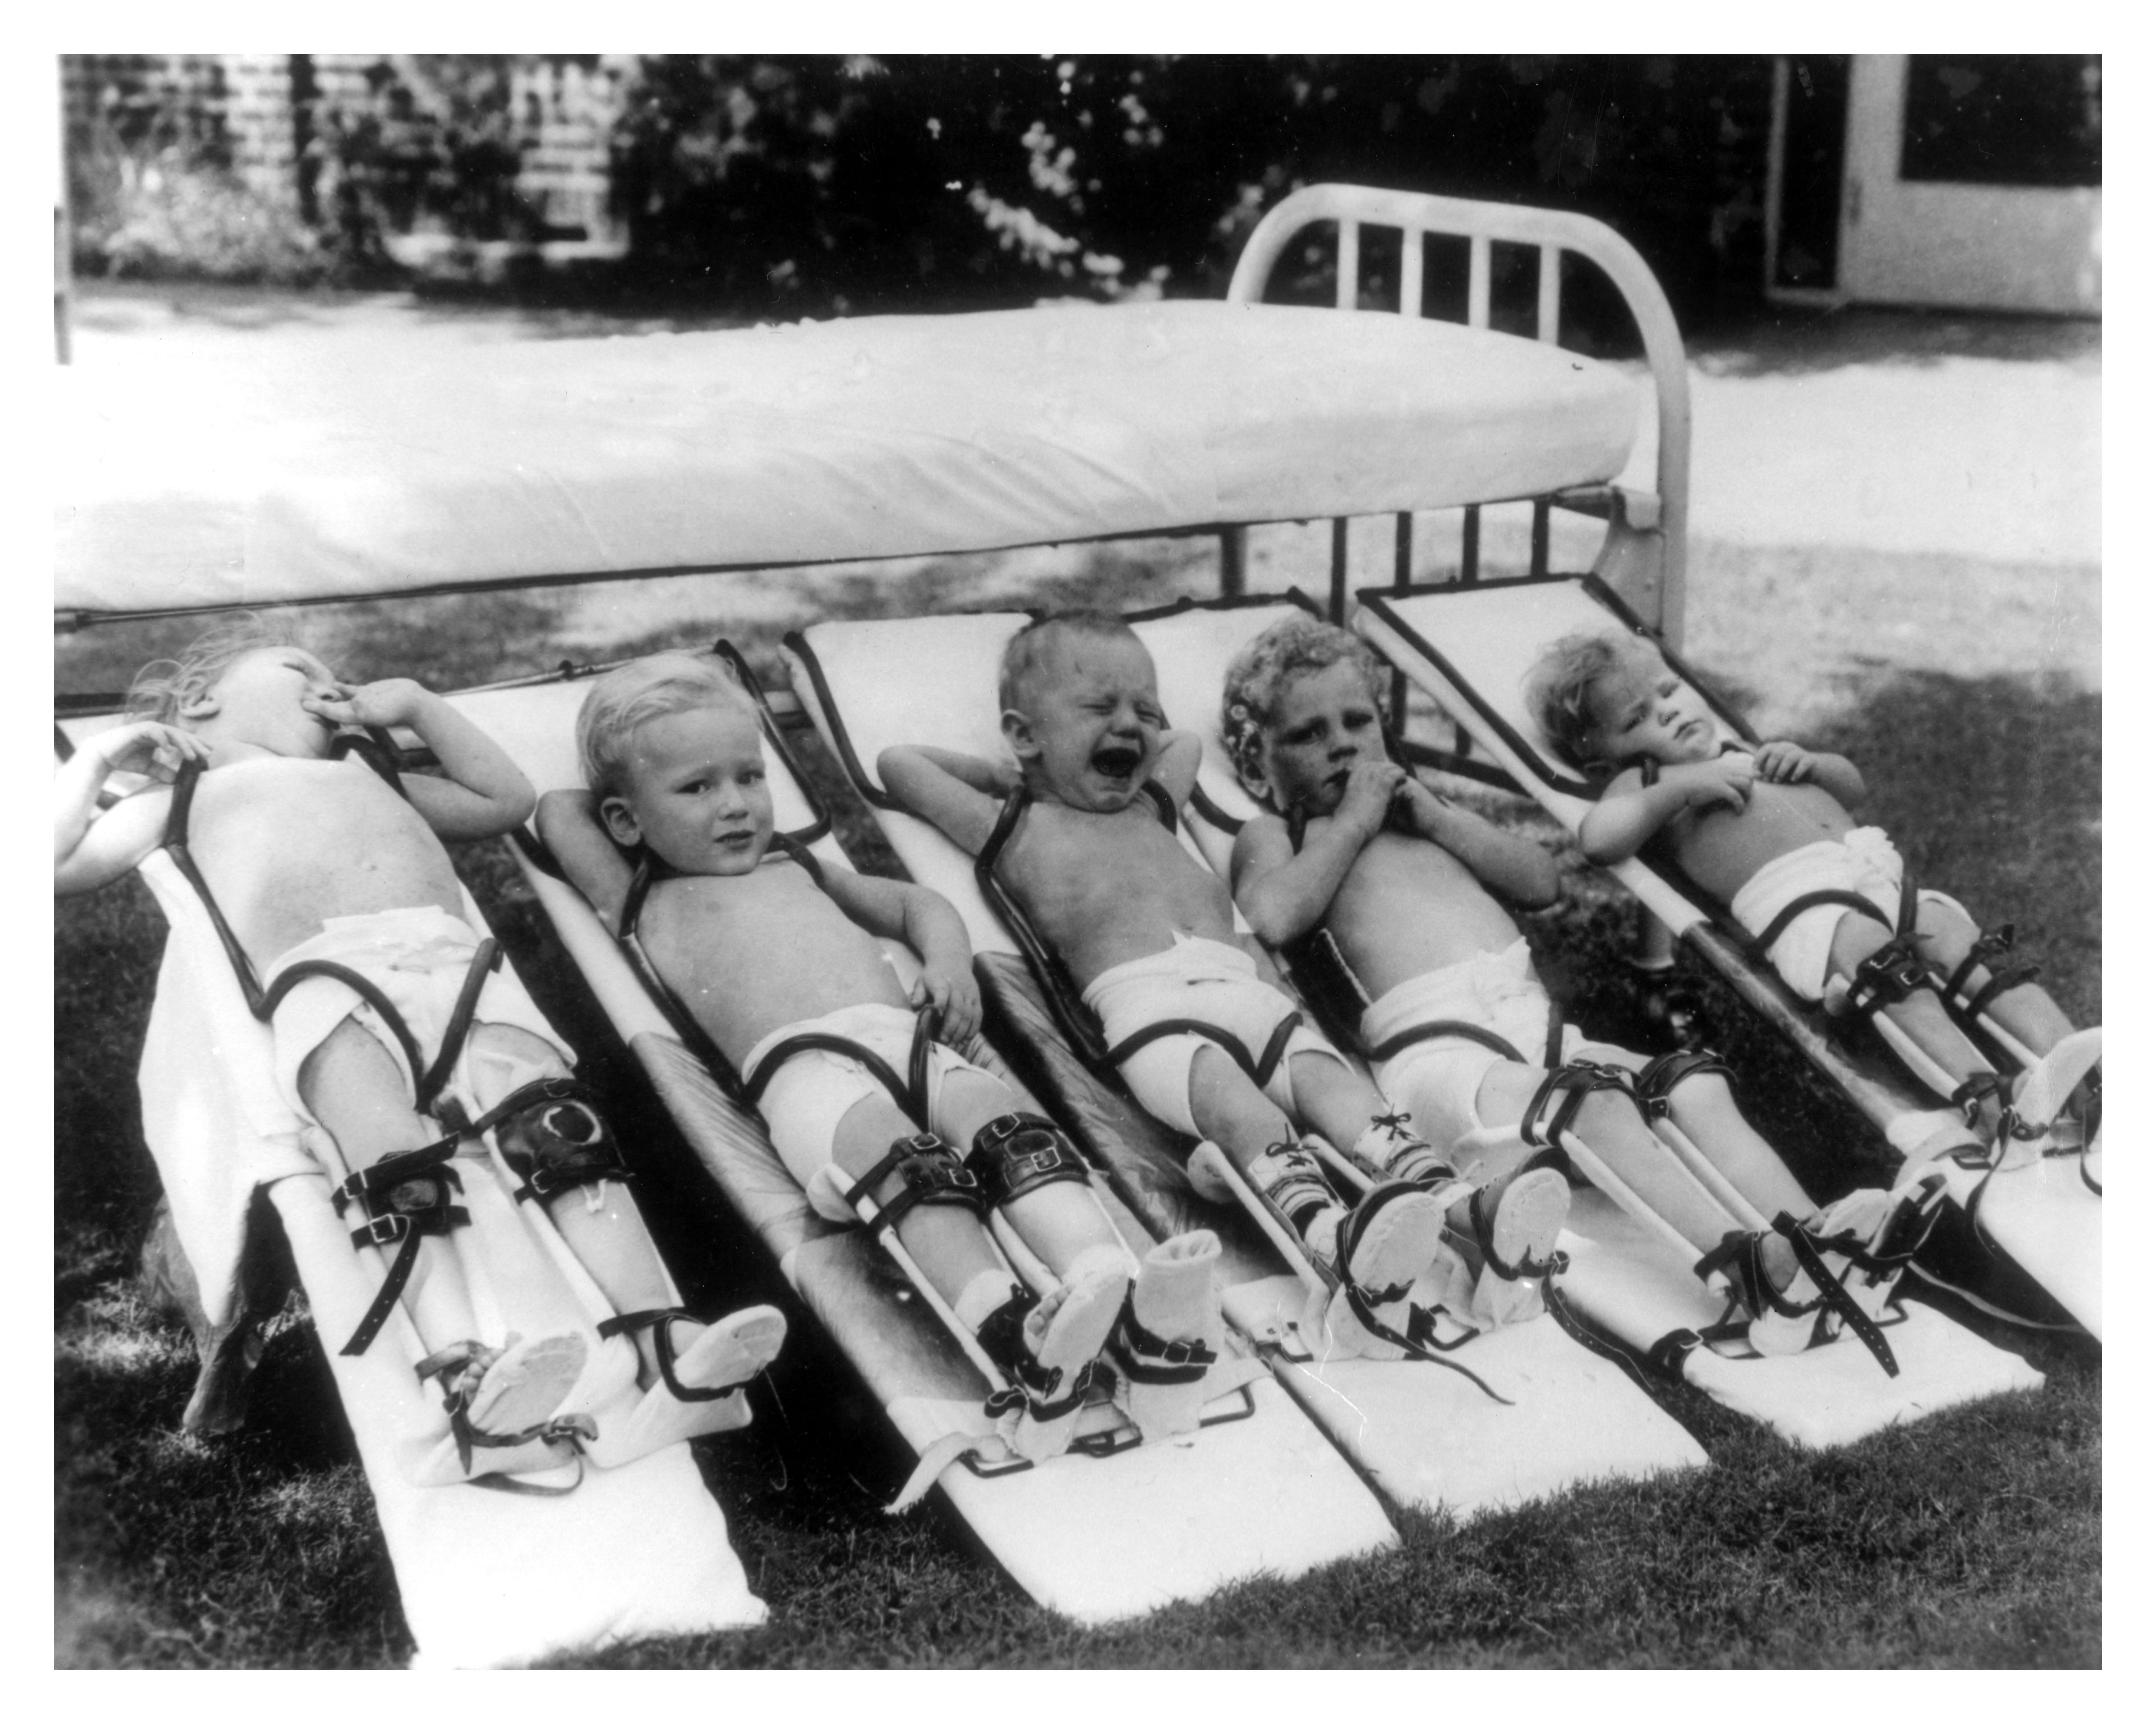
A Childhood Epidemic:
POLIO

Slide 2
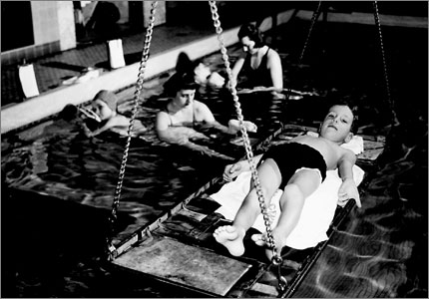
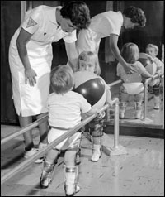
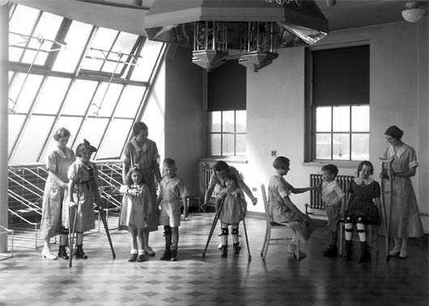
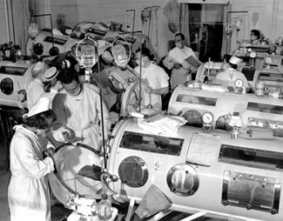

The Faces of Polio
Notes:
Mainly effects children under 5, but there are exceptions

Slide 3
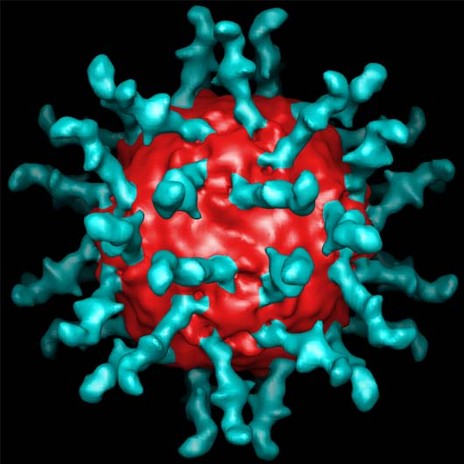
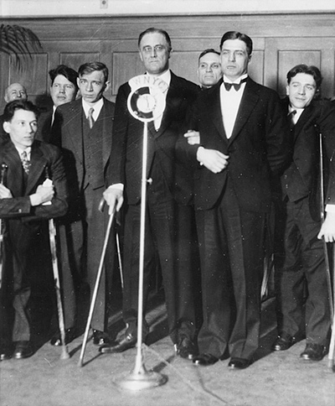
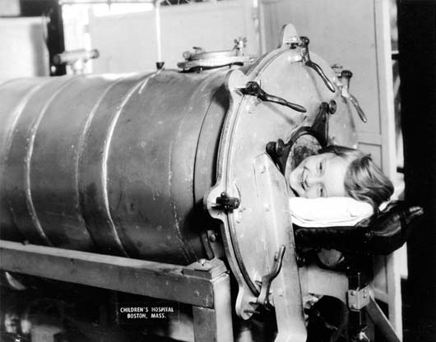
Polio Timeline
From the Smithsonian National Museum of American History
1789 First clinical description of Polio symptoms
1894 First epidemic of Polio in the US
1908 Identified a virus as the cause of Polio
1916 First large Polio outbreak
1921 Franklin D. Roosevelt contracted Polio
1927 Scientists developed the “iron lung”
Notes:
1789- British Physician Michael Underwood; oftentimes none, but can have flu-like symptoms, in severe cases, virus attacks nervous system-brain & spinal cord and causes meningitis and paralysis of the muscles, paralysis can happen in just a few hours
1894- Vermont, 132 cases
1908- Karl Landsteiner and Erwin Popper
1916- 27,000 cases and 6,000 deaths
1921- was 39, kept it a secret, ??what does that say about the time, attitudes towards disability?, later on created warm springs community for the handicapped—blacks not allowed, march of dimes
1927- Philip Drinker and Louis Agassiz Shaw at Harvard University, people in early stages couldn’t breathe and often died, tank respirator uses vacuums to force air in and out of their lungs, if survive early stage, usually lived, still 24 people using them in 2004; talk about reality of picture

Slide 4
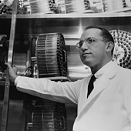
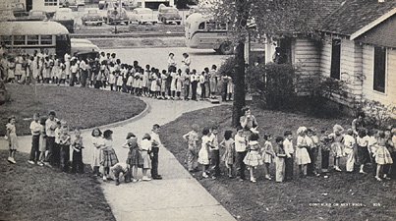
Polio Timeline
From the Smithsonian National Museum of American History
1935 Maurice Brodie and John Kolmer tested a vaccine
1947 Dr. Johnas Salk developed effective Polio vaccine
1957-59 Cases of Polio dropped 85-90%
1961 Dr. Albert Sabin developed oral Polio vaccine
1988 Several organizations joined together and began a campaign to eradicate Polio
Notes:
1935- New York Medical school and Philadelphia, started with children “volunteers” moved to sample of 10,000, administered killed virus, 9 kids died from trial, ethical??????, slowed testing on future vaccines
1947- uses killed virus, 2 million children participate
1988- Rotary International, PanAmerican Health Organization, World Health Organization, Centers for Disease Control, UNICEF

Slide 5
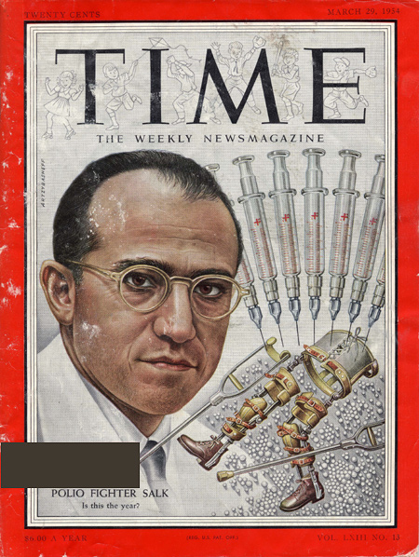
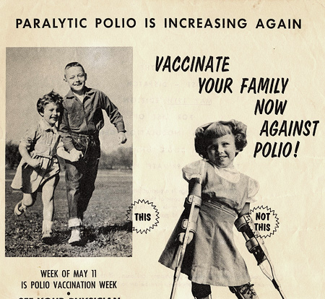
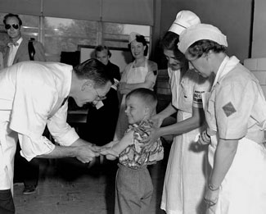
Human
Experimentation
Salk vs. Sabin
Notes:
Before his vaccine, polio was paralyzed and killed up to ½ million people every year, Vaccine developed in 1947 and by 1954, 1 million children had been vaccinated, 2 million children participated in the “largest human field experiment ever undertaken” Oshinsky … popularity
Use of vaccines ususally only in industrialized nations
Salk- killed virus, Sabin live virus…eventually captured Soviet Union’s market..1959 b/c live sometimes caused virus, people cautious
Implications: disability reform, march of dimes, vaccinations
http://www.npr.org/templates/story/story.php?storyId=4585992

Slide 6
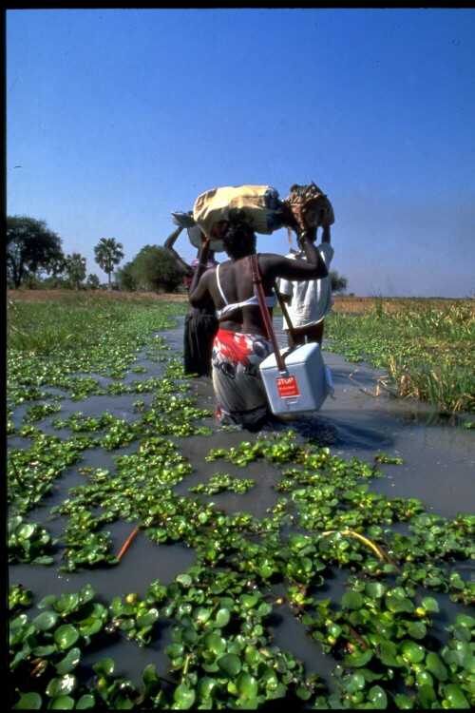
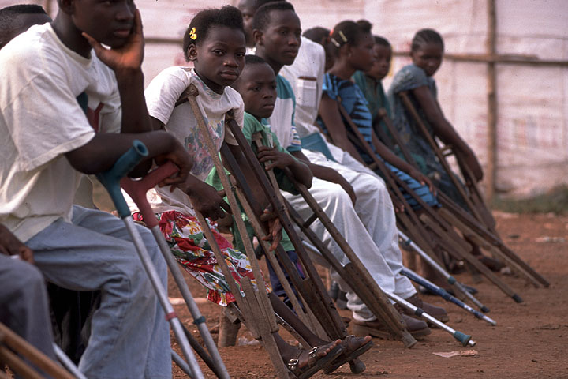
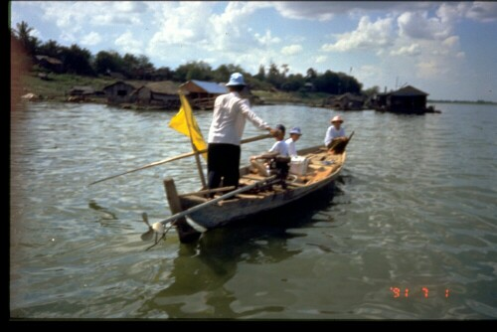
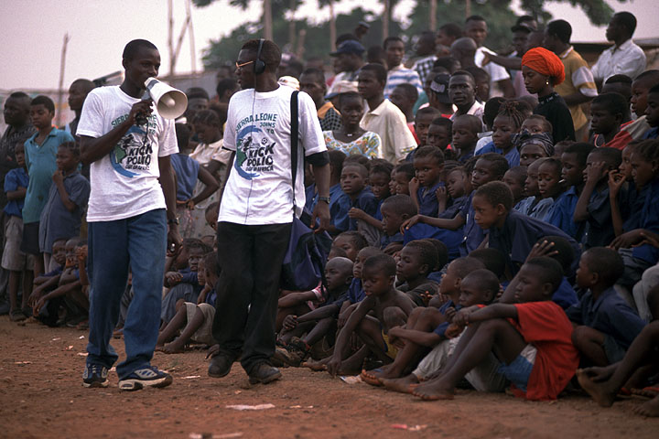
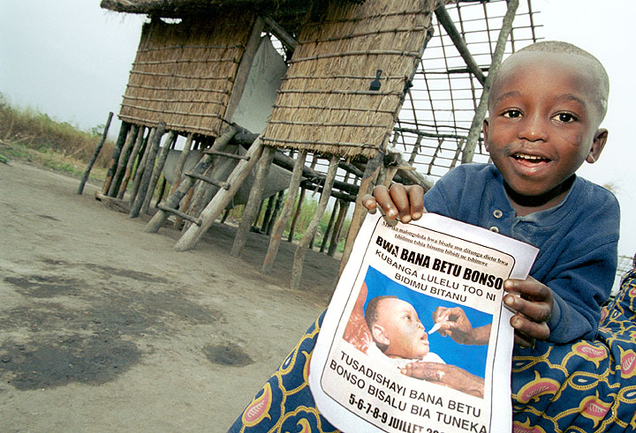
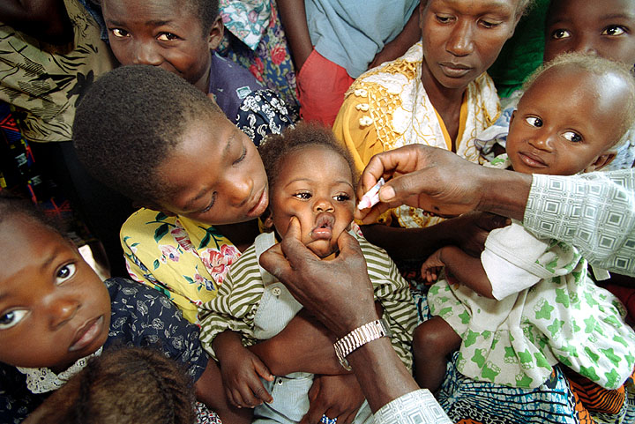
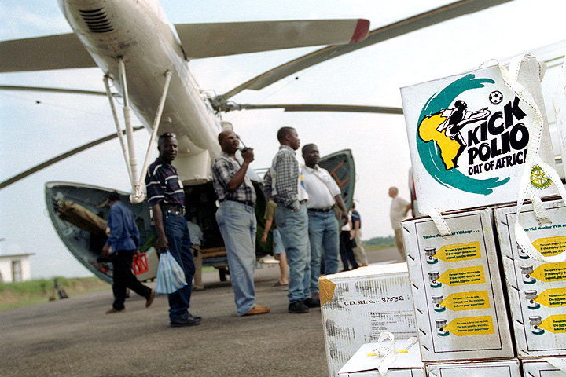
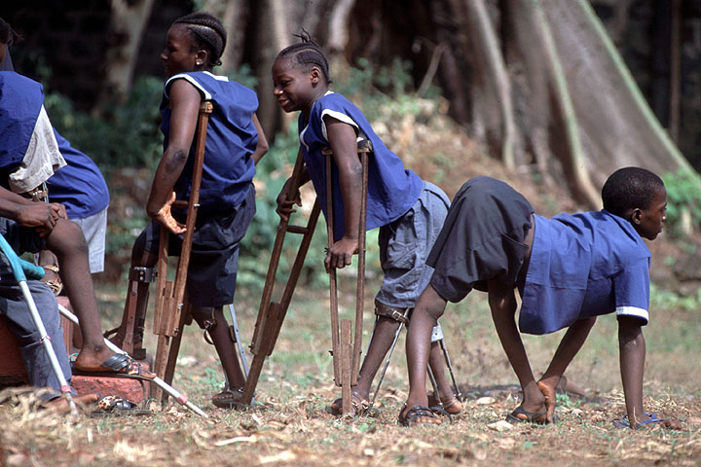
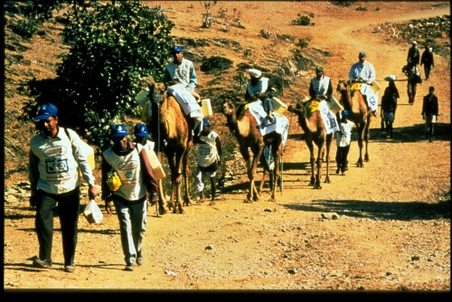
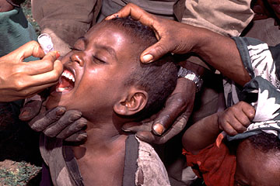
Today…
Notes:
Global Polio Erradication Innitiative, world health organization, national immunization days: Sierra leone, ethopia, nepal, Bangladesh, vietnam, angola, 10 million doses of medicine hand delivered by plane, boat, bicycle camel and foot to 2 million children
Worldwide: 2 billion children have been vaccinated
According to the World Health Organization
In 1988, there were 350,000 cases of Polio worldwide
Today, there are 1,144 drop of 99%
On its way to becoming the second disease to be eliminated from the world

Slide 7
The Status of Polio
In 1988, there were 350,000 cases of Polio worldwide
Today, there are 1,144
Notes:
According to the world health organization, drop of 99%

Slide 8
Epidemics in Comparison
Influenza 1918-1919: 40 million dead, infected 1/5 of world’s population and killed 2% of world’s population
Smallpox (1950s): 50 million cases every year, 30% of those died
Polio (before vaccine) : 13.6 people infected per 100,000 people
Cancer: 556.6 people infected per 100,000
AIDS: 20 million dead, 40 million living with HIV/AIDS
Notes:
Smallpox: 2% of world’s pop infected each year
Polio:.031% of population
Cancer: .57% population
AIDS: .31% of world’s pop. Died, .63% infected

Slide 9
Resources
http://www.childrenshospital.org/dream/DreamRsch2005/polio.html
http://americanhistory.si.edu/polio/americanepi/communities.htm
http://www.kera.org/media/polio/
http://www.childrenshospital.org/research/polio_gallery/photo3.html
http://health2k.state.nv.us/disease/diseases/poliomyelitis.htm
http://www.utexas.edu/features/2005/polio/
http://www.polioeradication.org
http://www.biology.arizona.edu/immunology/tutorials/AIDS/impacts.html
http://www.post-polio.org/ipn/ir-usa.html
http://www.npr.org/templates/story/story.php?storyId=4585992

