Slide 1
담당교수 : 정호엽 교수님
발표일 : 2022. 03. 25
+
캡스톤디자인1
Team M
20174188 김형균
20174299 이성준
20195134 장시원
20195135 김범수

Slide 2
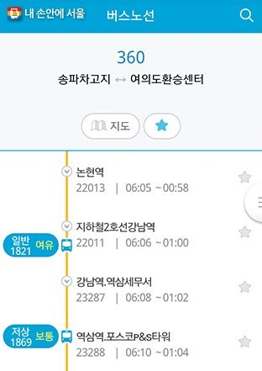
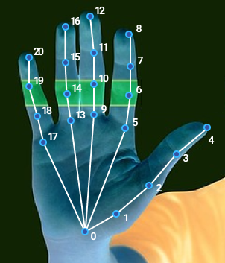
Content 1
+
city bus congestion analysis program using ride data
There are 93 city bus routes in Gwangju, some of which pass through similar routes. Therefore, if you go through a similar route but take a bus with fewer people,
you will be able to move more comfortably.
There is already a program in the metropolitan area that shows the level of bus congestion,
but Gwangju City does not have to check the get off, so there is no such program yet due to a lack of data.
Content 2
screen switching program using gesture recognition
It is a program that allows you to switch the screen with gesture recognition.
When using a tablet or laptop, you can use it without touching the device.
Recognize the hand shape through the camera and move a page or screen up and down.
There are many existing motion recognition technologies, so we need to make a new difference.
01

