Slide 1
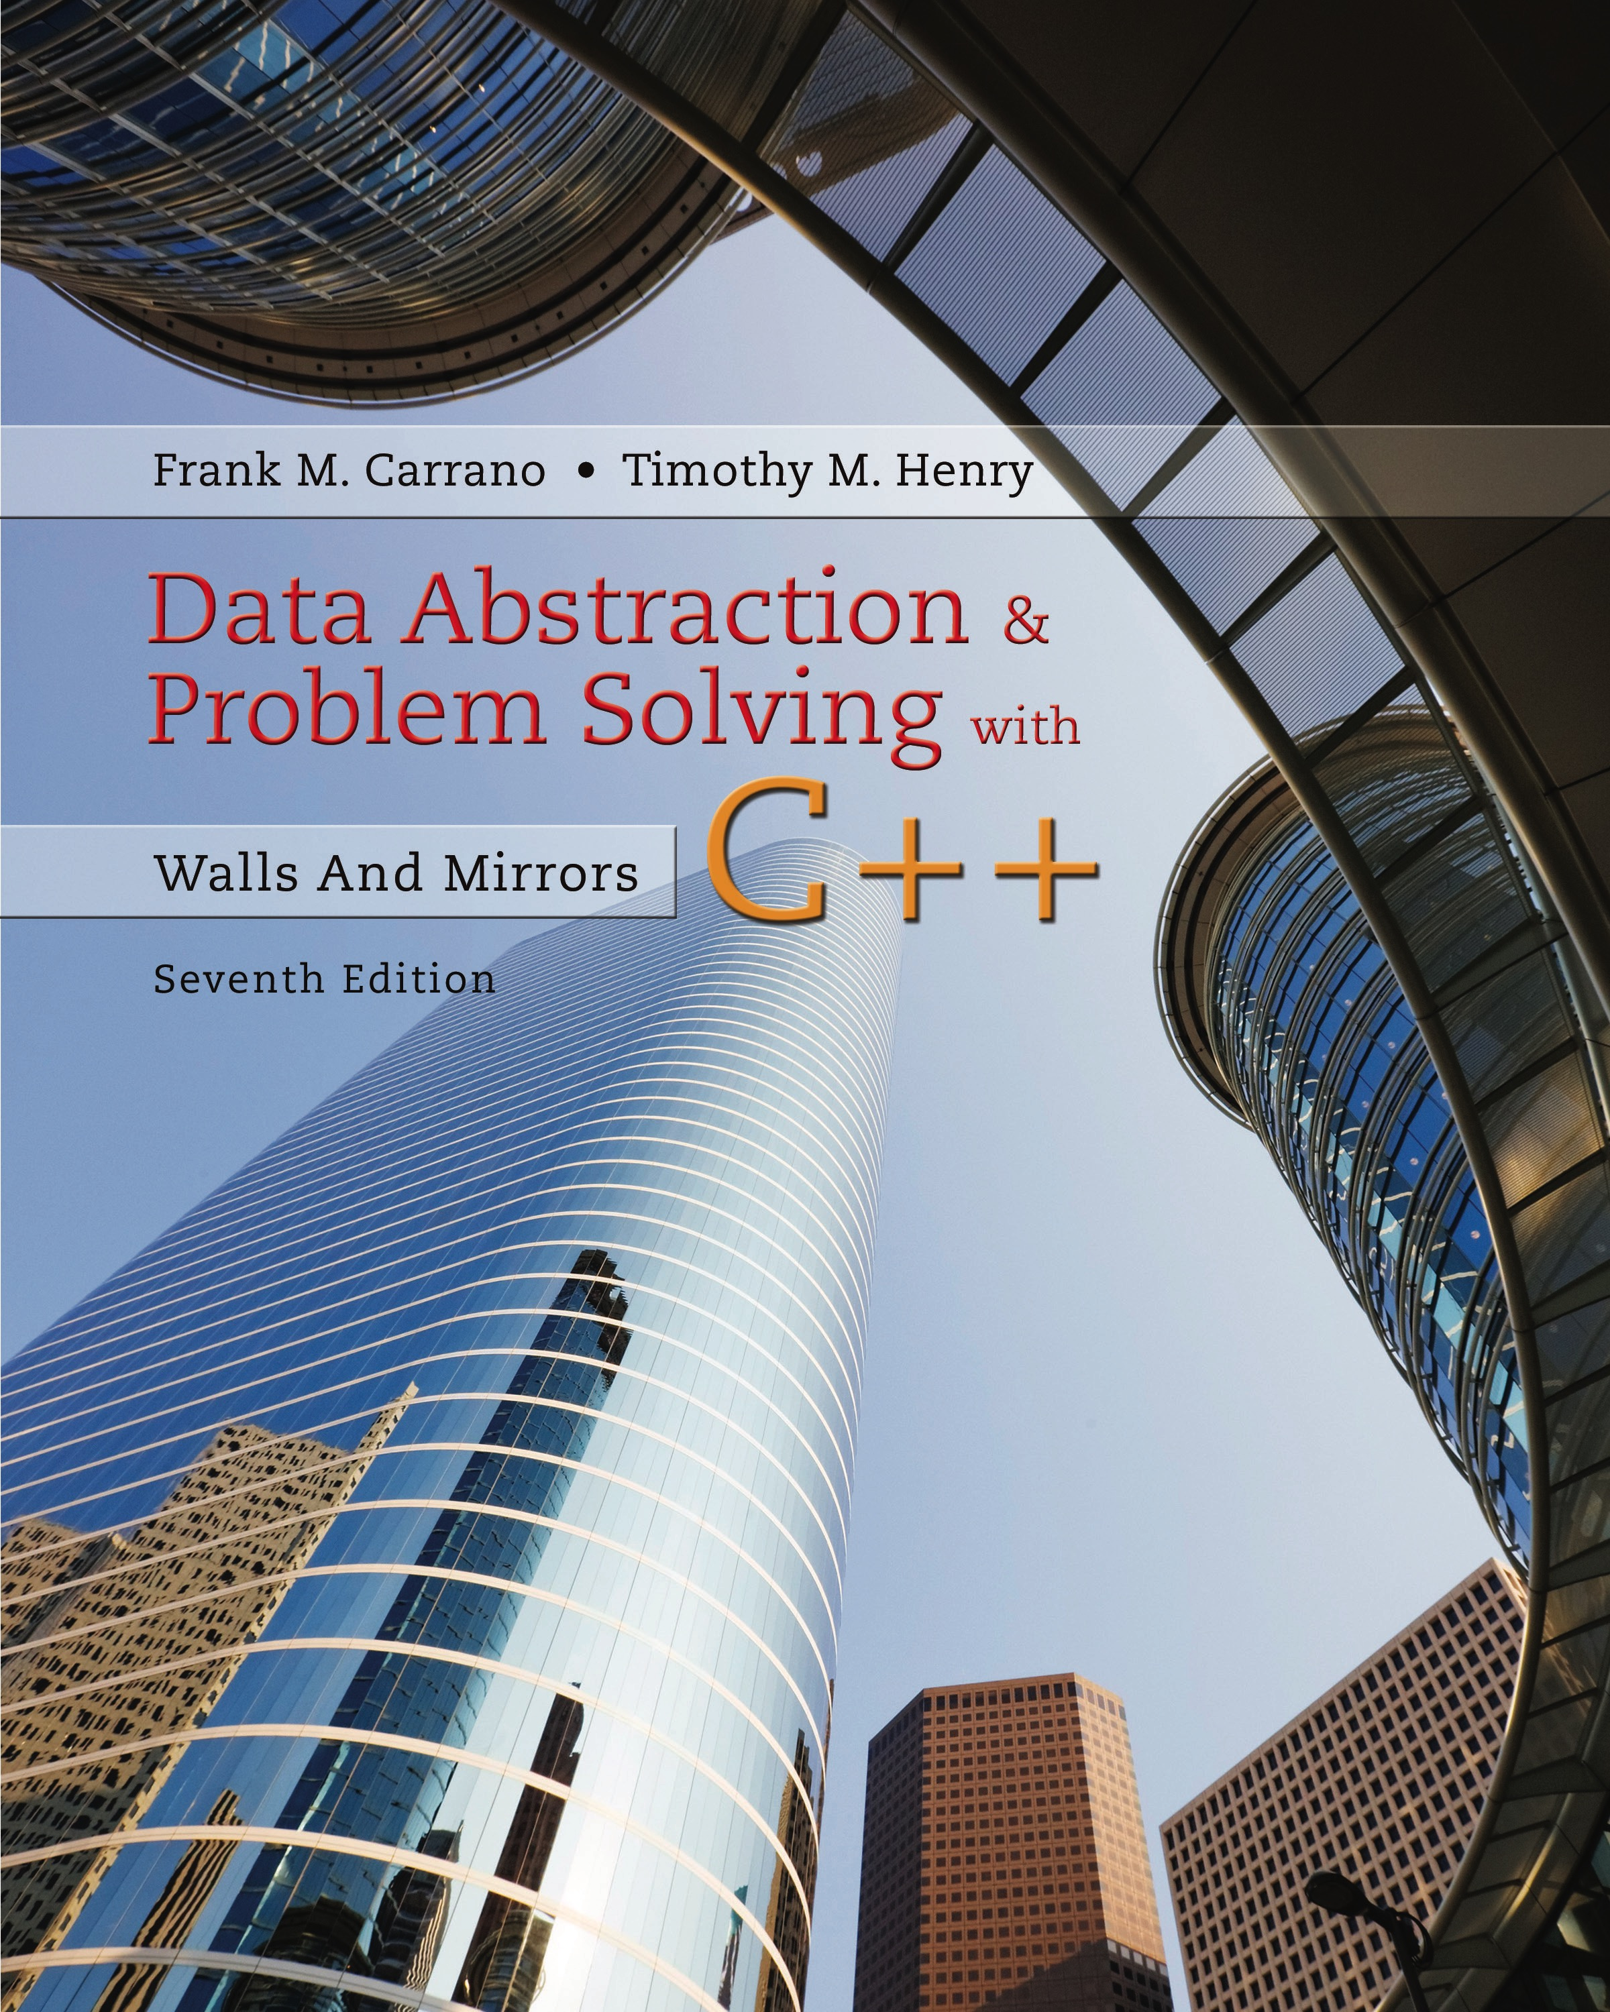
Data Abstraction & Problem Solving with C++: Walls and Mirrors
Seventh Edition
Chapter 3
Array-Based Implementations
Copyright © 2017, 2013, 2007 Pearson Education, Inc. All Rights Reserved
Notes:
If this PowerPoint presentation contains mathematical equations, you may need to check that your computer has the following installed:
1) MathType Plugin
2) Math Player (free versions available)
3) NVDA Reader (free versions available)

Slide 2
The Approach (1 of 2)
An A D T is
A collection of data … and …
A set of operations on that data
Specifications indicate
What A D T operations do
But not how to implement
First step for implementation
Choose data structure

Slide 3
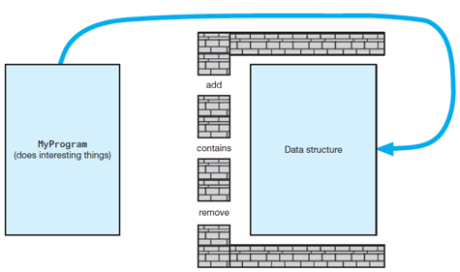
The Approach (2 of 2)
Figure 3-1 Violating the wall of A D T operations

Slide 4
Core Methods
Poor approach
Define entire class and attempt test
Better plan – Identify, then test basic (core) methods
Create the container (constructors)
Add items
Display/list items
Remove items

Slide 5
Using Fixed-Size Arrays
Must keep track of array elements used, available
Decide if first object goes in element 0 or 1
Consider if the add method places elements in consecutive elements of array
What happens when add method has used up final available element?

Slide 6
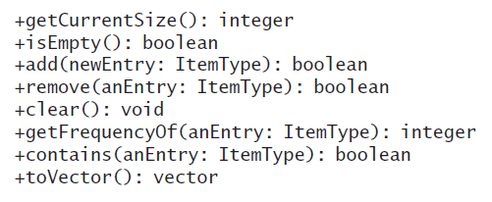
Array-Based Implementation of A D T Bag (1 of 2)
Core ArrayBag methods

Slide 7
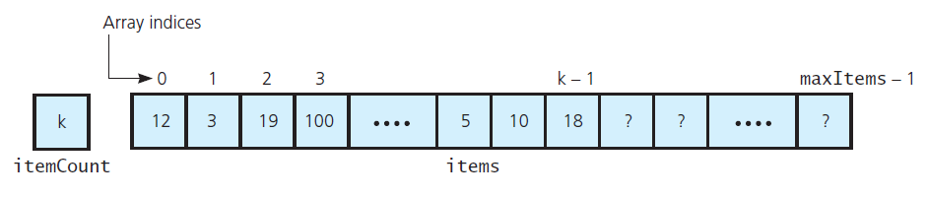
Array-Based Implementation of A D T Bag (2 of 2)
Figure 3-2 An array-based implementation of the A D T bag

Slide 8
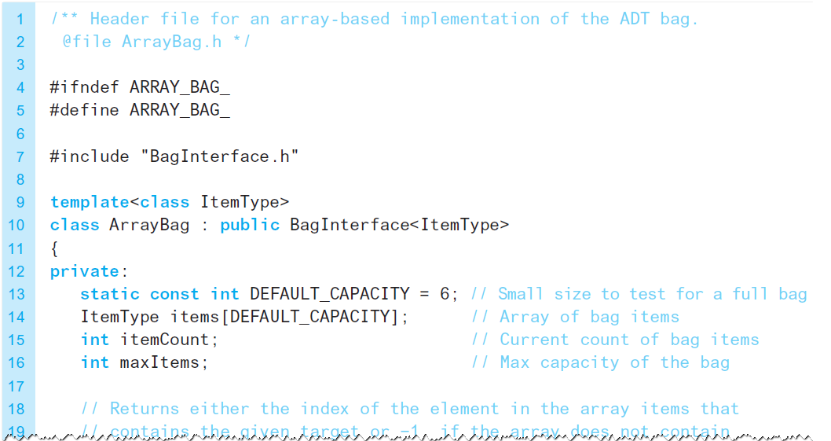
The Header File (1 of 2)
Listing 3-1 The header file for the class ArrayBag

Slide 9
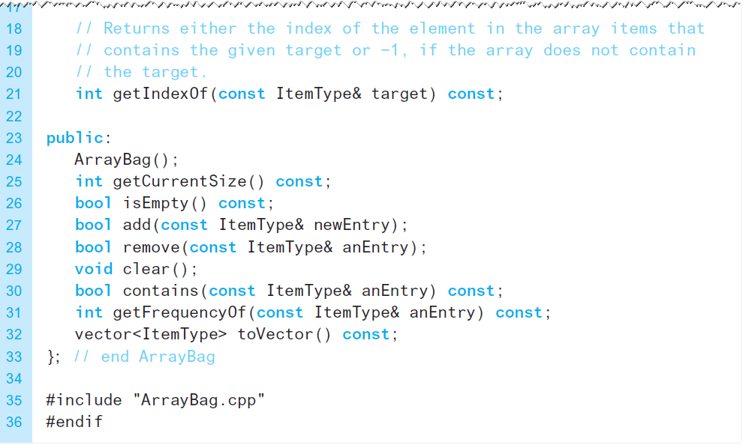
The Header File (2 of 2)
Listing 3-1 [Continued]

Slide 10
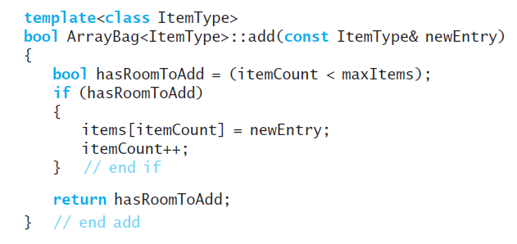
Defining the Core Methods (1 of 4)
The method add

Slide 11
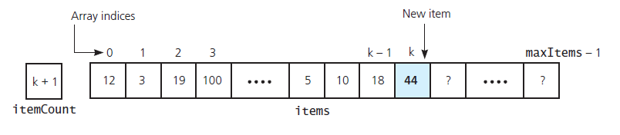
Defining the Core Methods (2 of 4)
Figure 3-3 Inserting a new entry into an array-based bag

Slide 12
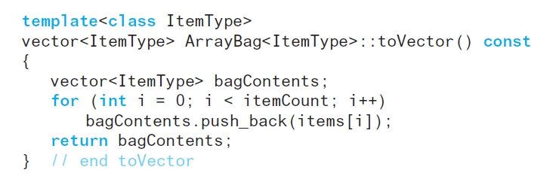
Defining the Core Methods (3 of 4)
The method toVector

Slide 13
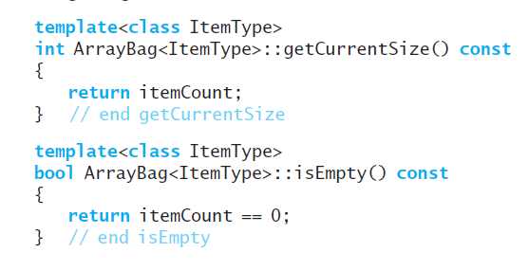
Defining the Core Methods (4 of 4)
Methods getCurrentSize and isEmpty

Slide 14
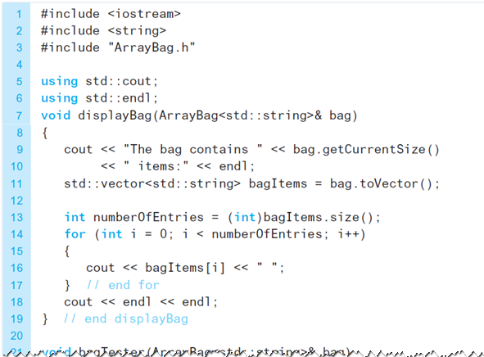
Testing the Core Methods (1 of 3)
Listing 3-2 A program that tests the core methods of the class ArrayBag

Slide 15
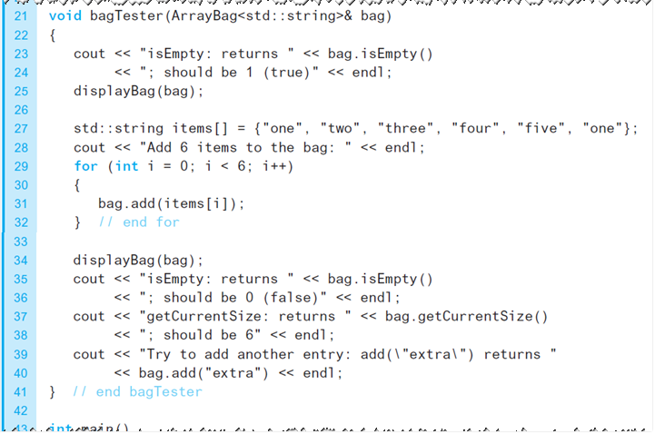
Testing the Core Methods (2 of 3)
Listing 3-2 [Continued]

Slide 16
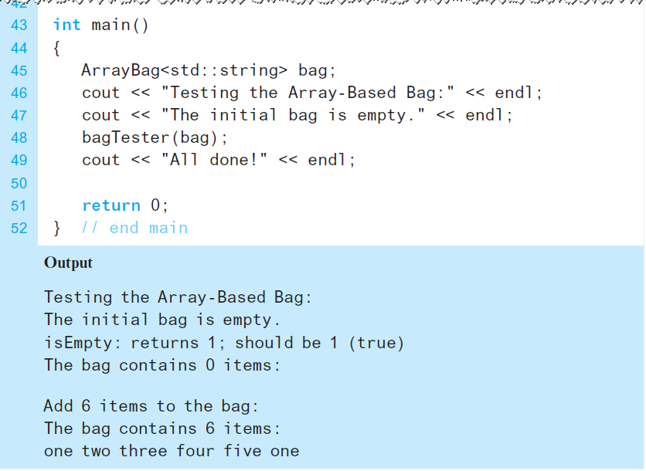
Testing the Core Methods (3 of 3)
Listing 3-2 [Continued]

Slide 17
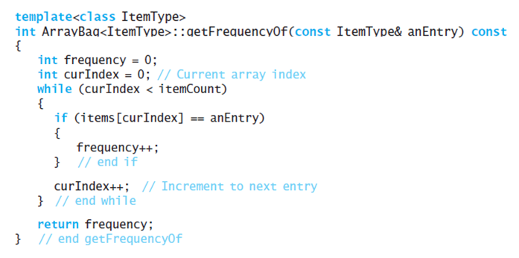
Implementing More Methods (1 of 2)
Method getFrequencyOf

Slide 18
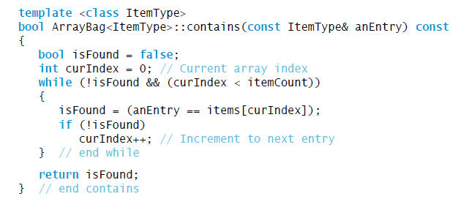
Implementing More Methods (2 of 2)
Possible implementation of method contains

Slide 19
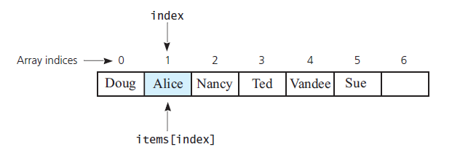
Methods That Remove Entries (1 of 7)
Figure 3-4 The array items after a successful search for the string “Alice”

Slide 20
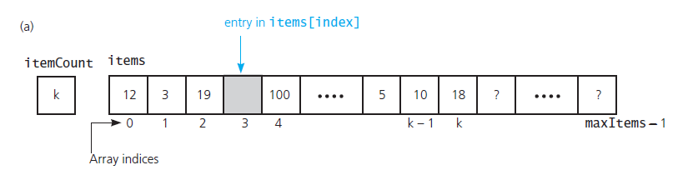
Methods That Remove Entries (2 of 7)
Figure 3-5 (a) A gap in the array items after the entry in items[index] and decrementing itemCount;

Slide 21
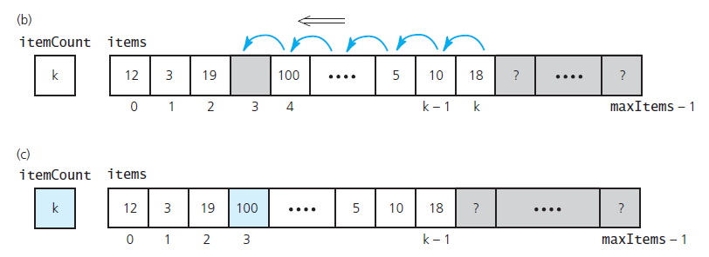
Methods That Remove Entries (3 of 7)
Figure 3-5 (b) shifting subsequent entries to avoid a gap; (c) the array after shifting

Slide 22
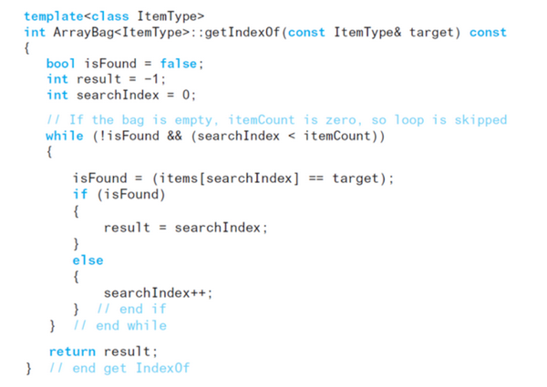
Methods That Remove Entries (4 of 7)
Method getIndexOf

Slide 23
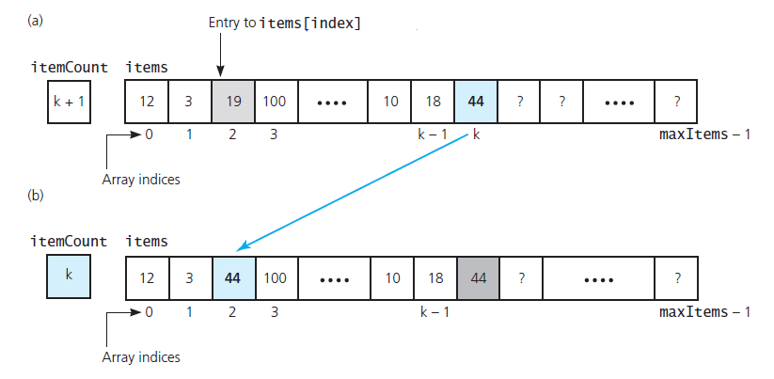
Methods That Remove Entries (5 of 7)
Figure 3-6 Avoiding a gap in the array while removing an entry

Slide 24
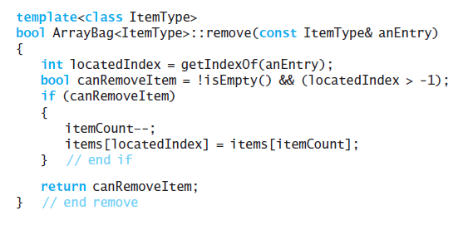
Methods That Remove Entries (6 of 7)
Method remove

Slide 25
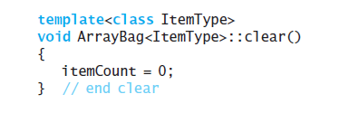
Methods That Remove Entries (7 of 7)
Method clear

Slide 26
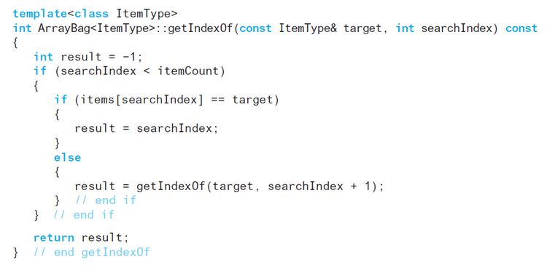
Recursion in the Implementation (1 of 3)
Method getIndexOf

Slide 27
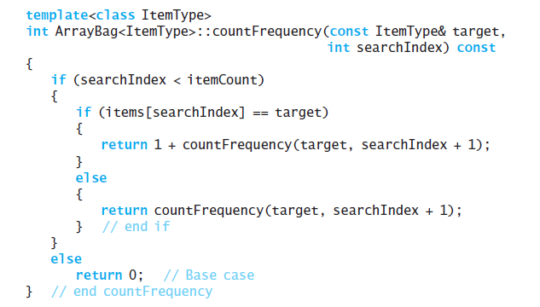
Recursion in the Implementation (2 of 3)
Method countFrequency

Slide 28
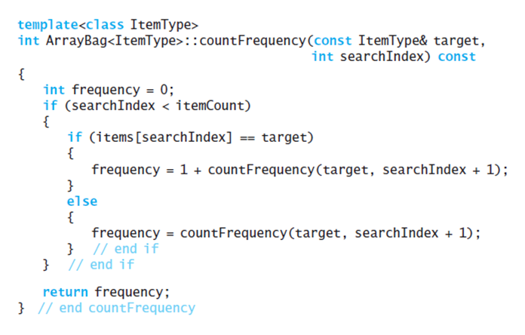
Recursion in the Implementation (3 of 3)
Alternative method countFrequency

Slide 29

Copyright

