Slide 1
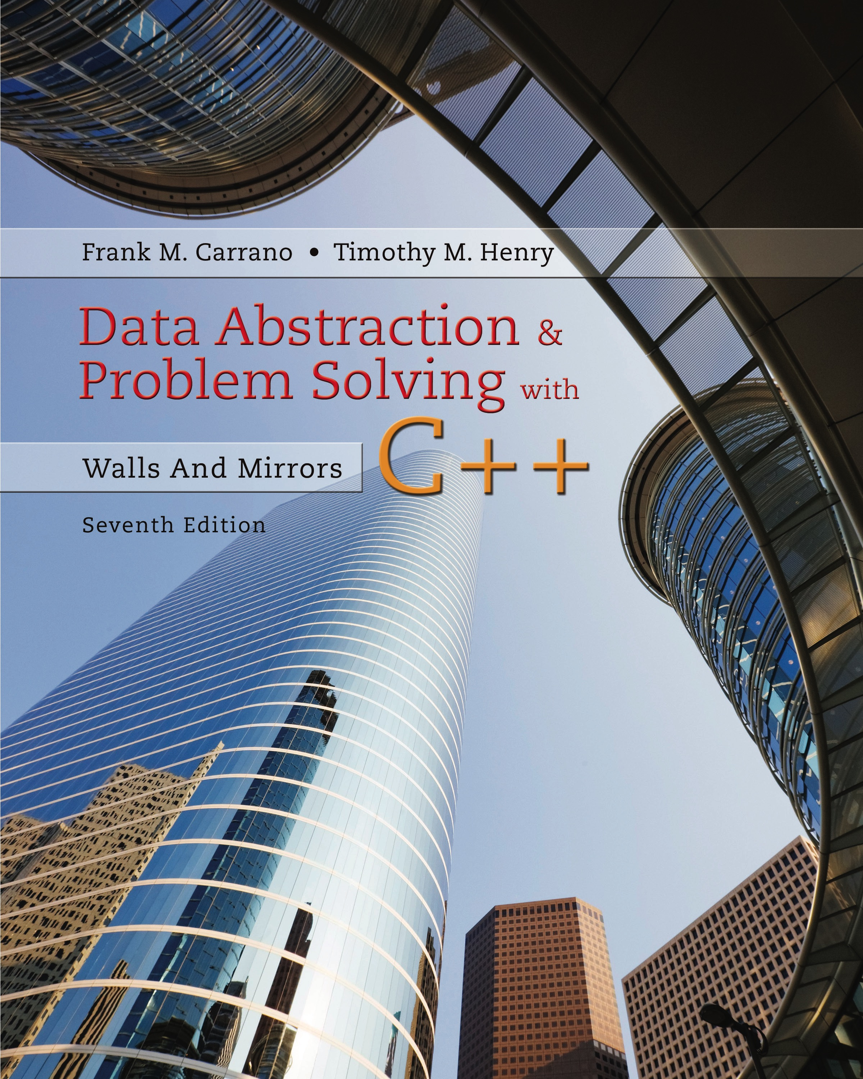
Data Abstraction & Problem Solving with C++: Walls and Mirrors
Seventh Edition
Chapter 4
Link-Based Implementations
Copyright © 2017, 2013, 2007 Pearson Education, Inc. All Rights Reserved
Notes:
If this PowerPoint presentation contains mathematical equations, you may need to check that your computer has the following installed:
1) MathType Plugin
2) Math Player (free versions available)
3) NVDA Reader (free versions available)

Slide 2
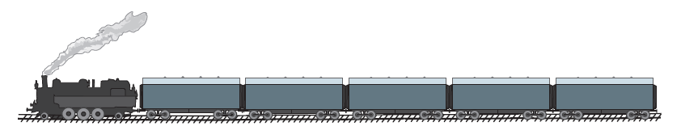
Preliminaries (1 of 4)
Another way to organize data items
Place them within objects—usually called nodes
Linked together into a “chain,” one after the other
Figure 4-1 A freight train

Slide 3
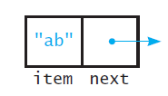
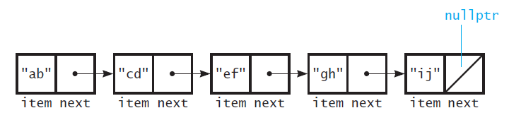
Preliminaries (2 of 4)
Figure 4-2 A node
Figure 4-3 Several nodes linked together

Slide 4
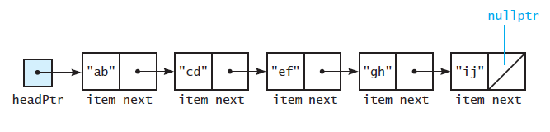
Preliminaries (3 of 4)
Figure 4-4 A head pointer to the first of several linked nodes

Slide 5
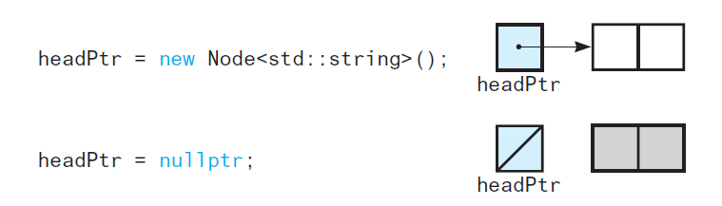
Preliminaries (4 of 4)
Figure 4-5 A lost node

Slide 6
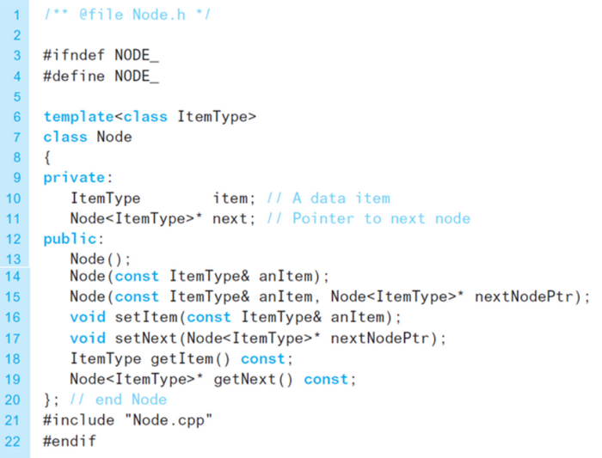
The Class Node (1 of 3)
Listing 4-1 The header file for the template class Node

Slide 7
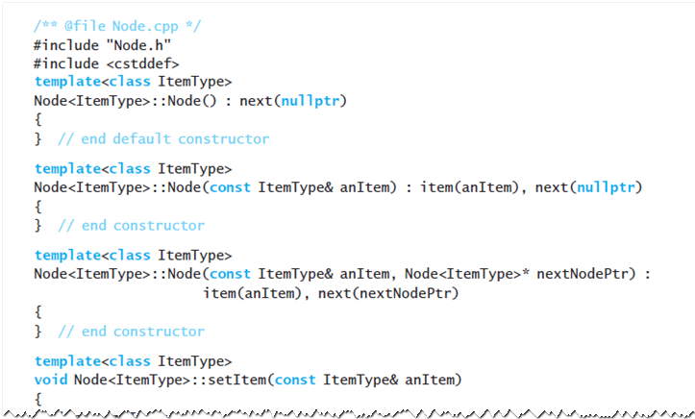
The Class Node (2 of 3)
Listing 4-2 The implementation file for the class Node

Slide 8
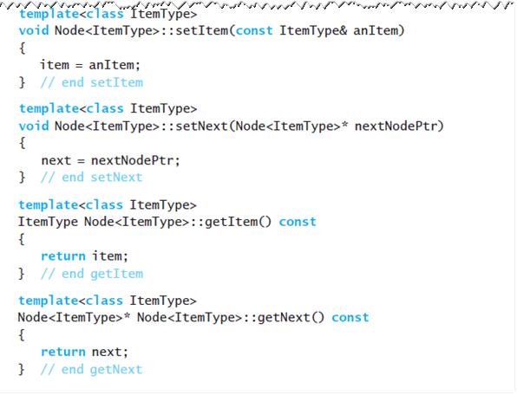
The Class Node (3 of 3)
Listing 4-2 (continued)

Slide 9
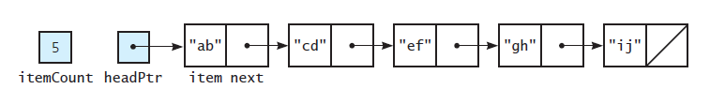
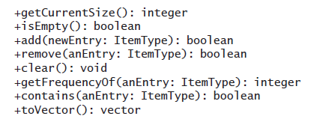
A Link-Based Implementation of the A D T Bag
Figure 4-6 A link-based implementation of the A D T bag
Bag operations, given in U M L notation

Slide 10
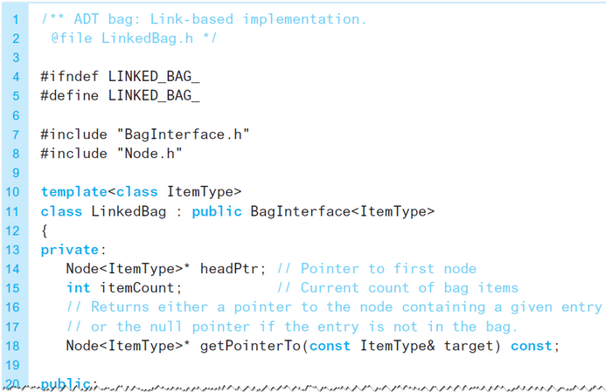
The Header File (1 of 2)
Listing 4-3 The header file for the class LinkedBag

Slide 11
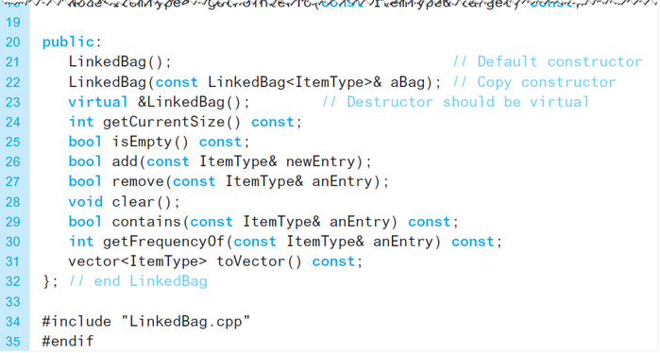
The Header File (2 of 2)
Listing 4-3 (continued)

Slide 12

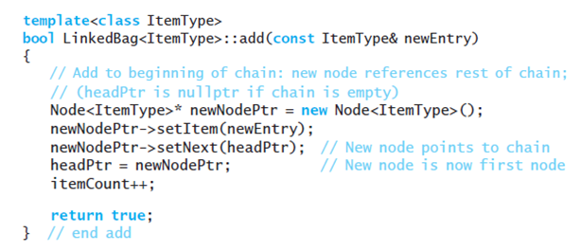
Defining the Core Methods (1 of 6)
Default Constructor
Inserting at the beginning of a linked chain

Slide 13
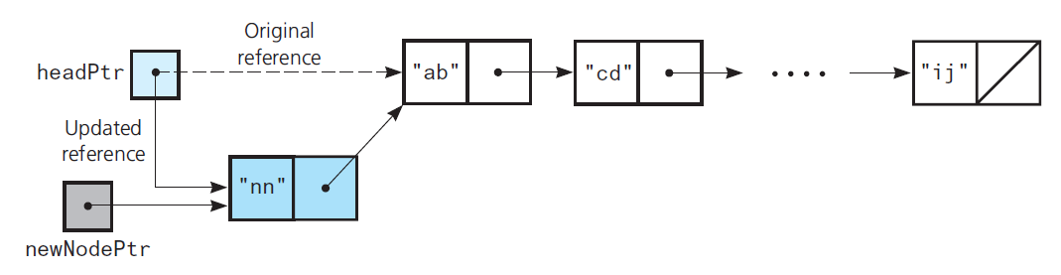
Defining the Core Methods (2 of 6)
Figure 4-7 Inserting at the beginning of a linked chain

Slide 14
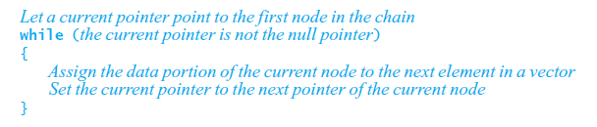
Defining the Core Methods (3 of 6)
Traverse operation visits each node in linked chain
Must move from node to node
High-level pseudocode for this loop

Slide 15
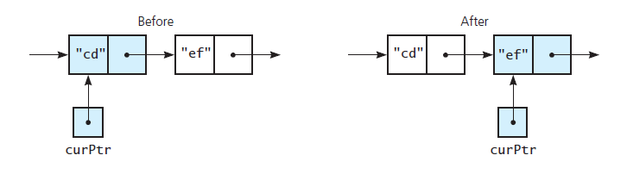
Defining the Core Methods (4 of 6)
Figure 4-8 The effect of the assignment

Slide 16
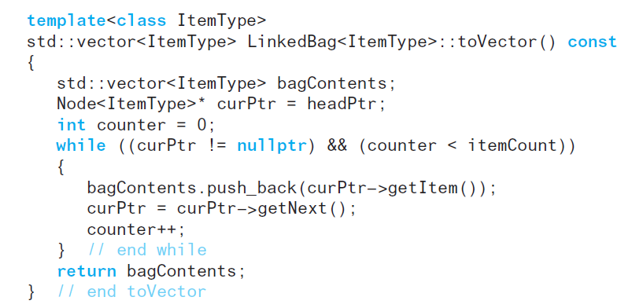
Defining the Core Methods (5 of 6)
Definition of toVector

Slide 17
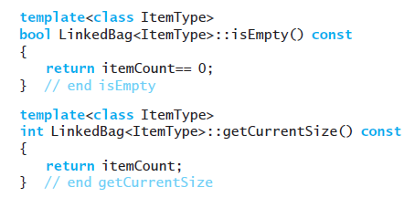
Defining the Core Methods (6 of 6)
Methods isEmpty and getCurrentSize

Slide 18
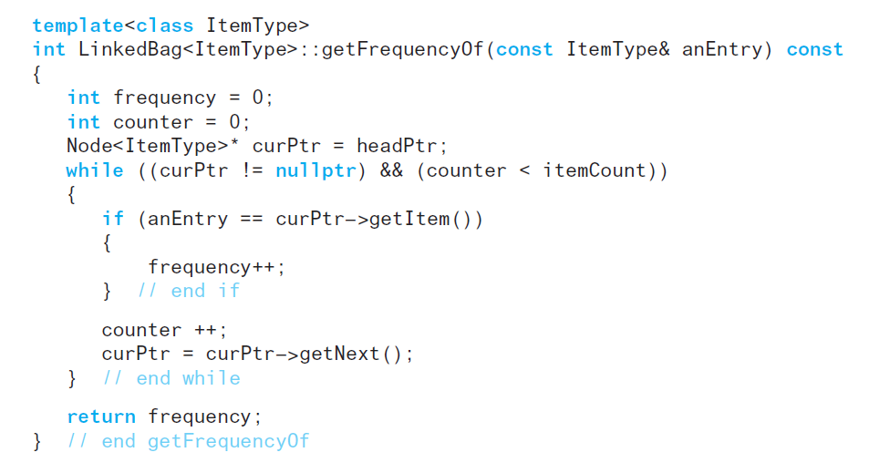
Implementing More Methods (1 of 9)
Method getFrequencyOf

Slide 19
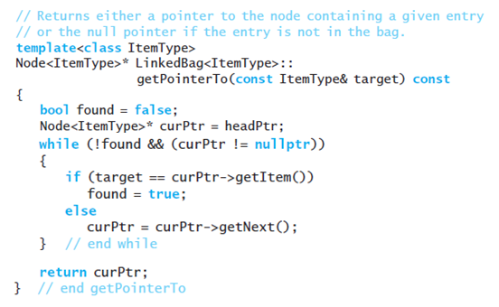
Implementing More Methods (2 of 9)
Search for a specific entry. To avoid duplicate code, we perform this search in a private method

Slide 20
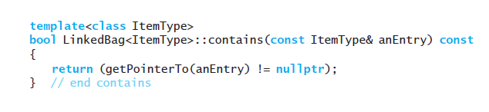
Implementing More Methods (3 of 9)
Note: definition of the method contains calls getPointerTo

Slide 21
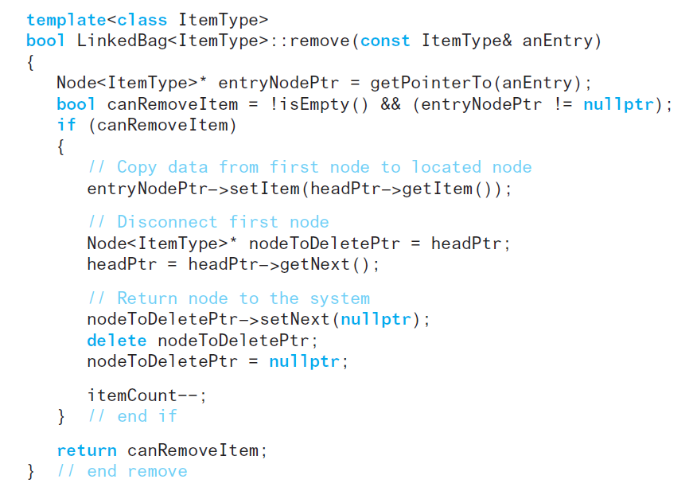
Implementing More Methods (4 of 9)
Method remove also calls getPointerTo

Slide 22
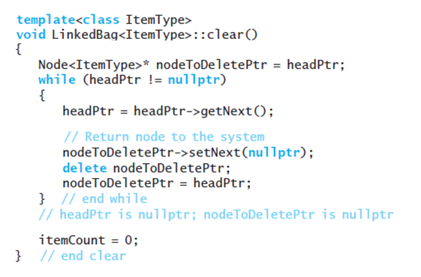
Implementing More Methods (5 of 9)
Method clear deallocates all nodes in the chain.

Slide 23
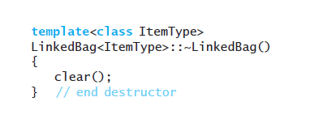
Implementing More Methods (6 of 9)
Destructor calls clear, destroys instance of a class

Slide 24
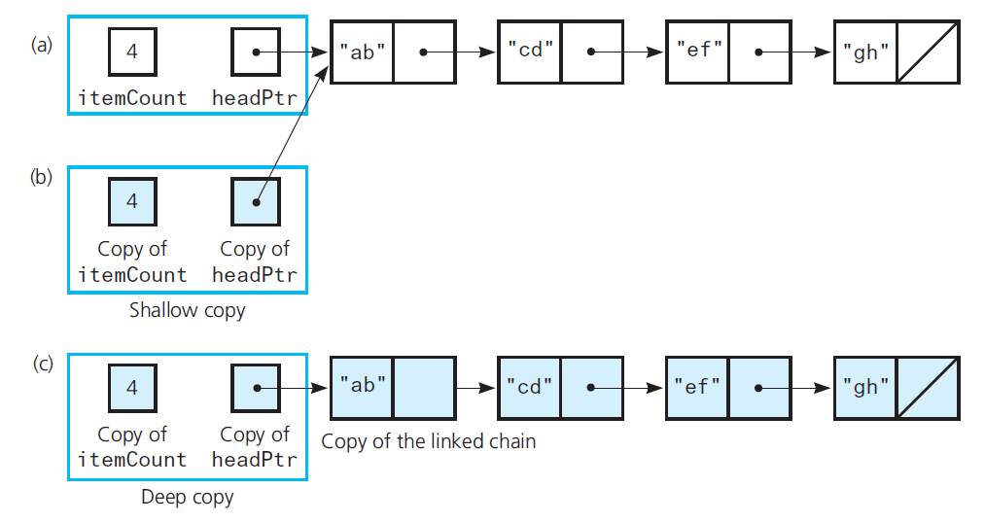
Implementing More Methods (7 of 9)
Figure 4-9 (a) A linked chain and its shallow copy; (b) a linked chain and its deep copy

Slide 25
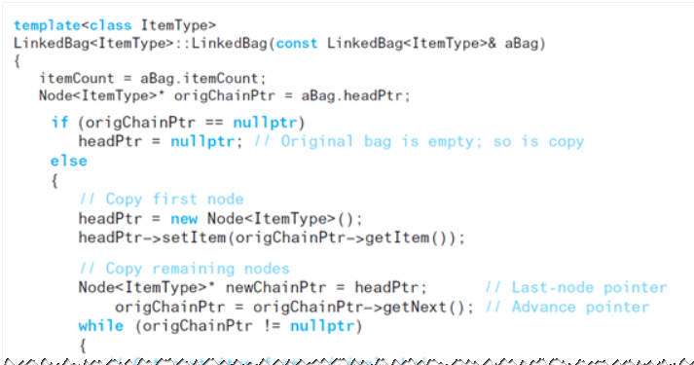
Implementing More Methods (8 of 9)
Copy constructor to accomplish deep copy.

Slide 26
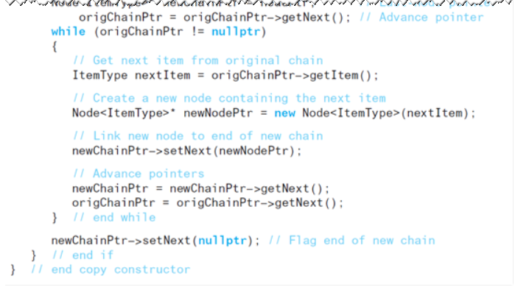
Implementing More Methods (9 of 9)
Copy constructor to accomplish deep copy.

Slide 27
Recursive Definitions Methods in LinkedBag (1 of 3)
Revise methods in class to use recursion
Traverse chain of linked nodes
Make no changes to the chain
Method toVector
Has a straightforward recursive implementation
Must be a private method
Receives head pointer as parameter
Vector must also be a parameter

Slide 28
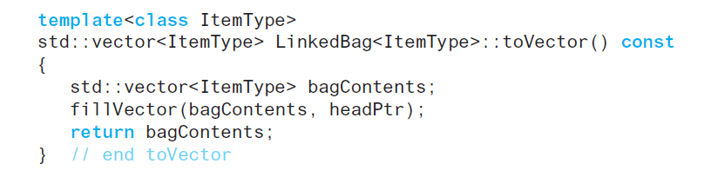
Recursive Definitions Methods in LinkedBag (2 of 3)
Method toVector

Slide 29
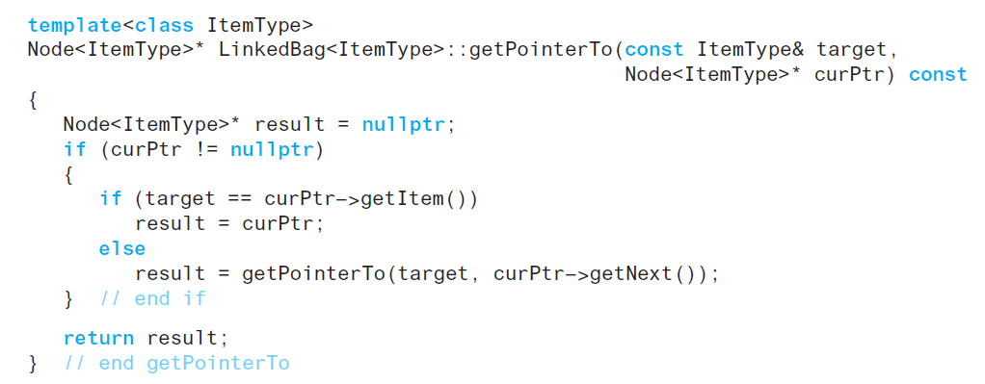
Recursive Definitions Methods in LinkedBag (3 of 3)
Private method getPointerTo
Locates given entry within linked chain
Traversal stops if it locates node that contains given entry

Slide 30
Testing Multiple A D T Implementations (1 of 7)
Recall test program of Listing 3-2
Used A D T bag methods when we tested our implementation
Can use the same code—with a few changes
Change each occurrence of ArrayBag to LinkedBag and recompile the program

Slide 31
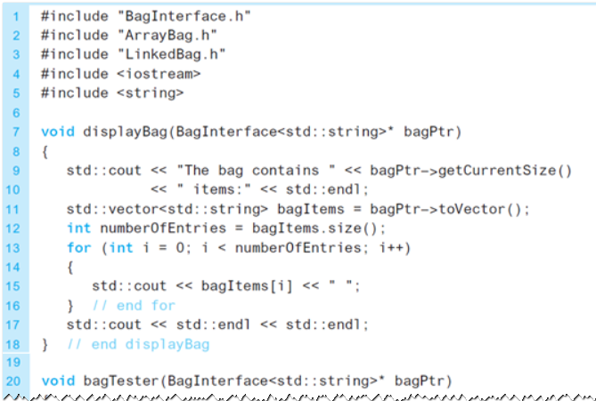
Testing Multiple A D T Implementations (2 of 7)
Listing 4-4 A program that tests the core methods of classes that are derived from the abstract class BagInterface

Slide 32
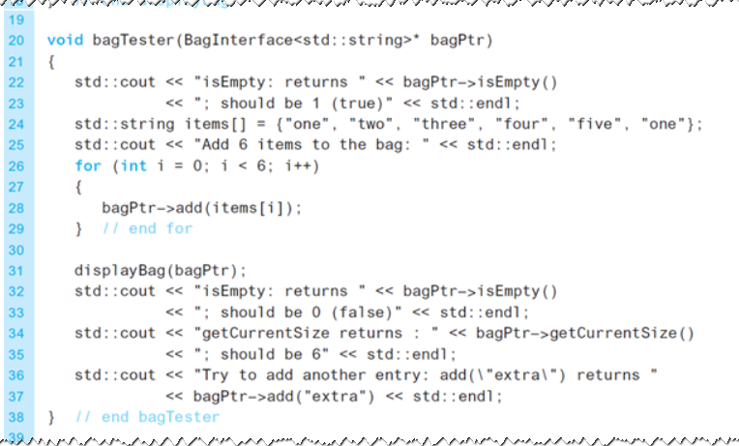
Testing Multiple A D T Implementations (3 of 7)
Listing 4-4 [continued]

Slide 33
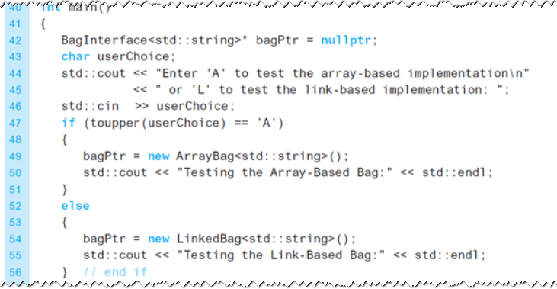
Testing Multiple A D T Implementations (4 of 7)
Listing 4-4 [continued]

Slide 34
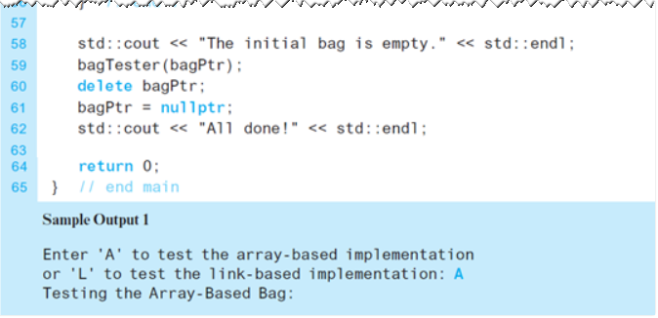
Testing Multiple A D T Implementations (5 of 7)
Listing 4-4 [continued]

Slide 35
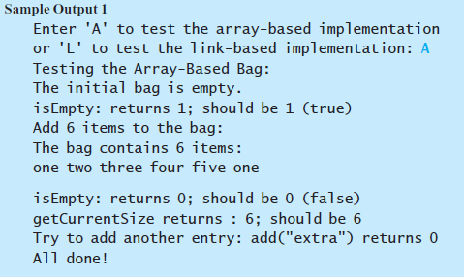
Testing Multiple A D T Implementations (6 of 7)
Listing 4-4 [continued]

Slide 36
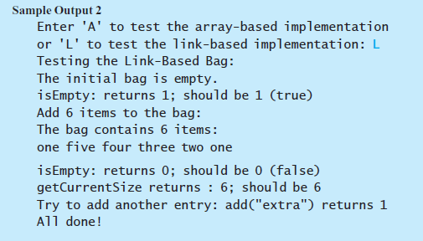
Testing Multiple A D T Implementations (7 of 7)
Listing 4-4 [continued]

Slide 37
Comparing Array-Based and Link-Based Implementations (1 of 2)
Arrays easy to use, but have fixed size
Not always easy to predict number of items in A D T
Array could waste space
Increasing size of dynamically allocated array can waste storage and time
Can access array items directly with equal access time
An array-based implementation is a good choice for a small bag

Slide 38
Comparing Array-Based and Link-Based Implementations (2 of 2)
Linked chains do not have fixed size
In a chain of linked nodes, an item points explicitly to the next item
Link-based implementation requires more memory
Must traverse a linked chain to access its i^{th} node
Time to access i^{th} node in a linked chain depends on i

Slide 39

Copyright

