Slide 1
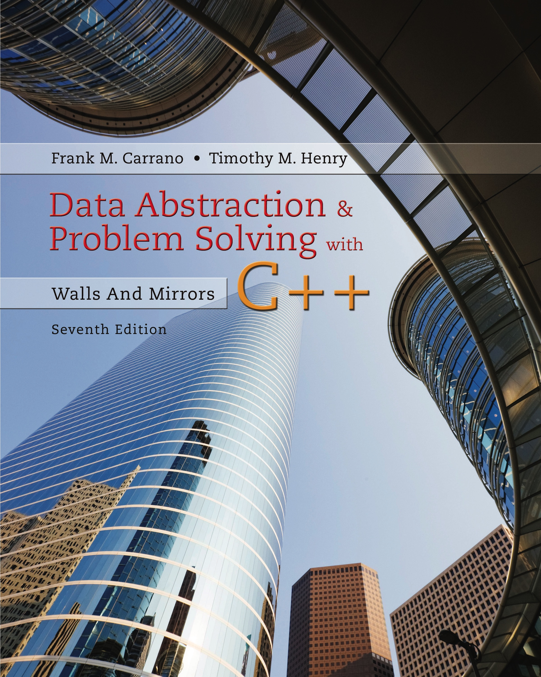
Data Abstraction & Problem Solving with C++: Walls and Mirrors
Seventh Edition
Chapter 5
Recursion as a Problem-Solving Technique
Copyright © 2017, 2013, 2007 Pearson Education, Inc. All Rights Reserved
Notes:
If this PowerPoint presentation contains mathematical equations, you may need to check that your computer has the following installed:
1) MathType Plugin
2) Math Player (free versions available)
3) NVDA Reader (free versions available)

Slide 2

Defining Languages
A language a set of strings of symbols from a finite alphabet.
Consider the C++ language
The set of algebraic expressions forms a language
A grammar states the rules of a language.

Slide 3
The Basics of Grammars (1 of 5)
A grammar uses several special symbols
x | y means x or y.
x y (and sometimes
) means x followed by y.
< word > means any instance of word, where word is a symbol that must be defined elsewhere in the grammar.

Slide 4
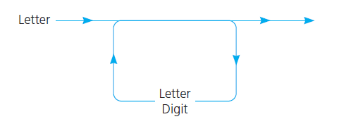
The Basics of Grammars (2 of 5)
Figure 5-1 A syntax diagram for C++ identifiers

Slide 5
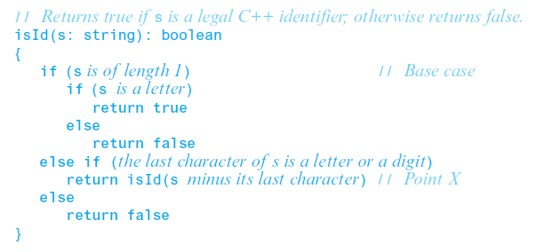
The Basics of Grammars (3 of 5)
Pseudocode for a recursive valued function that determines whether a string is in the language C++Identifiers

Slide 6
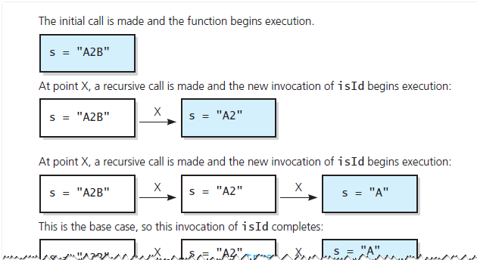
The Basics of Grammars (4 of 5)
Figure 5-2 Trace of i s I d(“A2B”)

Slide 7
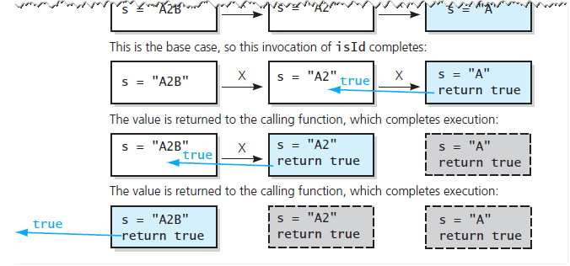
The Basics of Grammars (5 of 5)
Figure 5-2 [continued]

Slide 8

Two Simple Languages (1 of 2)
Palindromes
Recursive definition of palindrome
The first and last characters of s are the same
s minus its first and last characters is a palindrome
Grammar for the language of palindromes

Slide 9

Two Simple Languages (2 of 2)
Strings of the form
Grammar for the language

Slide 10
Algebraic Expressions
Compiler must recognize and evaluate algebraic expressions
Determine if legal expression
If legal, evaluate expression

Slide 11
Kinds of Algebraic Expressions (1 of 2)
Infix expressions
Every binary operator appears between its operands
This convention necessitates …
Associativity rules
Precedence rules
Use of parentheses

Slide 12
Kinds of Algebraic Expressions (2 of 2)
Prefix expression
Operator appears before its operands
a + b equivalent to +ab
Postfix expressions
Operator appears after its operands
a + b equivalent to ab+

Slide 13
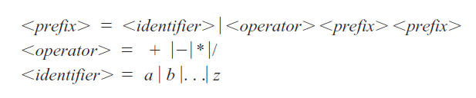
Prefix Expressions (1 of 11)
Grammar that defines language of all prefix expressions
Recursive algorithm that recognizes whether string is a prefix expression
Check if first character is an operator
Remainder of string consists of two consecutive prefix expressions

Slide 14
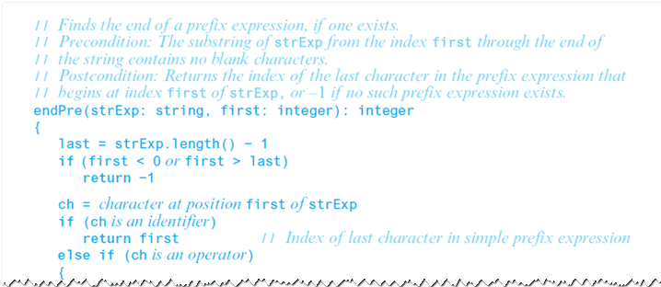
Prefix Expressions (2 of 11)
endPre determines the end of a prefix expression

Slide 15
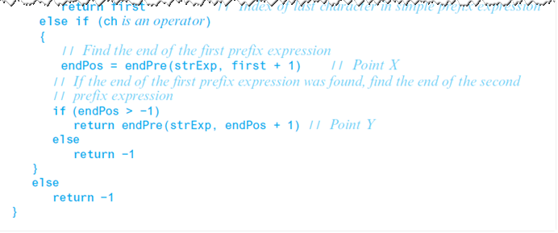
Prefix Expressions (3 of 11)
endPre determines the end of a prefix expression

Slide 16
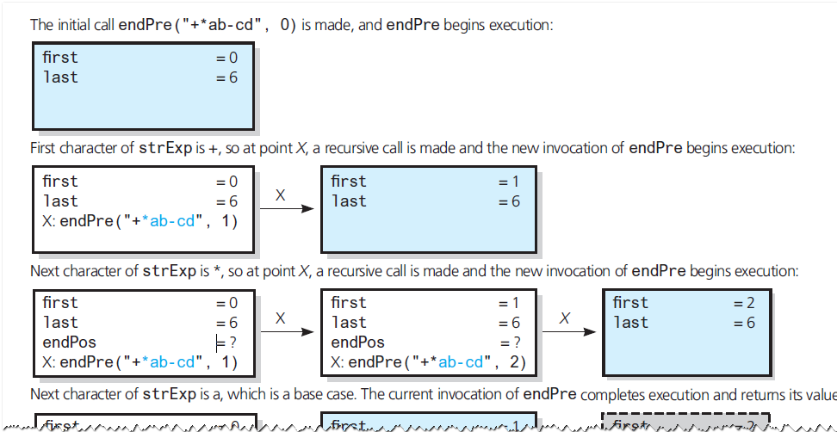
Prefix Expressions (4 of 11)
Figure 5-3 Trace of

Slide 17
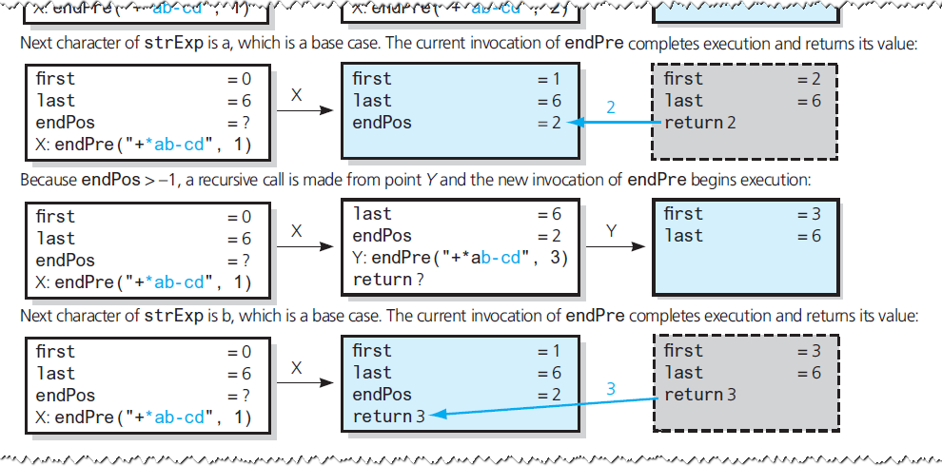
Prefix Expressions (5 of 11)
Figure 5-3 [Continued]

Slide 18
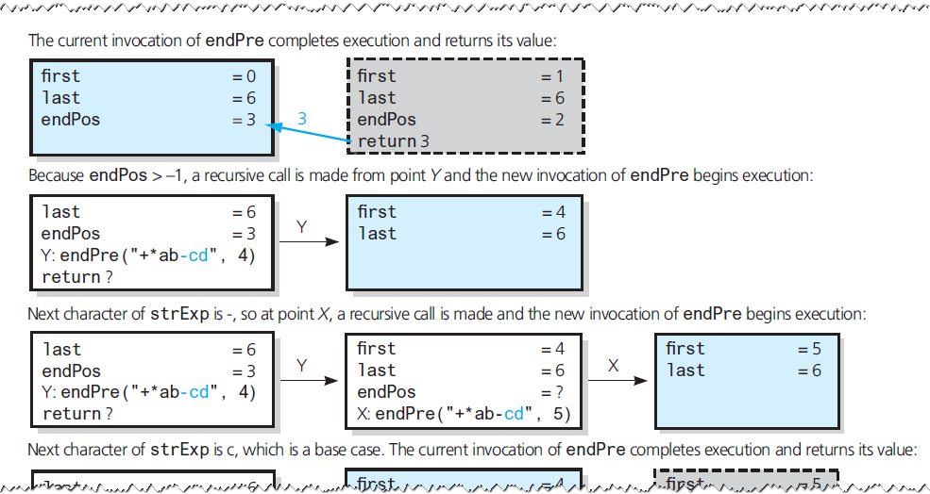
Prefix Expressions (6 of 11)
Figure 5-3 [Continued]

Slide 19
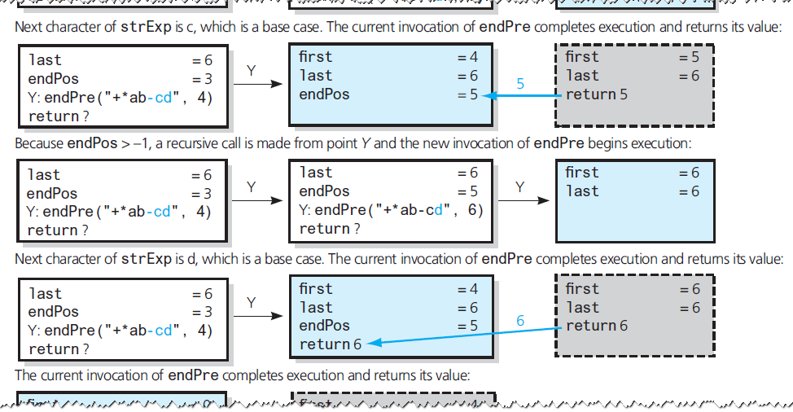
Prefix Expressions (7 of 11)
Figure 5-3 [Continued]

Slide 20
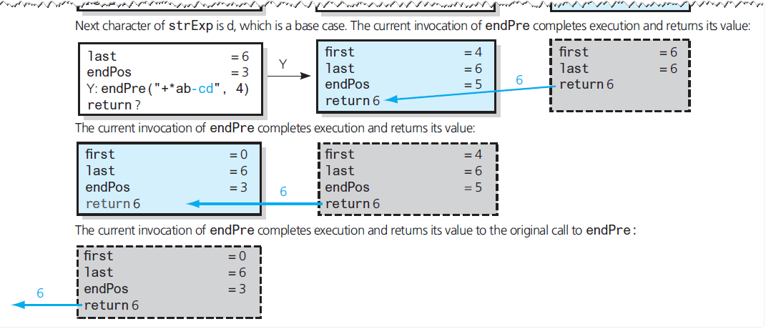
Prefix Expressions (8 of 11)
Figure 5-3 [Continued]

Slide 21
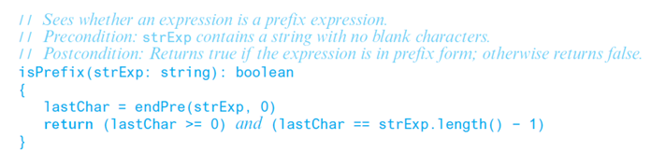
Prefix Expressions (9 of 11)
A recognition algorithm for prefix expressions

Slide 22
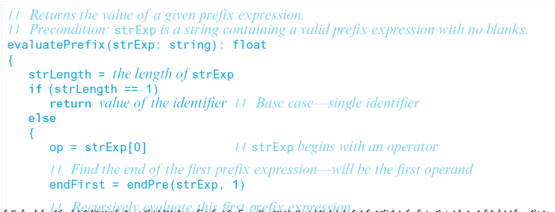
Prefix Expressions (10 of 11)
An algorithm to evaluate a prefix expression

Slide 23
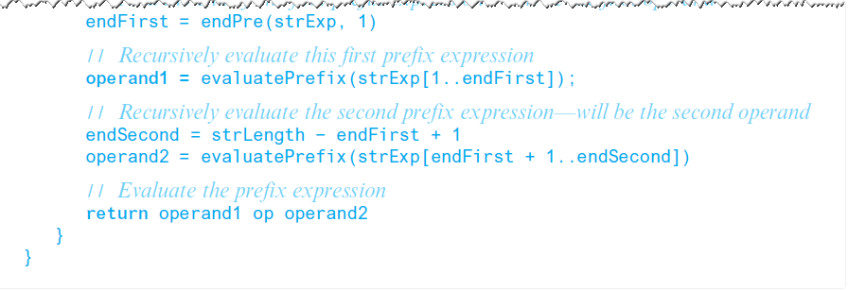
Prefix Expressions (11 of 11)
An algorithm to evaluate a prefix expression

Slide 24
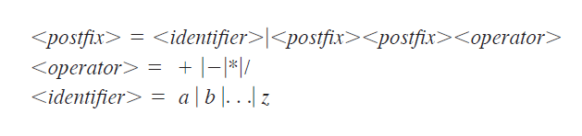
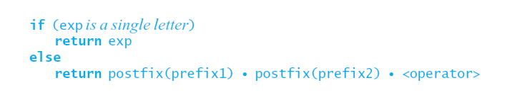
Postfix Expressions (1 of 2)
Grammar that defines the language of all postfix expressions
An algorithm that converts a prefix expression to postfix form

Slide 25
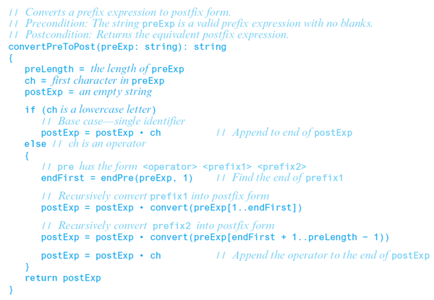
Postfix Expressions (2 of 2)
Recursive algorithm that converts a prefix expression to postfix form

Slide 26
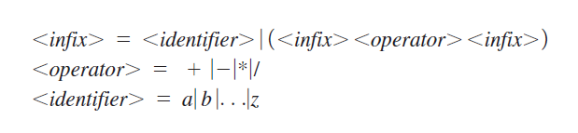
Fully Parenthesized Expressions
Grammar for language of fully parenthesized algebraic expressions
Most programming languages support definition of algebraic expressions
Includes both precedence rules for operators and rules of association

Slide 27
Backtracking
Strategy for guessing at a solution and …
Backing up when an impasse is reached
Retracing steps in reverse order
Trying a new sequence of steps
Combine recursion and backtracking to solve problems

Slide 28
Searching for an Airline Route (1 of 11)
Must find a path from some point of origin to some destination point
Program to process customer requests to fly
From some origin city
To some destination city
Use three input text files
names of cities served
Pairs of city names, flight origins and destinations
Pairs of names, request origins, destinations

Slide 29
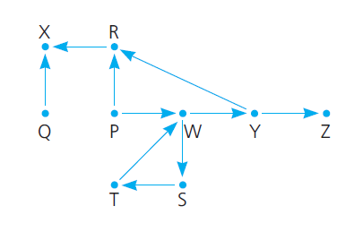
Searching for an Airline Route (2 of 11)
Figure 5-4 Flight map for H P Air

Slide 30
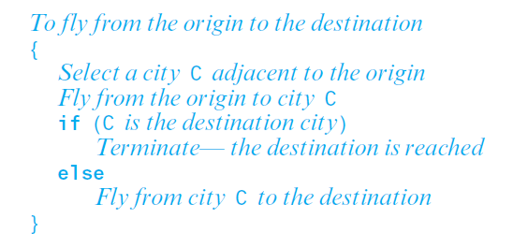
Searching for an Airline Route (3 of 11)
A recursive search strategy

Slide 31
Searching for an Airline Route (4 of 11)
Possible outcomes of exhaustive search strategy
Reach destination city, decide possible to fly from origin to destination
Reach a city, C from which no departing flights
You go around in circles
Use backtracking to recover from a wrong choice (2 or 3)

Slide 32
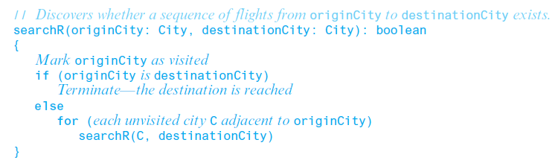
Searching for an Airline Route (5 of 11)
Refinement of the recursive search algorithm

Slide 33
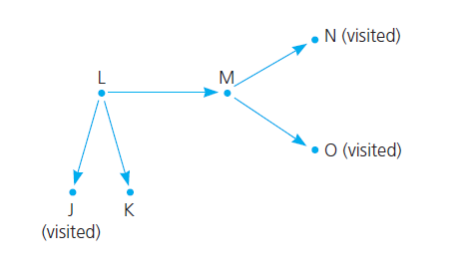
Searching for an Airline Route (6 of 11)
Figure 5-5 A piece of a flight map

Slide 34
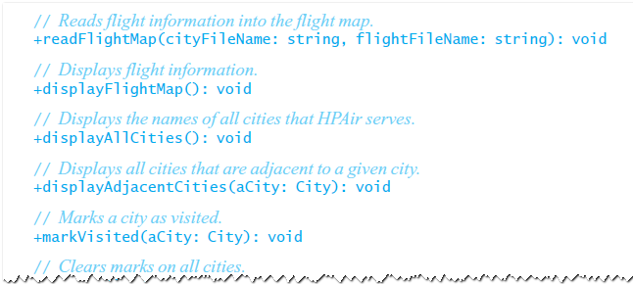
Searching for an Airline Route (7 of 11)
A D T flight map operations

Slide 35
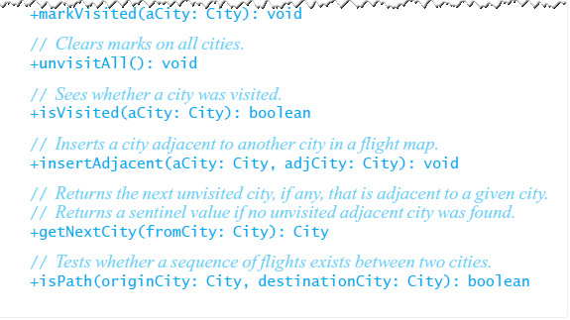
Searching for an Airline Route (8 of 11)
A D T flight map operations

Slide 36
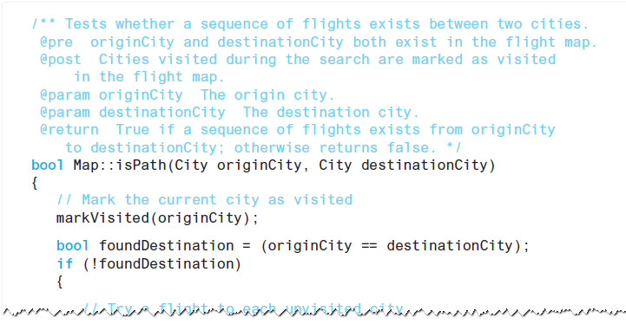
Searching for an Airline Route (9 of 11)
C++ implementation of searchR

Slide 37
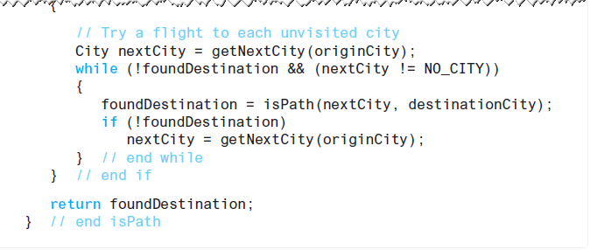
Searching for an Airline Route (10 of 11)
C++ implementation of searchR

Slide 38
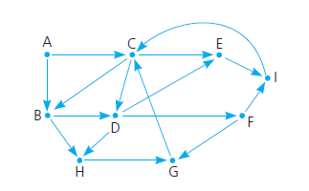
Searching for an Airline Route (11 of 11)
Figure 5-6 Flight map for Checkpoint Question 6

Slide 39
The Eight Queens Problem (1 of 7)
Chessboard contains 64 squares
Form eight rows and eight column
Problem asks you to place eight queens on the chessboard …
So that no queen can attack any other queen.
Note there are 4,426,165,368 ways to arrange eight queens on a chessboard
Exhausting to check all possible ways

Slide 40
The Eight Queens Problem (2 of 7)
However, each row and column can contain exactly one queen.
Attacks along rows or columns are eliminated, leaving only 8! = 40,320 arrangements
Solution now more feasible

Slide 41
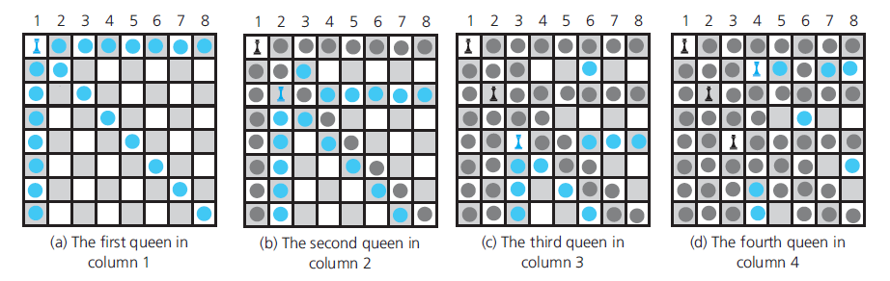
The Eight Queens Problem (3 of 7)
Figure 5-7 Placing one queen at a time in each column …

Slide 42
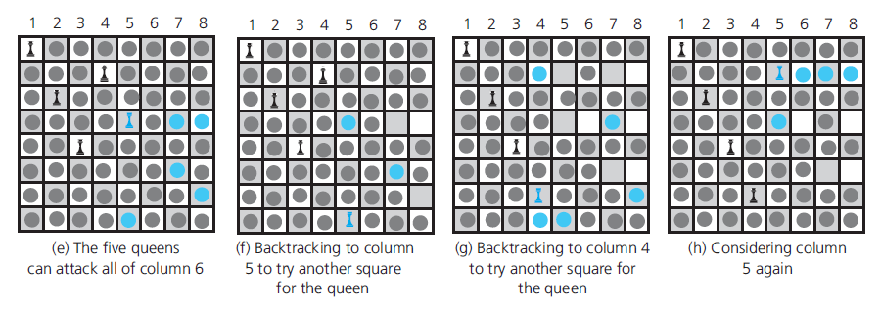
The Eight Queens Problem (4 of 7)
Figure 5-7 [Continued]

Slide 43
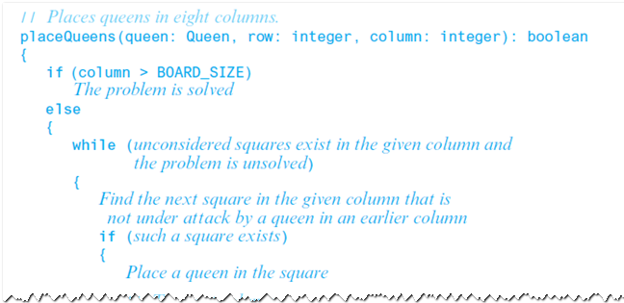
The Eight Queens Problem (5 of 7)
Pseudocode describes the algorithm for placing queens

Slide 44
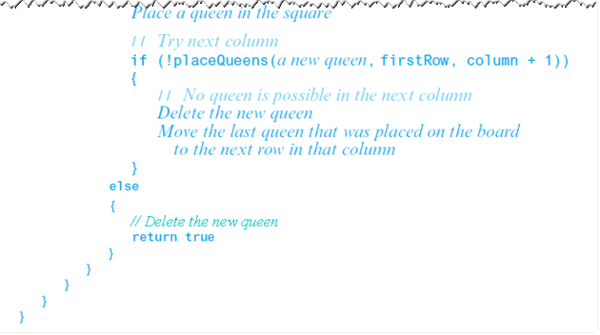
The Eight Queens Problem (6 of 7)
Pseudocode describes the algorithm for placing queens

Slide 45
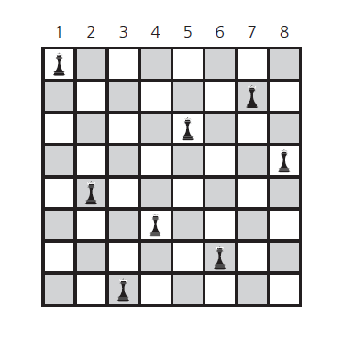
The Eight Queens Problem (7 of 7)
Figure 5-8 A solution to the Eight Queens problem

Slide 46
Relationship Between Recursion and Mathematical Induction
Recursion solves a problem by
Specifying a solution to one or more base cases
Then demonstrating how to derive solution to problem of arbitrary size
From solutions to smaller problems of same type.
Can use induction to prove
Recursive algorithm either is correct
Or performs certain amount of work

Slide 47
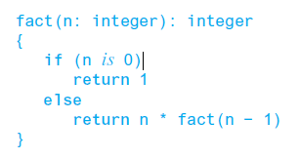
Correctness of Recursive Factorial Function (1 of 2)
Pseudocode describes recursive function that computes factorial

Slide 48
Correctness of Recursive Factorial Function (2 of 2)
Inductive hypothesis
Inductive conclusion

Slide 49
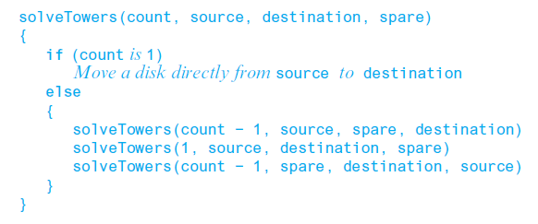
The Cost of Towers of Hanoi (1 of 2)
Pseudocode to solution to the Towers of Hanoi problem
Consider: given N disks …
How many moves does solveTowers make?

Slide 50
The Cost of Towers of Hanoi (2 of 2)
Claim
Basis
Show that the property is true for N = 1
Inductive hypothesis
Assume that property is true for N = k
Inductive conclusion
Show that property is true for N = k + 1

Slide 51

Copyright

