Slide 1
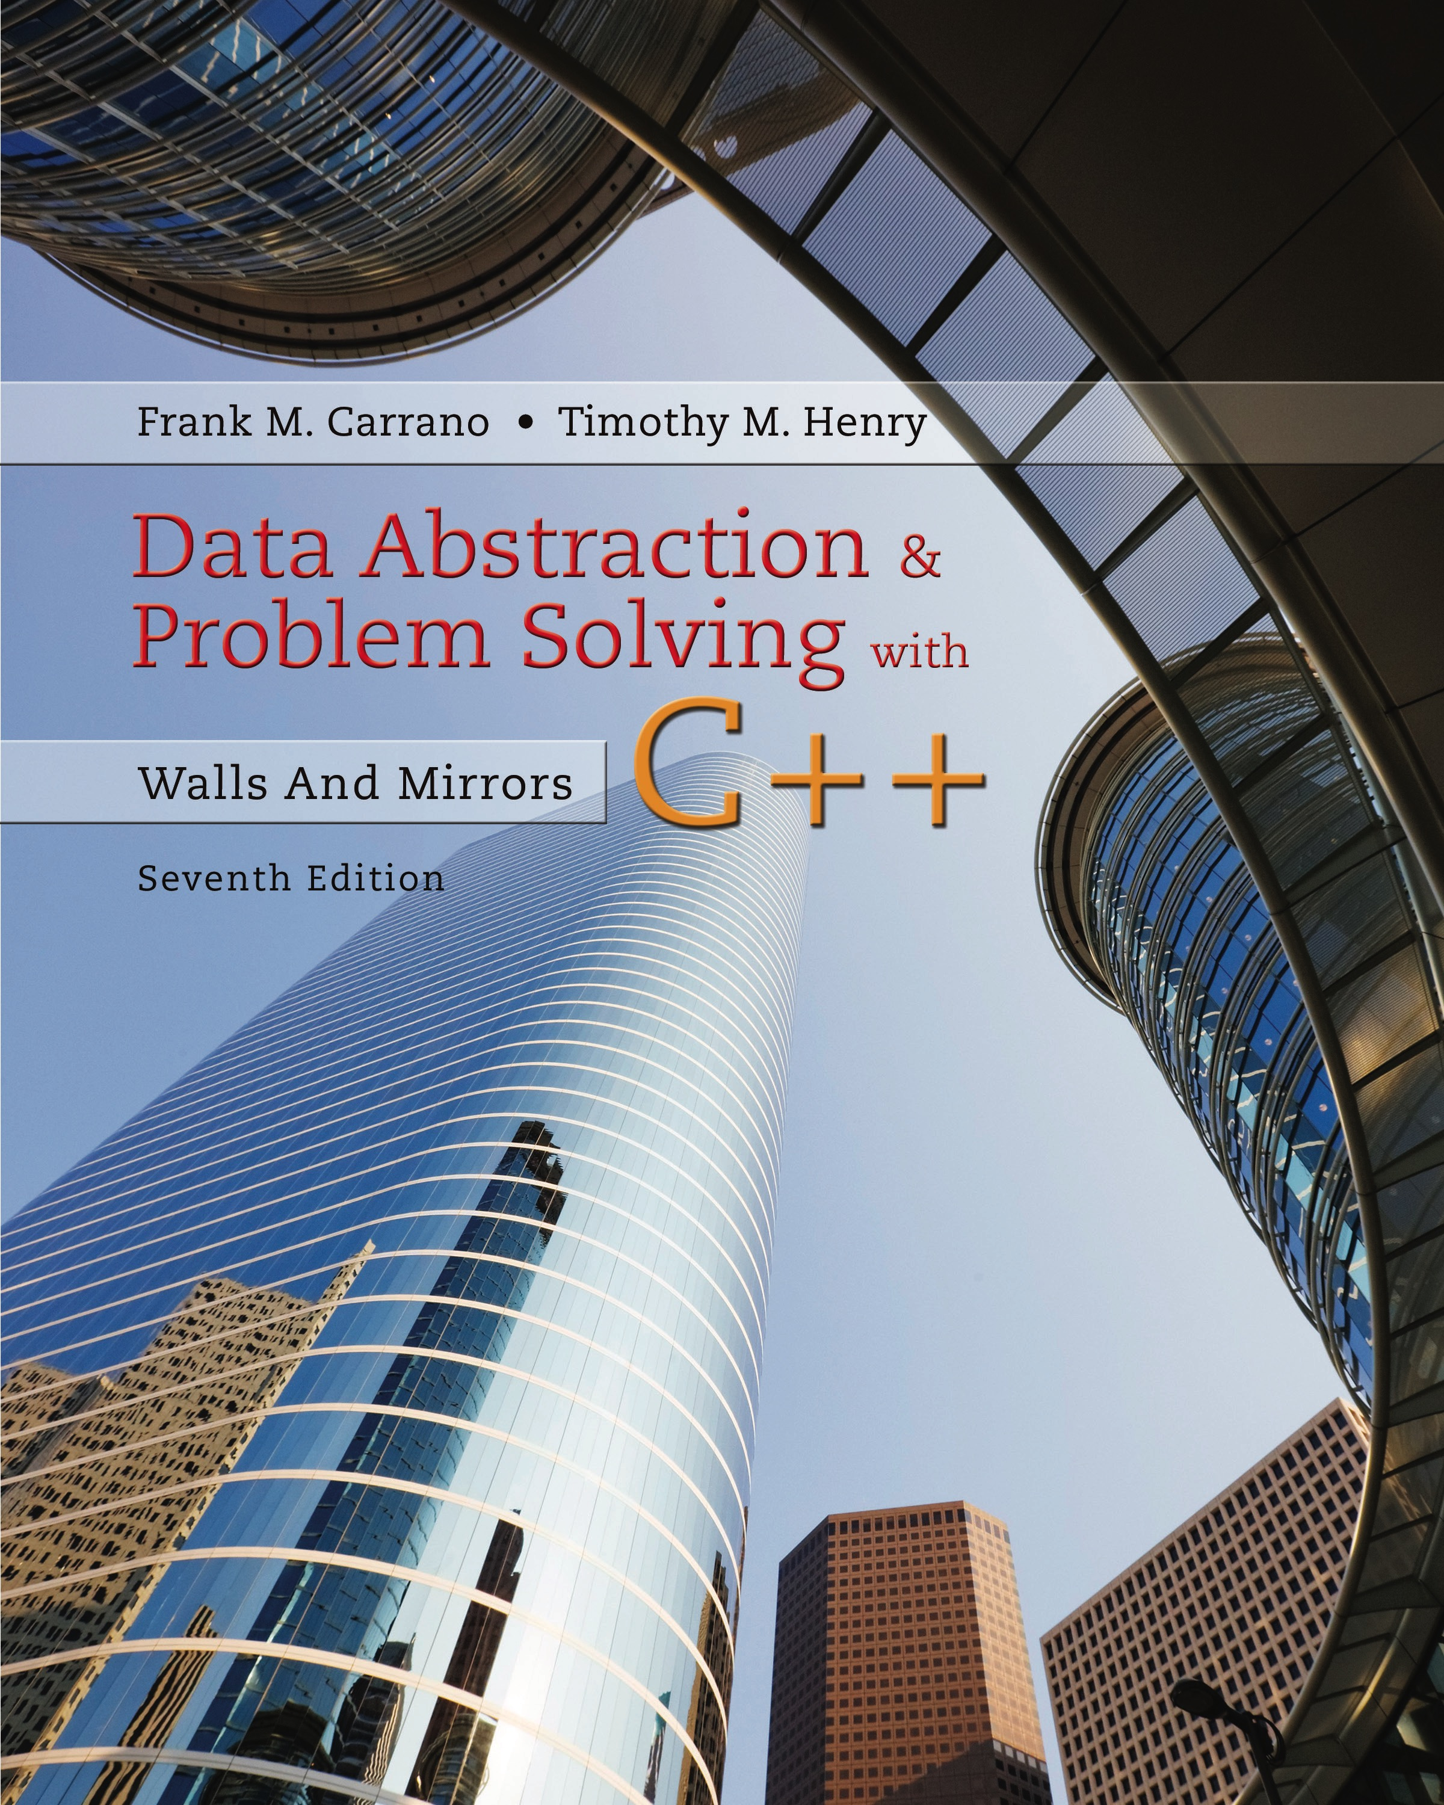
Data Abstraction & Problem Solving with C + +: Walls and Mirrors
Seventh Edition
Chapter 6
Stacks
Copyright © 2017, 2013, 2007 Pearson Education, Inc. All Rights Reserved
Notes:
If this PowerPoint presentation contains mathematical equations, you may need to check that your computer has the following installed:
1) MathType Plugin
2) Math Player (free versions available)
3) NVDA Reader (free versions available)

Slide 2
The Abstract Data Type Stack
Operations on a stack
Last-in,
First-out behavior.
Applications demonstrated
Evaluating algebraic expressions
Searching for a path between two points

Slide 3


Developing an A D T During the Design of a Solution (1 of 4)
Consider typing a line of text on a keyboard
Use of backspace key to make corrections
You type
Corrected input will be
Must decide how to store the input line.

Slide 4
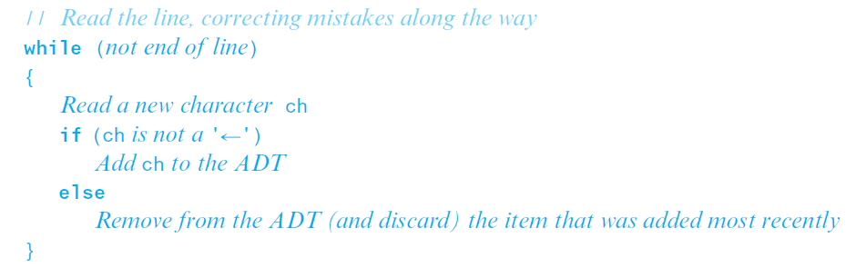
Developing an A D T During the Design of a Solution (2 of 4)
Initial draft of solution.
Two required operations
Add new item to A D T
Remove item added most recently

Slide 5
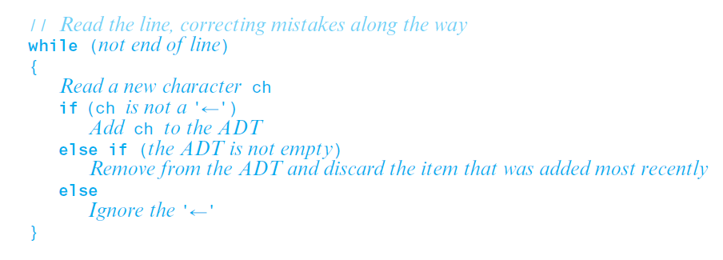
Developing an A D T During the Design of a Solution (3 of 4)
Read and correct algorithm.
Third operation required
See whether A D T is empty

Slide 6
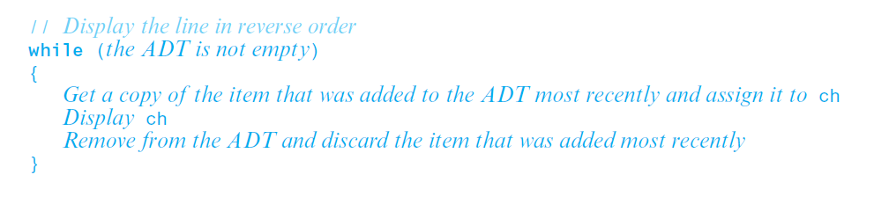
Developing an A D T During the Design of a Solution (4 of 4)
Write-backward algorithm
Fourth operation required
Get item that was added to A D T most recently.

Slide 7
Specifications for the A D T Stack (1 of 6)
See whether stack is empty.
Add new item to the stack.
Remove from and discard stack item that was added most recently.
Get copy of item that was added to stack most recently.

Slide 8
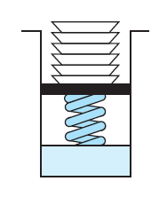
Specifications for the A D T Stack (2 of 6)
Figure 6-1 A stack of cafeteria plates
L I F O: The last item inserted onto a stack is the first item out

Slide 9
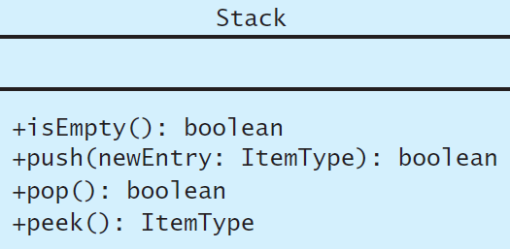
Specifications for the A D T Stack (3 of 6)
Figure 6-2 U M L diagram for the class Stack

Slide 10
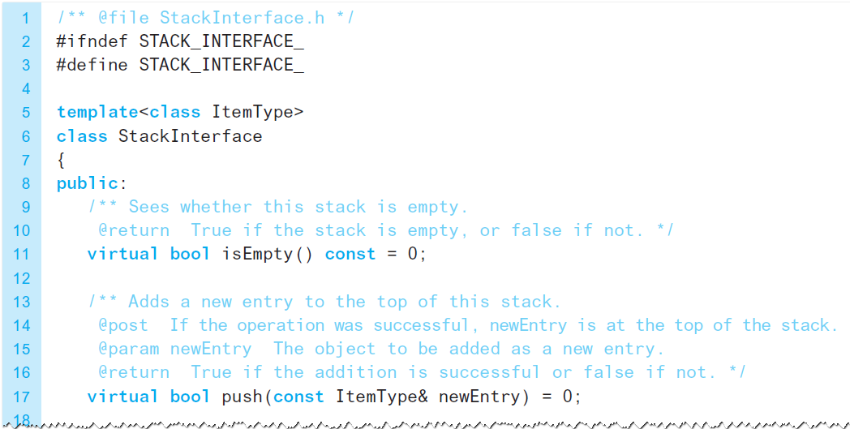
Specifications for the A D T Stack (4 of 6)
Listing 6-1 A C++ interface for stacks

Slide 11
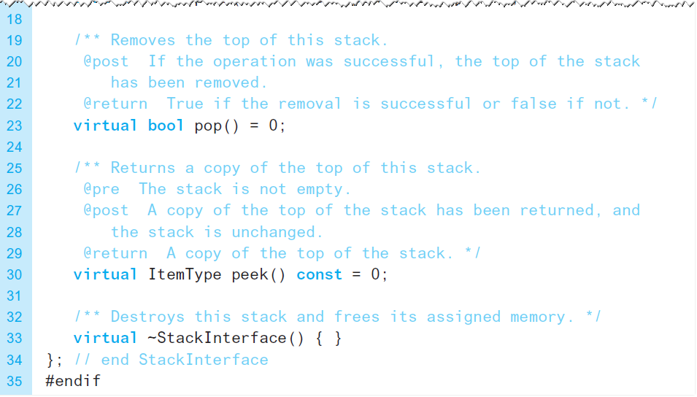
Specifications for the A D T Stack (5 of 6)
Listing 6-1 [Continued]

Slide 12
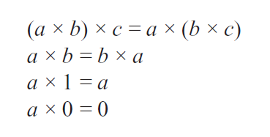
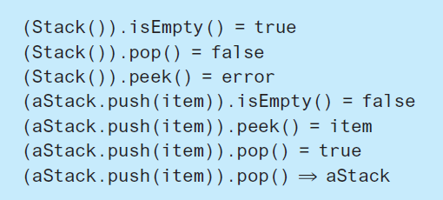
Specifications for the A D T Stack (6 of 6)
Axioms for multiplication
Axioms for A D T stack

Slide 13


Checking for Balanced Braces (1 of 5)
Example of curly braces in C + + language
Balanced
Not balanced
Requirements for balanced braces
For each }, must match an already encountered {
At end of string, must have matched each {

Slide 14
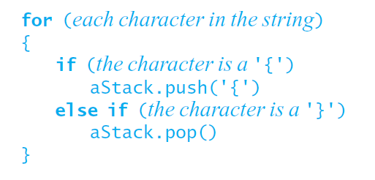
Checking for Balanced Braces (2 of 5)
Initial draft of a solution.

Slide 15
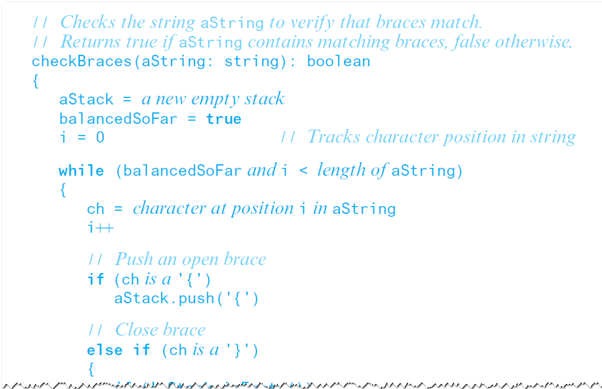
Checking for Balanced Braces (3 of 5)
Detailed pseudocode solution.

Slide 16
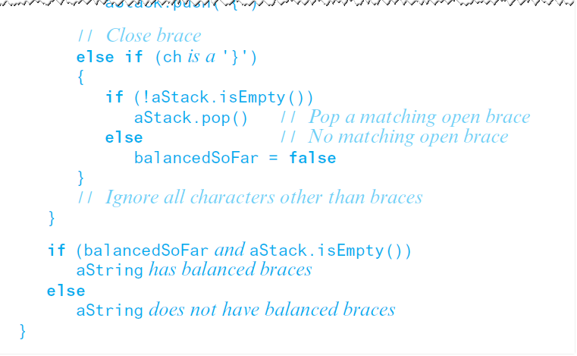
Checking for Balanced Braces (4 of 5)
Detailed pseudocode solution.

Slide 17
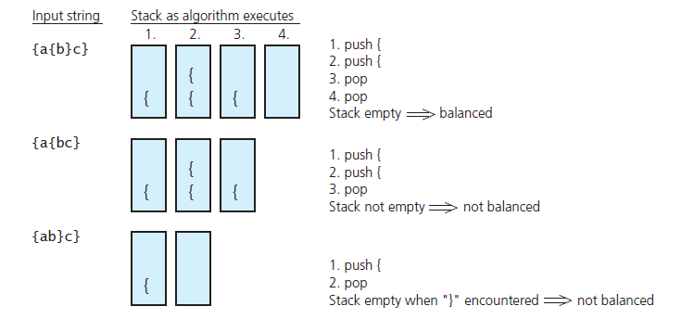
Checking for Balanced Braces (5 of 5)
Figure 6-3 Traces of algorithm that checks for balanced braces

Slide 18
Recognizing Strings in a Language (1 of 3)
Given a definition of a language, L
Special palindromes
Special middle character $
Example
A stack is useful in determining whether a given string is in a language
Traverse first half of string
Push each character onto stack
Reach $, undo, pop character, match or not

Slide 19
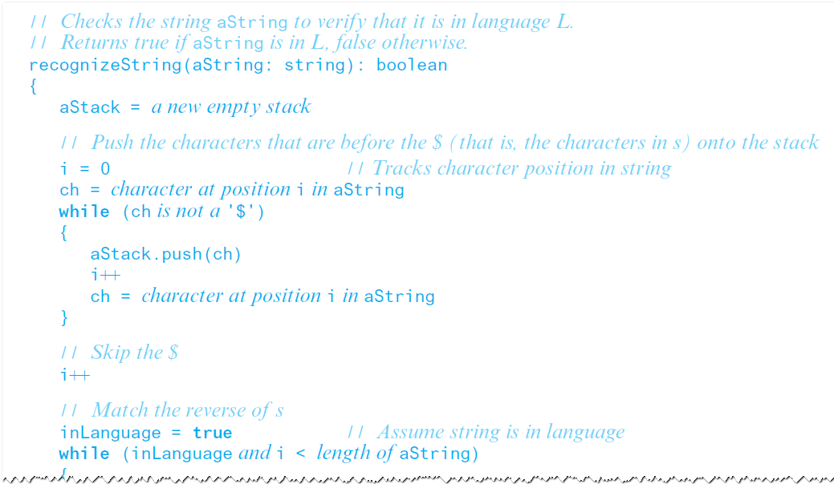
Recognizing Strings in a Language (2 of 3)
Algorithm to recognize string in language L

Slide 20
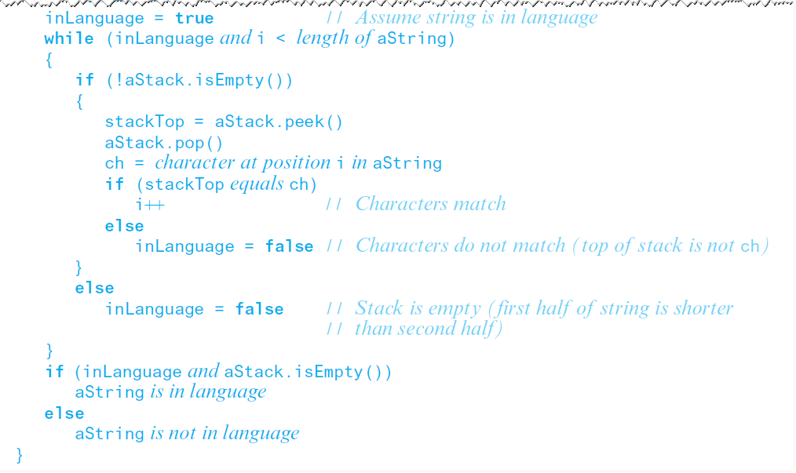
Recognizing Strings in a Language (3 of 3)
Algorithm to recognize string in language L

Slide 21
Using Stacks with Algebraic Expressions
Strategy
Develop algorithm to evaluate postfix
Develop algorithm to transform infix to postfix
These give us capability to evaluate infix expressions
This strategy easier than directly evaluating infix expression

Slide 22
Evaluating Postfix Expressions (1 of 3)
Infix expression
Equivalent postfix
Operator in postfix applies to two operands immediately preceding
Assumptions for our algorithm
Given string is correct postfix
No unary, no exponentiation operators
Operands are single lowercase letters, integers

Slide 23
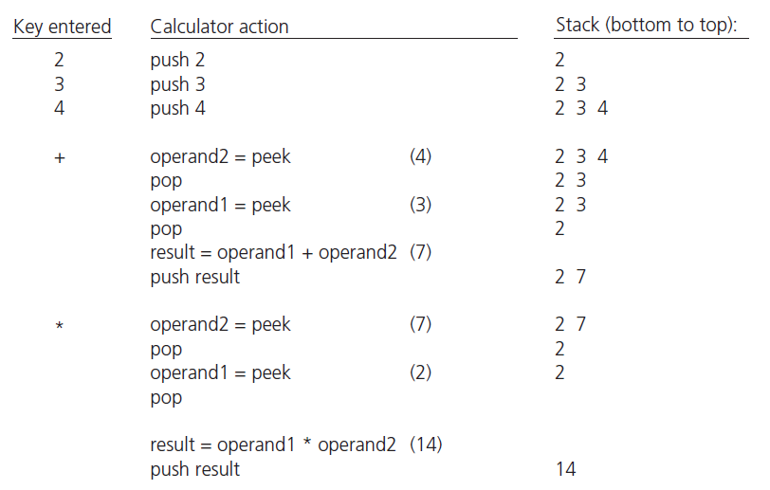
Evaluating Postfix Expressions (2 of 3)
Figure 6-4 The effect of a postfix calculator on a stack when evaluating the expression

Slide 24
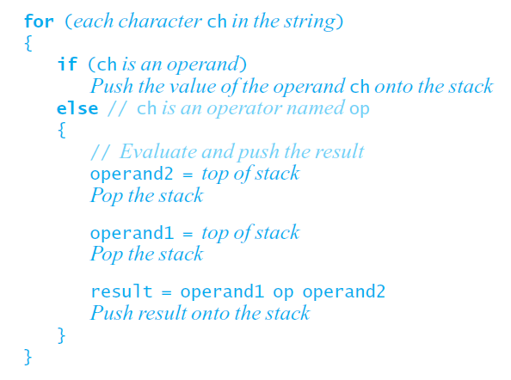
Evaluating Postfix Expressions (3 of 3)
A pseudocode algorithm that evaluates postfix expressions

Slide 25
Infix to Postfix (1 of 6)
Important facts
Operands always stay in same order with respect to one another.
Operator will move only “to the right” with respect to the operands;
If in the infix expression the operand x precedes the operator op,
Also true that in the postfix expression the operand x precedes the operator op.
All parentheses are removed.

Slide 26
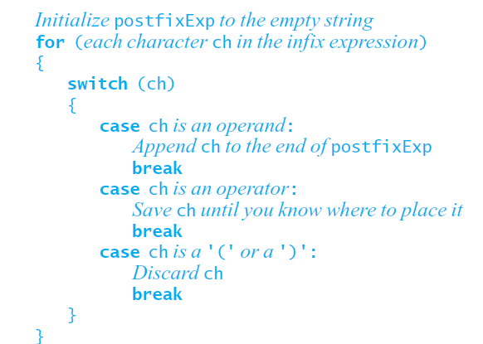
Infix to Postfix (2 of 6)
First draft of algorithm to convert infix to postfix

Slide 27
Infix to Postfix (3 of 6)
Determining where to place operators in postfix expression
Parentheses
Operator precedence
Left-to-right association
Note difficulty
Infix expression not always fully parenthesized
Precedence and left-to-right association also affect results

Slide 28
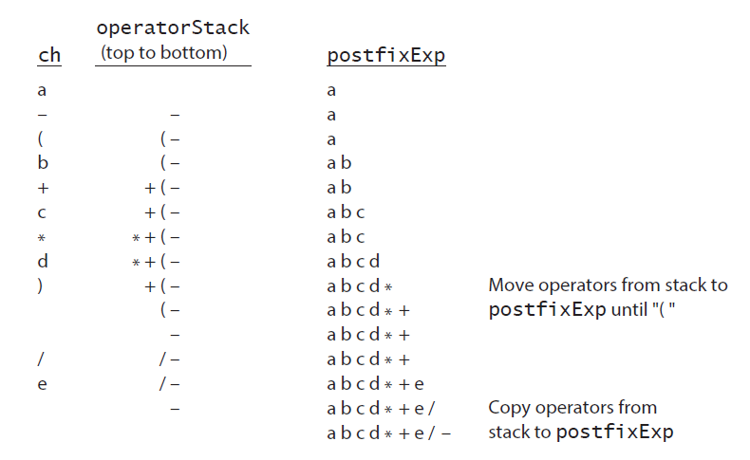
Infix to Postfix (4 of 6)
Figure 6-5 A trace of the algorithm that converts the infix
expression
to postfix form

Slide 29
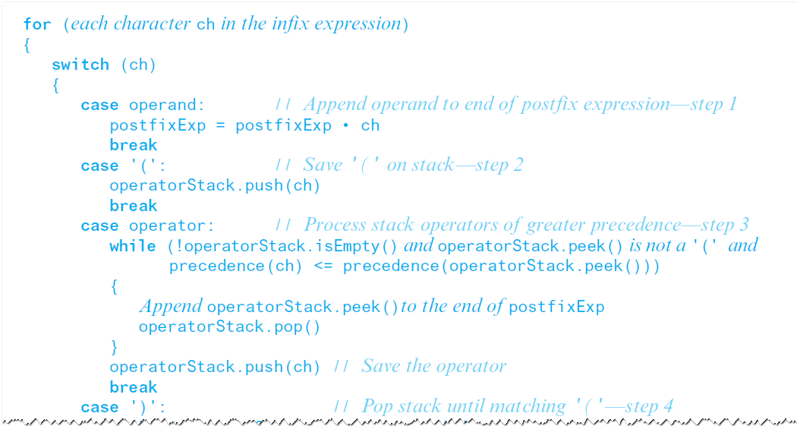
Infix to Postfix (5 of 6)
Pseudocode algorithm that converts infix to postfix

Slide 30
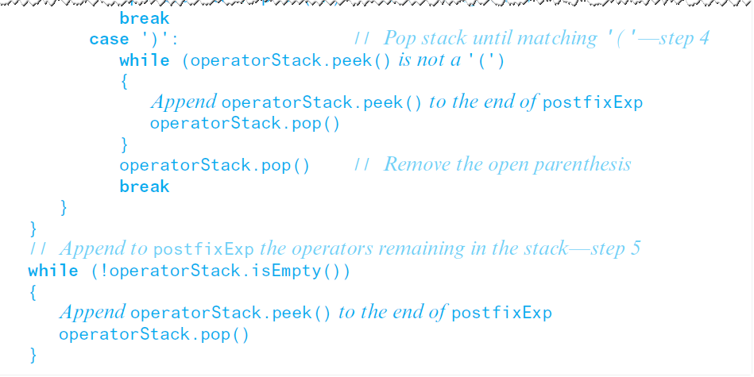
Infix to Postfix (6 of 6)
Pseudocode algorithm that converts infix to postfix

Slide 31
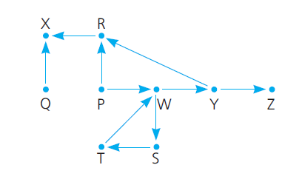
Using Stack to Search a Flight Map (1 of 12)
Figure 6-6 A flight map

Slide 32
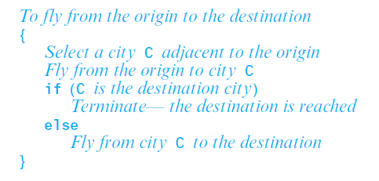
Using Stack to Search a Flight Map (2 of 12)
Recall recursive search strategy.

Slide 33
Using Stack to Search a Flight Map (3 of 12)
Possible outcomes of exhaustive search strategy
Reach destination city, decide possible to fly from origin to destination
Reach a city, C from which no departing flights
You go around in circles
Use backtracking to recover from a wrong choice (2 or 3)

Slide 34
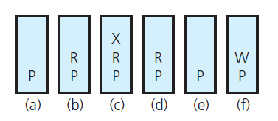
Using Stack to Search a Flight Map (4 of 12)
Strategy requires information about order in which it visits cities
Figure 6-7 The stack of cities as you travel from P to W

Slide 35
Using Stack to Search a Flight Map (5 of 12)
Stack will contain directed path from
Origin city at bottom to …
Current visited city at top
When to backtrack
No flights out of current city
Top of stack city already somewhere in the stack

Slide 36
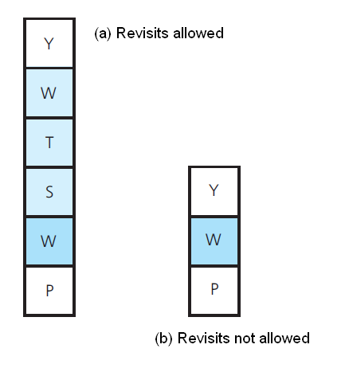
Using Stack to Search a Flight Map (6 of 12)
Figure 6-8 The effect of revisits on the stack of cities

Slide 37
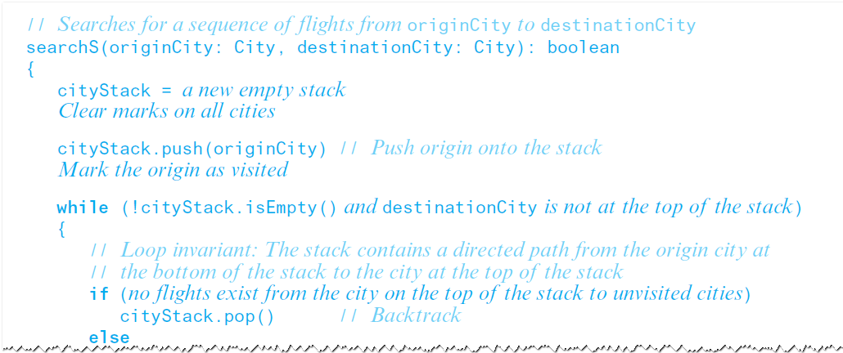
Using Stack to Search a Flight Map (7 of 12)
Final draft of algorithm.

Slide 38
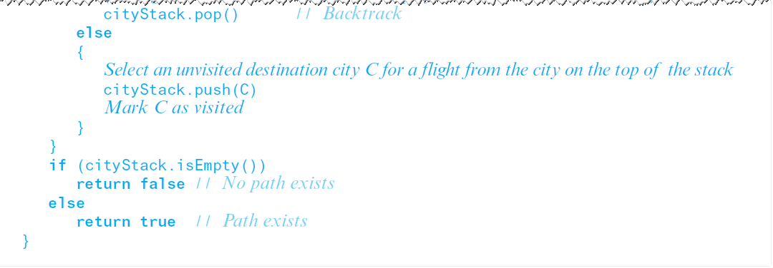
Using Stack to Search a Flight Map (8 of 12)
Final draft of algorithm.

Slide 39
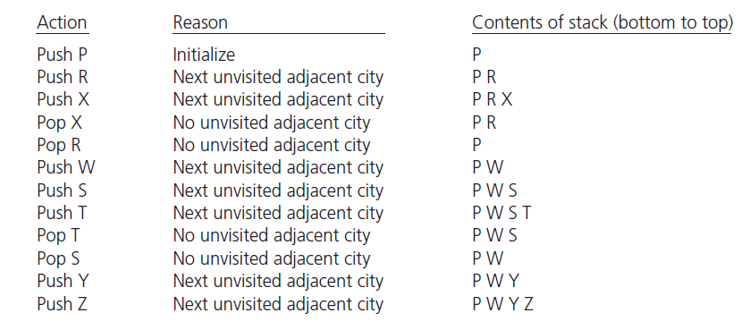
Using Stack to Search a Flight Map (9 of 12)
Figure 6-9 A trace of the search algorithm, given the flight map in Figure 6-6 (see slide 31)

Slide 40
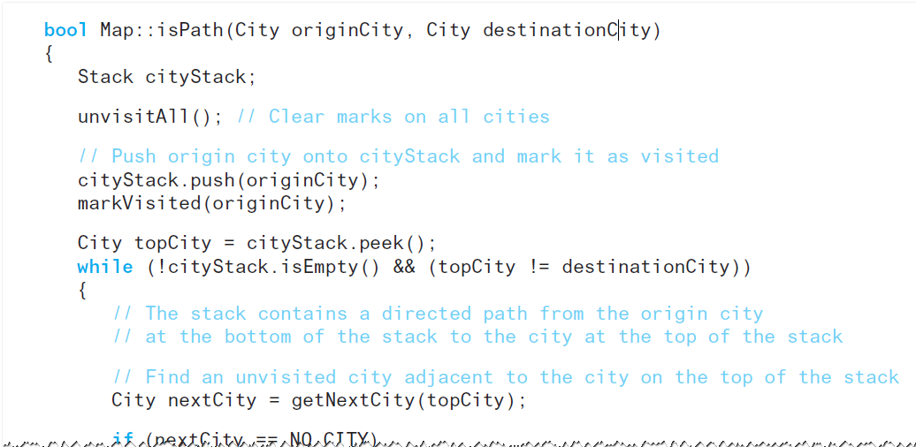
Using Stack to Search a Flight Map (10 of 12)
C++ implementation of searchS

Slide 41
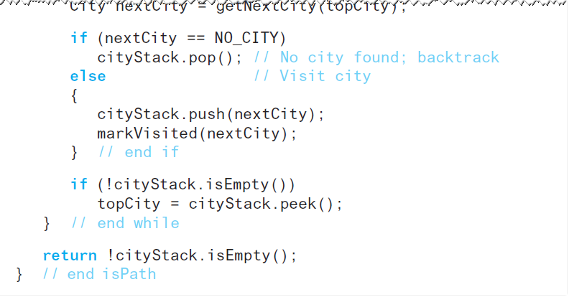
Using Stack to Search a Flight Map (11 of 12)
C++ implementation of searchS

Slide 42
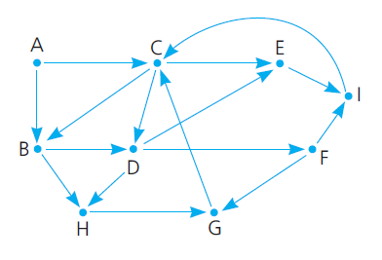
Using Stack to Search a Flight Map (12 of 12)
Figure 6-10 Flight map for Checkpoint Question 8

Slide 43
Relationship Between Stacks and Recursion (1 of 3)
Key aspects of common strategy
Visiting a new city
Backtracking
Termination

Slide 44
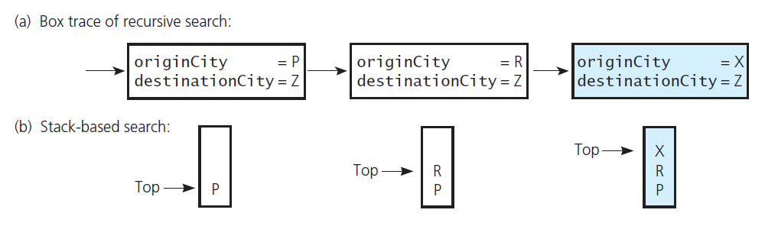
Relationship Between Stacks and Recursion (2 of 3)
Figure 6-11 Visiting city P, then R, then X: (a) box trace versus (b) stack

Slide 45
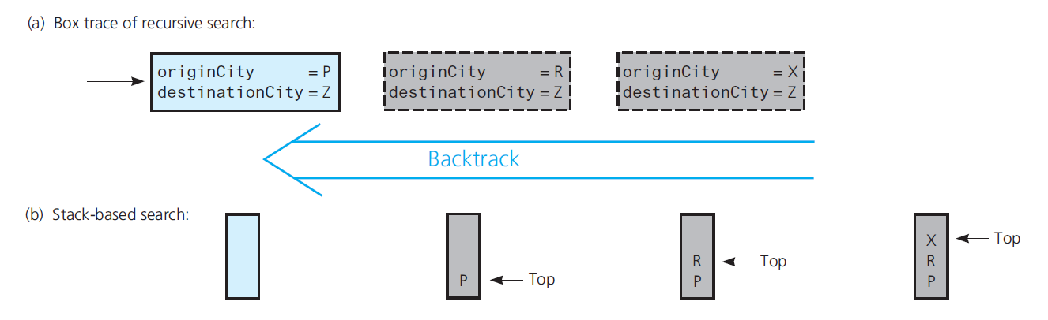
Relationship Between Stacks and Recursion (3 of 3)
Figure 6-12 Backtracking from city X to R to P: (a) box trace versus (b) stack

Slide 46

Copyright

