Slide 1
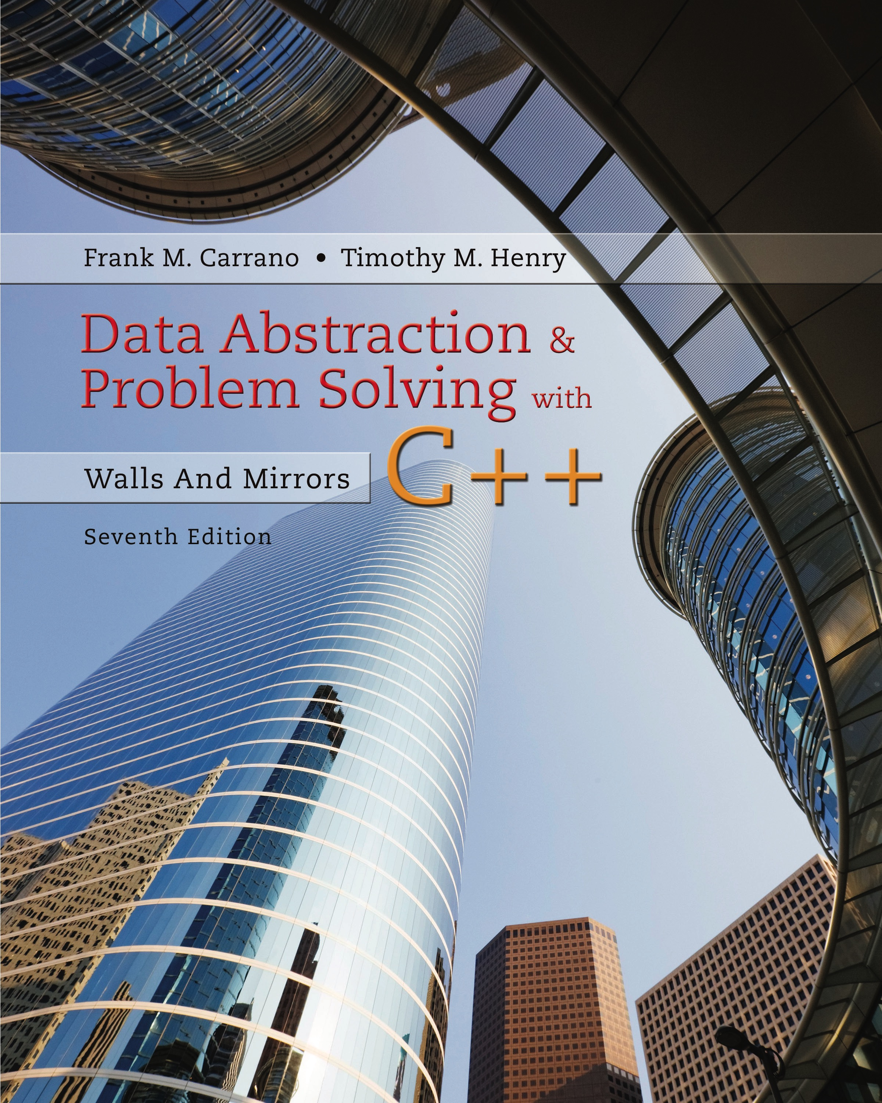
Data Abstraction & Problem Solving with C++: Walls and Mirrors
Seventh Edition
Chapter 7
Implementations of the A D T Stack
Copyright © 2017, 2013, 2007 Pearson Education, Inc. All Rights Reserved
Notes:
If this PowerPoint presentation contains mathematical equations, you may need to check that your computer has the following installed:
1) MathType Plugin
2) Math Player (free versions available)
3) NVDA Reader (free versions available)

Slide 2
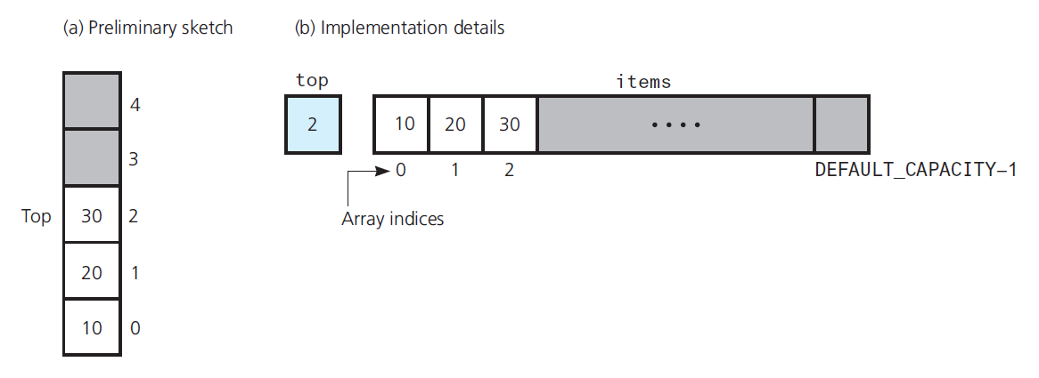
An Array-Based Implementation (1 of 7)
Figure 7-1 Using an array to store a stack’s entries

Slide 3
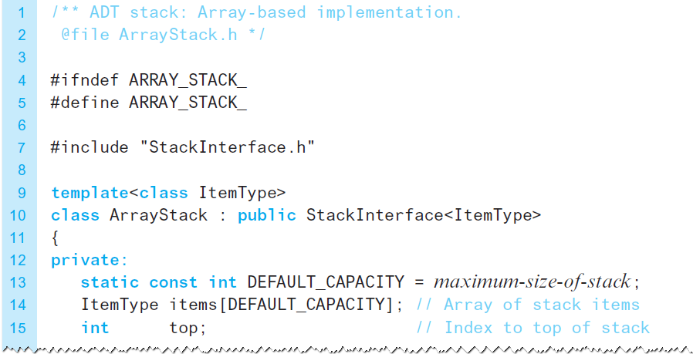
An Array-Based Implementation (2 of 7)
Listing 7-1 The header file for an array-based stack

Slide 4
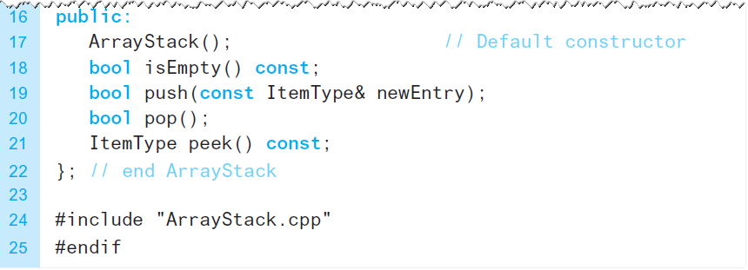
An Array-Based Implementation (3 of 7)
Listing 7-1 [Continued]

Slide 5
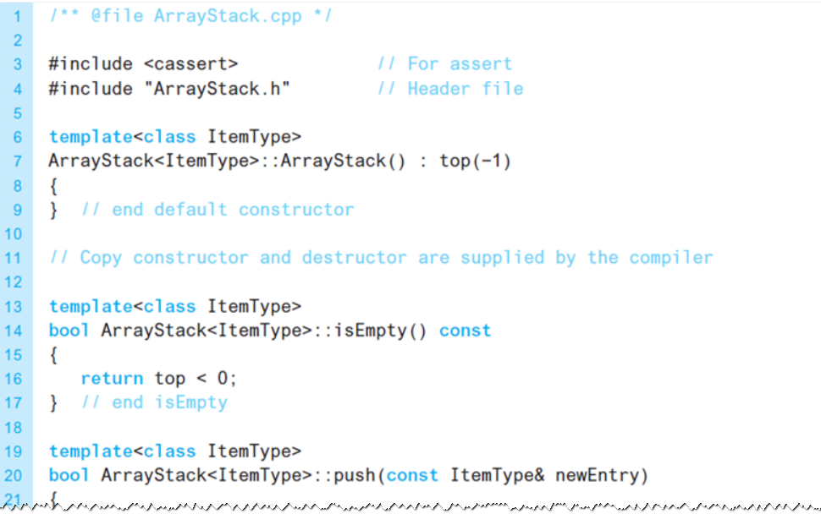
An Array-Based Implementation (4 of 7)
Listing 7-2 The implementation file for an array-based stack

Slide 6
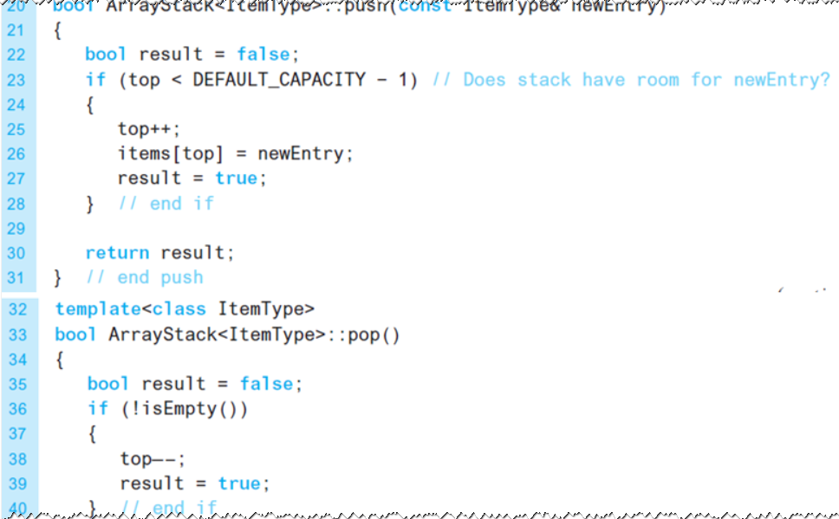
An Array-Based Implementation (5 of 7)
Listing 7-2 [Continued]

Slide 7
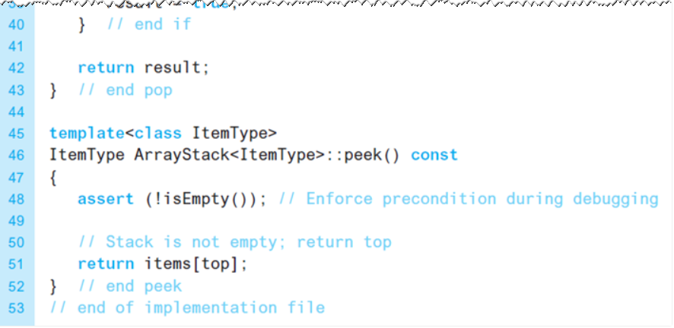
An Array-Based Implementation (6 of 7)
Listing 7-2 [Continued]

Slide 8
An Array-Based Implementation (7 of 7)
Protecting the A D T’s walls
Implement stack as a class
Declaring items and top as private
Note
push receives newEntry as constant reference argument
push uses newEntry as an alias … no copy made

Slide 9
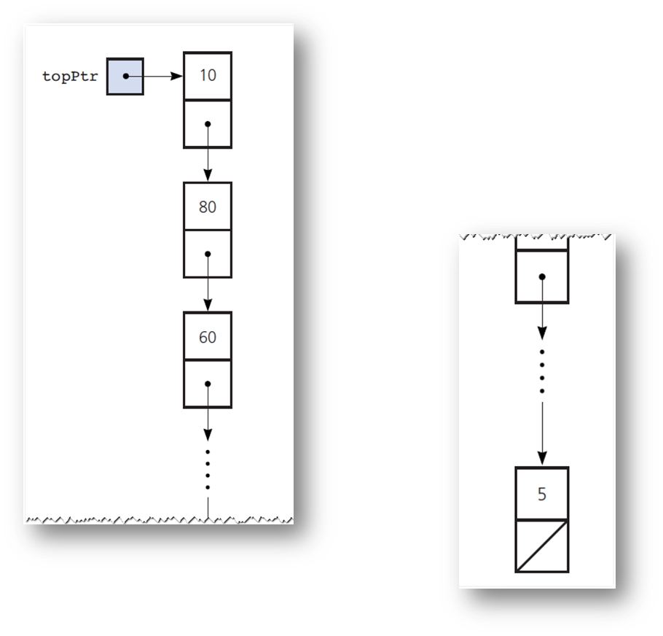
A Link-Based Implementation (1 of 9)
Figure 7-2 A link-based implementation of a stack

Slide 10
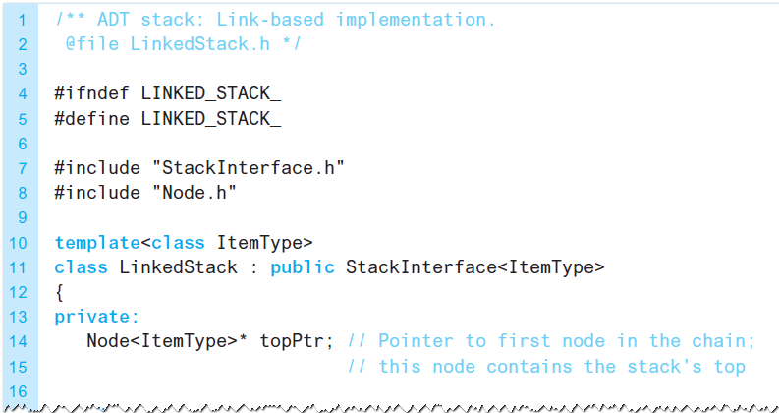
A Link-Based Implementation (2 of 9)
Listing 7-3 The header file for the class LinkedStack

Slide 11
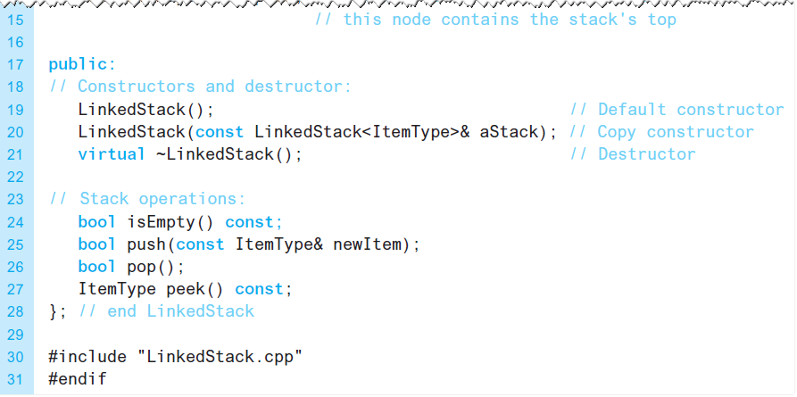
A Link-Based Implementation (3 of 9)
Listing 7-3 [Continued]

Slide 12
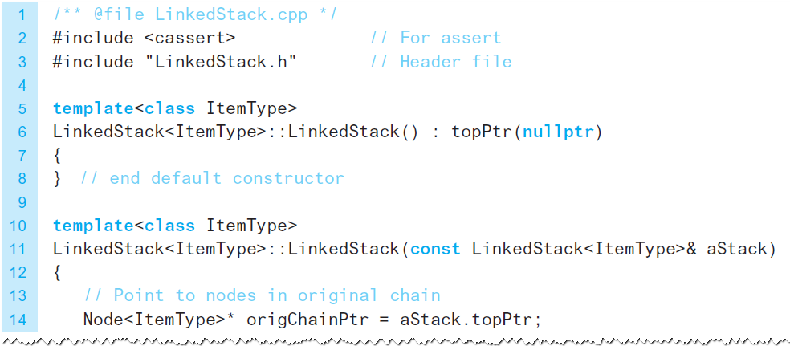
A Link-Based Implementation (4 of 9)
Listing 7-4 The implementation file for the class LinkedStack

Slide 13
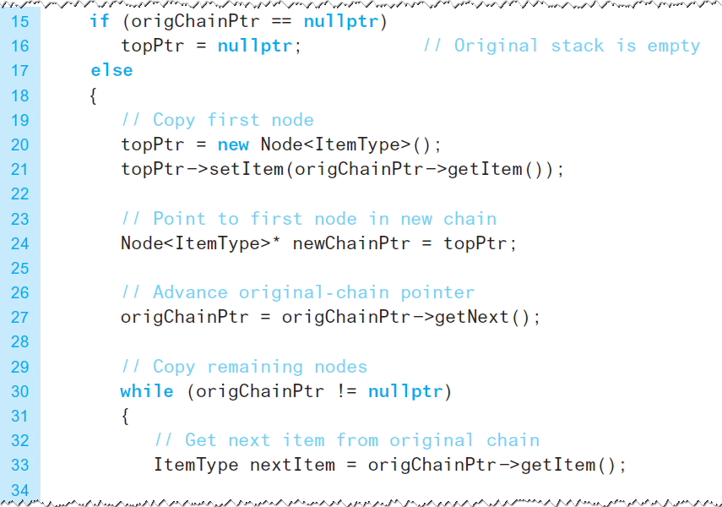
A Link-Based Implementation (5 of 9)
Listing 7-4 [Continued]

Slide 14
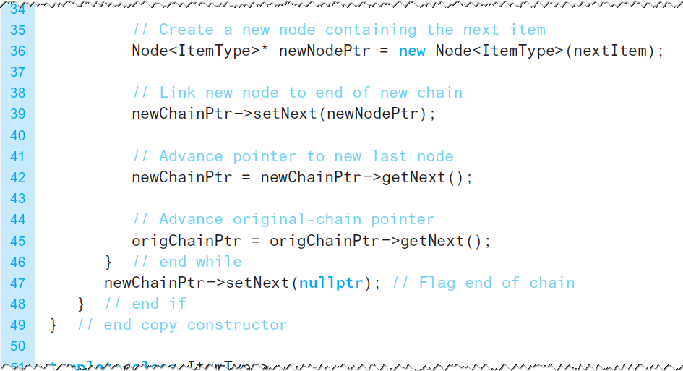
A Link-Based Implementation (6 of 9)
Listing 7-4 [Continued]

Slide 15
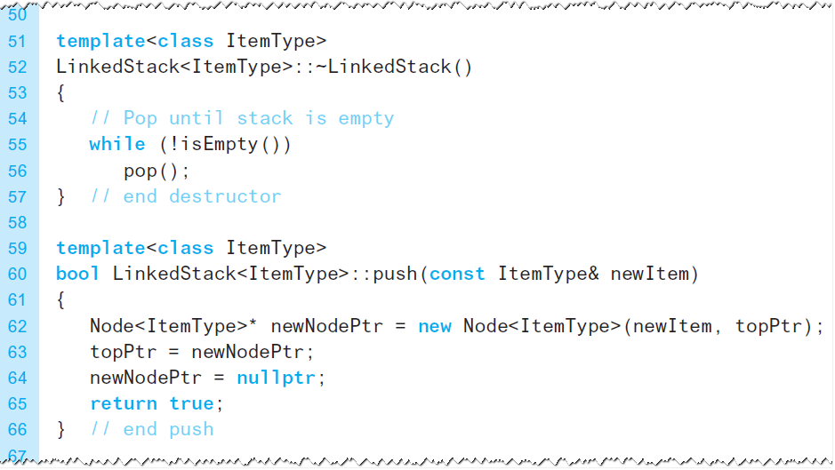
A Link-Based Implementation (7 of 9)
Listing 7-4 [Continued]

Slide 16
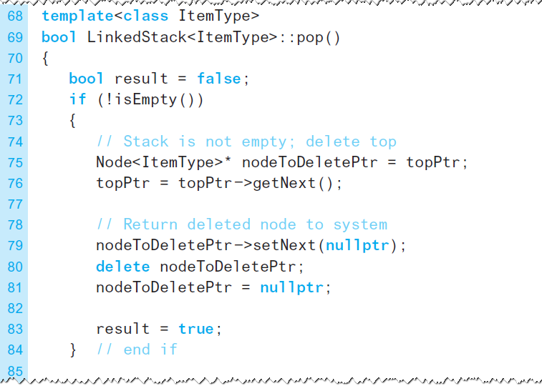
A Link-Based Implementation (8 of 9)
Listing 7-4 [Continued]

Slide 17
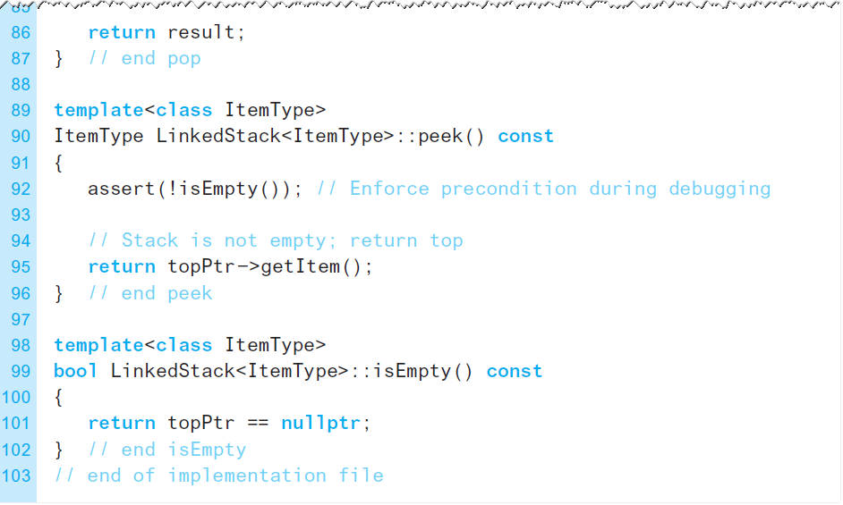
A Link-Based Implementation (9 of 9)
Listing 7-4 [Continued]

Slide 18
Implementations That Use Exceptions (1 of 3)
Method peek does not expect client to look at top of an empty stack
assert statement merely issues error message, and halts execution
Consider having peek throw an exception
Listings follow on next slides

Slide 19
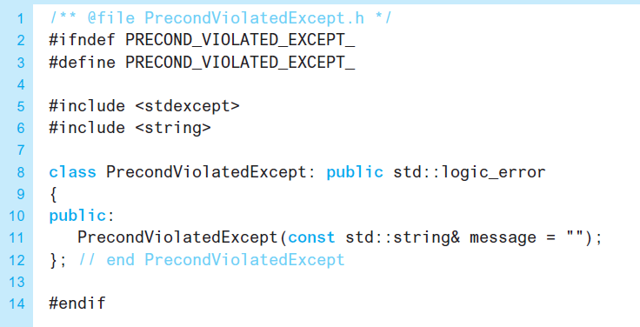
Implementations That Use Exceptions (2 of 3)
Listing 7-5 The header file for the class PrecondViolatedExcep

Slide 20
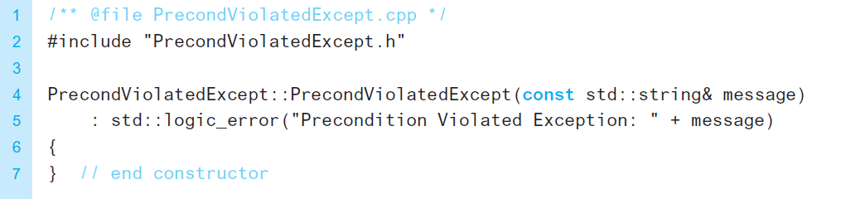
Implementations That Use Exceptions (3 of 3)
Listing 7-6 Implementation file for the class PrecondViolatedExcep

Slide 21

Copyright

