Slide 1
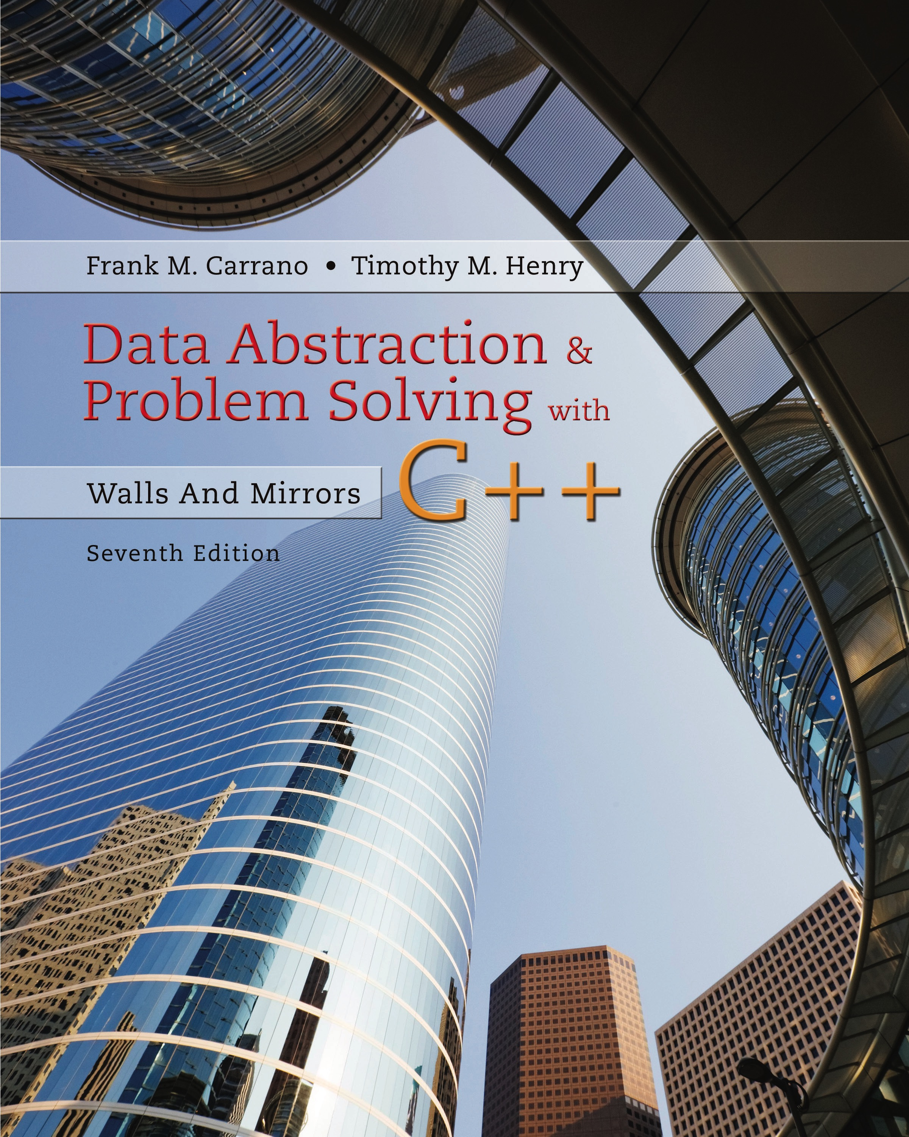
Data Abstraction & Problem Solving with C++: Walls and Mirrors
Seventh Edition
Chapter 10
Algorithm Efficiency
Copyright © 2017, 2013, 2007 Pearson Education, Inc. All Rights Reserved
Notes:
If this PowerPoint presentation contains mathematical equations, you may need to check that your computer has the following installed:
1) MathType Plugin
2) Math Player (free versions available)
3) NVDA Reader (free versions available)

Slide 2
What Is a Good Solution? (1 of 2)
A program incurs a real and tangible cost.
Computing time
Memory required
Difficulties encountered by users
Consequences of incorrect actions by program
A solution is good if …
The total cost incurs …
Over all phases of its life … is minimal

Slide 3
What Is a Good Solution? (2 of 2)
Important elements of the solution
Good structure
Good documentation
Efficiency
Be concerned with efficiency when
Developing underlying algorithm
Choice of objects and design of interaction between those objects

Slide 4
Measuring Efficiency of Algorithms (1 of 3)
Important because
Choice of algorithm has significant impact
Examples
Responsive word processors
Grocery checkout systems
Automatic teller machines
Video machines
Life support systems

Slide 5
Measuring Efficiency of Algorithms (2 of 3)
Analysis of algorithms
The area of computer science that provides tools for contrasting efficiency of different algorithms
Comparison of algorithms should focus on significant differences in efficiency
We consider comparisons of algorithms, not programs

Slide 6
Measuring Efficiency of Algorithms (3 of 3)
Difficulties with comparing programs (instead of algorithms)
How are the algorithms coded
What computer will be used
What data should the program use
Algorithm analysis should be independent of
Specific implementations, computers, and data

Slide 7
The Execution Time of Algorithms
An algorithm’s execution time is related to number of operations it requires.
Algorithm’s execution time is related to number of operations it requires.
Example: Towers of Hanoi
Solution for n disks required
moves
If each move requires time m
Solution requires
time units

Slide 8
Algorithm Growth Rates (1 of 2)
Measure an algorithm’s time requirement as function of problem size
Most important thing to learn
How quickly algorithm’s time requirement grows as a function of problem size
Algorithm A requires time proportional to
Algorithm B requires time proportional to n
Demonstrates contrast in growth rates

Slide 9
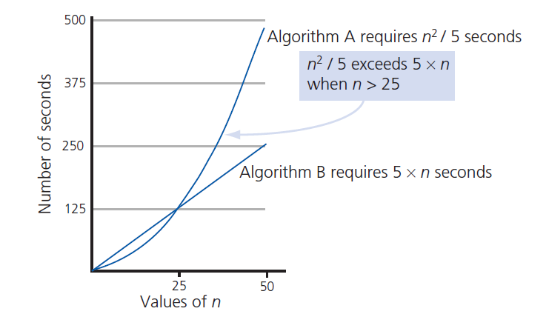
Algorithm Growth Rates (2 of 2)
Figure 10-1 Time requirements as a function of problem size n

Slide 10
Analysis and Big O Notation (1 of 6)
Algorithm A is said to be order
Denoted as
Function
called algorithm’s growth rate function
Notation with capital O denotes order
Algorithm A of order denoted
Constants k and n₀ exist such that
A requires no more than
time units
For problem of size

Slide 11
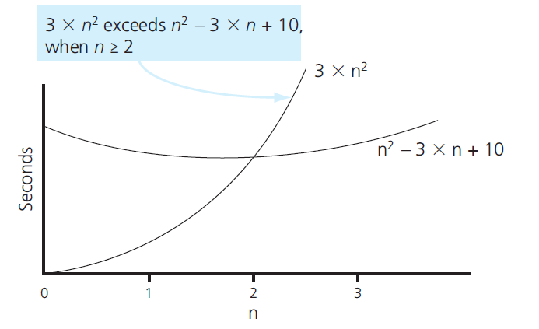
Analysis and Big O Notation (2 of 6)
Figure 10-2 The graphs of

Slide 12

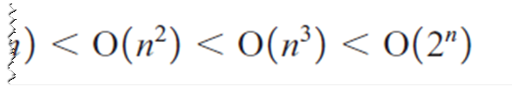
Analysis and Big O Notation (3 of 6)
Order of growth of some common functions

Slide 13
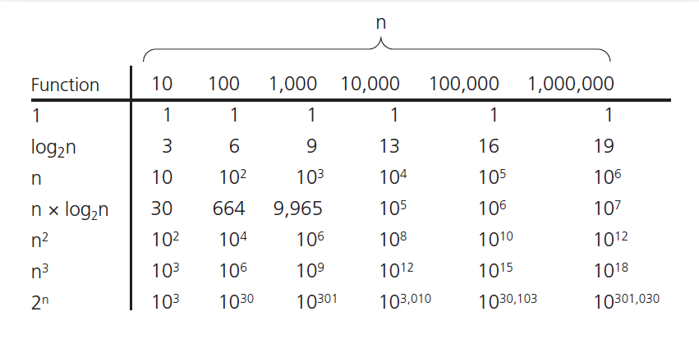
Analysis and Big O Notation (4 of 6)
Figure 10-3 A comparison of growth-rate functions

Slide 14
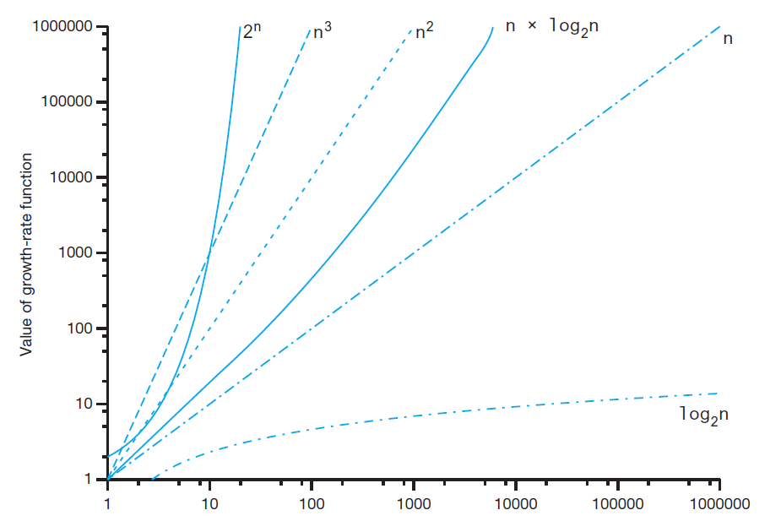
Analysis and Big O Notation (5 of 6)
Figure 10-3 A comparison of growth-rate functions

Slide 15
Analysis and Big O Notation (6 of 6)
Worst-case analysis
Worst case analysis usually considered
Easier to calculate, thus more common
Average-case analysis
More difficult to perform
Must determine relative probabilities of encountering problems of given size

Slide 16
Keeping Your Perspective (1 of 2)
A D T used makes a difference
Array-based getEntry is
Link-based getEntry is
Choosing implementation of A D T
Consider how frequently certain operations will occur
Seldom used but critical operations must also be efficient

Slide 17
Keeping Your Perspective (2 of 2)
If problem size is always small
Possible to ignore algorithm’s efficiency
Weigh trade-offs between
Algorithm’s time and memory requirements
Compare algorithms for style and efficiency

Slide 18
Efficiency of Searching Algorithms
Sequential search
Worst case:
Average case:
Best case:
Binary search
,
in worst case
At same time, maintaining array in sorted order requires overhead cost … can be substantial

Slide 19

Copyright

