Slide 1
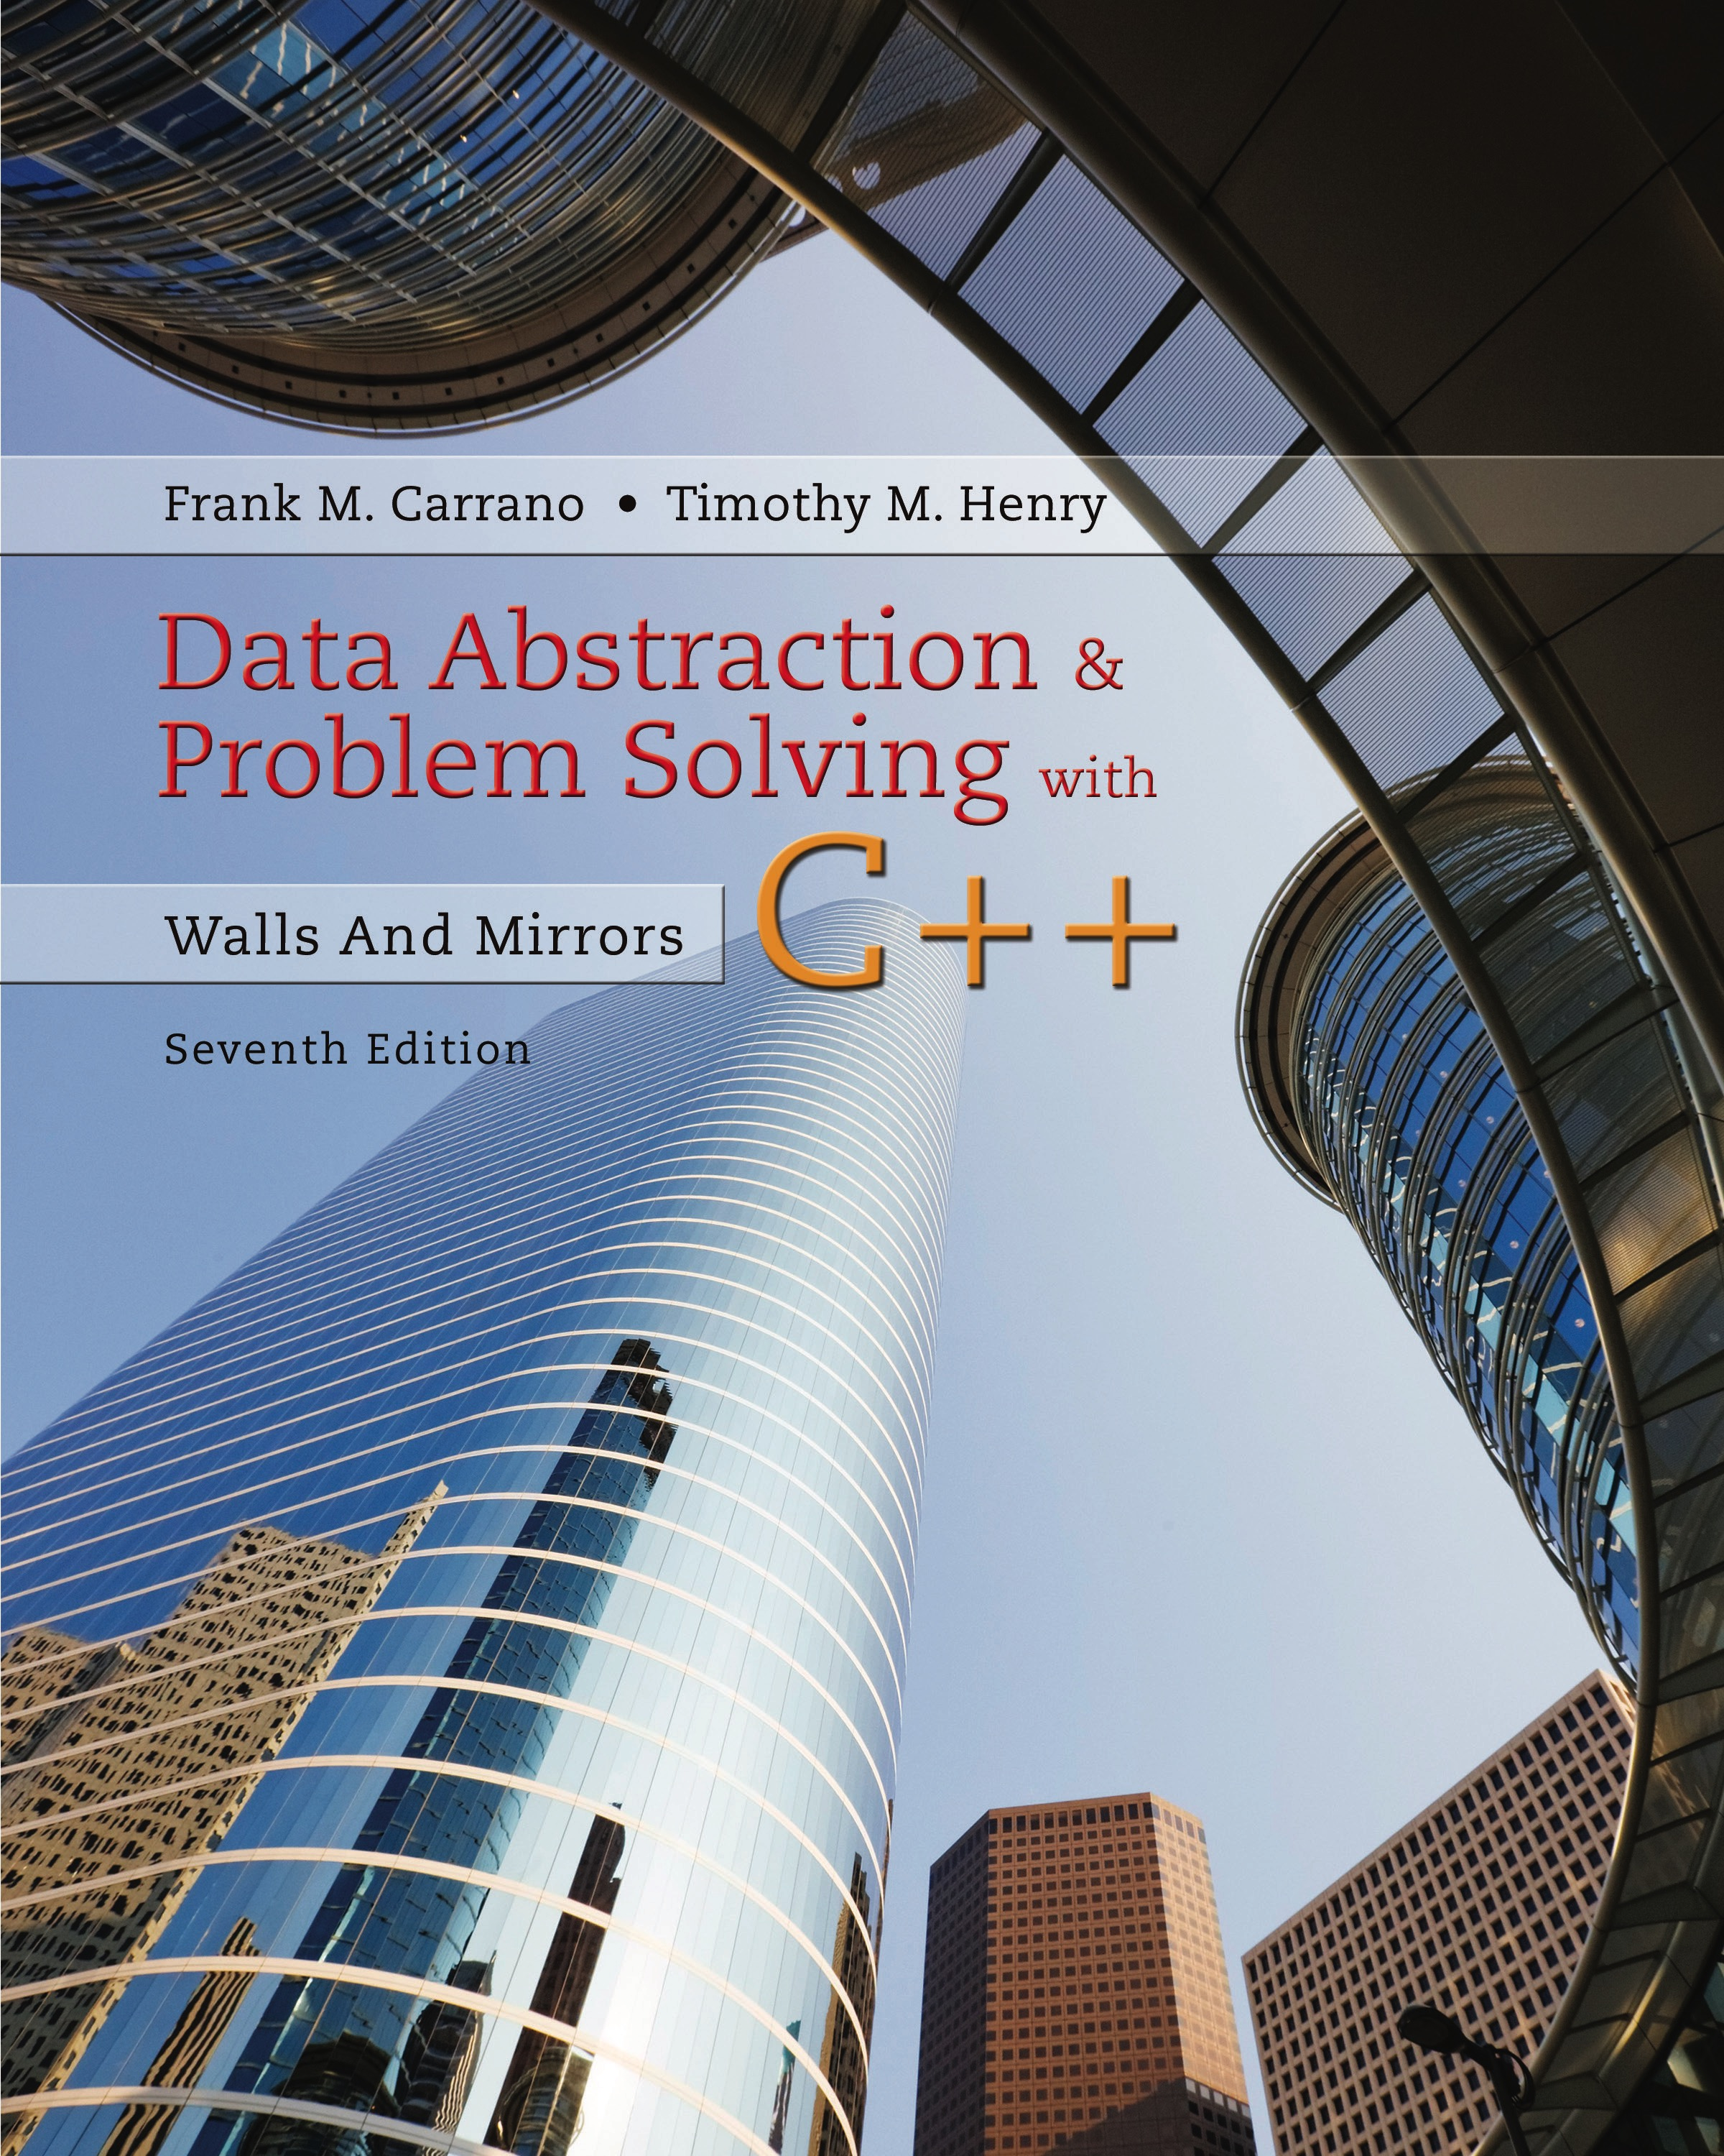
Data Abstraction & Problem Solving with C++: Walls and Mirrors
Seventh Edition
Chapter 18
Dictionaries and Their Implementations
Copyright © 2017, 2013, 2007 Pearson Education, Inc. All Rights Reserved
Notes:
If this PowerPoint presentation contains mathematical equations, you may need to check that your computer has the following installed:
1) MathType Plugin
2) Math Player (free versions available)
3) NVDA Reader (free versions available)

Slide 2
The A D T Dictionary (1 of 3)
Figure 18-1 A collection of data about certain cities
City | Country | Population
Buenos Aires | Argentina | 13,639,000
Cairo | Egypt | 17,816,000
Johannesburg | South Africa | 7,618,000
London | England | 8,586,000
Madrid | Spain | 5,427,000
Mexico City | Mexico | 19,463,000
Mumbai | India | 16,910,000
New York City | U.S.A. | 20,464,000
Paris | France | 10,755,000
Sydney | Australia | 3,785,000
Tokyo | Japan | 37,126,000
Toronto | Canada | 6,139,000

Slide 3
The A D T Dictionary (2 of 3)
Consider need to search such a collection for
Name
Address
Criterion chosen for search is search key
The A D T dictionary uses a search key to identify its entries

Slide 4
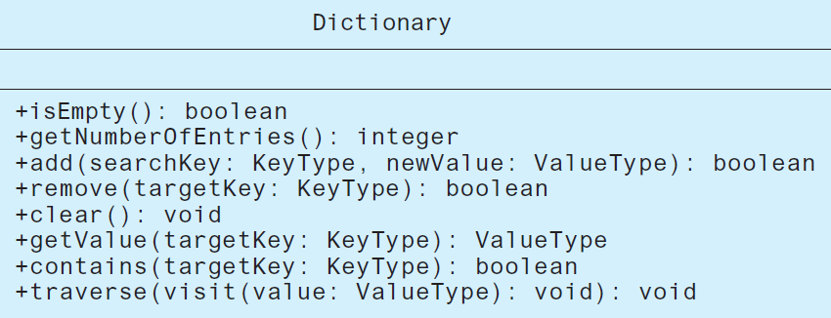
The A D T Dictionary (3 of 3)
Figure 18-2 U M L diagram for a class of dictionaries

Slide 5

Possible Implementations (1 of 9)
Categories of linear implementations
Sorted by search key array-based
Sorted by search key link-based
Unsorted array-based
Unsorted link-based
Figure 18-3 A dictionary entry

Slide 6
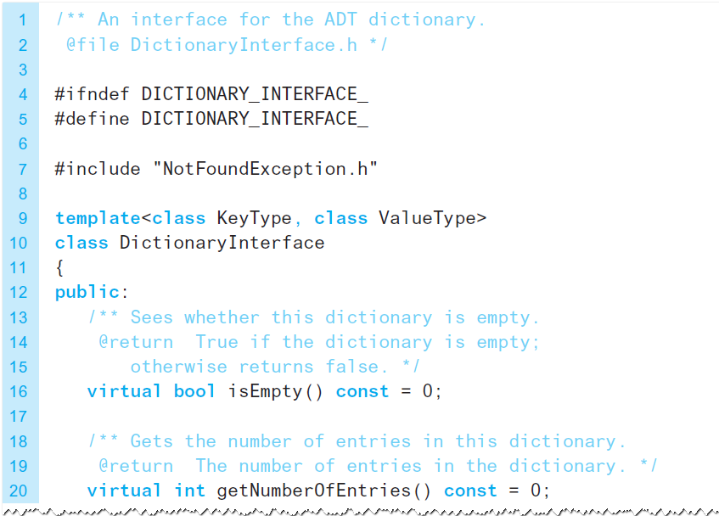
Possible Implementations (2 of 9)
Listing 18-2 A header file for a class of dictionary entries

Slide 7
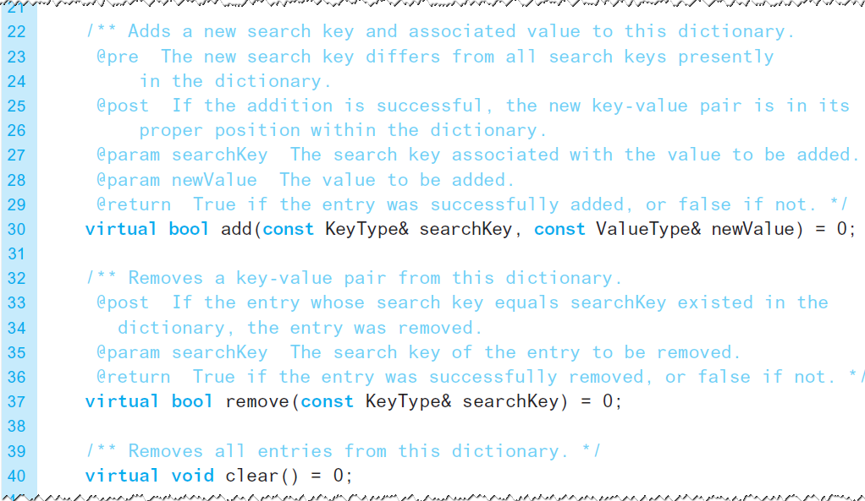
Possible Implementations (3 of 9)
Listing 18-2 [Continued]

Slide 8
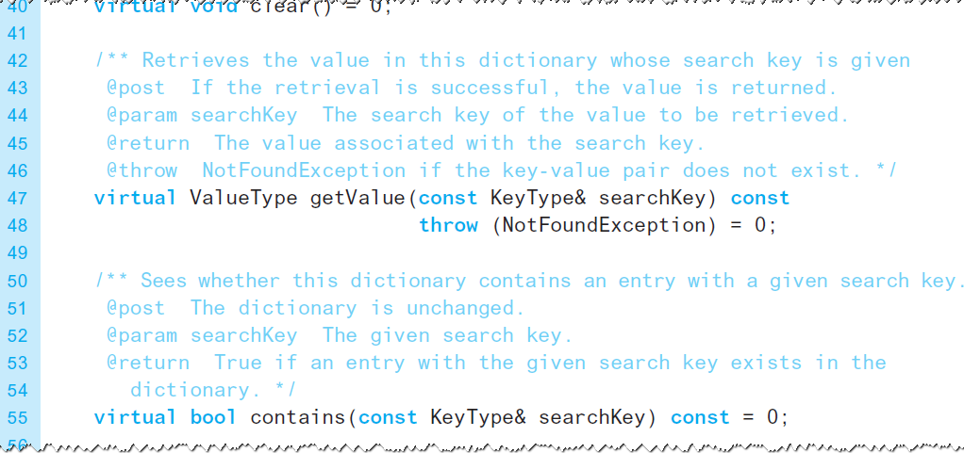
Possible Implementations (4 of 9)
Listing 18-2 [Continued]

Slide 9
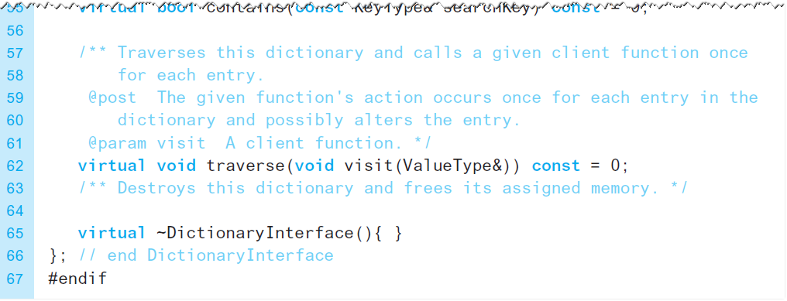
Possible Implementations (5 of 9)
Listing 18-2 [Continued]

Slide 10
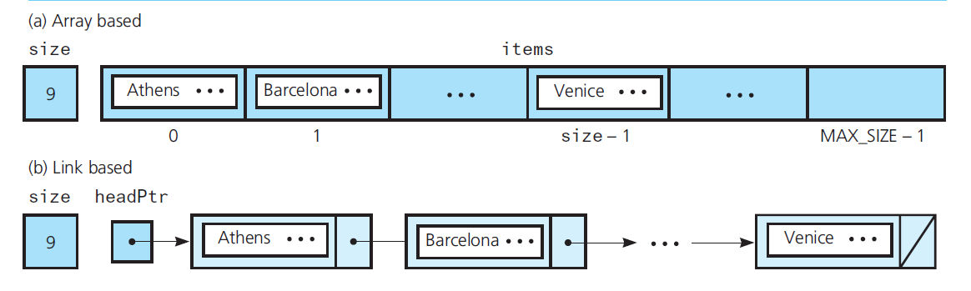
Possible Implementations (6 of 9)
Figure 18-4 Data members for two sorted linear implementations of the A D T dictionary for the data in Figure 18-1 (see slide 2)

Slide 11
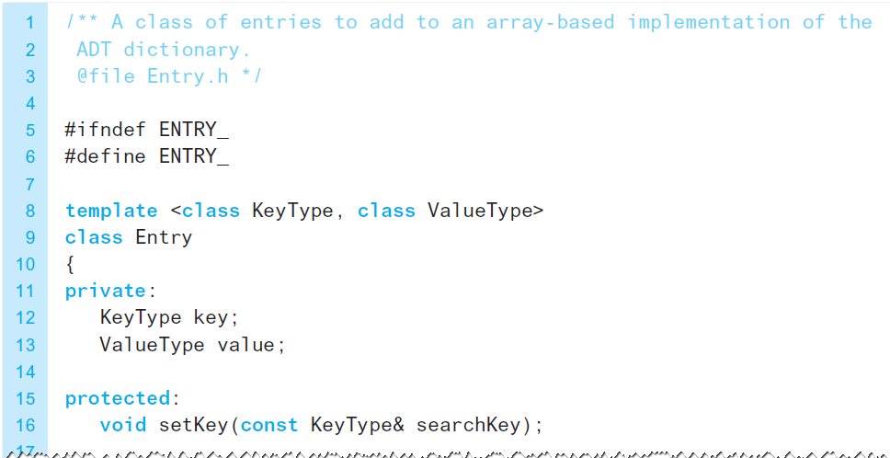
Possible Implementations (7 of 9)
Listing 18-2 [Continued]

Slide 12
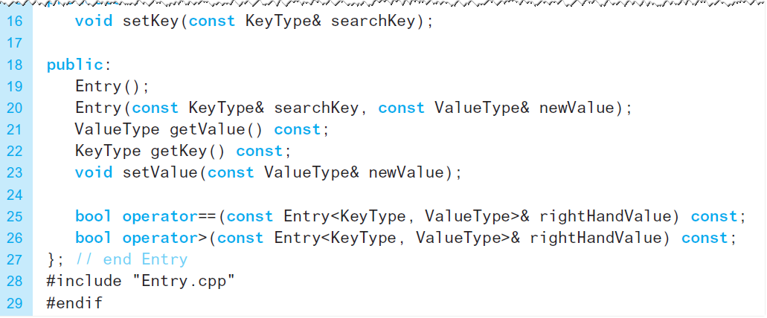
Possible Implementations (8 of 9)
Listing 18-2 [Continued]

Slide 13
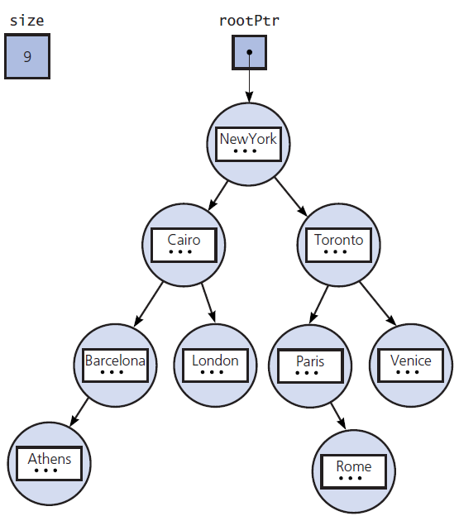
Possible Implementations (9 of 9)
Figure 18-5 The data members for a binary search tree implementation of the A D T dictionary for the data in Figure 18-1 (see slide 2)

Slide 14
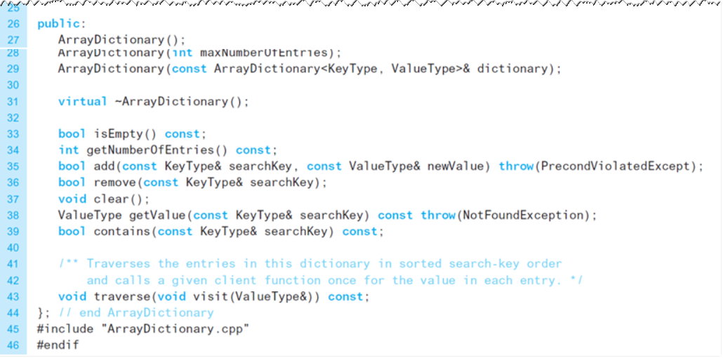
Sorted Array-Based Implementation of A D T Dictionary
Listing 18-3 A header file for the class ArrayDictionary

Slide 15
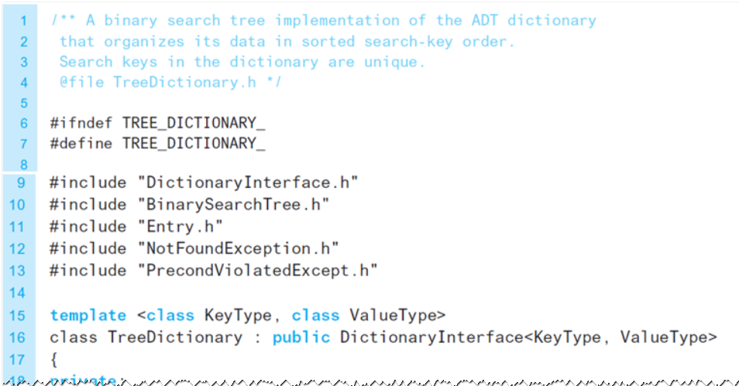
Binary Search Tree Implementation of the A D T Dictionary (1 of 3)
Listing 18-4 A header file for the class TreeDictionary

Slide 16
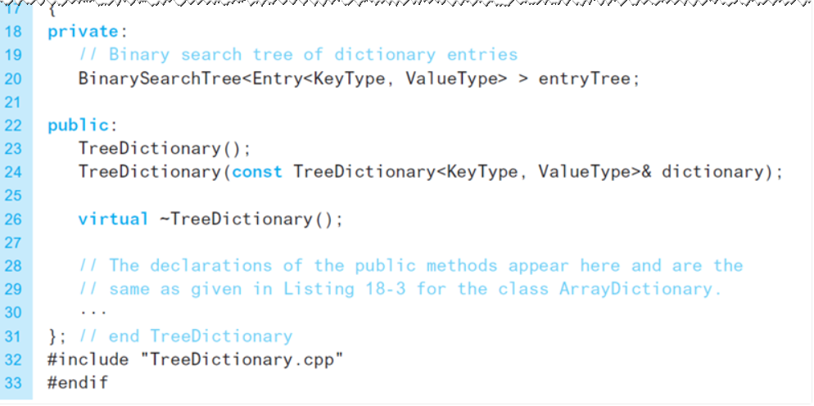
Binary Search Tree Implementation of the A D T Dictionary (2 of 3)
Listing 18-4 [Continued]

Slide 17
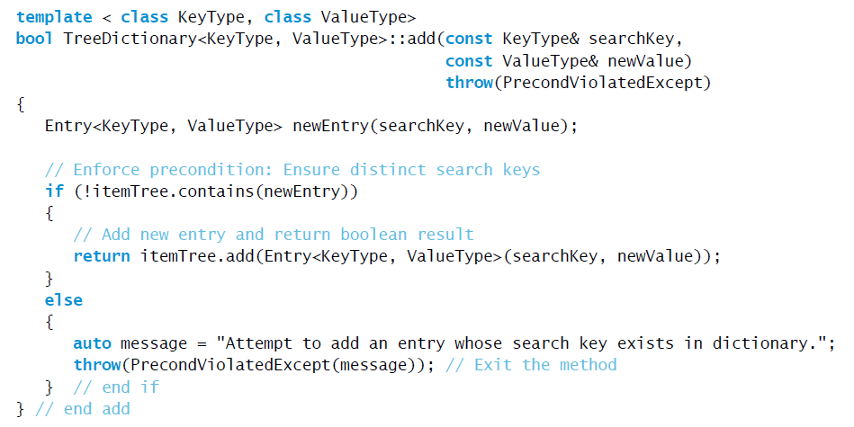
Binary Search Tree Implementation of the A D T Dictionary (3 of 3)
Method add which prevents duplicate keys.

Slide 18
Selecting an Implementation
Linear implementations
Perspective
Efficiency
Motivation
Consider
What operations are needed
How often each operation is required

Slide 19
Three Scenarios (1 of 5)
A. Addition and traversal in no particular order
Unsorted order is efficient
Array-based versus pointer-based
B. Retrieval
Sorted array-based can use binary search
Binary search impractical for link-based
Max size of dictionary affects choice

Slide 20
Three Scenarios (2 of 5)
C. Addition, removal, retrieval, traversal in sorted order
Add and remove need to find position, then add or remove from that position
Array-based best for find, link-based best for addition/removal

Slide 21
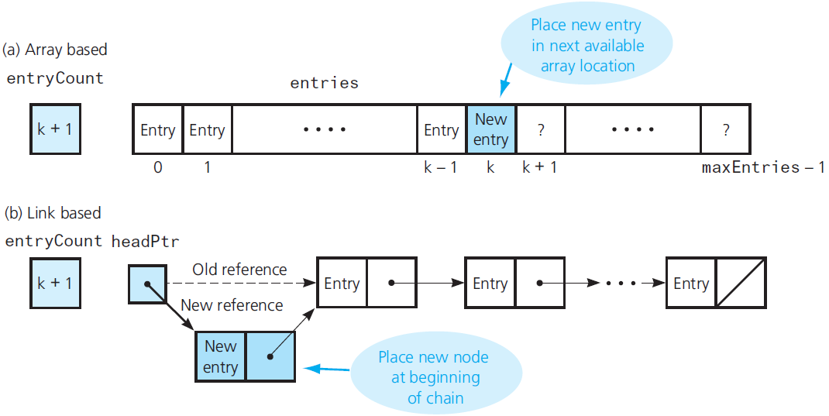
Three Scenarios (3 of 5)
Figure 18-6 Addition for unsorted linear implementations

Slide 22
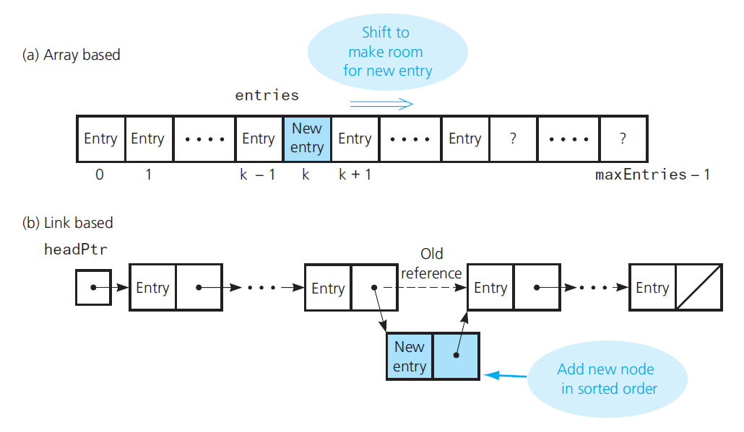
Three Scenarios (4 of 5)
Figure 18-7 Addition for sorted linear implementations

Slide 23
Three Scenarios (5 of 5)
Figure 18-8 The average-case order of the A D T dictionary operations for various implementations
Blank | Addition | Removal | Retrieval | Traversal
Unsorted array-based | O(1) | O(n) | O(n) | O(n)
Unsorted link-based | O(1) | O(n) | O(n) | O(n)
Sorted array-based | O(n) | O(n) | O(log n) | O(n)
Sorted link-based | O(n) | O(n) | O(n) | O(n)
Binary search tree | O(log n) | O(log n) | O(log n) | O(n)

Slide 24
Hashing as a Dictionary Implementation (1 of 3)
Situations occur for which search-tree implementations are not adequate.
Consider a method which acts as an “address calculator” which determines an array index
Used for add, getValue, remove operations
Called a hash function
Tells where to place item in a hash table

Slide 25
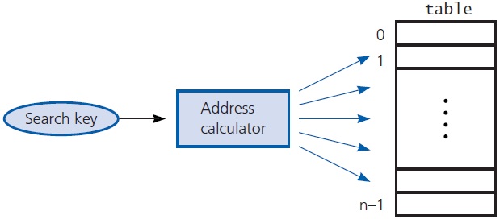
Hashing as a Dictionary Implementation (2 of 3)
Figure 18-9 Address calculator

Slide 26
Hashing as a Dictionary Implementation (3 of 3)
Perfect hash function
Maps each search key into a unique location of the hash table
Possible if you know all the search keys
Collision occurs when hash function maps more than one entry into same array location
Hash function should
Be easy, fast to compute
Place entries evenly throughout hash table

Slide 27
Hash Functions
Sufficient for hash functions to operate on integers – examples:
Select digits from an I D number
Folding – add digits, sum is the table location
Modulo arithmetic
Convert character string to an integer – use A S C I I values

Slide 28
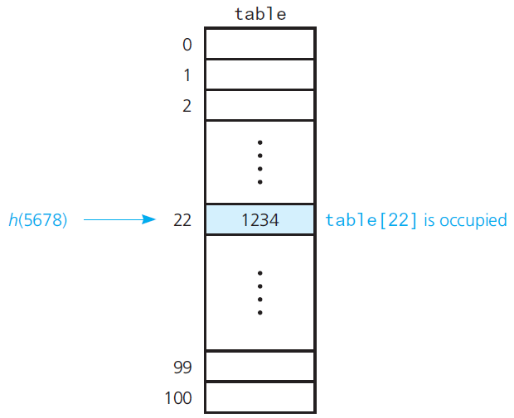
Resolving Collisions with Open Addressing (1 of 7)
Figure 18-10 A collision

Slide 29
Resolving Collisions with Open Addressing (2 of 7)
Approach 1: Open addressing
Linear probing
Quadratic probing
Double hashing
Increase size of hash table

Slide 30
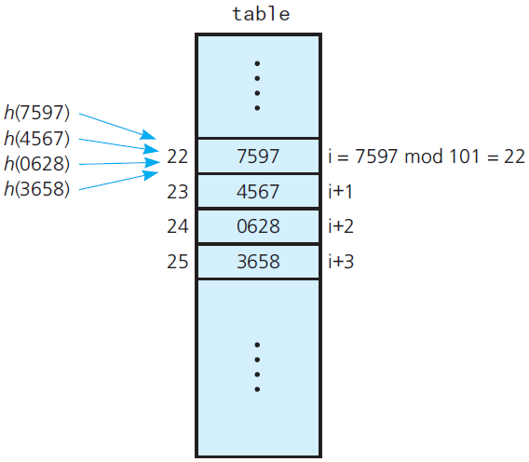
Resolving Collisions with Open Addressing (3 of 7)
Figure 18-11 Linear probing with

Slide 31
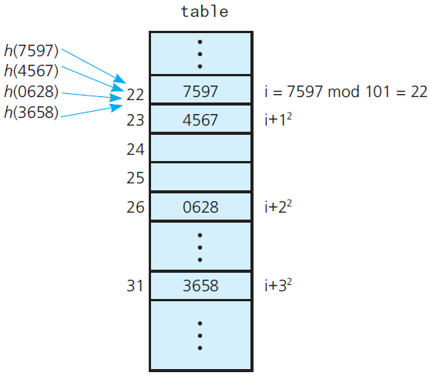
Resolving Collisions with Open Addressing (4 of 7)
Figure 18-12 Quadratic probing with

Slide 32
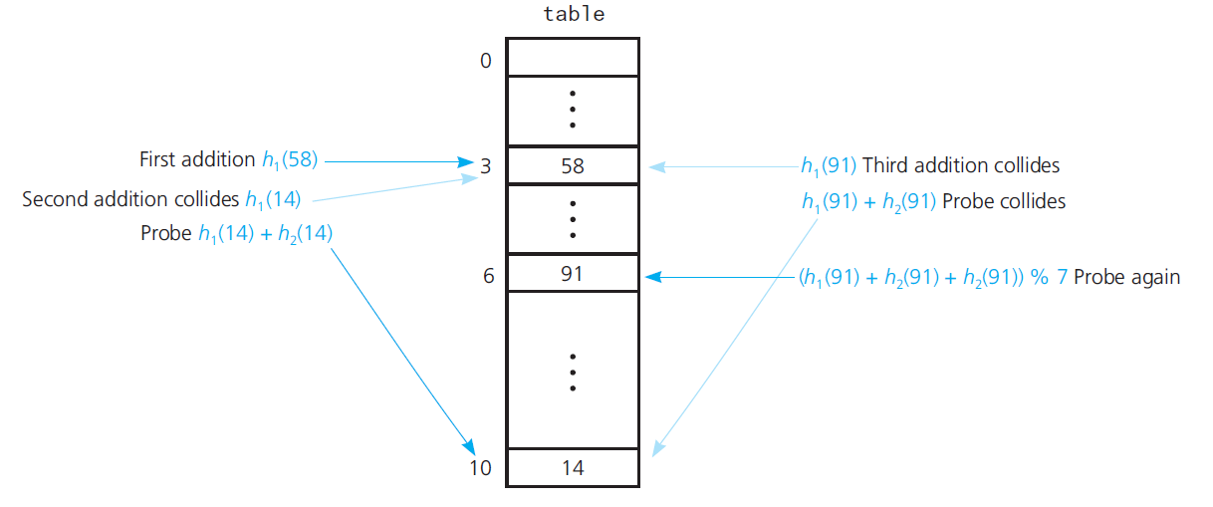
Resolving Collisions with Open Addressing (5 of 7)
Figure 18-13 Double hashing during the addition of 58, 14, and 91

Slide 33
Resolving Collisions with Open Addressing (6 of 7)
Approach 2: Resolving collisions by restructuring the hash table
Buckets
Separate chaining

Slide 34
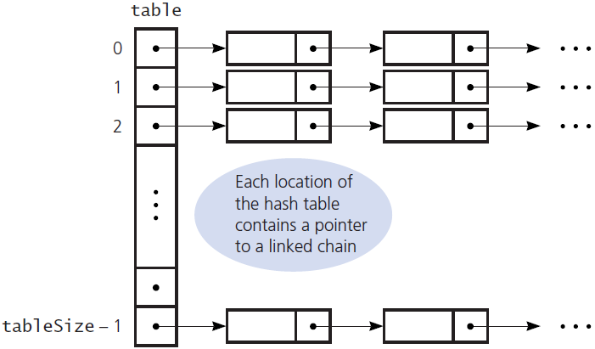
Resolving Collisions with Open Addressing (7 of 7)
Figure 18-14 Separate chaining

Slide 35
The Efficiency of Hashing (1 of 6)
Load factor measures how full a hash table is
Unsuccessful searches
Generally require more time than successful
Do not let the hash table get too ful

Slide 36
The Efficiency of Hashing (2 of 6)
Linear probing – average number of comparisons

Slide 37
The Efficiency of Hashing (3 of 6)
Quadratic probing and double hashing – average number of comparisons

Slide 38
The Efficiency of Hashing (4 of 6)
Efficiency of the retrieval and removal operations under the separate-chaining approach

Slide 39
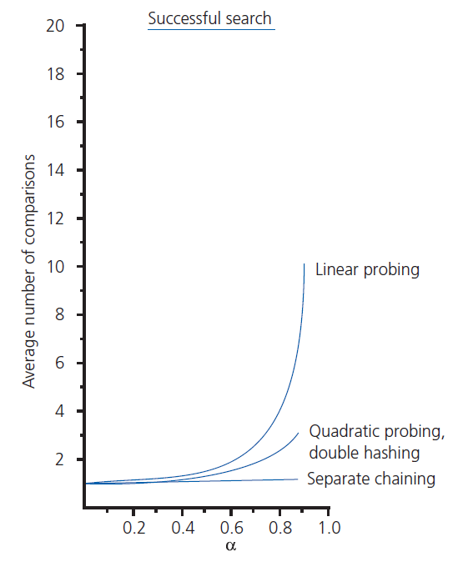
The Efficiency of Hashing (5 of 6)
Figure 18-15 The relative efficiency of four collision-resolution methods

Slide 40
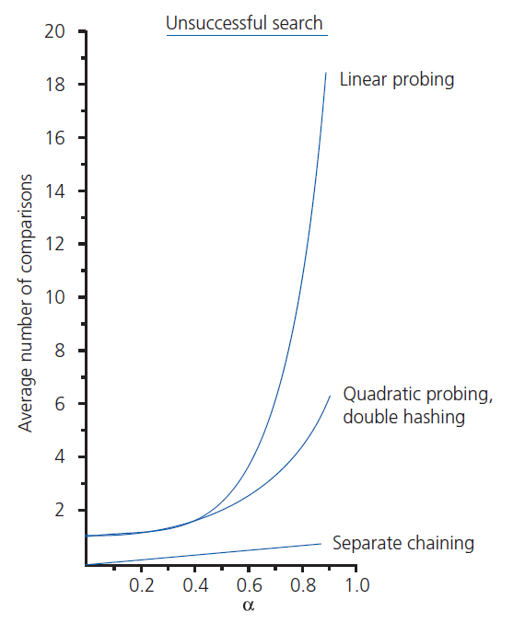
The Efficiency of Hashing (6 of 6)
Figure 18-15 [Continued]

Slide 41
What Constitutes a Good Hash Function?
Is hash function easy and fast to compute?
Does hash function scatter data evenly throughout hash table?
How well does hash function scatter random data?
How well does hash function scatter non-random data?

Slide 42
Dictionary Traversal: An Inefficient Operation Under Hashing
Entries hashed into table[i] and table[i+1] have no ordering relationship
Hashing does not support well traversing a dictionary in sorted order
Generally better to use a search tree
In external storage possible to see
Hashing implementation of getValue
And search-tree for ordered operations simultaneously

Slide 43

Using Hashing, Separate Chaining to Implement A D T Dictionary (1 of 3)
Figure 18-16 A dictionary entry when separate chaining is used

Slide 44
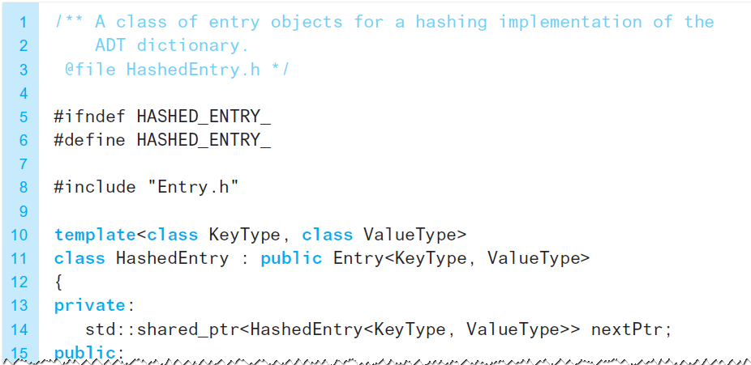
Using Hashing, Separate Chaining to Implement A D T Dictionary (2 of 3)
Listing 18-5 The class HashedEntry

Slide 45
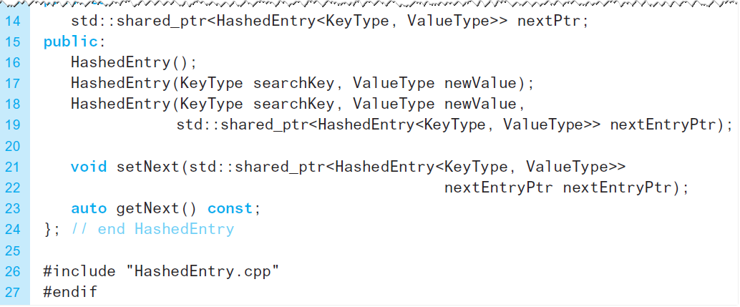
Using Hashing, Separate Chaining to Implement A D T Dictionary (3 of 3)
Listing 18-5 [Continued]

Slide 46

Copyright

