Slide 1

Data Abstraction & Problem Solving with C + +: Walls and Mirrors
Seventh Edition
Chapter 21
Processing Data in External Storage
Copyright © 2017, 2013, 2007 Pearson Education, Inc. All Rights Reserved
Notes:
If this PowerPoint presentation contains mathematical equations, you may need to check that your computer has the following installed:
1) MathType Plugin
2) Math Player (free versions available)
3) NVDA Reader (free versions available)

Slide 2
Look at External Storage (1 of 4)
External storage
Used when program reads/writes data to/from a C++ file
Generally there is more external storage than internal memory
Direct access files essential for external data collections

Slide 3
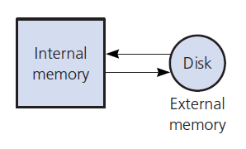
Look at External Storage (2 of 4)
Figure 21-1 Internal and external memory

Slide 4
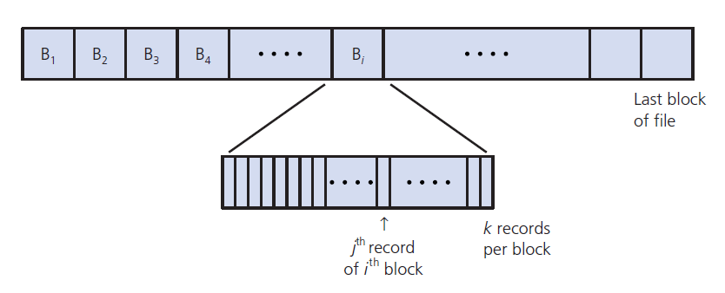
Look at External Storage (3 of 4)
Figure 21-2 A file partitioned into blocks of records

Slide 5
Look at External Storage (4 of 4)
Direct access I/O
Involves blocks instead of records
Buffer stores data (blocks) temporarily
Record updated within block (in buffer)
Work to minimize block I/O
Takes more time for disk access

Slide 6
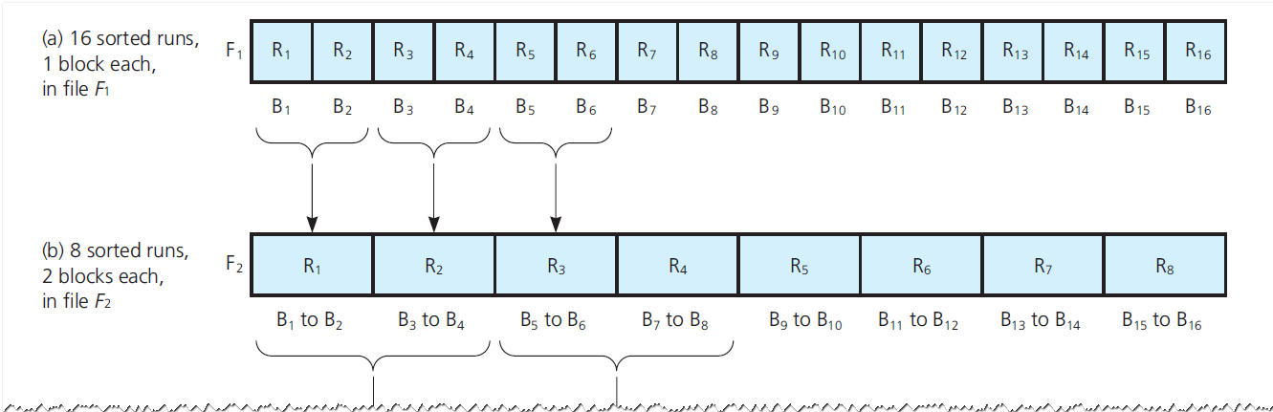
Working with External Data (1 of 4)
Figure 21-3 Sorting a block of an external file F by merging the results of internal sorts and using two external work files F₁ and F₂

Slide 7
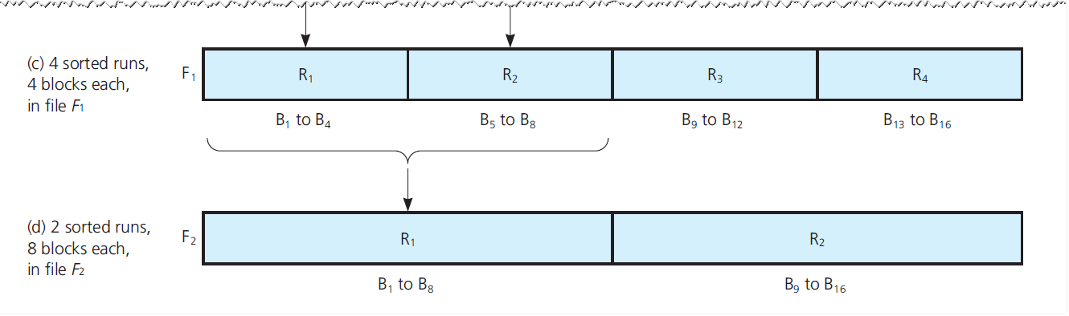
Working with External Data (2 of 4)
Figure 21-3 [Continued]

Slide 8
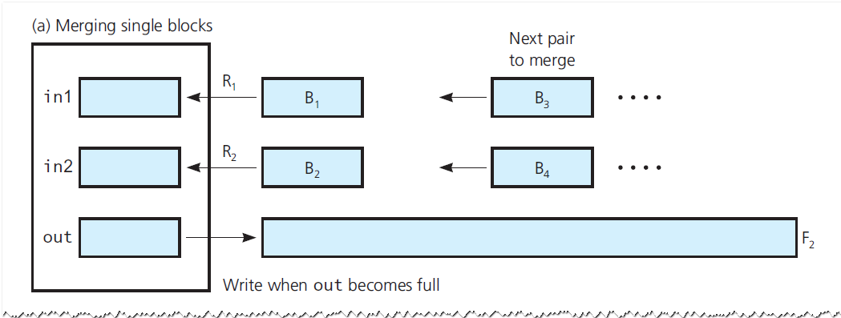
Working with External Data (3 of 4)
Figure 21-4 Phase 2 of an external sort: Merging sorted runs

Slide 9
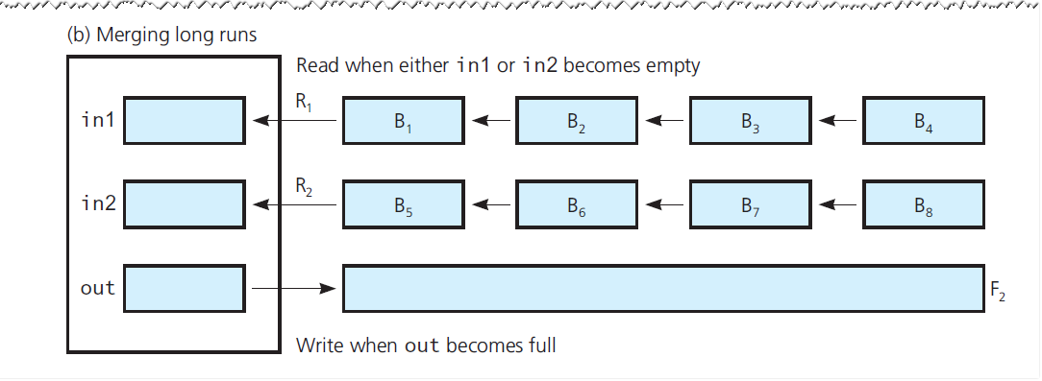
Working with External Data (4 of 4)
Figure 21-4 [Continued]

Slide 10
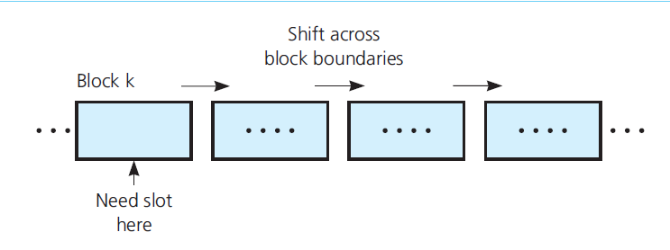
Basic Data Management Operations
Figure 21-5 Shifting across block boundaries

Slide 11
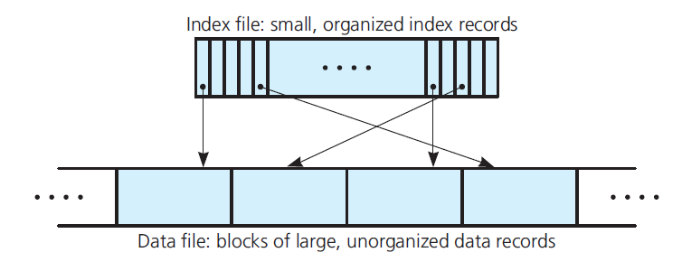
Indexing an External File (1 of 3)
Figure 21-6 A data file with an index

Slide 12
Indexing an External File (2 of 3)
Advantages of an index file
Index record smaller than a data record
Data file need not be kept in any particular order
Possible to maintain several indexes simultaneously
Index file reduces number of block accesses
Shift index records, not data records

Slide 13
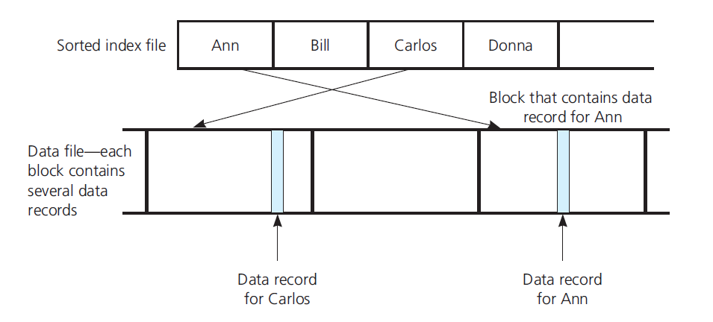
Indexing an External File (3 of 3)
Figure 21-7 A data file with a sorted index file

Slide 14
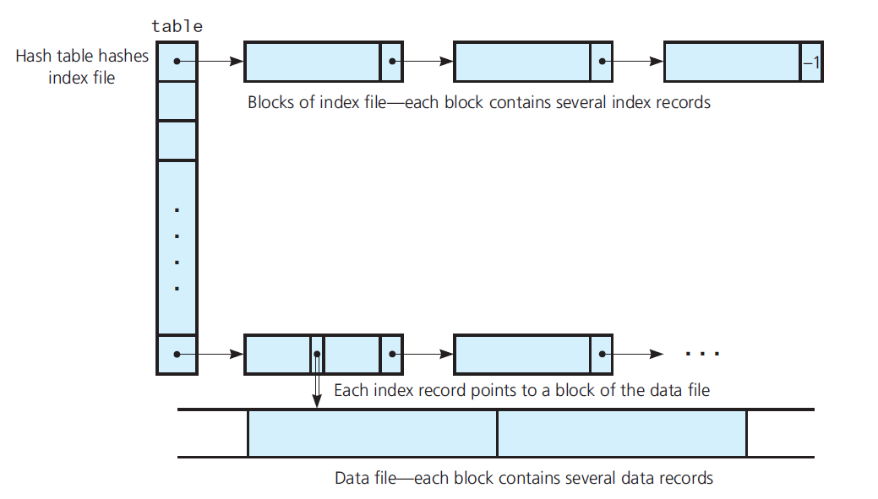
External Hashing (1 of 4)
Figure 21-8 A hashed index file

Slide 15
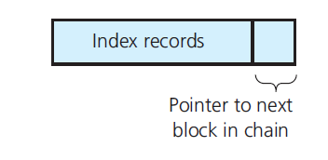
External Hashing (2 of 4)
Figure 21-9 A single block with a pointer

Slide 16

External Hashing (3 of 4)
Addition when an index file uses external hashing.
Add data record into data file.
Add corresponding index record into index file.

Slide 17
External Hashing (4 of 4)
Removal when an index file uses external hashing
Search index file for corresponding index record
Remove data record from data file

Slide 18
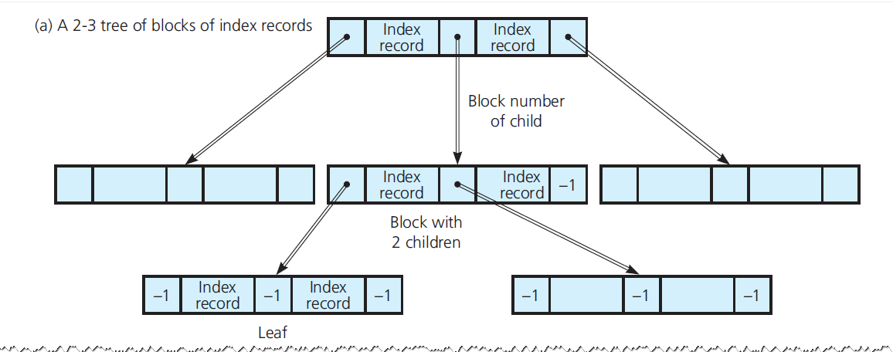
B-Trees (1 of 14)
Figure 21-10 An index file organized as a 2-3 tree

Slide 19
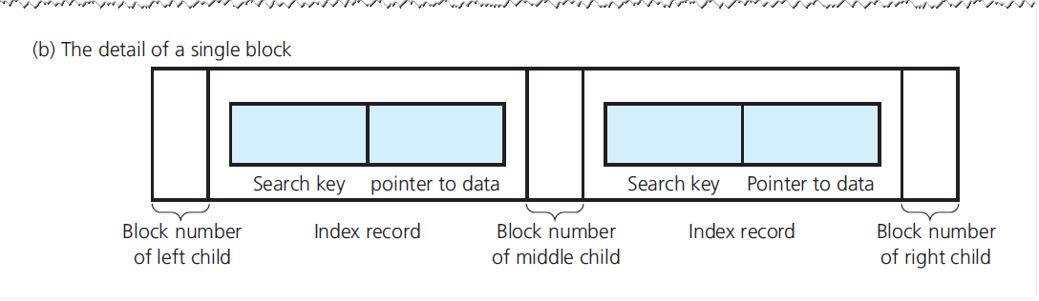
B-Trees (2 of 14)
Figure 21-10 [Continued]

Slide 20
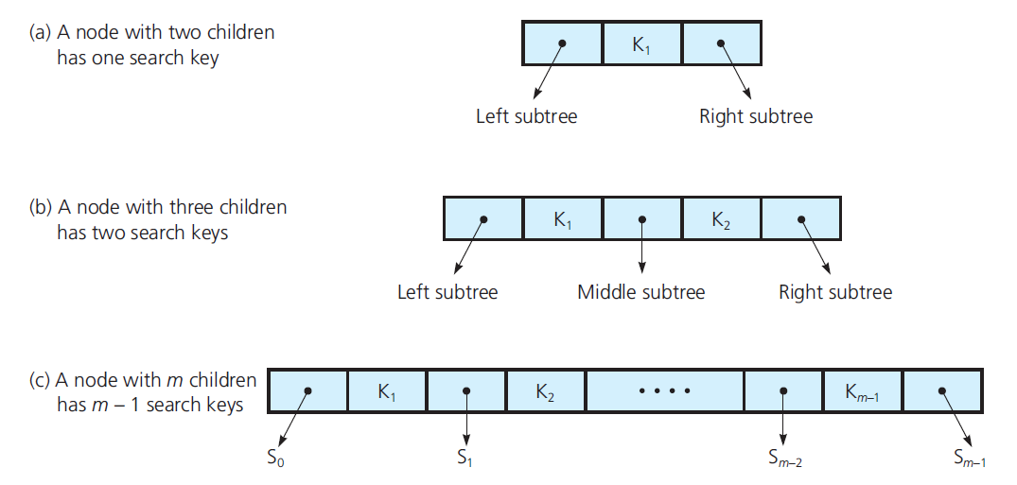
B-Trees (3 of 14)
Figure 21-11 Nodes with two, three, and m children and their search keys

Slide 21
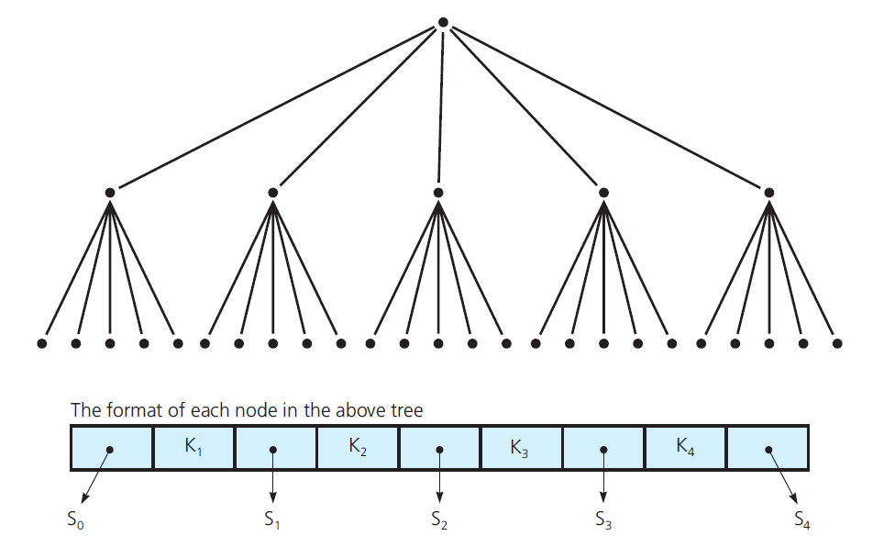
B-Trees (4 of 14)
Figure 21-12 A full tree whose internal nodes have five children

Slide 22
B-Trees (5 of 14)
Adding a record to a B-tree
Add data record to data file
Add a corresponding index record to index file

Slide 23
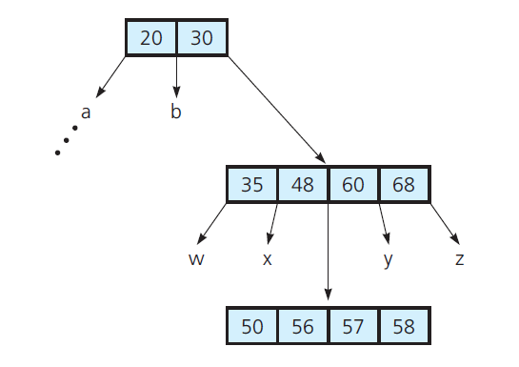
B-Trees (6 of 14)
Figure 21-13 A B-tree of degree 5

Slide 24
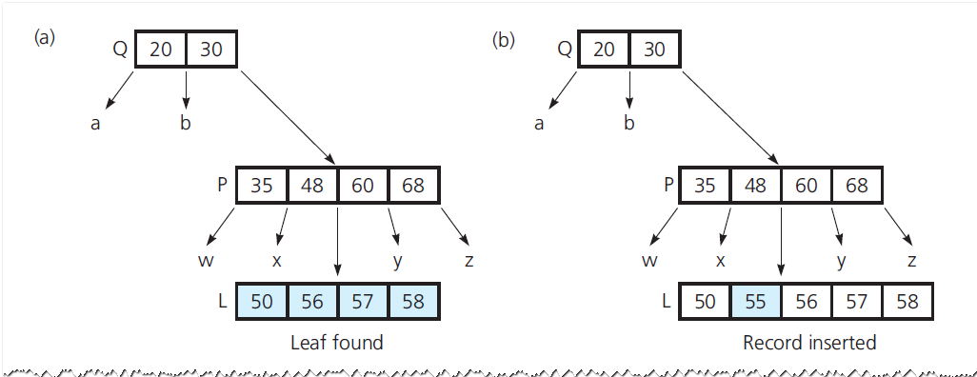
B-Trees (7 of 14)
Figure 21-14 (a through d) The steps for adding 55 to a B-tree; (e) splitting the root

Slide 25
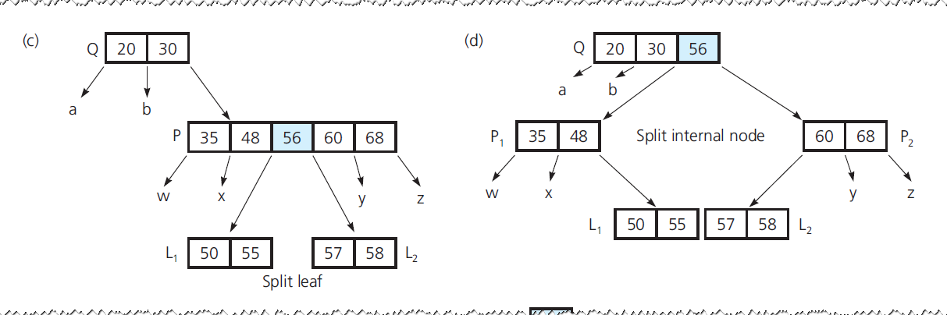
B-Trees (8 of 14)
Figure 21-14 [Continued]

Slide 26
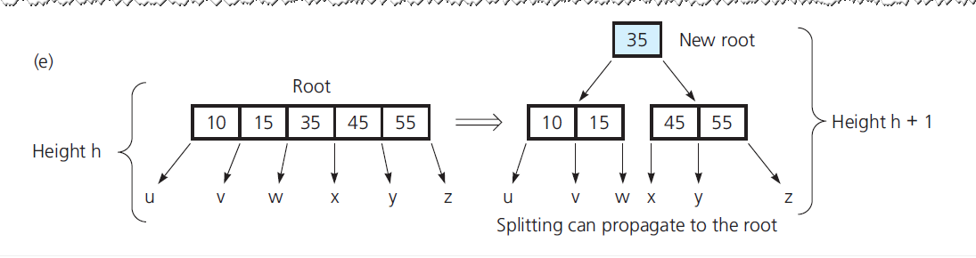
B-Trees (9 of 14)
Figure 21-14 [Continued]

Slide 27
B-Trees (10 of 14)
Removing a record from a B-tree
Locate index record in index file
Remove data record from data file

Slide 28
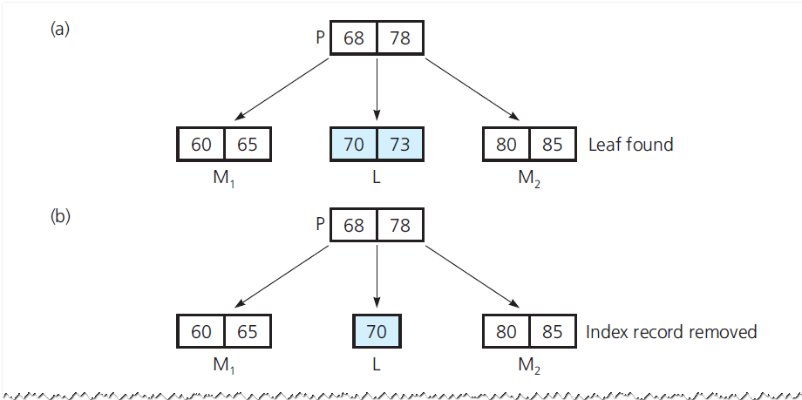
B-Trees (11 of 14)
Figure 21-15 (a through e) The steps for removing 73; (f) removing the root

Slide 29
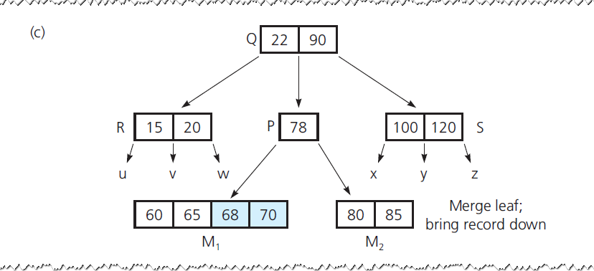
B-Trees (12 of 14)
Figure 21-15 [Continued]

Slide 30
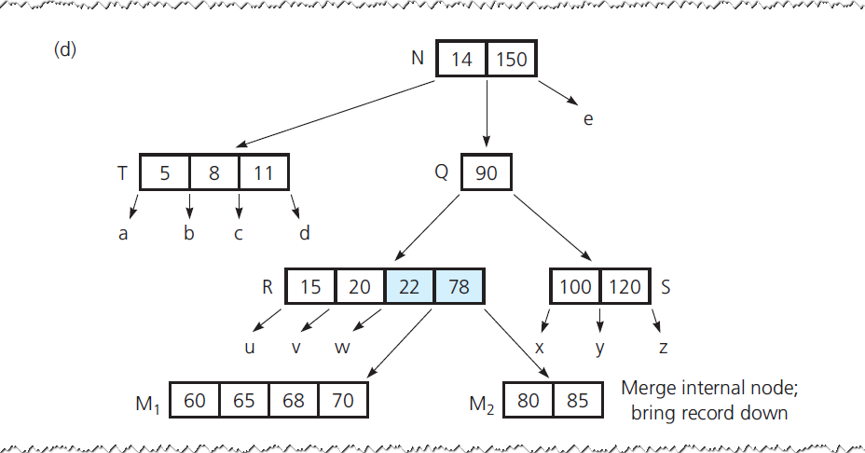
B-Trees (13 of 14)
Figure 21-15 [Continued]

Slide 31
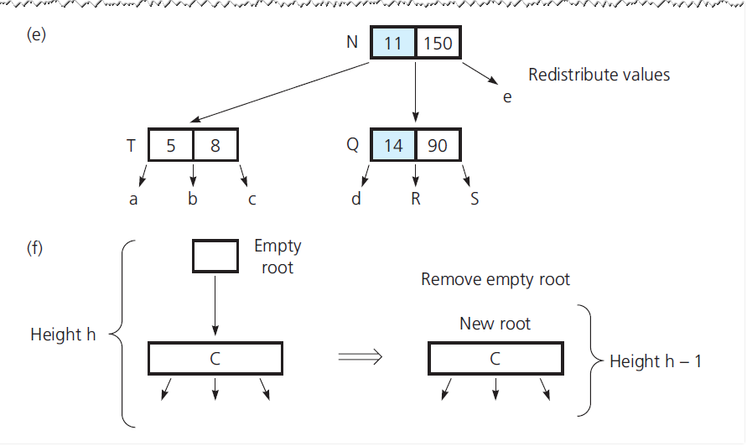
B-Trees (14 of 14)
Figure 21-15 [Continued]

Slide 32
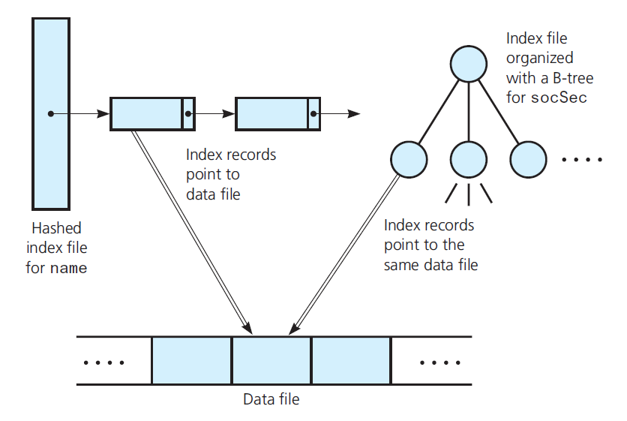
Multiple Indexing (1 of 2)
Figure 21-16 Multiple index files

Slide 33
Multiple Indexing (2 of 2)
A removal by name must update both indexes
Search name index file for jones and remove index record.
Remove appropriate data record from data file, noting socSec value ssn of this record.
Search socSec index file for ssn and remove this index record.

Slide 34

Copyright

