Slide 1
Raspberry Pi
Zero W Bare Metal &
RPi3 Bare Metal
Edward Vidal Jr.

Slide 2
Raspberry Pi
Zero W Bare Metal
Bare Metal connects to the hardware with the Ultibo Run time Library (RTL).
Bare Metal only requires a few files compared to O/S system.
Bare Metal only requires a few files
  bootcode.bin
  fixup.dat
  start.elf
  kernel.img

Slide 3
Raspberry Pi
Zero W Bare Metal
With only 1 core & 512MB of memory
this is a good hardware solution for GPS.
Bare metal currently does not support Wi-Fi.

Slide 4
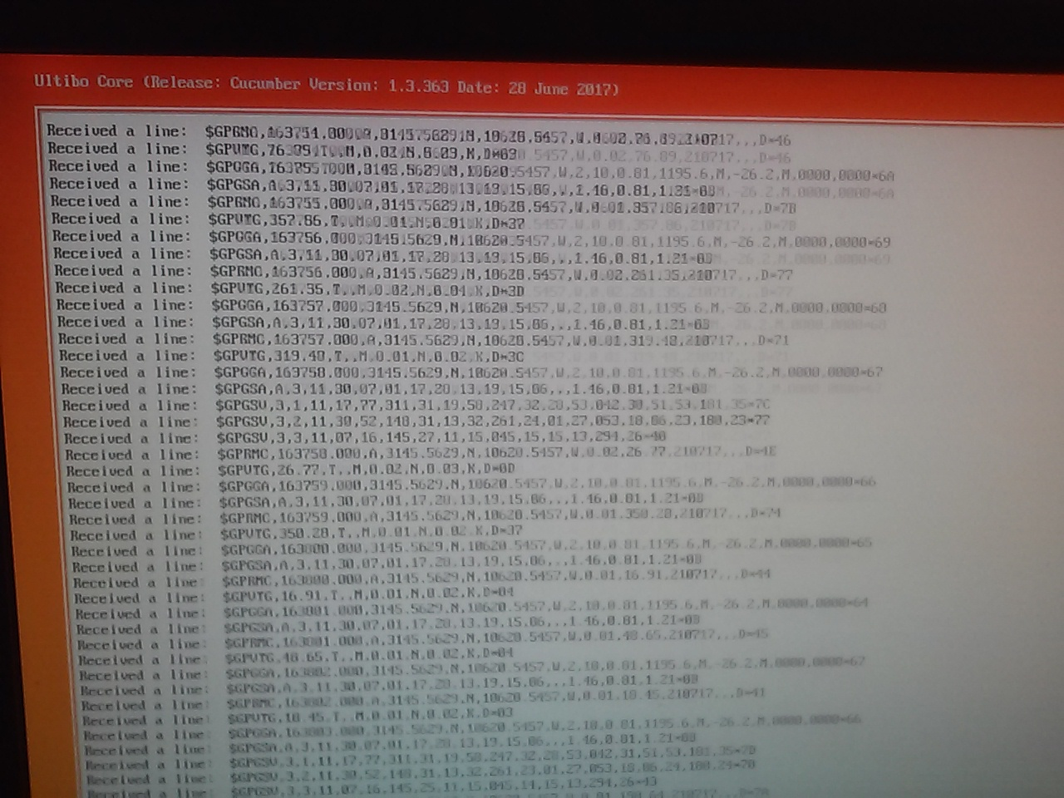

Slide 5
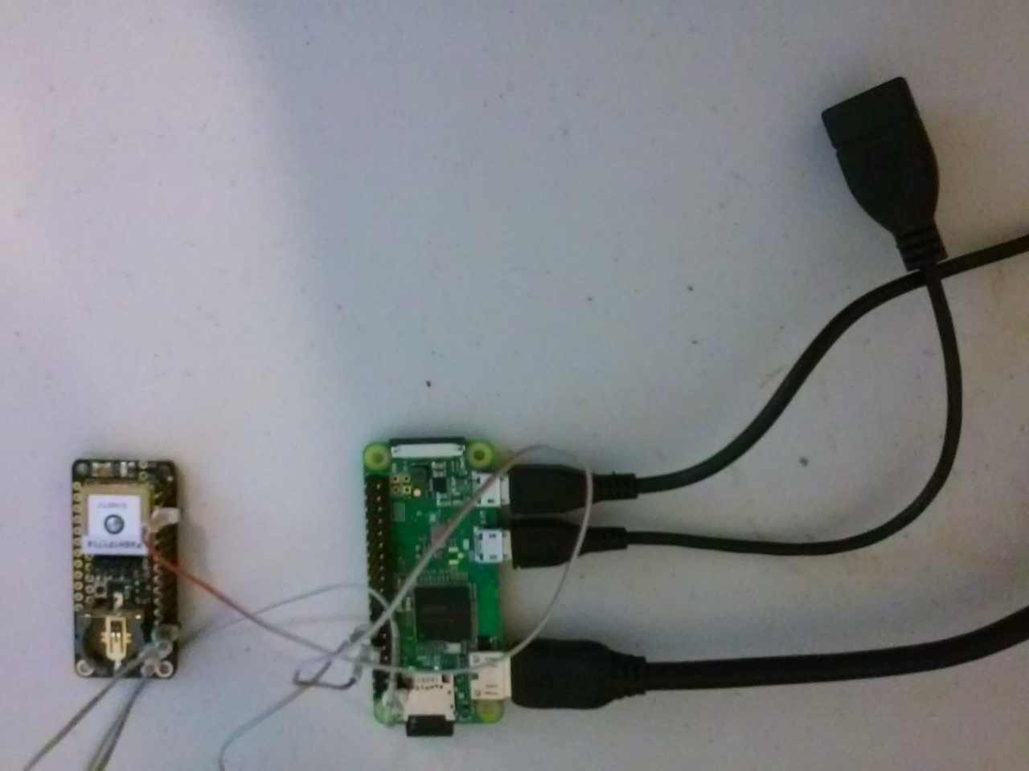

Slide 6
Raspberry Pi
RPi3 Bare Metal
Bare Metal connects to the hardware with the Ultibo Run time Library (RTL).
Bare Metal only requires a few files compared to O/S system.
Bare Metal only requires a few files
  bootcode.bin
  fixup.dat
  start.elf
  kernel7.img

Slide 7
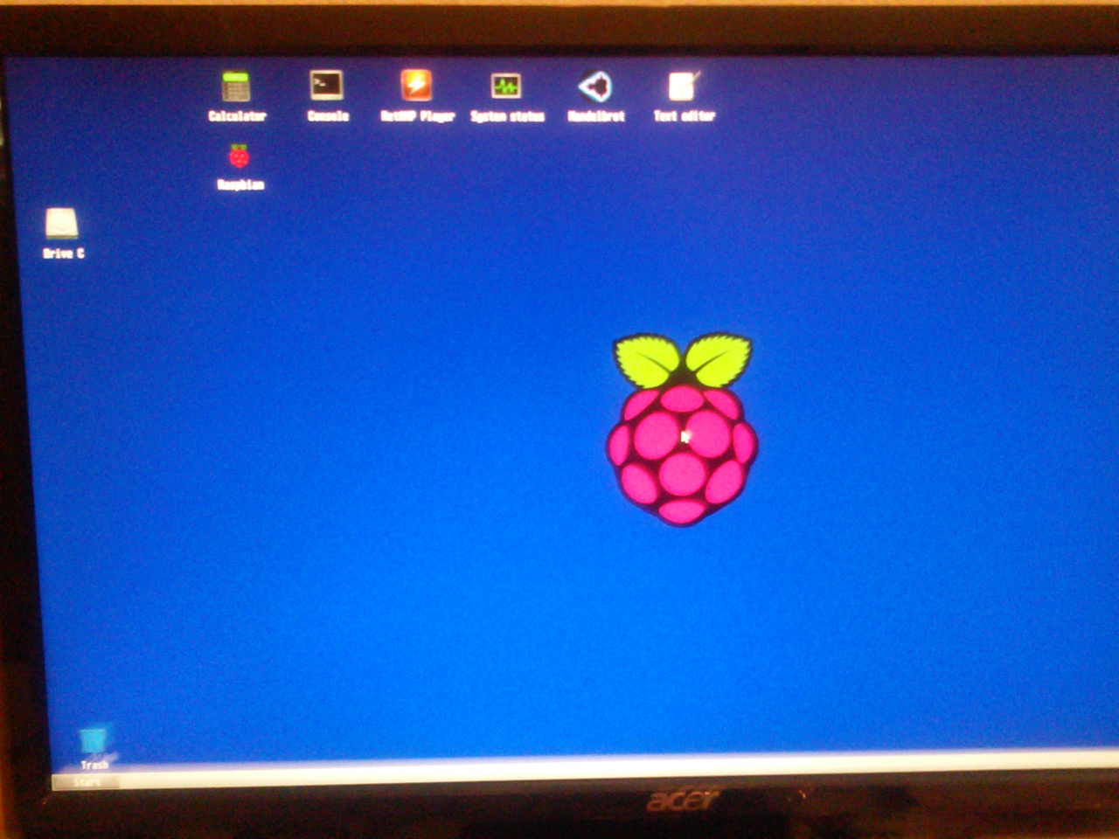

Slide 8
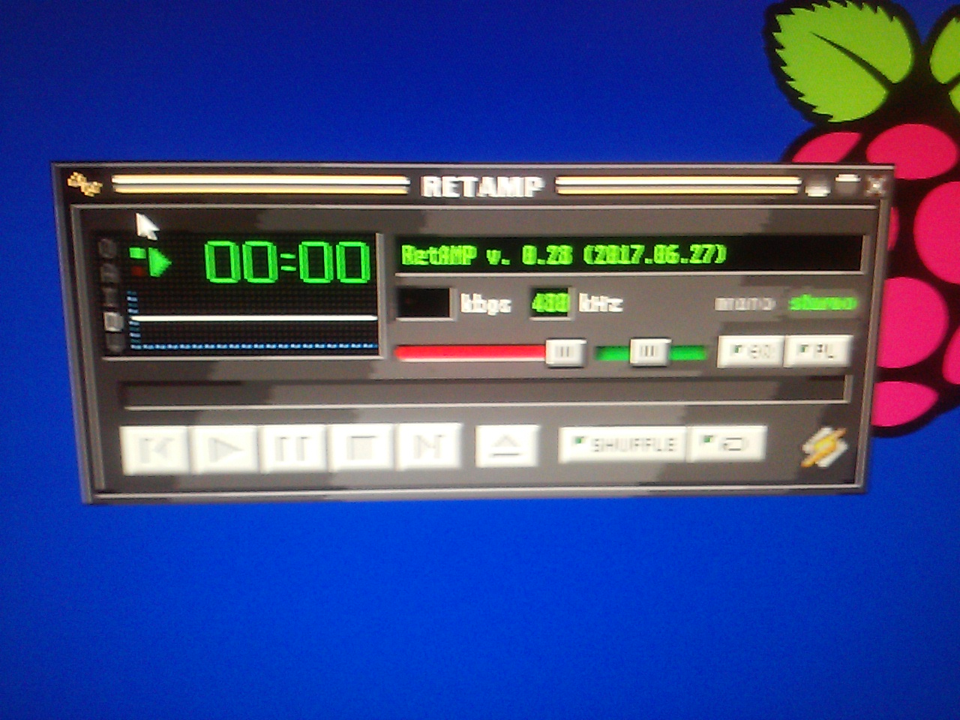

Slide 9
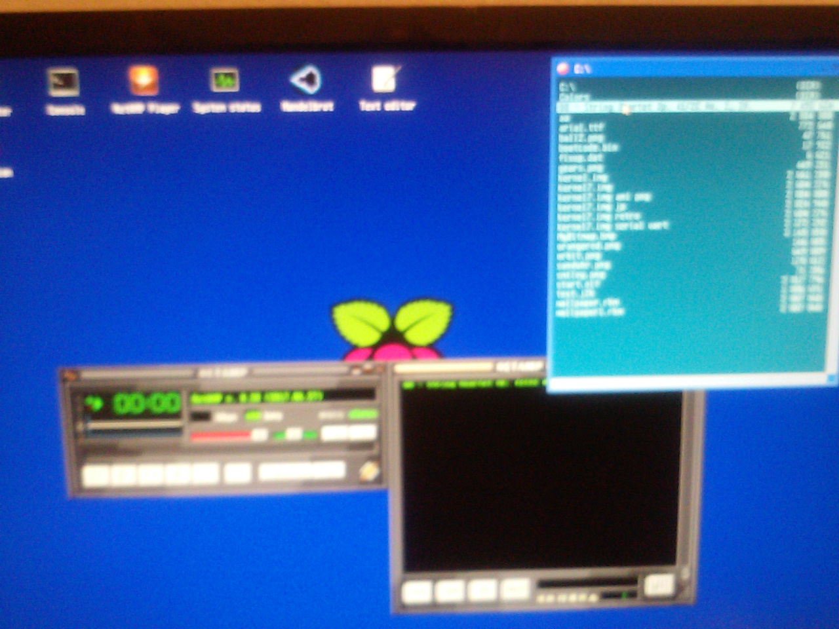

Slide 10
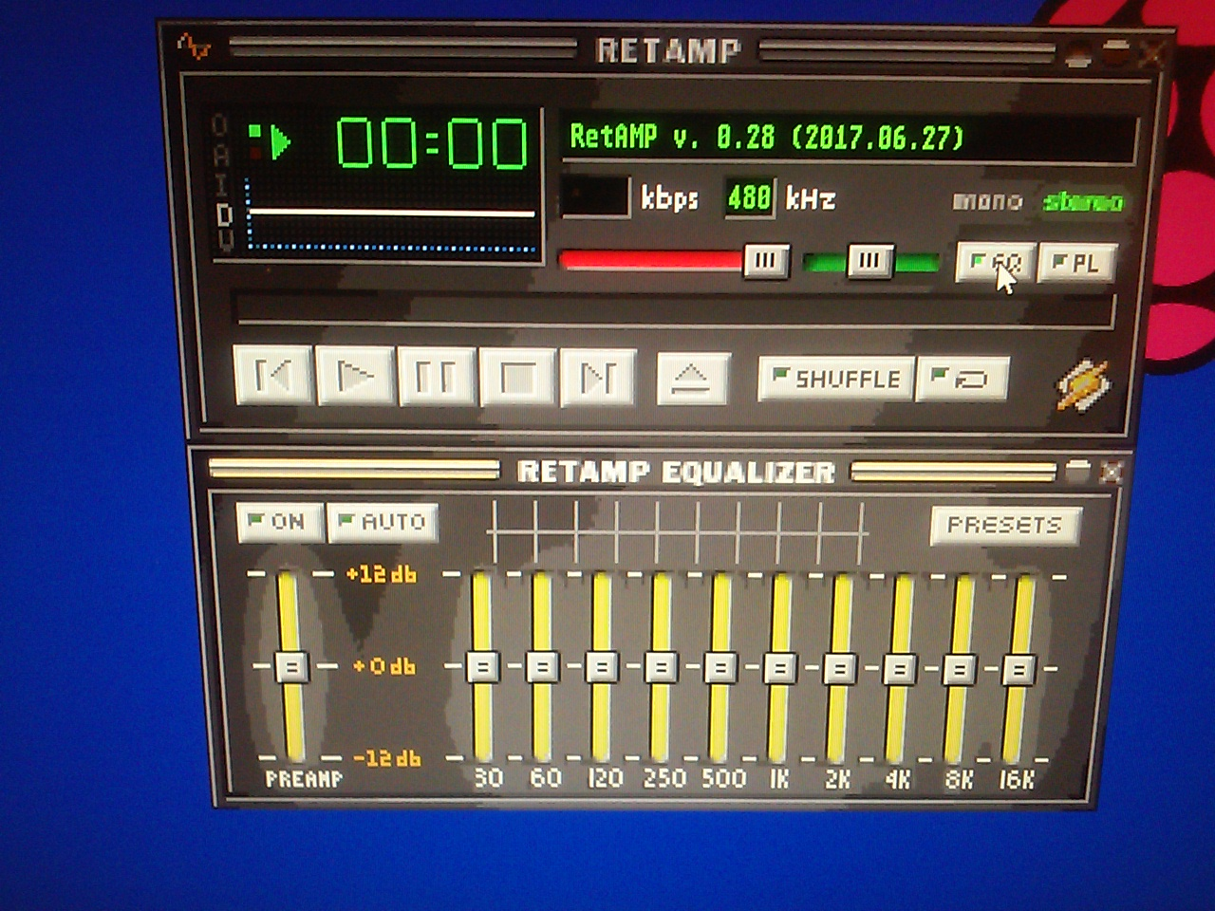

Slide 11
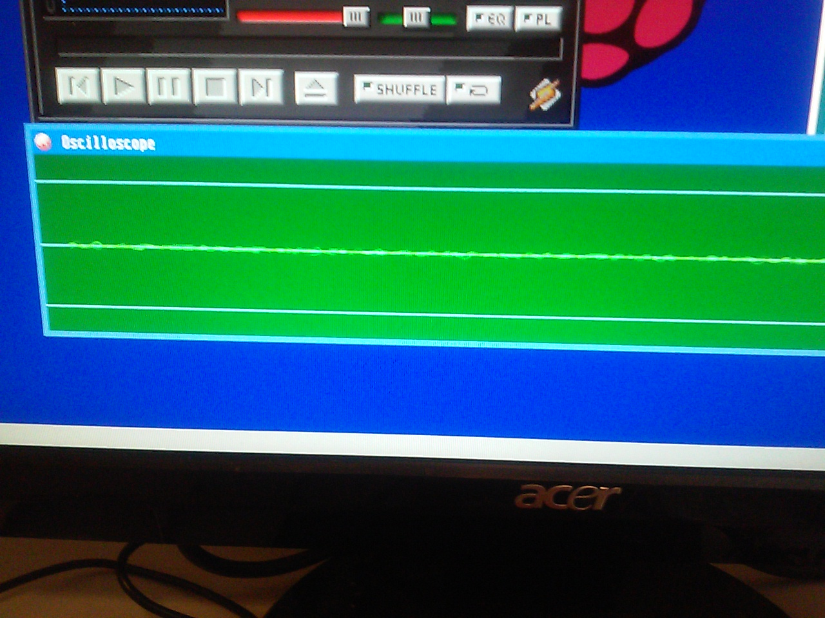

Slide 12
