Slide 1
Raspberry Pi Bare metal Image Compression
Edward Vidal Jr.

Slide 2
Raspberry Pi Bare metal Image Compression
Goals
Reduce the size of images
Decompress back to original size & quality
Reduce transfer times over the network
Reduce the number bits needed to represent the image.

Slide 3
https://ultibo.org/whats-in-a-name/
What’s in a name?
How do you describe something like Ultibo so that people can decide if it is what they are looking for or not?
At various times, and depending on the audience, we use terms like bare metal, unikernel, embedded platform and so on but none of them really seem to capture both the purpose and the possibilities of the Ultibo project. There are a number of purposes that drive what we are doing but it can be easy to miss the whole story if you just look at any one element. If you focus on just the technical details of creating programs without an operating systems and the necessities of drivers, devices and boards then you might not notice that there is a learning aspect to the project as well.
The world needs more good programmers to drive the development of future systems and applications, sadly there has been a catastrophic failure of industry, schools and universities to educate new generations of developers, many have no concept of how a pixel appears on screen or a packet crosses the internet, let alone the ability to understand the intricacies of modern computing. We don’t claim that Ultibo is the complete solution but without tools that make it possible to concentrate on learning instead of being swamped by the idiosyncrasies of an operating system then the situation is not likely to change.
On the other hand if you see Ultibo only as a teaching tool or a way to learn about the low level functionality of a computer then you miss the fact that Ultibo is a powerful platform which can be used for serious development and creating real products, without the unnecessary overhead and complexity of a full desktop operating system.
It’s a simple question with a multitude of answers, we don’t want to make Ultibo sound too complex or unapproachable so that people think it is beyond their knowledge, at the same time if we make it appear too simple then those who have a definite purpose in mind might think it is not advanced enough for their needs. In truth it should be possible to accommodate both ends of the spectrum, we still don’t know the best way to describe it but you can be sure we’ll continue thinking.

Slide 4
Raspberry Pi Bare metal Image Compression
https://en.wikipedia.org/wiki/JPEG_2000#Superior_compression_ratio
  Superior compression ratio
  Multiple resolution representation
  Progressive transmission by pixel and resolution accuracy
  Choice of lossless or lossy compression
Key basic technolgies
  Wavelet transform DWT
  (Embedded Block Coding with Optimized Truncation)

Slide 5
Raspberry Pi Bare metal Image Compression
Read the image file and split into compoents
Perform the DWT on the compoents
Perform encoding.

Slide 6
Raspberry Pi Bare metal Image Compression
Number representation
Decimal, binary, and hex
Bitmap size (2048*2048*3)+122
12583034 represented in hex C0007A
F 15 E 14 D 13 C 12 B 11 A 10
F 1111 E 1110 D 1101 C 1100 B 1101 A 1010

Slide 7
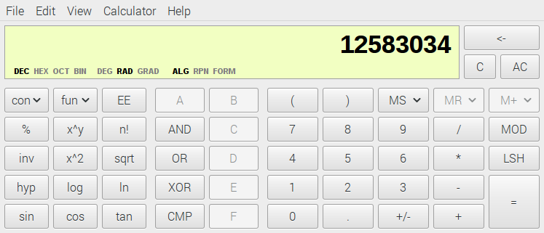
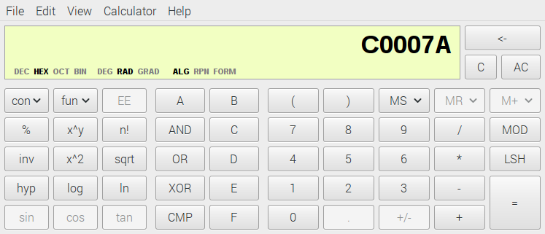

Slide 8
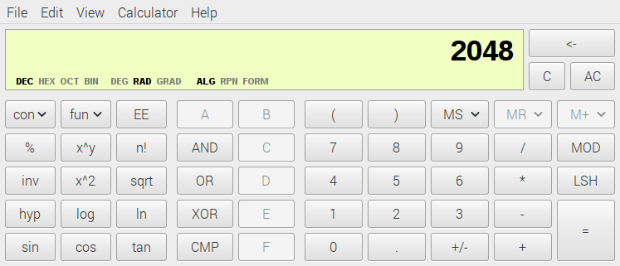
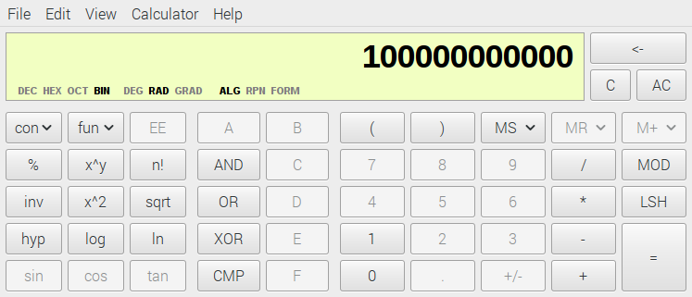
2048 1024 512 256 128 64 32 16 8 4 2 1

Slide 9
INFOHEADER
0000-0039
  size 7A 00 C0 00
  Width 00 00 00 08,height 00 00 00 08, bpp 00 18
  Imagesize 00 00 C0 00
  00000000 42 4D 7A 00 C0 00 00 00 00 00 7A 00 00 00 6C 00 BMz.......z...l.
  00000010 00 00 00 08 00 00 00 08 00 00 01 00 18 00 00 00 ................
  00000020 00 00 00 00 C0 00 13 0B 00 00 13 0B 00 00 00 00 ................
  00000030 00 00 00 00 00 00 42 47 52 73 00 00 00 00 00 00 ......BGRs

Slide 10
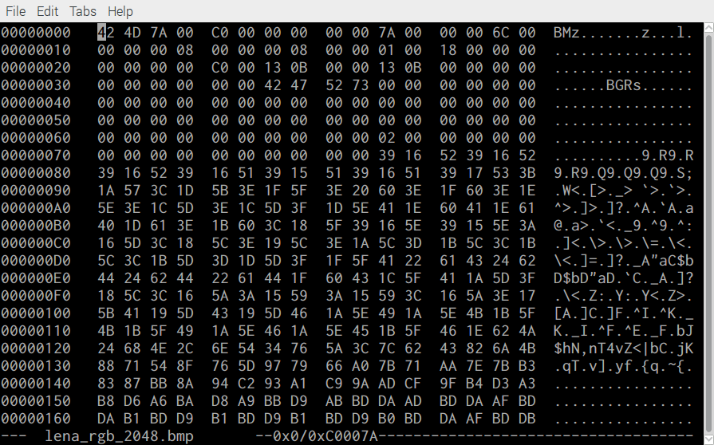

Slide 11
Raspberry Pi Bare metal Image Compression
fid = fopen('red-out.32t','r'); im1 = fread(fid, [2048,inf], 'char'); fclose(fid);
figure; imagesc(im1); colorbar; %colormap 'gray';
title"green sub band 2048 x 2048 RPi Raspbian"
fid = fopen('grn-out.32t','r'); im2 = fread(fid, [2048,inf], 'char'); fclose(fid);
figure; imagesc(im2); colorbar; %colormap 'gray';
title"red sub band 2048 x 2048 RPi Raspbian"
fid = fopen('blu-out.32t','r'); im3 = fread(fid, [2048,inf], 'char'); fclose(fid);
figure; imagesc(im3); colorbar; %colormap 'gray';
title"blue sub band 2048 x 2048 RPi Raspbian"

Slide 12
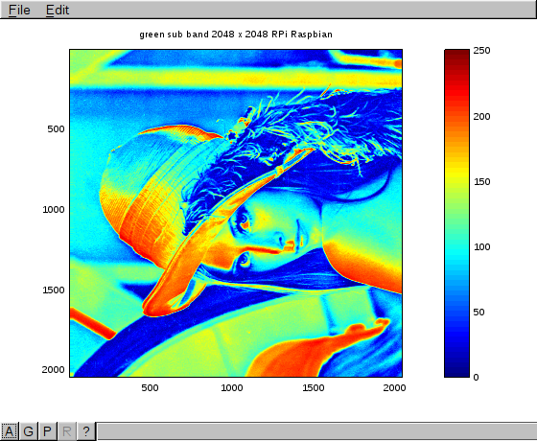

Slide 13
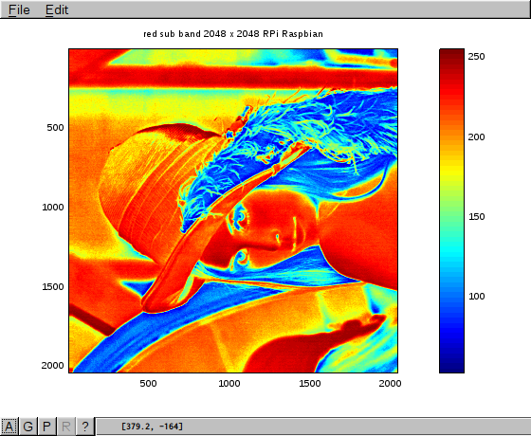

Slide 14
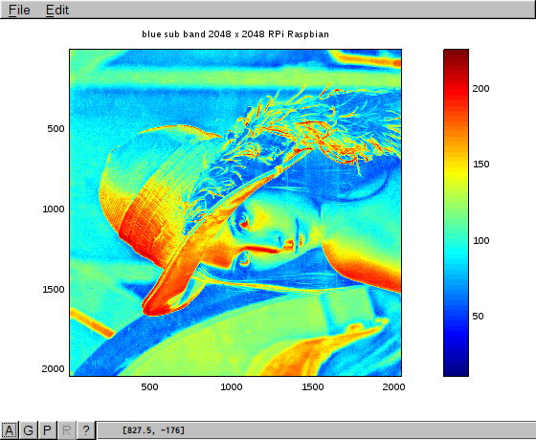

Slide 17
Internet provides the basic software
openjpeg repo
https://github.com/uclouvain/openjpeg
convert from cmake to script
to compile lib sources using
arm-none-eabi tools
libopenjp2.a
FPC repo
https://github.com/sysrpl/Codebot.Setup.git
my bare-metal repo
https://github.com/develone/jpeg-2000-test.git
build_fpc_lazarus.sh
firmware repo
https://github.com/raspberrypi/firmware
*bootcode.bin fixup.dat start.elf
build_ultibo_fpc.sh
build_ultibo_rtl_armv6.sh
build_ultibo_rtl_armv7.sh
dwtlift.c
*kernel7.img
ultibo Core repo
https://github.com/ultibohub/Core
Ultibo FPC repo
https://github.com/ultibohub/FPC
Pascal
DWT_LIFT_RPi2.lpr
*Bare-metal files in red
Plus the image to be
Compressed is all that
Is needed.

Slide 18
Raspberry Pi Bare metal Image Compression
RPi3 running RaspBian
  Used to compile the kernel7.img using Free Pascal Compiler FPC.
  Used to transfer the kernel7.img to Bare Metal under test.
  Used to transfer compressed image to RPi3 running RaspBian.

Slide 19
Raspberry Pi Bare metal Image Compression
RPi3 or RPi2 Bare Metal
Performs data compression using openjpeg static linked library.
Provides remote shell.
Provides TFTP Server.
Reboots when a new kernel7.img is received.

Slide 20
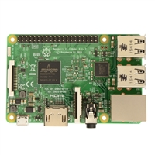
DHCP Server
With Wi-FI
RPi3B or RPi2B
Bare Metal
RPi3 RaspBian
Note *Bare metal currently does not
support Wi-Fi requires a RJ-45 connection to
DHCP Server required.

Slide 21
Raspberry Pi Bare metal Image Compression
Two RaspberryPi's
HDMI switch
Keyboard
Mouse

Slide 22
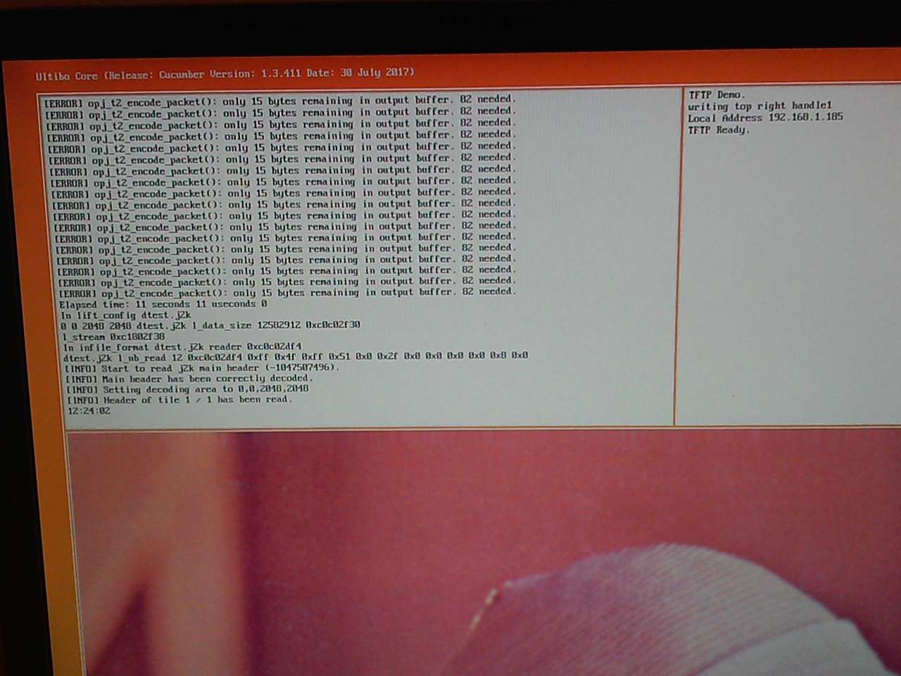

Slide 23
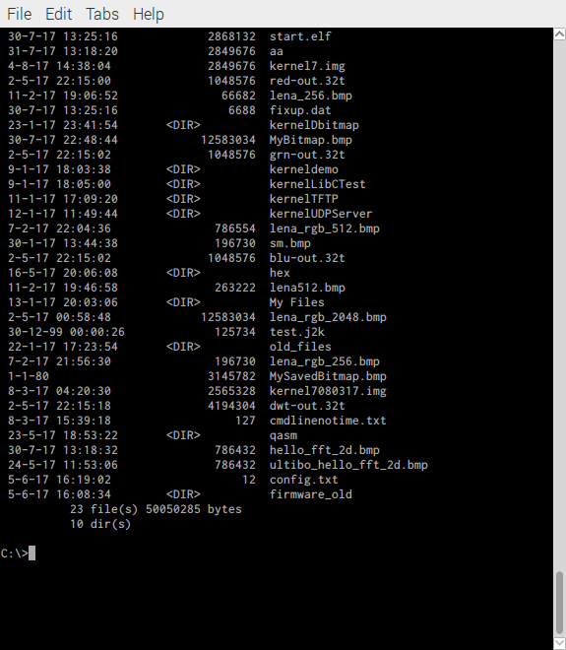

Slide 24
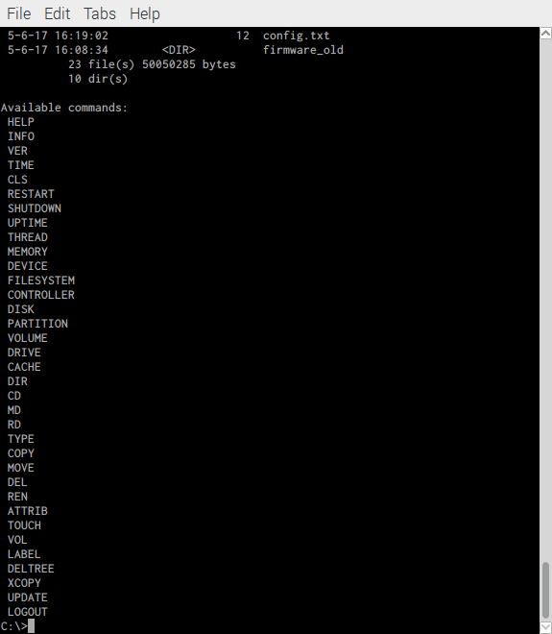

Slide 25
Original file 12583034 bytes compression ratio 100
Compressed file 125603 bytes
Original file transfer 12583034 bytes in 49.8 seconds
Compressed image transfwer greatly reduced 125603 bytes in 0.5 seconds

Slide 26
Raspberry Pi Bare metal Image Compression
Questions

