Slide 1
Raspberry Pi
GPS data reduction using
Octave
Edward Vidal Jr.

Slide 2
Raspberry Pi
GPS data reduction using
Octave
GPS receiver provides many messages in a 24 hour period.
To determine how good the data results are, these must be analyzed.
The data set contained 440486 messages.
First step is to extract the GPGGA messages.
GPGGA Essential fix data which provide 3D location and accuracy data.
The data set of GPGGA messages contained 81596 messages.

Slide 3
Raspberry Pi
GPS data reduction using
Octave
Where:
GGA Global Positioning System Fix Data
123519 Fix taken at 12:35:19 UTC
4807.038,N Latitude 48 deg 07.038' N
01131.000,E Longitude 11 deg 31.000' E
1 Fix quality: 0 = invalid
1 = GPS fix (SPS)
2 = DGPS fix
3 = PPS fix
4 = Real Time Kinematic
5 = Float RTK
6 = estimated (dead reckoning) (2.3 feature)
7 = Manual input mode
8 = Simulation mode
08 Number of satellites being tracked
0.9 Horizontal dilution of position
545.4,M Altitude, Meters, above mean sea level
46.9,M Height of geoid (mean sea level) above WGS84
ellipsoid
(empty field) time in seconds since last DGPS update
(empty field) DGPS station ID number
*47 the checksum data, always begins with *

Slide 4
Raspberry Pi
GPS data reduction using
Octave
std_elev = 5.8632
std_lat = 0.0015637
std_long = 0.0016972
Units in stats aren't consistent, since the elevation is in meters and the lat long are in deg min sec. More work is needed.

Slide 5
Raspberry Pi
GPS data reduction using
Octave
filename = 'gps.csv';
x = dlmread(filename,',');
figure
hist(x(1:41913,10))
title 'ELEVATION m'
std_elev = std(x(1:41913,10))
figure
hist(x(1:41913,3))
title 'LATITUDE N'
std_lat = std(x(1:41913,3))
figure
hist(x(1:41913,5))
title 'LONGITUDE W'
std(x(1:41913,5))
std_long = std(x(1:41913,5))
figure
hist(x(1:81596,8))
title 'NUMBER OF SAT'

Slide 6
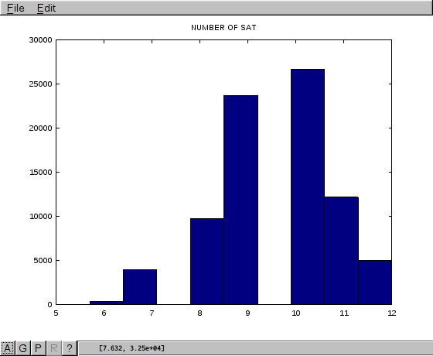

Slide 7
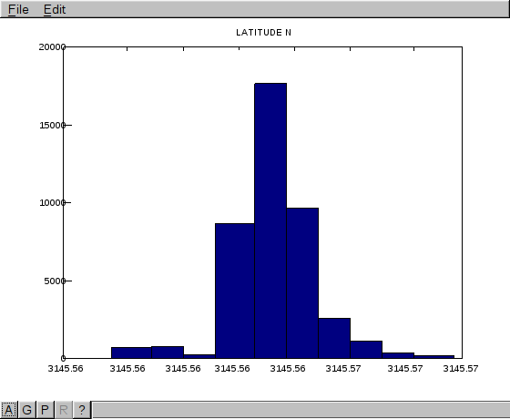

Slide 8
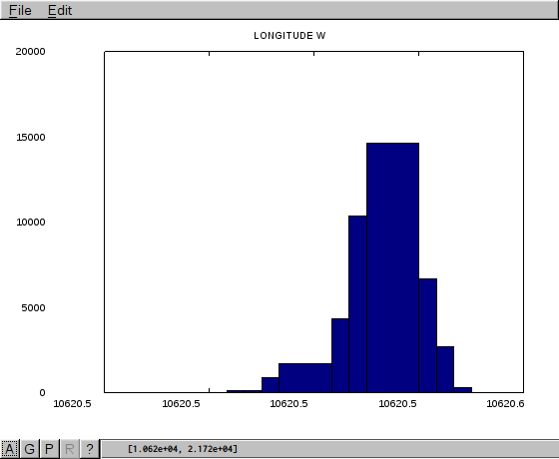

Slide 9
