Slide 1
Raspberry Pi
Edward Vidal Jr

Slide 2
Raspberry Pi
Raspberry Pi Zero W
  1 core
  512 GB
Raspberry Pi 3B
  4 core
  1 GB

Slide 3
Raspberry Pi
Software
  Ultibo Bare Metal single application with very few files compared to O/S.
  RaspBian
    Linux based operating system
      Applications
        Language
        Python
        C
        Java
        Scripting
        Chromium web browser
        Compiler GCC
        Libreoffice
        Calc Spreadsheet
        Writer Documents
        Impress Presentation

Slide 4
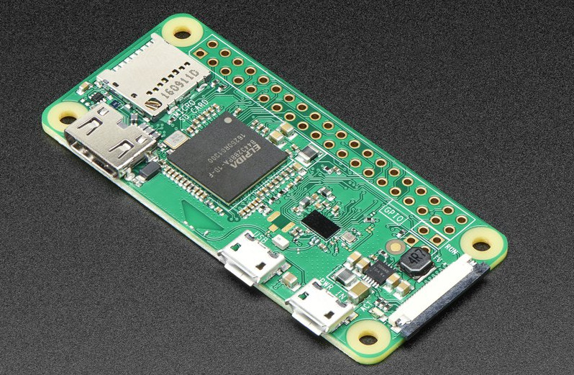
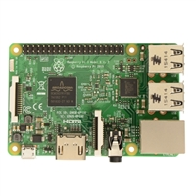
Raspberry Pi Zero W
Product Dimensions: 66.0mm x 30.5mm x 5.0mm / 2.6" x 1.2" x 0.2"
Wi-Fi 1 Core 512GB HDMI mini connector
Raspberry Pi 3B
Twice the size of Raspberry Pi Zero W
Wi-Fi 4 Core 1GB 4 USB RJ-45 HDMI
Standard Connectors.

