Slide 1
Bare-metal WebCam
Edward Vidal Jr.

Slide 2
Requirements Hardware
Raspberry Pi 2B or Raspberry Pi 3B
Pi Camera
Network connection
Power supply
7in touch display or HDMI monitor optional
Micro SD-card 4G minium

Slide 3
Requirements Software
Windows or Ubuntu Linux with wine
Provides IDE to compile using FPC & Lazarus
Can be compiled on Raspberry Pi with RaspBian from the command with FPC.
Original Code
https://ultibo.org/forum/viewtopic.php?f=15&t=834
https://github.com/ultibohub/Core/releases/download/2.0.029/Ultibo-Core-2.0.029-Beetroot.exe

Slide 4
Bare-metal WebCam
Only requires 6 files
  config.txt
    start_x=1
    cpu_mem=128
kernel7.img
bootcode.bin
fixup.dat
start_x.elf
index.html

Slide 5
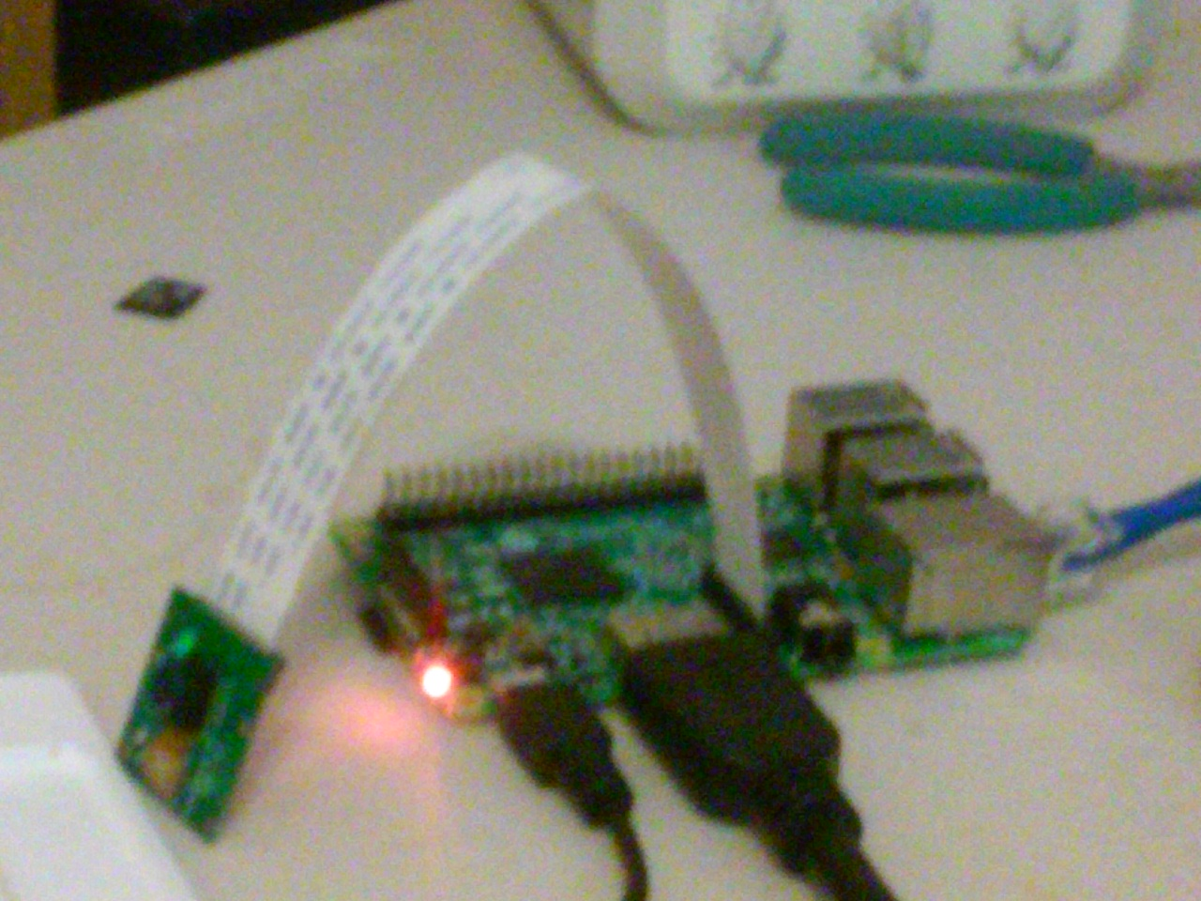
Raspberry Pi with Camera

Slide 6
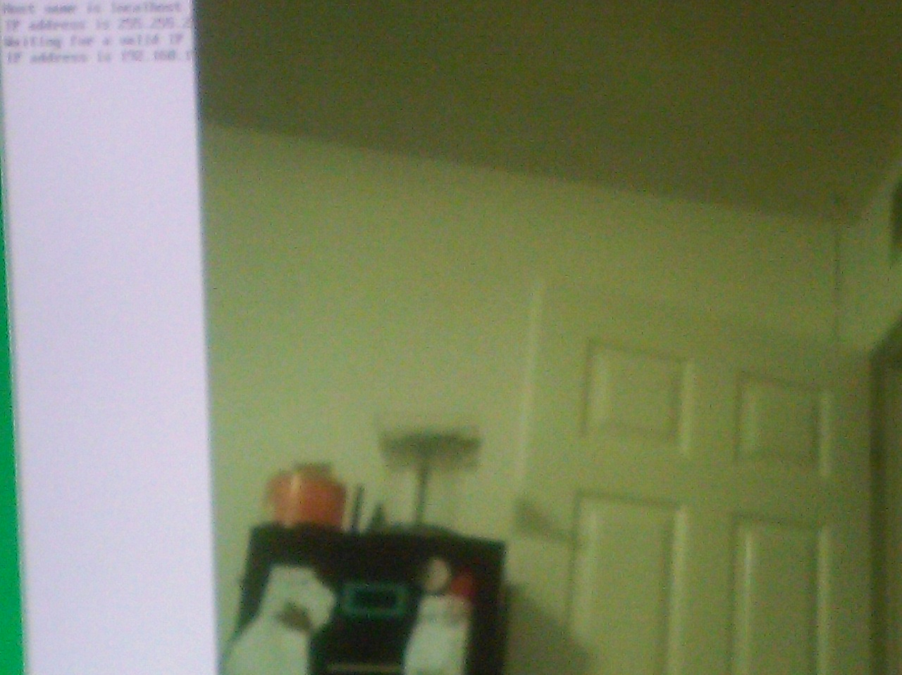
Raspberry Pi when Camera take picture

Slide 7
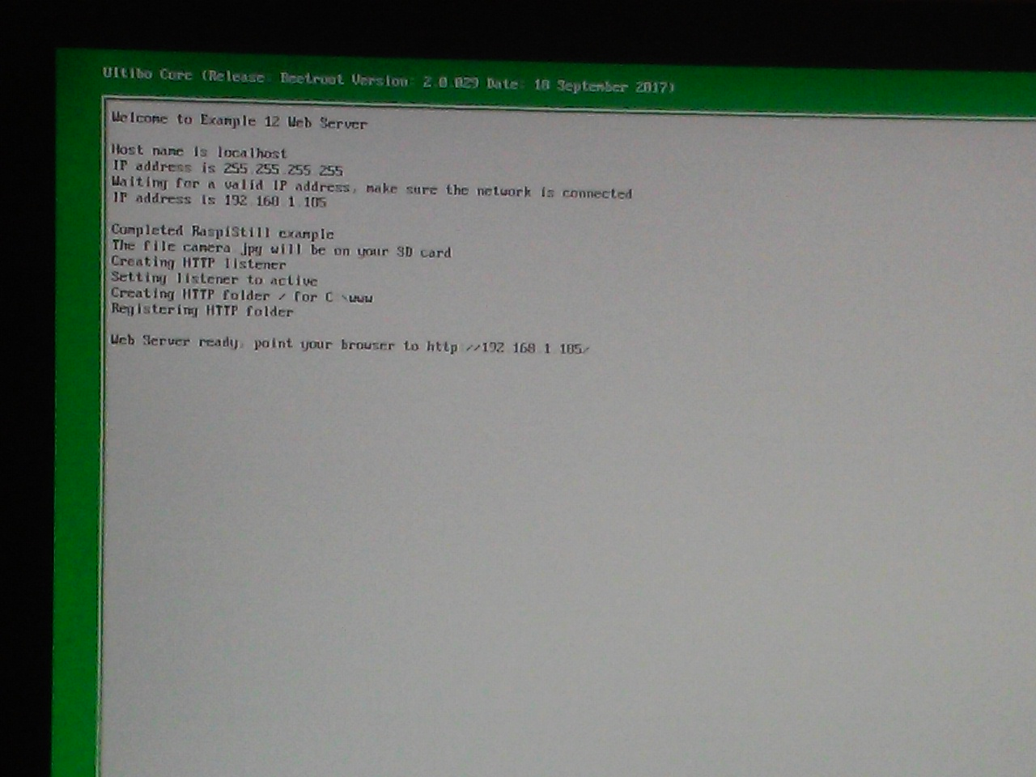
Raspberry Pi Web Server Information

Slide 8
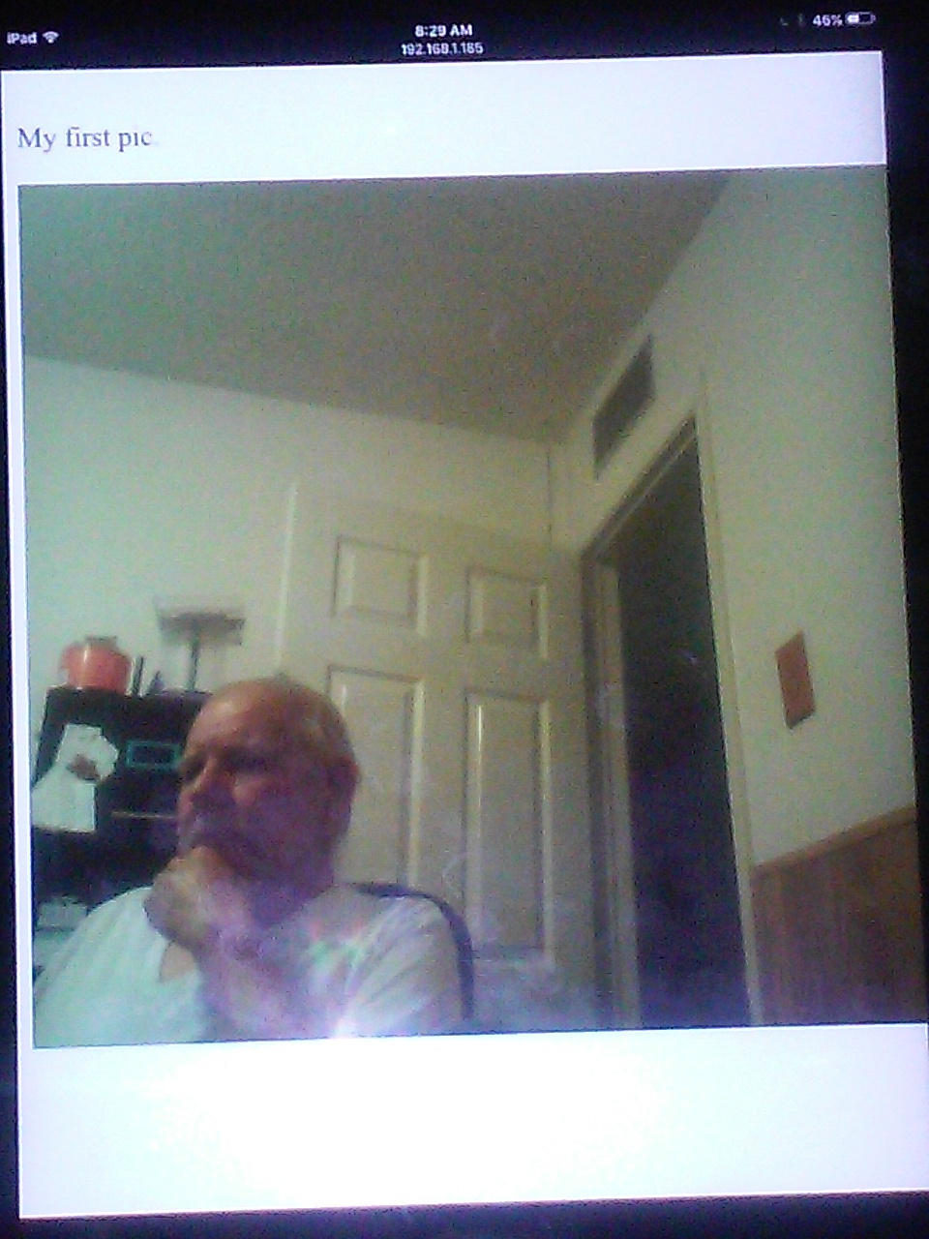
Image viewed on IPAD
Using Safari

Slide 9
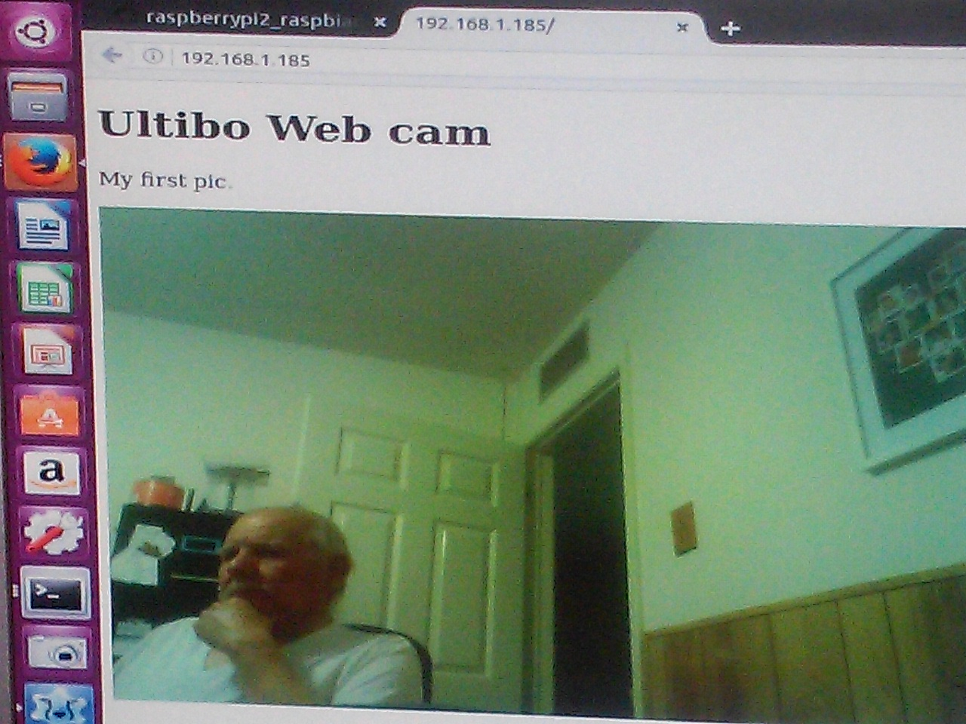
Image viewed on
Ubuntu 16.04
Using FireFox

Slide 10
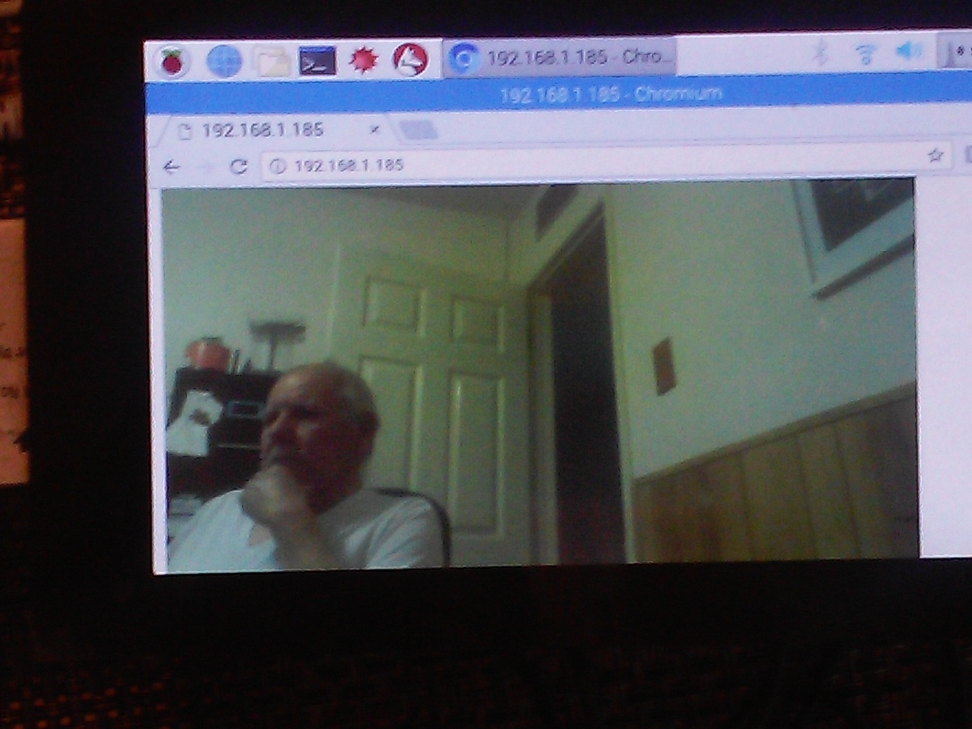
Rpi2B with 7in. Touch disp

Slide 11
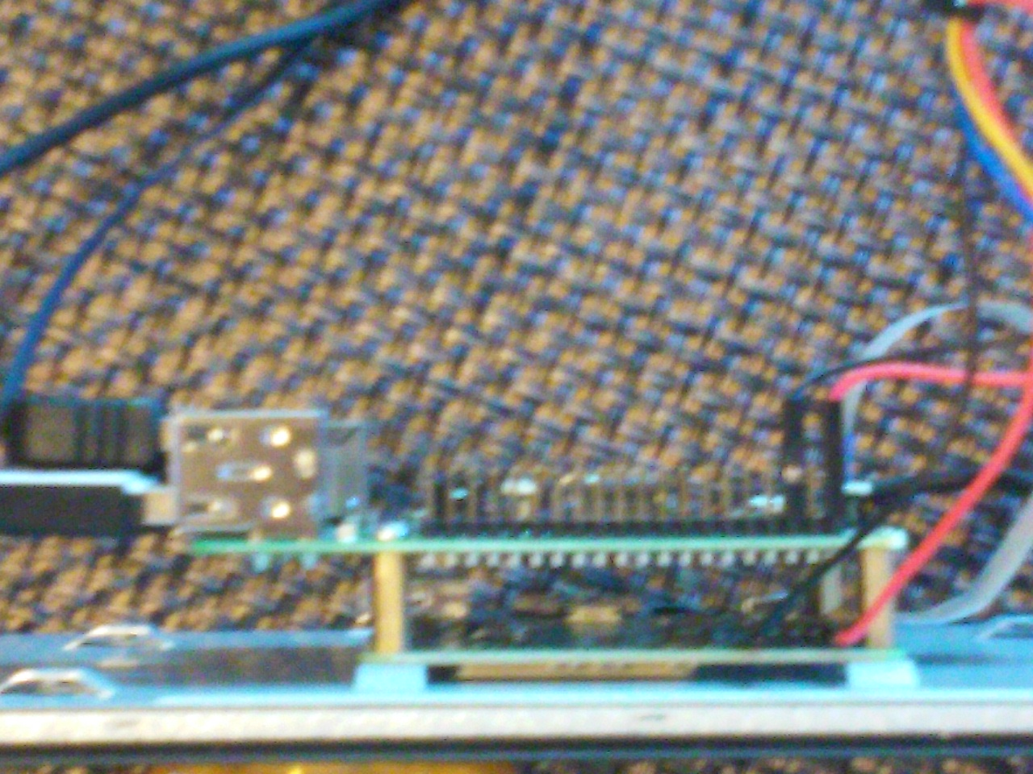
Rpi2B with display electronics side view

Slide 12
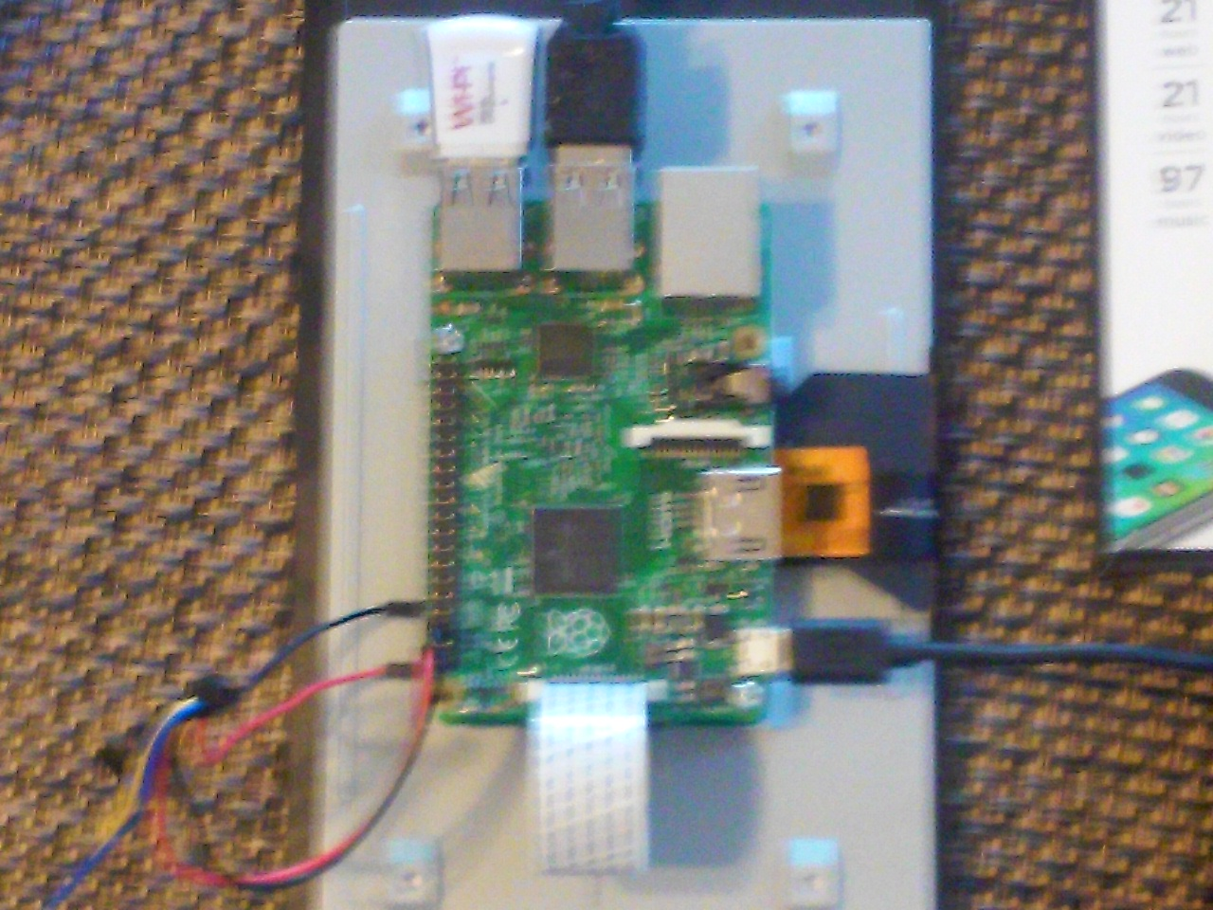
Rpi2B with display electronics back view

Slide 13
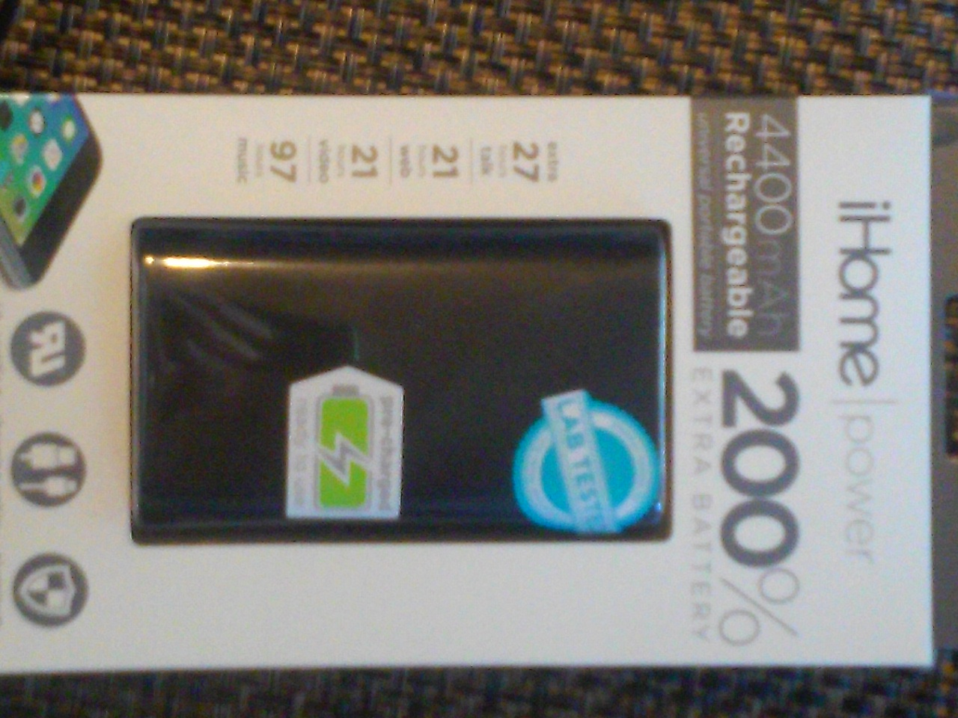
Power Pack to provide power to Rpi2B and display

Slide 14
Bare-metal WebCam
Questions?

