Slide 1
Dedicated_CPU toggling GPIO and 2nd Dedicated_CPU counting toggles of the first
Edward Vidal

Slide 2
Goal
Toggle a GPIO in a DedicatedCPU using Ultibo
Provide a method of replacing the kernel7.img
using TFTP which updates the remote system.

Slide 3
Steps
Started with Example Advanced/DedicatedCPU
Created two versions one for the RPi2B & one for the RPi3B
The RPi2B would toggle the GPIO and RPi3B would count GPIO toggles
Added GPIOToggleUnit.pas
Converted Pascal to Assembly on RPi2B.
Trying to convert Pascal to Assembly on RPi3B
Added TFTP & remote shell.

Slide 4
Results
Converted Pascal to Assembly on RPi2B.
./pigs r 16 r 16 r 16
1
0
1

Slide 5
192.168.1.195
192.168.1.185
Ultibo_Dedicated_RPi2
Ultibo_Dedicated_RPi3
192.168.1.181
RPi3 Raspbian
Lazarus FPC
Following the build of kernel7.img
For the RPi2B
/home/pi/Ultibo_DedicatedCPU/RPi2
tftp 192.168.1.195 < cmdstftp
Following the build of kernel7.img
For the RPi4B
/home/pi/Ultibo_DedicatedCPU/Ultibo_DedicatedCPU_2nd/RPi3
tftp 192.168.1.185 < cmdstftp

Slide 6
192.168.1.185
192.168.1.195
Ultibo_Dedicated_RPi2
RPi3 Raspbian
piscope
gpio 16
gpio 16
RPi2 toggles gpio 16 at 5923791 MHz

Slide 7
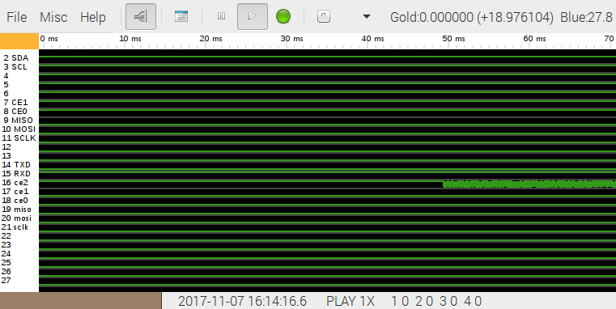
RPi2 toggles GPIO 16
Toggles of GPIO 16 captured RPi3 Raspbian w/piscope

Slide 8
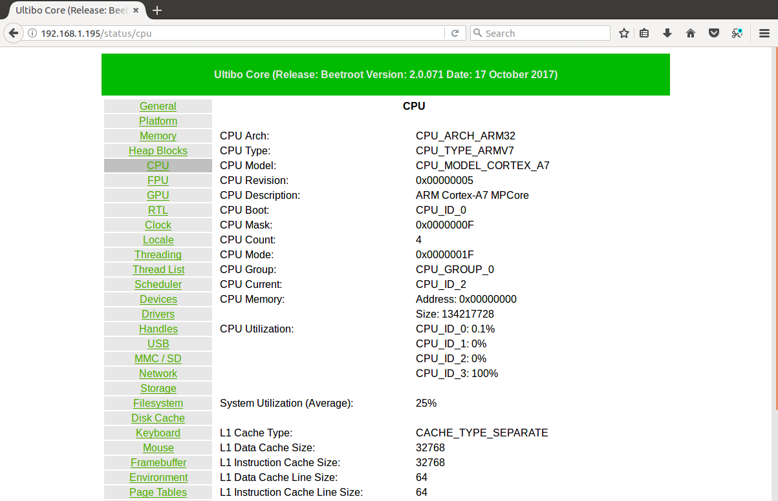
RPi2 CPU 3 running at 100%

