Slide 1
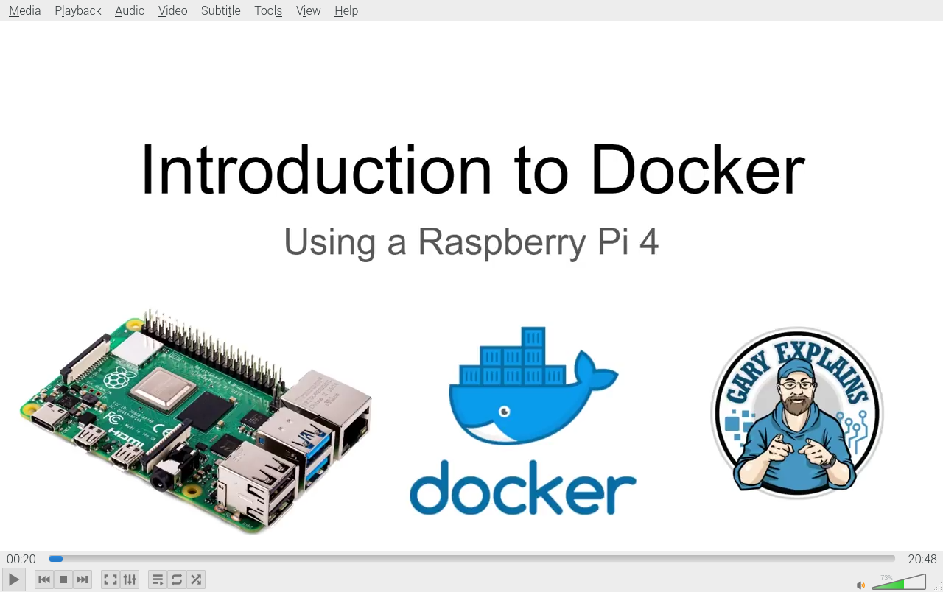

Slide 2
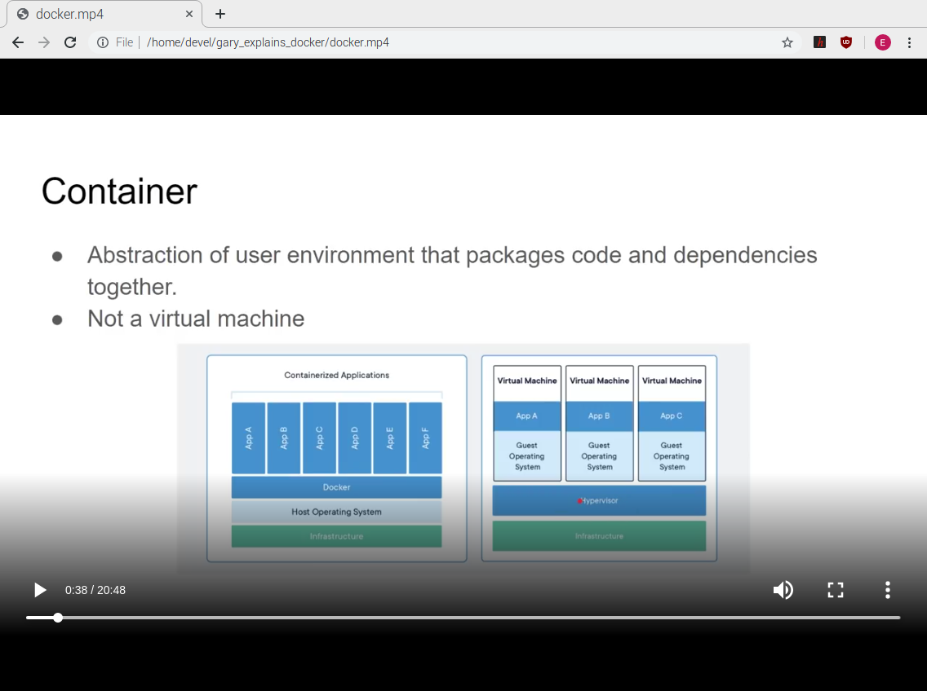

Slide 3
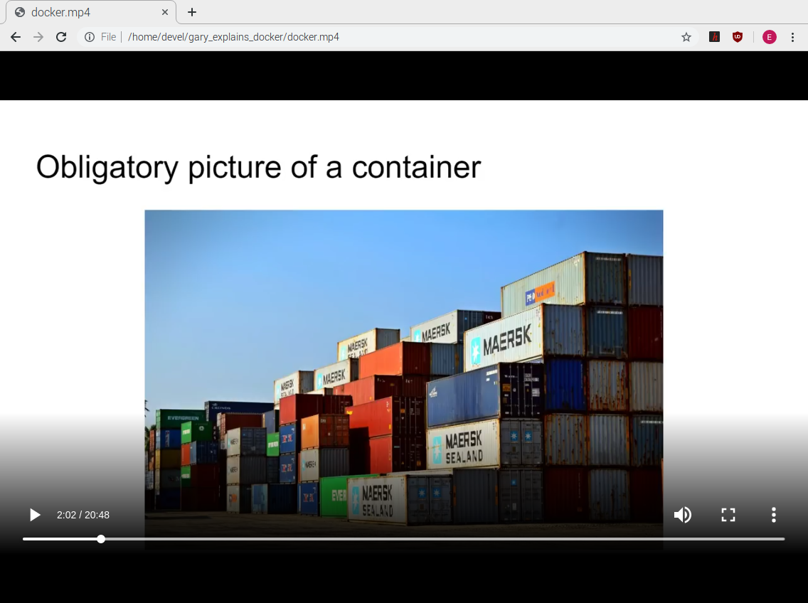

Slide 4
As of 01/12/20
Docker is supported with buster and there is no need to edit the get-docker.sh

Slide 5
docker version
docker version
Client: Docker Engine - Community
Version: 19.03.5
API version: 1.40
Go version: go1.12.12
Git commit: 633a0ea
Built: Wed Nov 13 07:37:22 2019
OS/Arch: linux/arm
Experimental: false
Server: Docker Engine - Community
Engine:
Version: 19.03.5
API version: 1.40 (minimum version 1.12)
Go version: go1.12.12
Git commit: 633a0ea
Built: Wed Nov 13 07:31:17 2019
OS/Arch: linux/arm
Experimental: false
containerd:
Version: 1.2.10
GitCommit: b34a5c8af56e510852c35414db4c1f4fa6172339
runc:
Version: 1.0.0-rc8+dev
GitCommit: 3e425f80a8c931f88e6d94a8c831b9d5aa481657
docker-init:
Version: 0.18.0
GitCommit: fec3683

Slide 6
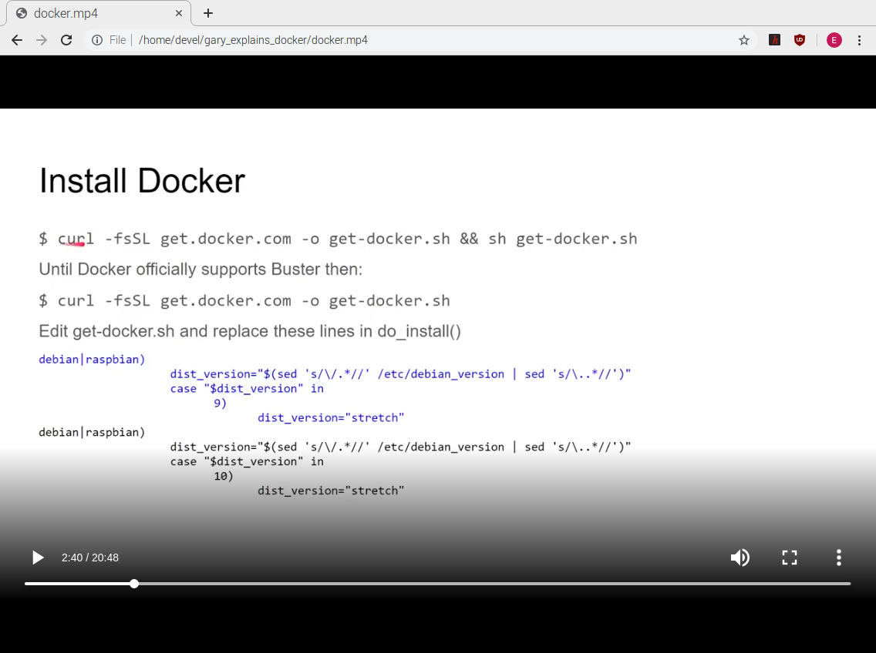

Slide 7
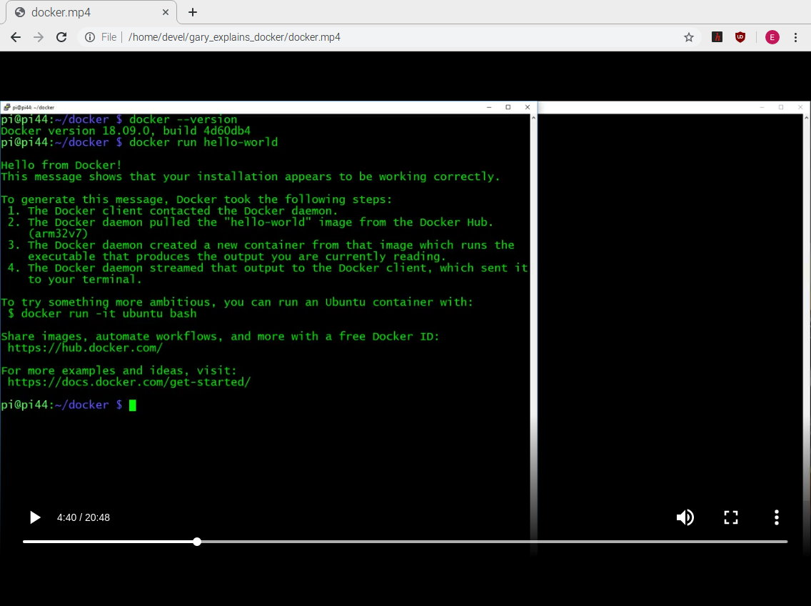

Slide 8
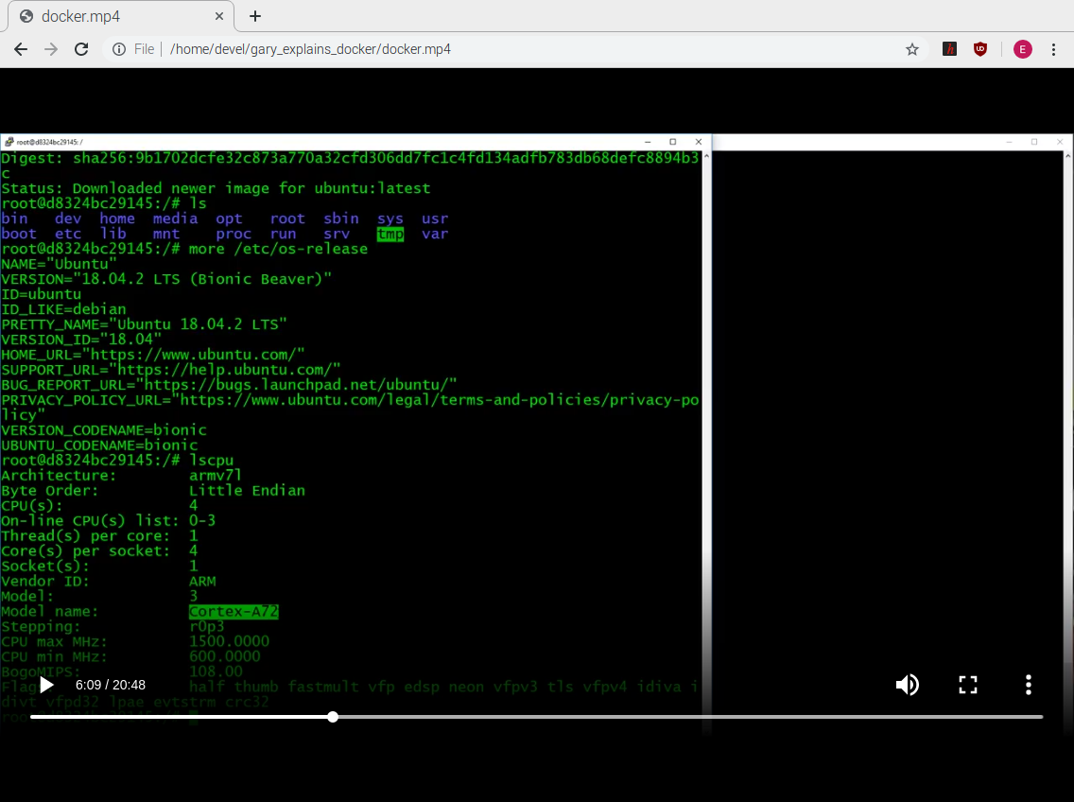

Slide 9
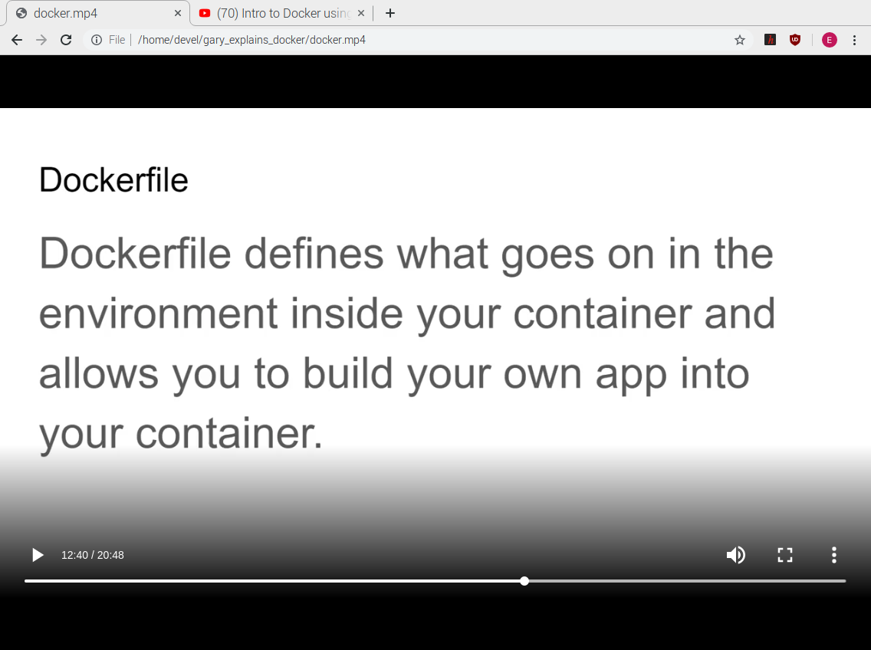

Slide 10
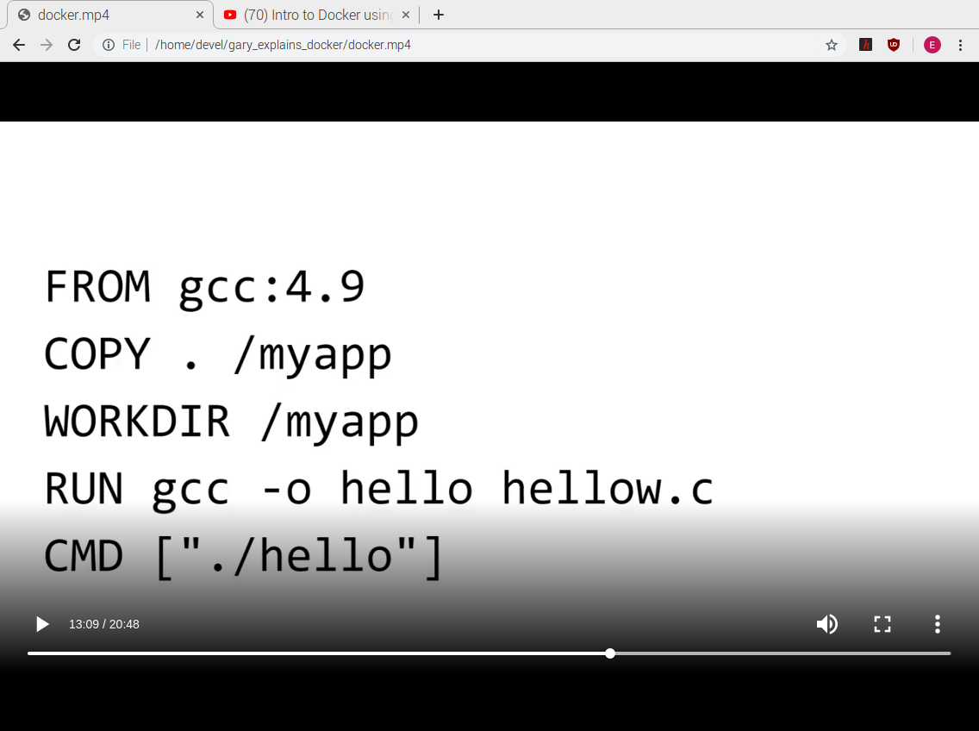

Slide 11
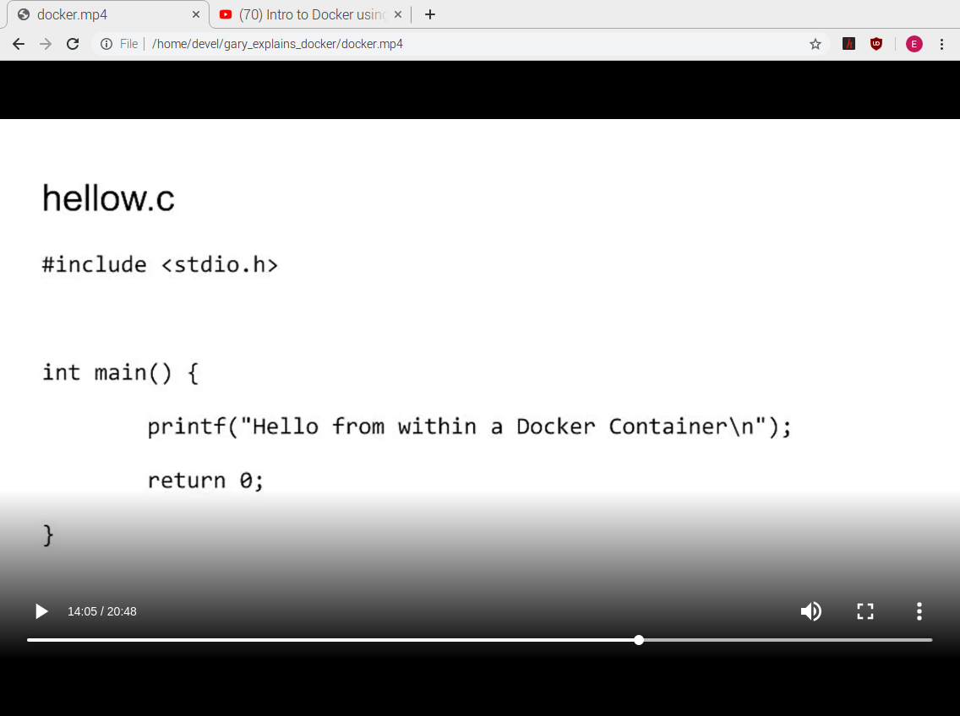

Slide 12
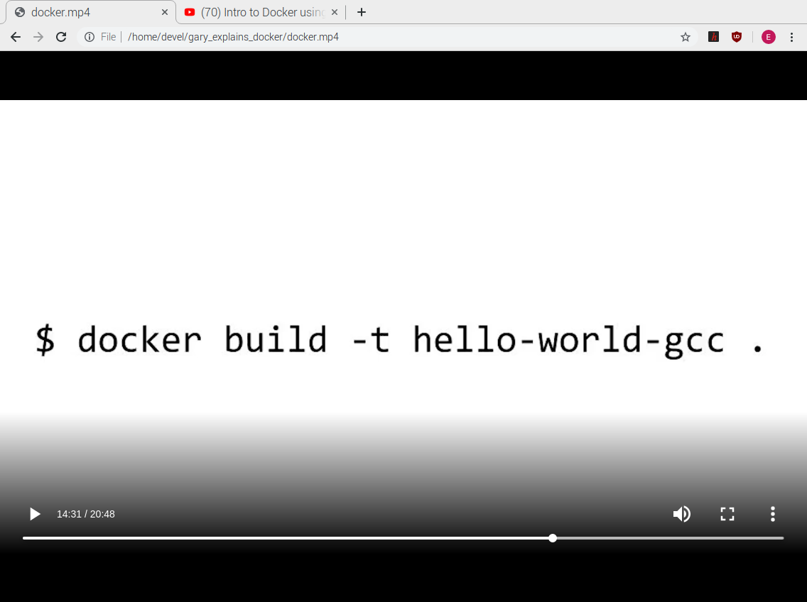

Slide 13
