Slide 1
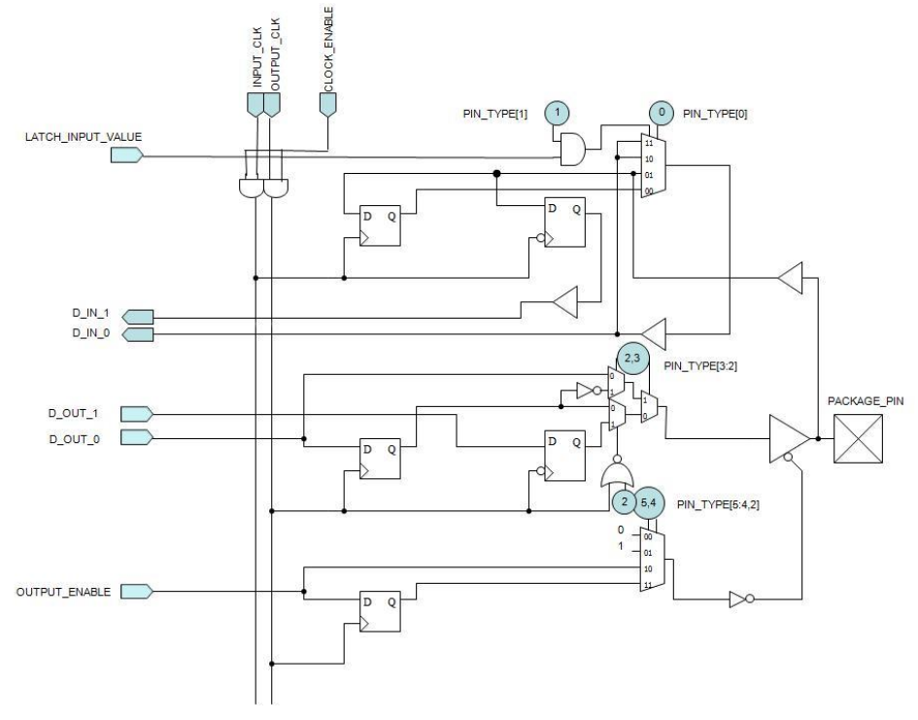
o_data[k] i_ram_data
i_data[k] o_ram_data
io_data[k] io_ram_data
!i_dir o_ram_we_n

Slide 2
ppio #(.W(16))
sdramioi(o_ram_we_n, io_ram_data, o_ram_data, i_ram_data);
module ppio(i_dir, io_data, i_data, o_data);
parameter W=8;
input i_dir;
inout [(W-1):0] io_data;
input [(W-1):0] i_data;
output [(W-1):0] o_data;
genvar k;
generate
for(k=0; k<W; k = k+1)
SB_IO #(.PULLUP(1'b0),
.PIN_TYPE(6'b101001))
theio(
.OUTPUT_ENABLE(!i_dir),
.PACKAGE_PIN(io_data[k]),
.D_OUT_0(i_data[k]),
.D_IN_0( o_data[k])
);
endgenerate
endmodule

Slide 3
Chg’ed catzip toplevl to be similar to xulalx25soc
assign io_ram_data = (ram_drive_data) ? o_ram_data : 16'bzzzz_zzzz_zzzz_zzzz;
reg [15:0] r_ram_data_ext_clk;
// always @(posedge intermediate_clk_n)
always @(posedge s_clk)
r_ram_data_ext_clk <= io_ram_data;
always @(posedge s_clk)
i_ram_data <= r_ram_data_ext_clk;
assign o_ram_clk = s_clk;

Slide 4
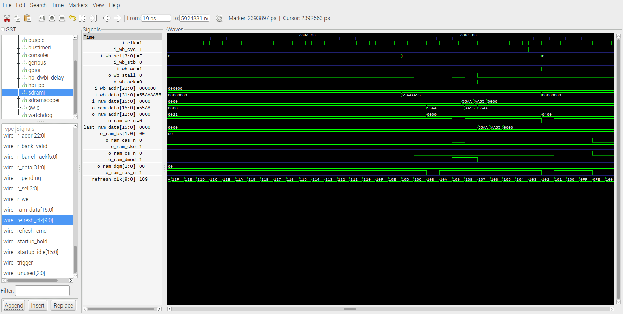
Write 0x2000000 0x55AAAA55
Address 0x0000 o_ram_data 0x55AA
o_ram_we_n & o_ram_cas_n & o_ram_dmod catzip
Error in simulation no lower 16 bits & hw
o_ram_data should be 0xaa55
Lower 16 bits get written to upper 16 bits hw

Slide 5
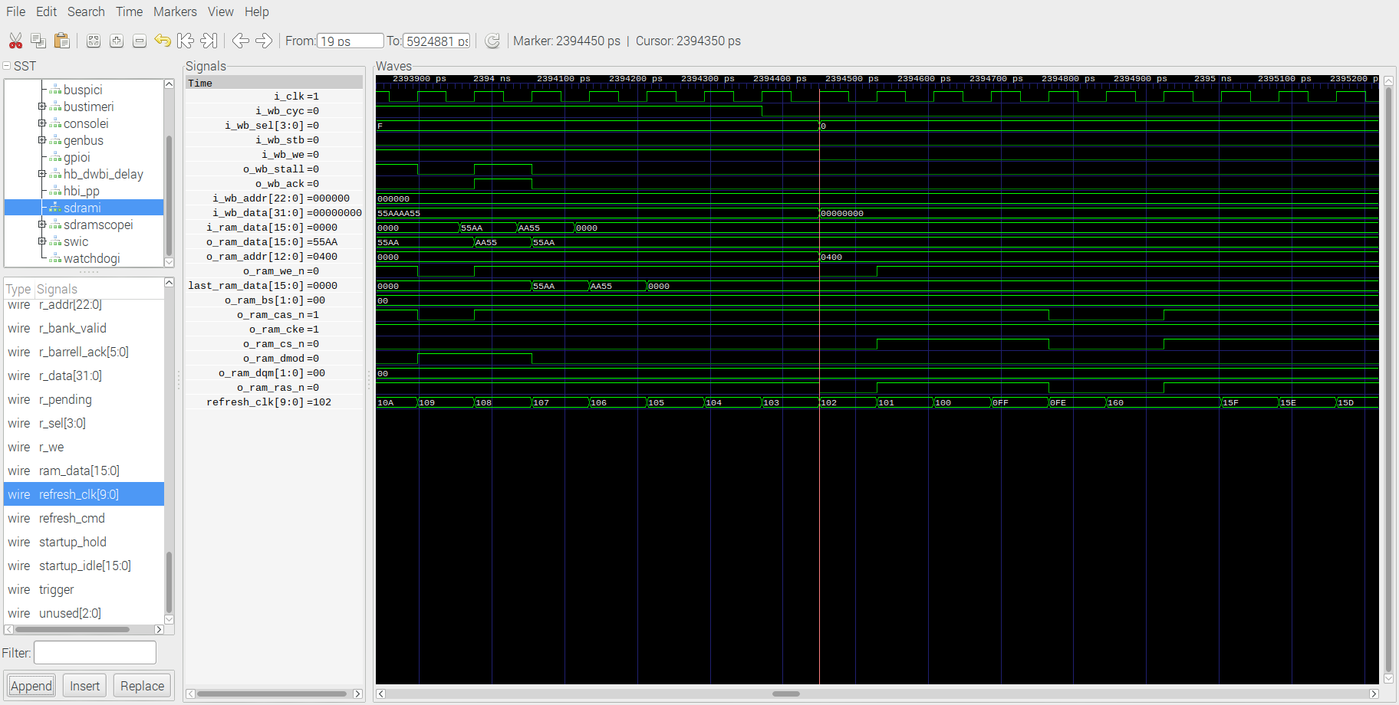
Write 0x2000000 0x55AAAA55
Address 0x0400 o_ram_data 0x55AA
o_ram_we_n & o_ram_ras_n
catzip
Error in simulation no lower 16 bits & hw
o_ram_data should be 0xaa55
Lower 16 bits get written to upper 16 bits hw

Slide 6
xula2lx25soc toplevel
wire ram_drive_data
reg [15:0] r_ram_data, // Data lines (input)
wire [15:0] ram_data, // Data lines (output)
assign io_ram_data = (ram_drive_data) ? ram_data : 16'bzzzz_zzzz_zzzz_zzzz;
reg [15:0] r_ram_data_ext_clk;
// always @(posedge intermediate_clk_n)
always @(posedge clk_s)
r_ram_data_ext_clk <= io_ram_data;
always @(posedge clk_s)
r_ram_data <= r_ram_data_ext_clk;
module busmaster(i_clk, i_rst,
i_rx_stb, i_rx_data, o_tx_stb, o_tx_data, i_tx_busy,
// The SPI Flash lines
o_sf_cs_n, o_sd_cs_n, o_spi_sck, o_spi_mosi, i_spi_miso,
// The SDRAM lines
o_ram_cs_n, o_ram_cke, o_ram_ras_n, o_ram_cas_n,
o_ram_we_n, o_ram_bs, o_ram_addr,
o_ram_drive_data, i_ram_data, o_ram_data,

Slide 7
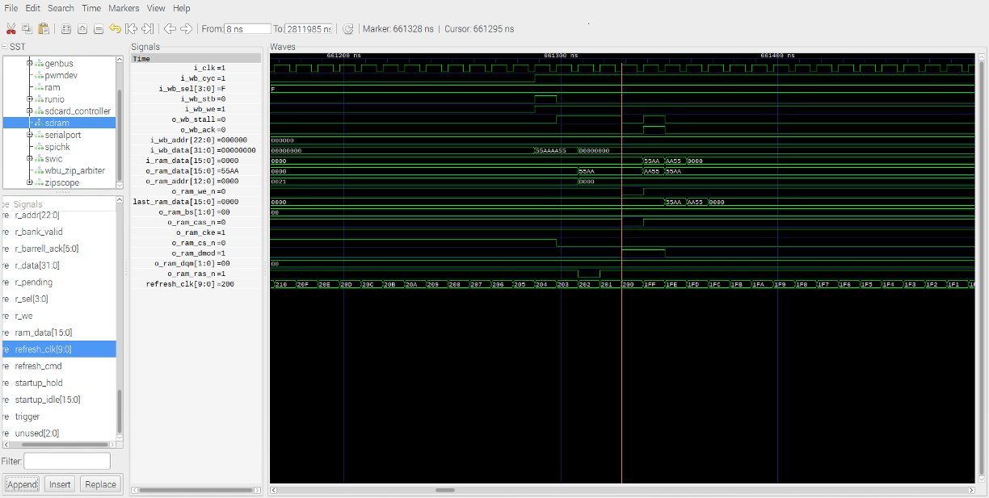
Write 0x2000000 0x55AAAA55
Address 0x0000 o_ram_data 0x55AA
o_ram_we_n & o_ram_cas_n & o_ram_dmod xulalx25soc

Slide 8
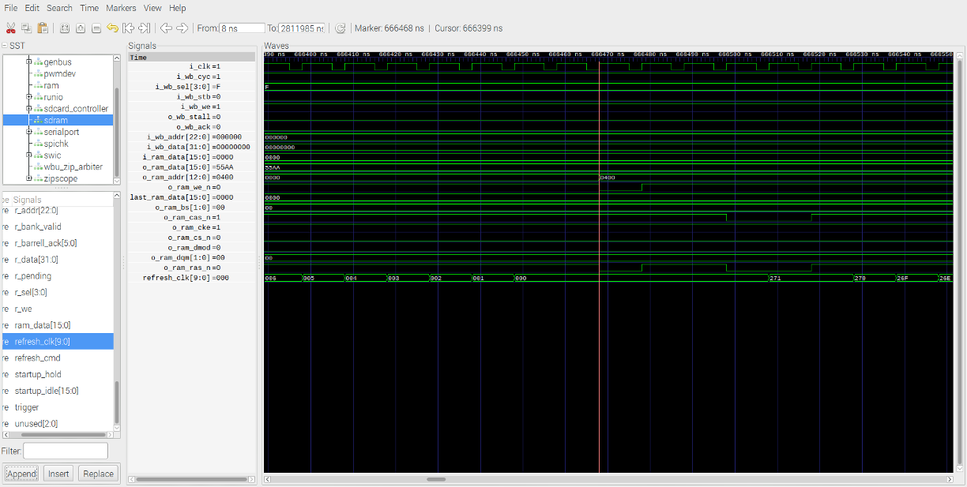
Write 0x2000000 0x55AAAA55
Address 0x0400 o_ram_data 0x55AA
o_ram_we_n & o_ram_ras_n
xulalx25soc
Error in simulation hw okay xulalx25soc
Should be o_ram_data 0xaa55

