Slide 1
Bookworm vs Bullseye

Slide 2
Bookworm vs Bullseye
RPi5
cat /etc/os-release
PRETTY_NAME="Debian GNU/Linux 12 (bookworm)"
NAME="Debian GNU/Linux"
VERSION_ID="12"
VERSION="12 (bookworm)"
VERSION_CODENAME=bookworm
ID=debian
HOME_URL="https://www.debian.org/"
SUPPORT_URL="https://www.debian.org/support"
BUG_REPORT_URL="https://bugs.debian.org/"
RPi4
cat /etc/os-release
PRETTY_NAME="Debian GNU/Linux 11 (bullseye)"
NAME="Debian GNU/Linux"
VERSION_ID="11"
VERSION="11 (bullseye)"
VERSION_CODENAME=bullseye
ID=debian
HOME_URL="https://www.debian.org/"
SUPPORT_URL="https://www.debian.org/support"
BUG_REPORT_URL="https://bugs.debian.org/"

Slide 3
Bookworm vs Bullseye
ii binutils-arm-none-eabi 2.35.2-2+14+b2 arm64 GNU assembler, linker and binary utilities for ARM Cortex-R/M processors
ii gcc-arm-none-eabi 15:8-2019-q3-1+b1 arm64 GCC cross compiler for ARM Cortex-R/M processors
ii libnewlib-arm-none-eabi 3.3.0-1 all C library and math library compiled for bare metal using Cortex A/R/M
ii libstdc++-arm-none-eabi-newlib 15:8-2019-q3-1+13 all GNU Standard C++ Library v3 for ARM Cortex-R/M processors (newlib)
ii binutils-arm-none-eabi 2.40-2+18+b1 arm64 GNU assembler, linker and binary utilities for ARM Cortex-R/M processors
ii gcc-arm-none-eabi 15:12.2.rel1-1 arm64 GCC cross compiler for ARM Cortex-R/M processors
ii libnewlib-arm-none-eabi 3.3.0-1.3 all C library and math library compiled for bare metal using Cortex A/R/M
ii libstdc++-arm-none-eabi-dev 15:12.2.rel1-1+23 all GNU Standard C++ Library v3 for ARM Cortex-R/M processors (headers)
ii libstdc++-arm-none-eabi-newlib 15:12.2.rel1-1+23 all GNU Standard C++ Library v3 for ARM Cortex-R/M processors (newlib)

Slide 4
picow_freertos_iperf.c
Bullseye
head_tail.c
head_tail.h
char tmp[80];
char * ptrhead;
char * ptrtail;
char * ptrendofbuf;
char * ptrtopofbuf;
Circular buffer functions
tcp_debug.h
Uses Networking
functions
char client_message[BUF_SIZE];
Uses Circular
buffer functions
tcp_debug.c
Networking functions

Slide 5
Bookworm
head_tail.c
picow_freertos_iperf.c
head_tail.h
char tmp[80];
char * ptrhead;
char * ptrtail;
char * ptrendofbuf;
char * ptrtopofbuf;
Circular buffer functions
char client_message[BUF_SIZE]
tcp_debug.h
Uses Networking functions
extern char client_message[BUF_SIZE];
Uses Circular
buffer functions
tcp_debug.c
Networking functions

Slide 6
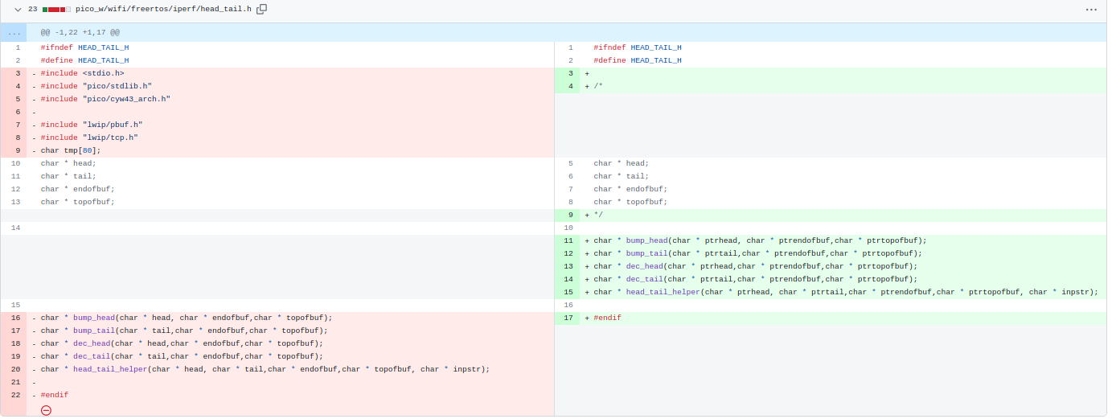

Slide 7
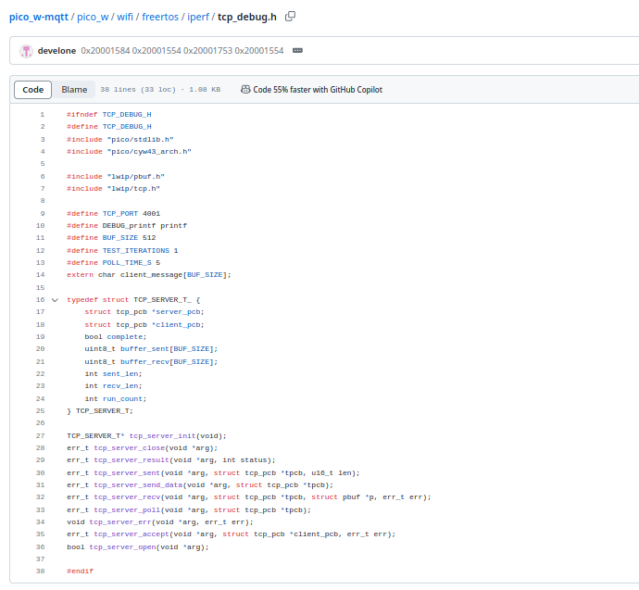

Slide 8
