Slide 1
Draft 03/15/18
Requirements
Draft 03/15/18
Quick Boot time
Rapid updates transfer the kernel7.img or kernel.img
Max uptime
Gbit Ethernet will require next gen Rpi3B+
Systems with 1 or 2 Displays
Displays with touch support
  Up to 30 in.

Slide 2
Systems Required
Development
  Lazarus IDE (Ultibo Edition)
  Compilers
  Linkers
  Git Tools revison control
  WebBroswer
  Office Tools
  Telnet
  TFTP
Testing Deployment
  Executables
    kernel7.img or kernel.img
  Firmware
    bootcode.bin
    fixup_x.dat
    start_x.elf
    config.txt

Slide 3
Linux Distros
Redhat Centos & Fedora
Debian Ubuntu RaspBian
Distros
  Create packages from source in either rpm or deb formats.
  Provide Repositories on the Internet.

Slide 4
Package Managers
Red Hat Fedora Centos
  yum
  rpm
Debian Ubuntu RaspBian
  apt-get
  dpkg

Slide 5
Packages
Dependancies
  Libc
  Libm
  Source code

Slide 6
Package Installers
Manual ISO install plus additional packages then cloned
Cobbler
LiveDVD creator
Satellite Server Spacewalk
pi-gen this is the method that will be used to create the Raspbian with Lazarus IDE (Ultibo Edition)

Slide 7
Pi-gen installer
Raspbian Packages
Downloaded from Internet
Local repository
pi-gen
ultibo94af3cb.tgz
Zip File

Slide 8
Configuration Files
Adding new users.
Adding application software.
Changing services that were set by default.
Locking down system.

Slide 9
DEMO SYSTEM REQUIREMENTS
3 RASPBERRY Pi 2B or Pi 3B.
3 HDMI monitors
1 Logitech wireless keyboard & mouse.
1 D-Link 4 port hub
1 32 GB mirco sd card Lazarus IDE (Ultibo Edition)
2 4 GB mirco sd card or > for Ultibo systems
1 RASPBERRY Pi Camera
1 Micro Servo - High Powered, High Torque Metal Gear[ID:2307] = $11.95

Slide 10
RaspBian
Lazarus (Ultibo Edition)
RaspBian
Lazarus (Ultibo Edition)
https://github.com/develone/Ultibo_Projects.git
pi@raspberrypi:~ $ git clone https://github.com/develone/Ultibo_Projects.git
Cloning into 'Ultibo_Projects'...
remote: Counting objects: 153, done.
remote: Compressing objects: 100% (120/120), done.
remote: Total 153 (delta 58), reused 114 (delta 22), pack-reused 0
Receiving objects: 100% (153/153), 2.71 MiB | 1.60 MiB/s, done.
Resolving deltas: 100% (58/58), done.
Compile UltiboDemoRPi2_TFTP.lpi using Lazarus (Ultibo Edition)
cd Ultibo_Projects
/run_demos.sh 185 jpeg
tftping DWT_LIFT_RPi2 kernel7.img
to ultibo system 192.168.1.185
tftp> tftp> Sent 3111876 bytes in 10.7 seconds
./run_demos.sh 200 jpeg
tftping DWT_LIFT_RPi2 kernel7.img
to ultibo system 192.168.1.200
tftp> tftp> Sent 3111876 bytes in 11.1 seconds
Compile RaspiVid_TFTP.lpi using Lazarus (Ultibo Edition)
./run_demos.sh 200 video
tftping RaspiVid_TFTP kernel7.img
to ultibo system 192.168.1.200
tftp> tftp> Sent 3145892 bytes in 15.5 seconds
Compile PWM_TFTP_SERVO.lpi using Lazarus (Ultibo Edition)
./run_demos.sh 185 servo
tftping PWM_TFTP_SERVO kernel7.img
to ultibo system 192.168.1.185
tftp> tftp> Sent 2743472 bytes in 10.8 seconds
./run_demos.sh 200 servo
no servo 192.168.1.200
RPi3B
Pi Camera
RPi3B
Servo
RPi2B
GPS

Slide 11
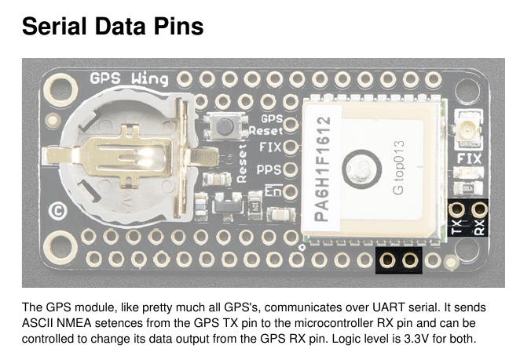
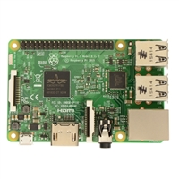
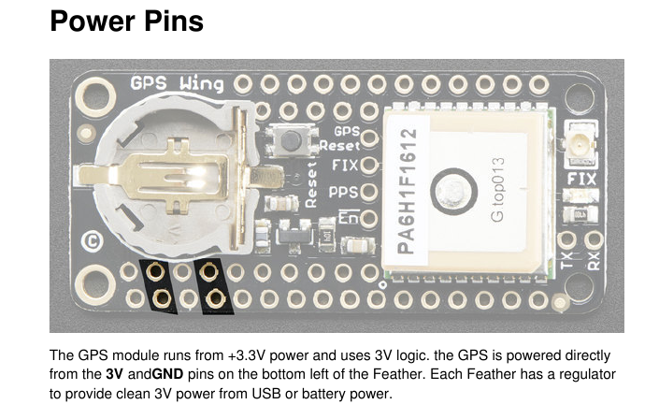
Pin 6 grd from Rpi2B to brown servo
Pin 2 +5 from Rpi2B to orange servo
Pin 12 PWM0 from Rpi2B to yellow servo
Pin 10 Rx from Rpi2B to GPS
Pin 1 +3.3 from Rpi2B to GPS pin 2
Pin 9 grd from Rpi2B to GPS pin 4

Slide 12
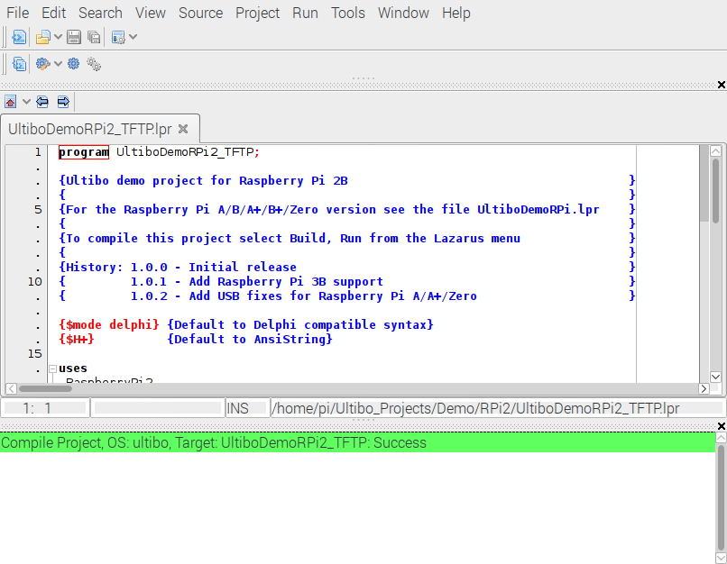
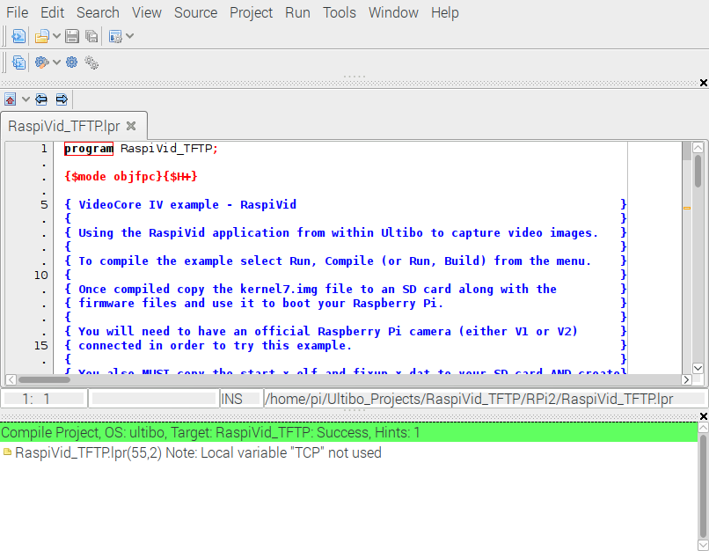
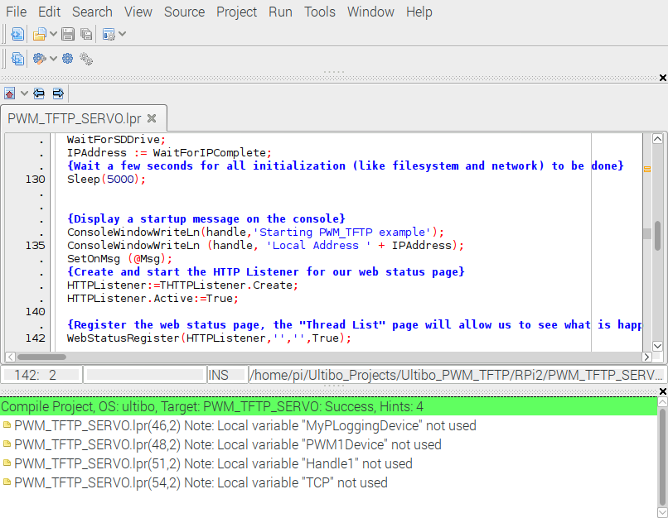
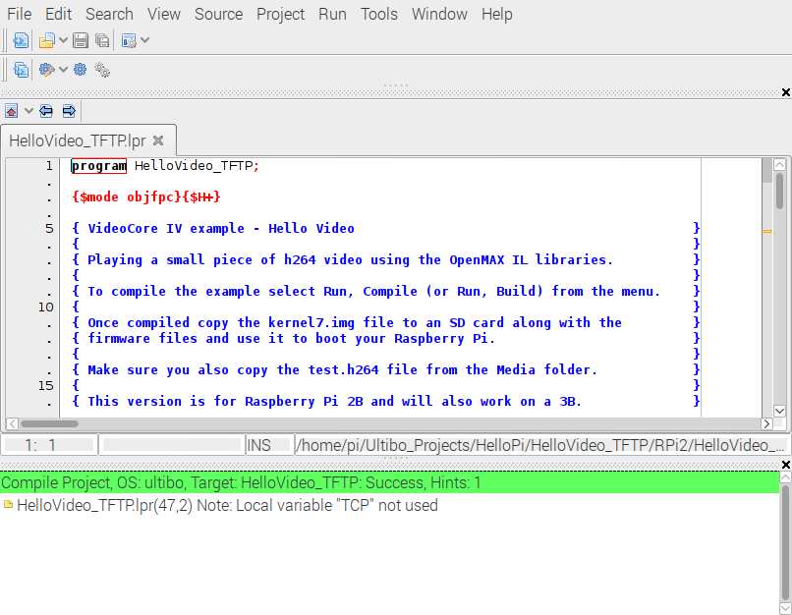
Examples of compiling 4 projects After opening the projects from main menu Project/Open Project
Green bar indicates that the code compiled & linked successfully with main menu Run/Compile

