Slide 1
Raspberry Pi & Pico

Slide 2
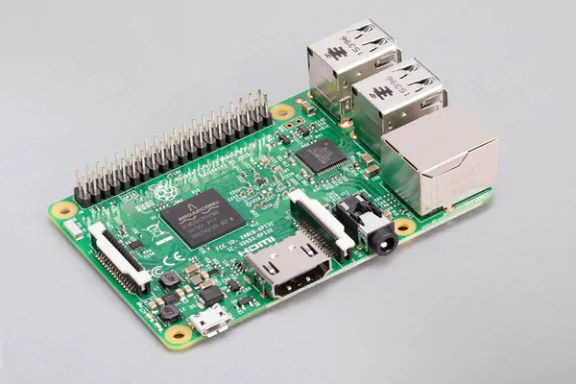

Slide 3
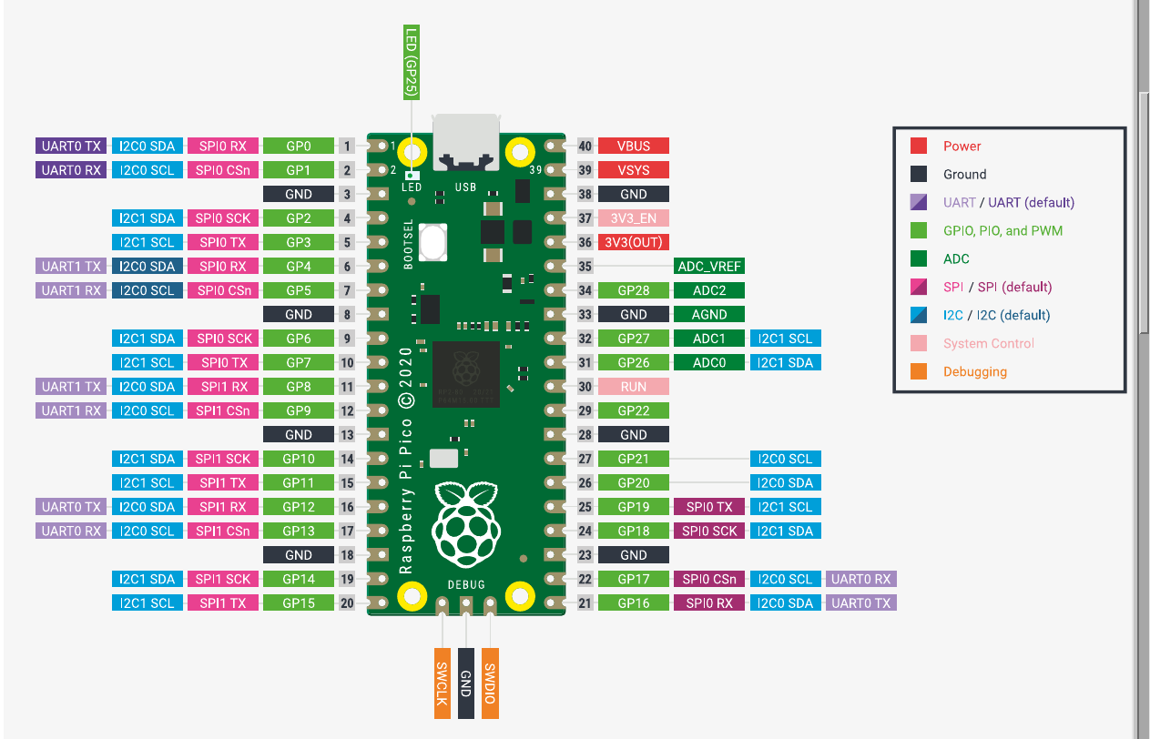

Slide 4
