Slide 1
Bare Metal QEMU Butterworth LP Filter.

Slide 2
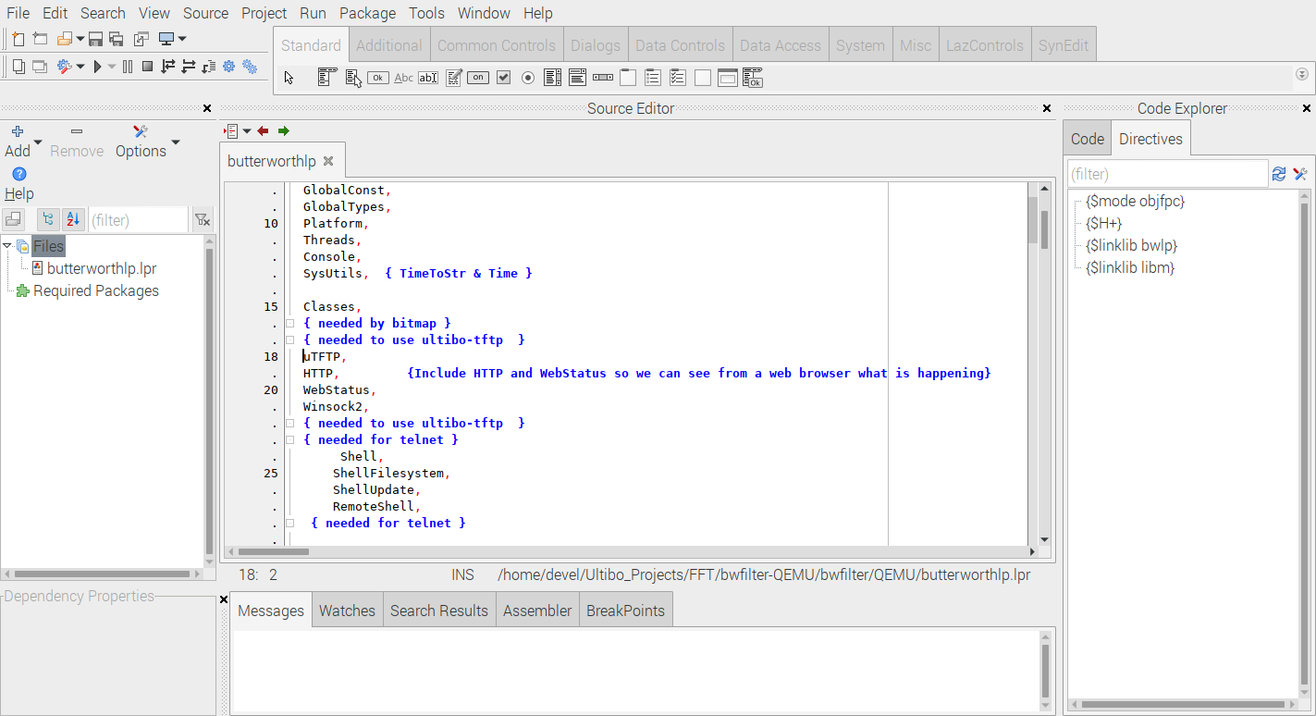
devel@pi4-60:~ $ ./ultibo/core/lazarus.sh

Slide 3
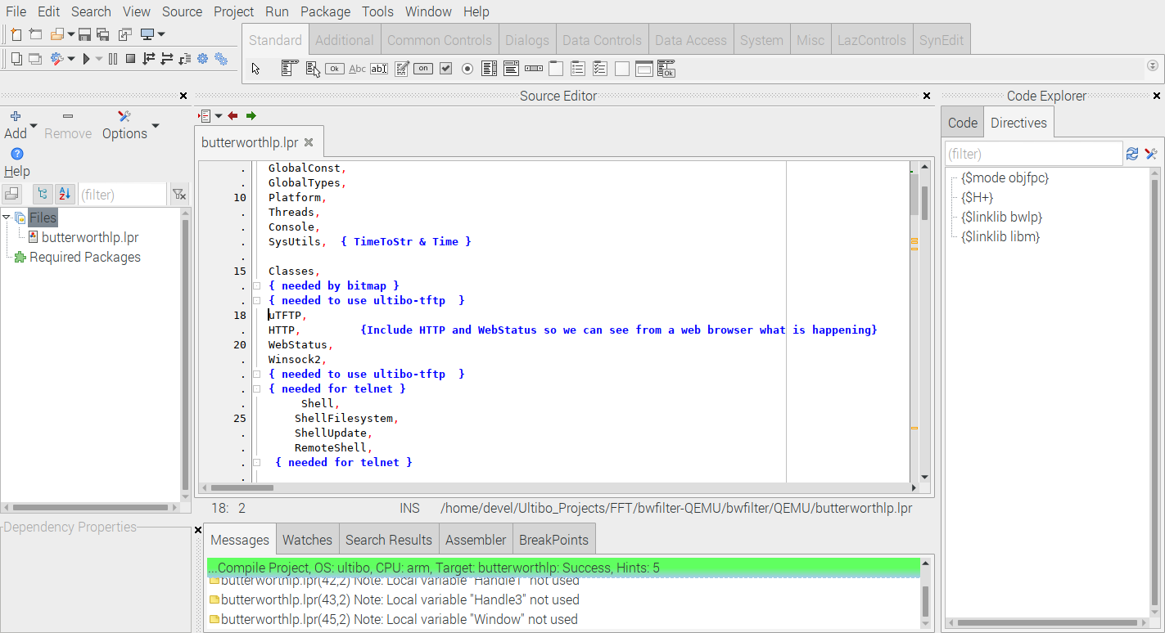

Slide 4
Steps to compile kernel.bin
devel@pi4-60:~/Ultibo_Projects/FFT/bwfilter-QEMU/bwfilter $ ./compile-ultibo.sh
Compile the butterworthlp.lpi
using Lazarus IDE (Ultibo-Edition)

Slide 5
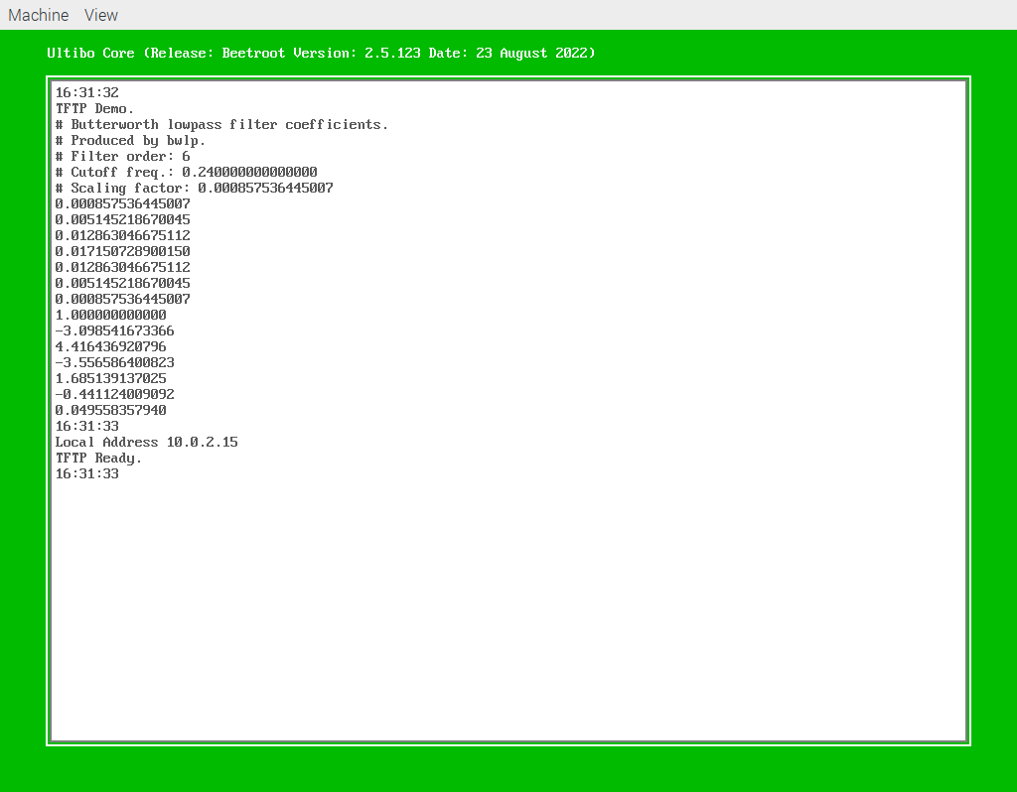
devel@pi4-60:~/Ultibo_Projects/FFT/bwfilter-QEMU/bwfilter/QEMU $ ./startqemu.sh

