Slide 1
Search Raspberry Pi Zero 2W openClaw
https://www.reddit.com/r/raspberry_pi/comments/1rc3gj1/personal_assistant_device_using_openclaw_and_pi/?utm_source=share&utm_medium=web3x&utm_name=web3xcss&utm_term=1&utm_content=share_button
Search Raspberry Pi Zero 2W openClaw github
Quick Setup for Pi Zero 2 W
https://www.google.com/search?client=firefox-b-1-e&channel=entpr&q=Raspberry+Pi>
Search raspberry pi zero 2w oled display
https://shop.pimoroni.com/products/adafruit-pioled-128x32-monochrome-oled-add-on-for-raspberry-pi?variant=42319359114
Ultibo and Pi-Zero 2W
https://ultibo.org/forum/viewtopic.php?p=14816#p14816

Slide 2
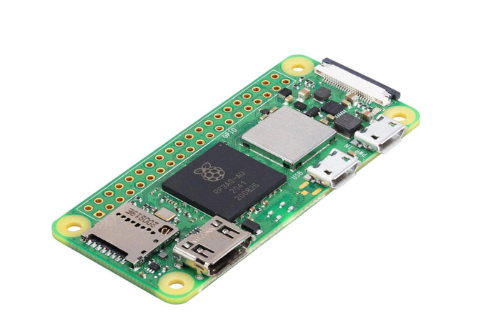
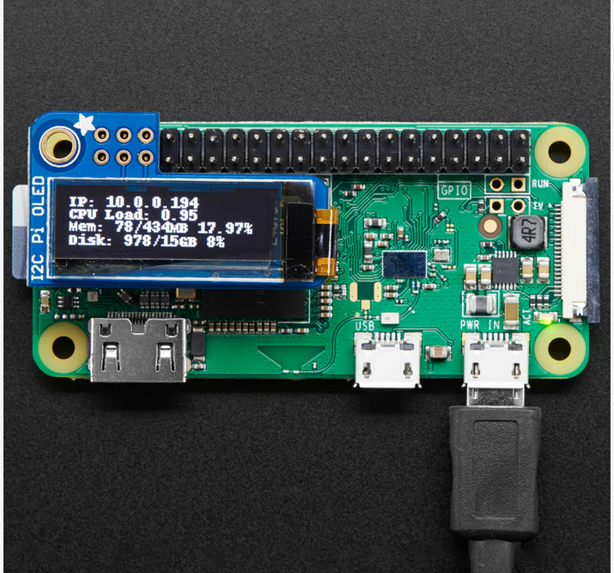
Raspberry Pi Zero 2w

