Slide 1
X-Window & Networking

Slide 2
Goal: Accessing 1of 5 RPi4B from the Over the Internet with graphical displays

Slide 3
Goal: Accessing 1of 5 RPi4B from the Over the Internet with graphical displays
Examples graphical displays
  Geany editor
  Octave matlab like program
  Gtkwave VCD viewer
  Mousepad editor
  GIMP
  Lazarus IDE (Ulitobo Editor)
    Bare metal for Pi
      QEMU, Rpi Zero, RPi3B+, RPi4, and CM4

Slide 4

Internet
RPi3B+ 1Gb
pass-thru
162.197.186.179
pi4-40
ATT Router
RPi4B 4Gb
RPi4B 4Gb
RPi4B 4Gb
RPi4B 4Gb
RPi5 8Gb
RPi3B+ 1Gb
192.168.1.212
pi4-50
192.168.1.211
pi4-30
192.168.1.245
pi4-60
192.168.1.229
pi4-27
192.168.1.93
pi5-70
192.168.1.231
pi4-37
Century Link
192.168.14.1
RPi ZeroW
Century Link6
192.168.32.1
sudo route add -net 192.168.42.0 netmask 255.255.255.0 gw 192.168.1.235 eth0
sudo route add -net 192.168.42.0 netmask 255.255.255.0 gw 192.168.1.235 wlan0
192.168.1.235
wiifiextender
RPi4B 4Gb
RPi3B+ 1Gb
192.168.42.116
pi4-20
192.168.42.119
pi4-3
Century Link4
192.168.16.1
Century Link3
192.168.12.1

Slide 5
Internet
TMO-G4AR.lan
192.168,12.1
RPi5 8Gb
RPi3B+ 1Gb
RPi5 8Gb
RPi5 8Gb
T-Mobile Router
192.168.12.208
pi5-70
192.168.1.231
pi4-37
192.168.12.237
pi5-80
192.168.12.196
pi5-90
RPi4B 4Gb
RPi4B 4Gb
RPi4B 4Gb
RPi4B 4Gb
192.168.1.212
pi4-50
192.168.1.211
pi4-30
192.168.1.245
pi4-60
192.168.1.229
pi4-27
Century Link
192.168.14.1
RPi ZeroW
Century Link6
192.168.32.1
sudo route add -net 192.168.42.0 netmask 255.255.255.0 gw 192.168.1.235 eth0
sudo route add -net 192.168.42.0 netmask 255.255.255.0 gw 192.168.1.235 wlan0
192.168.1.235
wiifiextender
RPi4B 4Gb
RPi3B+ 1Gb
192.168.42.116
pi4-20
192.168.42.119
pi4-3
Century Link4
192.168.16.1
Century Link3
192.168.12.1

Slide 6
Internet
TMO-G4AR.lan
192.168,12.1
T-Mobile Router
pi4-37 “SSID” "Century Link6"
pi4-3 “SSID” “Century Link3"
pi4-20 “SSID” “Century Link4"
RPi5 8Gb
RPi ZeroW
RPi5 8Gb
RPi5 8Gb
RPi4 4Gb
192.168.12.208
pi5-70
192.168.1.141
wifiextender
192.168.12.237
pi5-80
192.168.12.196
pi5-90
192.168.12.129
remte-vpn
RPi4 4Gb
pico_w
remote7
192.168.12.120
pico_w
remote8
192.168.12.106
pico_w
remote9
192.168.12.108
RPi3 1Gb
RPi3 1Gb
pico_w
remote5
192.168.16.114
pico_w
remote5
192.168.32.106
192.168.42.116
pi4-20
192.168.42.119
pi4-3
192.168.42.105
pi4-37

Slide 7
Internet
RPi3B+ 1Gb
pass-thru
162.197.186.179
pi4-40
ATT Router
RPi4B 4Gb
RPi4B 4Gb
RPi4B 4Gb
RPi4B 4Gb
RPi5 8Gb
RPi5 8Gb
RPi5 8Gb
192.168.1.212
pi4-50
192.168.1.230
pi4-30
192.168.1.218
pi4-2
192.168.1.229
pi4-27
192.168.1.93
pi5-70
192.168.1.240
pi5-80
192.168.1.253
pi5-90
Century Link
192.168.14.1
RPi ZeroW
sudo route add -net 192.168.42.0 netmask 255.255.255.0 gw 192.168.1.235 eth0
sudo route add -net 192.168.42.0 netmask 255.255.255.0 gw 192.168.1.235 wlan0
192.168.1.235
wiifiextender
RPi4B 4Gb
RPi3B+ 1Gb
RPi3B+ 1Gb
192.168.42.116
pi4-20
192.168.42.119
pi4-3
192.168.42.105
pi4-37
Century Link4
192.168.16.1
Century Link3
192.168.12.1
Century Link6
192.168.32.1

Slide 8
devel@pi5-90:~ $ ./scripts-rpi/route/2nd_level-tmo.sh
Kernel IP routing table
Destination Gateway Genmask Flags Metric Ref Use Iface
default TMO-G4AR.lan 0.0.0.0 UG 600 0 0 wlan0
192.168.12.0 0.0.0.0 255.255.255.0 U 600 0 0 wlan0
192.168.42.0 wifiextender.la 255.255.255.0 UG 0 0 0 wlan0
SIOCADDRT: File exists
Kernel IP routing table
Destination Gateway Genmask Flags Metric Ref Use Iface
default TMO-G4AR.lan 0.0.0.0 UG 600 0 0 wlan0
192.168.12.0 0.0.0.0 255.255.255.0 U 600 0 0 wlan0
192.168.42.0 wifiextender.la 255.255.255.0 UG 0 0 0 wlan0
devel@pi5-90:~ $ traceroute 192.168.42.116
traceroute to 192.168.42.116 (192.168.42.116), 30 hops max, 60 byte packets
1 wifiextender.lan (192.168.12.141) 77.323 ms 77.362 ms 77.354 ms
2 pi4-20 (192.168.42.116) 77.347 ms 77.405 ms 77.399 ms

Slide 9
pi4-50
Pico_w Zone1
remote1 192.168.1.160
remote3 192.168.1.178
remote4 192.168.1.177
remote5 192.168.1.168
remote6 192.168.1.175
pi4-37
Pico_w Zone2
SSID Century Link6
remote5 192.168.32.106
pi4-20
Pico_w Zone3
SSID Century Link4
remote5 192.168.16.114
pi4-3
Pico_w Zone4
SSID Century Link3
remote8 192.168.12.120
remote9 192.168.12.108
remote7 192.168.12.106

Slide 10
Goal: Accessing 1of 5 RPi4B from the Over the Internet with graphical displays
Steps Required
Need to ssh to
LAN Home RPi3B+ on 162.197.186.xx
Need to ssh to 1 of 5 RPi4B
Run Graphical Application

Slide 11
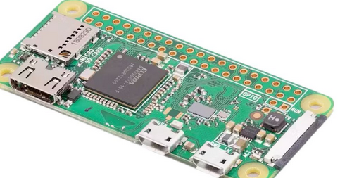
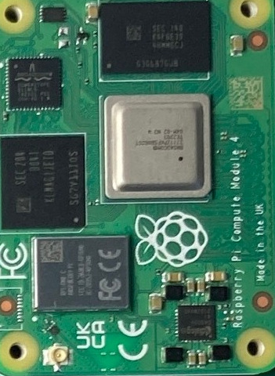
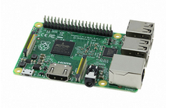
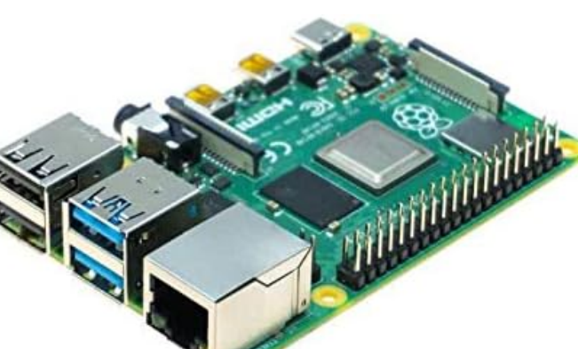
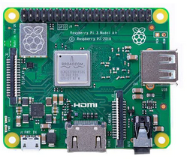
RPi Models
RPi CM4
RPi3B+
RPi3A
RPi4B

Slide 12
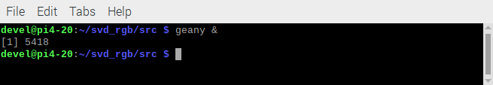
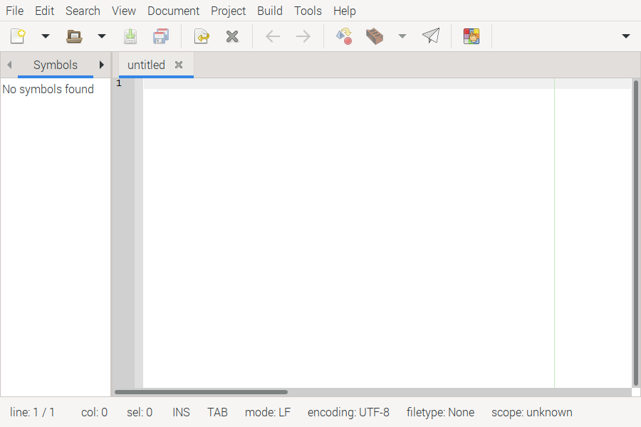

Slide 13
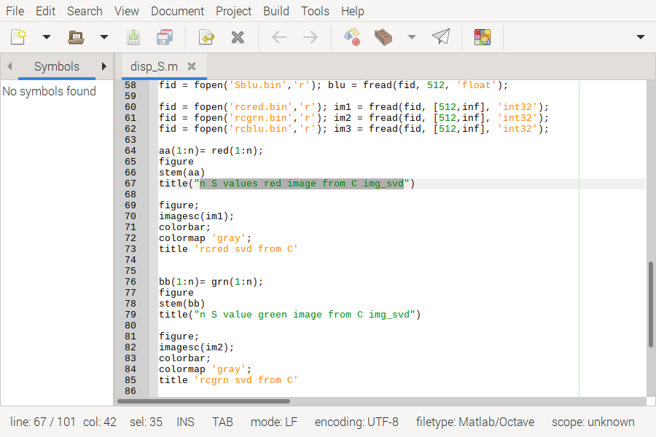

Slide 14
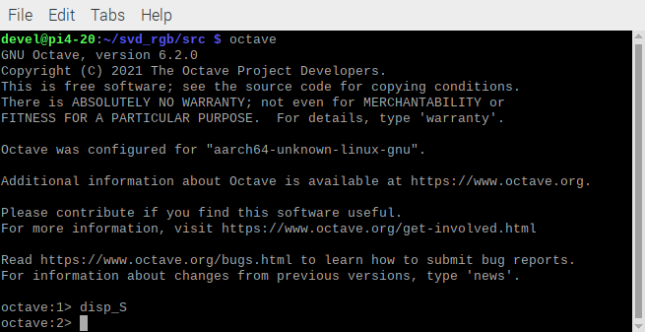

Slide 15
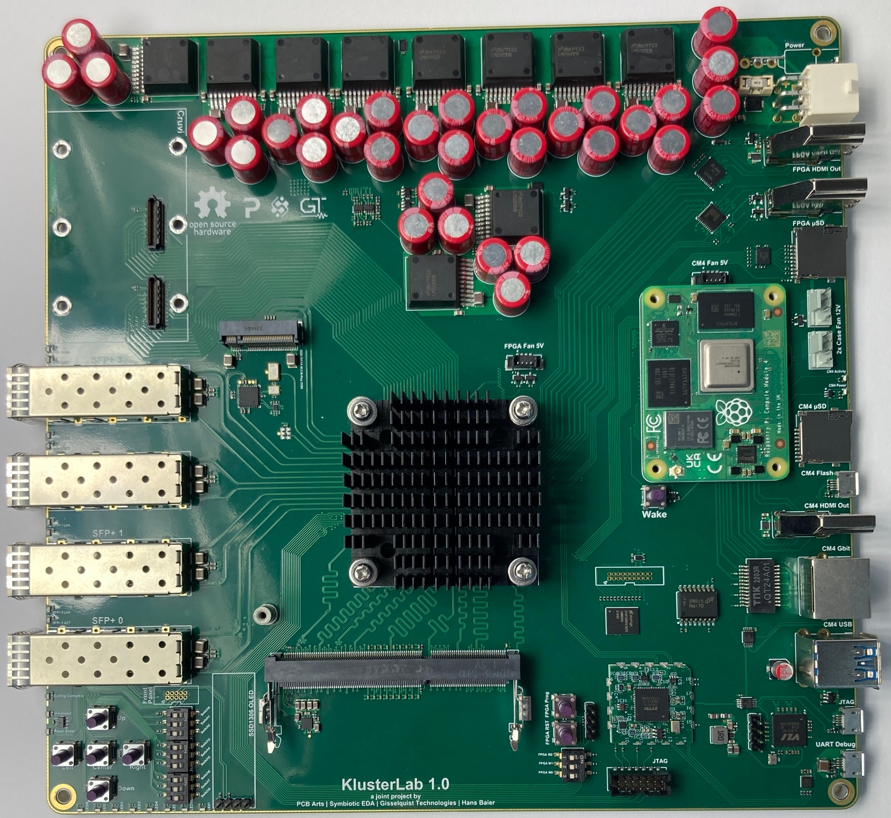
Rpi CM4 with FPGA Kintex-7 160T with 4 Ethernet 10Gb

Slide 16
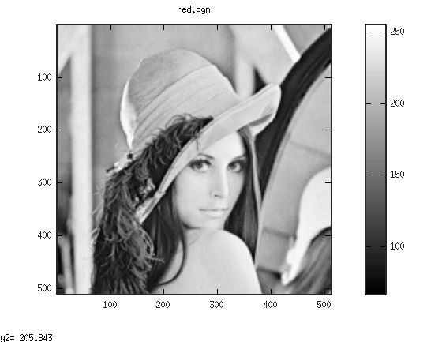
500 x 500 red subband lena

Slide 17

500 x 500 red subband lena reconstructed after perfoming KLT

Slide 18
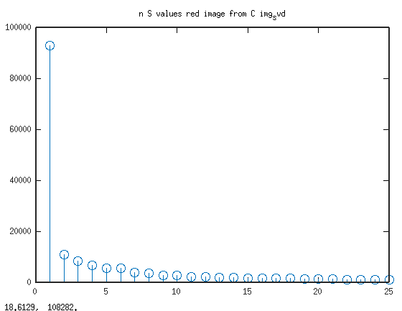
n S values red image from C img_svd

Slide 19
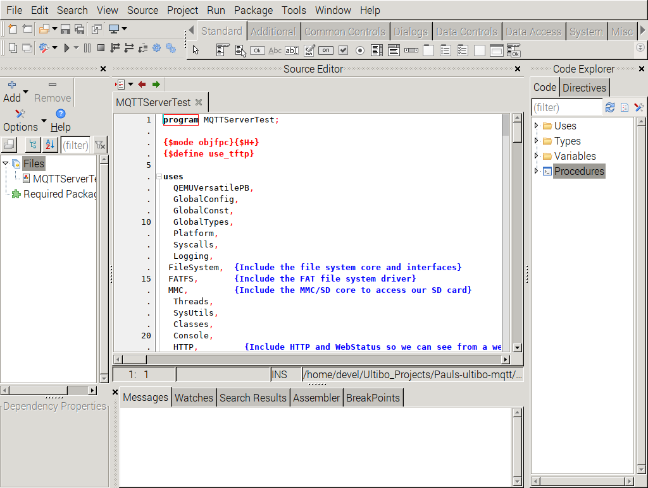
Goal: Accessing 1of 5 RPi4B from the Over the Internet with graphical displays

Slide 20
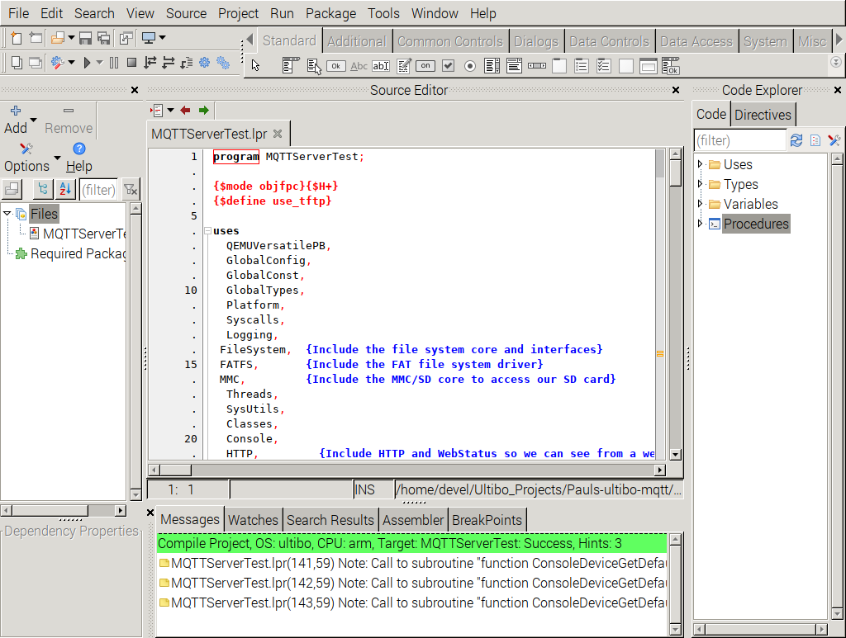
Goal: Accessing 1of 5 RPi4B from the Over the Internet with graphical displays

Slide 21
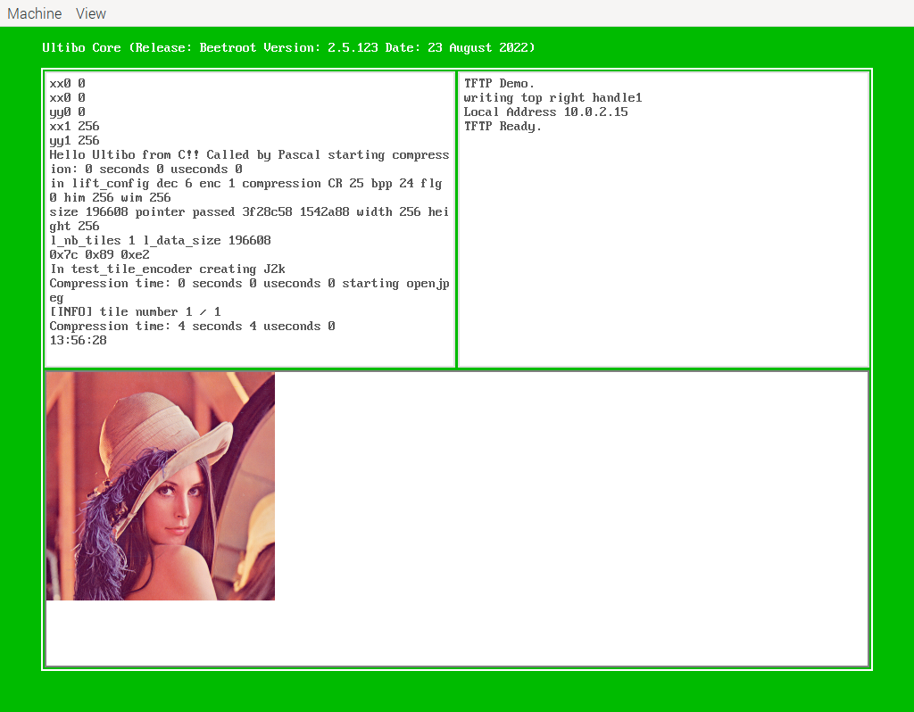
Goal: Accessing 1of 5 RPi4B from the Over the Internet with graphical displays
devel@pi4-20:~/Ultibo_Projects/jpeg2000/QEMU $ ./startqemu.s

Slide 22
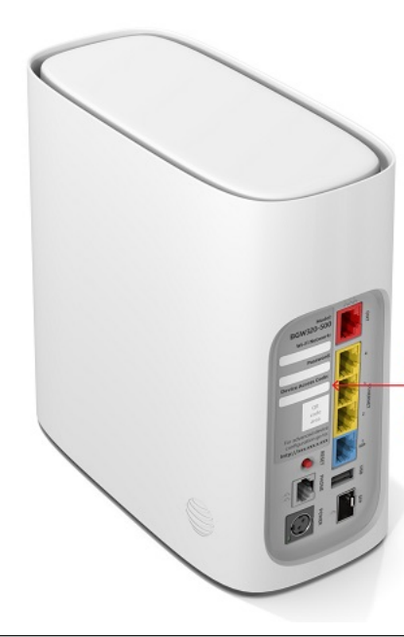
ATT Router

