Slide 1
X-Window & Networking

Slide 2
Goal: Accessing 1of 5 RPi4B from the Over the Internet with graphical displays

Slide 3
Goal: Accessing 1of 5 RPi4B from the Over the Internet with graphical displays
Examples graphical displays
  Geany editor
  Octave matlab like program
  Gtkwave VCD viewer
  Mousepad editor
  GIMP
  Lazarus IDE (Ulitobo Editor)
    Bare metal for Pi
      QEMU, Rpi Zero, RPi3B+, RPi4, and CM4

Slide 4

Internet
RPi3B+ 1Gb
pass-thru
162.197.186.179
pi4-40
ATT Router
RPi4B 8Gb
RPi3B+ 1Gb
RPi4B 4Gb
RPi4B 4Gb
RPi4B 4Gb
RPi4B 4Gb
192.168.1.212
pi4-50
192.168.1.211
pi4-30
192.168.1.245
pi4-60
192.168.1.229
pi4-27
192.168.1.218
pi4-2
192.168.1.231
pi4-37
RPi ZeroW
192.168.1.235
wiifiextender
RPi4B 4Gb
RPi3B+ 1Gb
192.168.42.116
pi4-20
192.168.42.119
pi4-3

Slide 5
pi4-50
Pico_w Zone1
remote1 192.168.1.160
remote3 192.168.1.178
remote4 192.168.1.177
remote5 192.168.1.168
remote6 192.168.1.175
pi4-37
Pico_w Zone2
SSID Century Link6
remote5 192.168.32.106
pi4-20
Pico_w Zone3
SSID Century Link4
remote5 192.168.16.114
pi4-3
Pico_w Zone4
SSID Century Link3
remote8 192.168.12.120
remote9 192.168.12.108
remote7 192.168.12.106

Slide 6
Goal: Accessing 1of 5 RPi4B from the Over the Internet with graphical displays
Steps Required
Need to ssh to
LAN Home RPi3B+ on 162.197.186.xx
Need to ssh to 1 of 5 RPi4B
Run Graphical Application

Slide 7
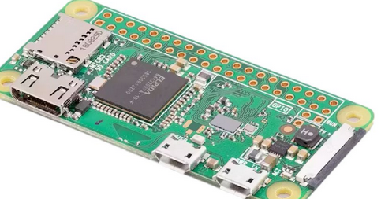
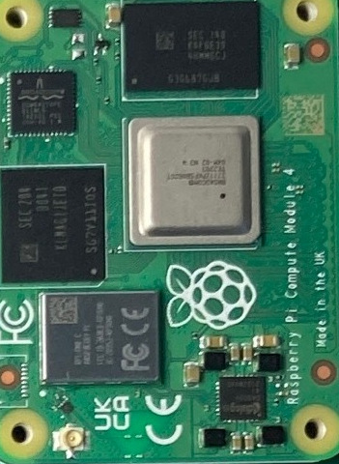
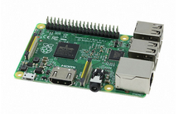
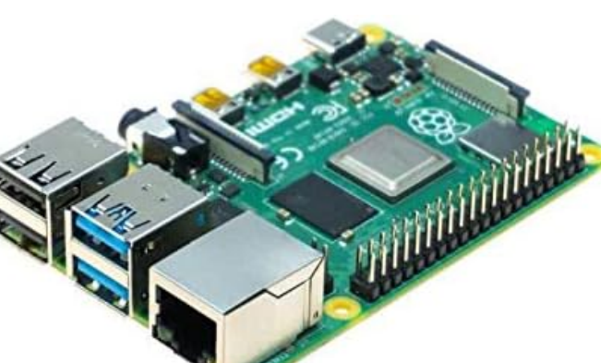
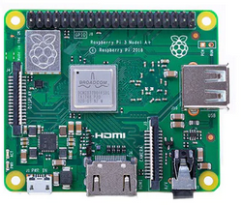
RPi Models
RPi CM4
RPi3B+
RPi3A
RPi4B

Slide 8
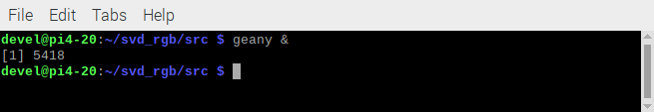
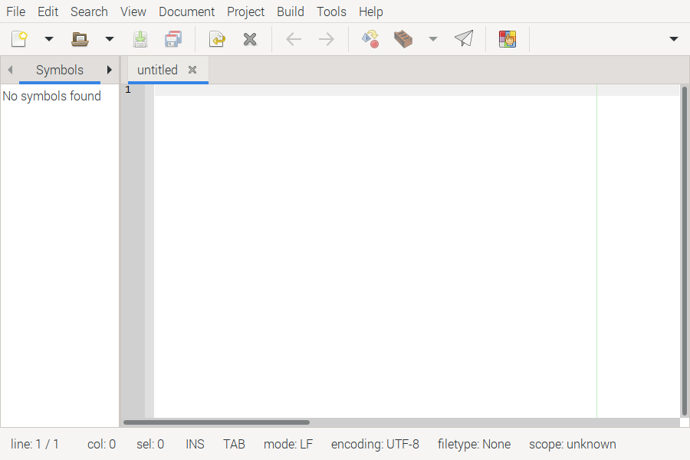

Slide 9
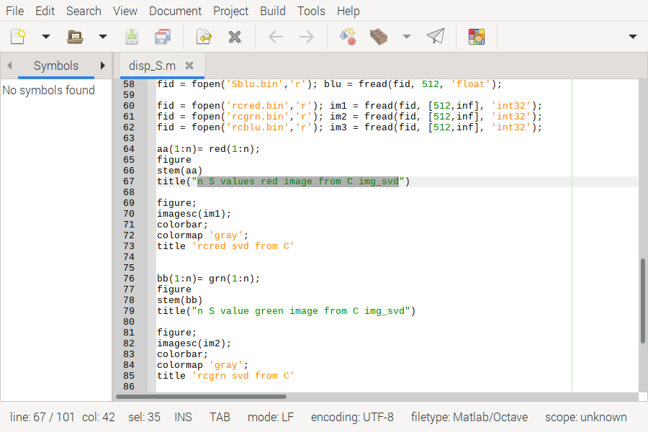

Slide 10
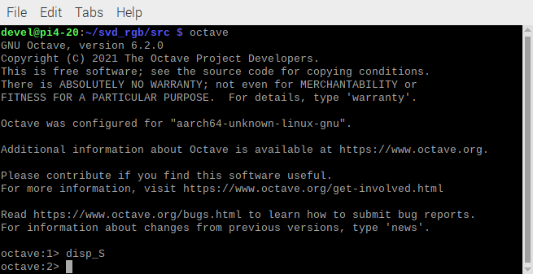

Slide 11
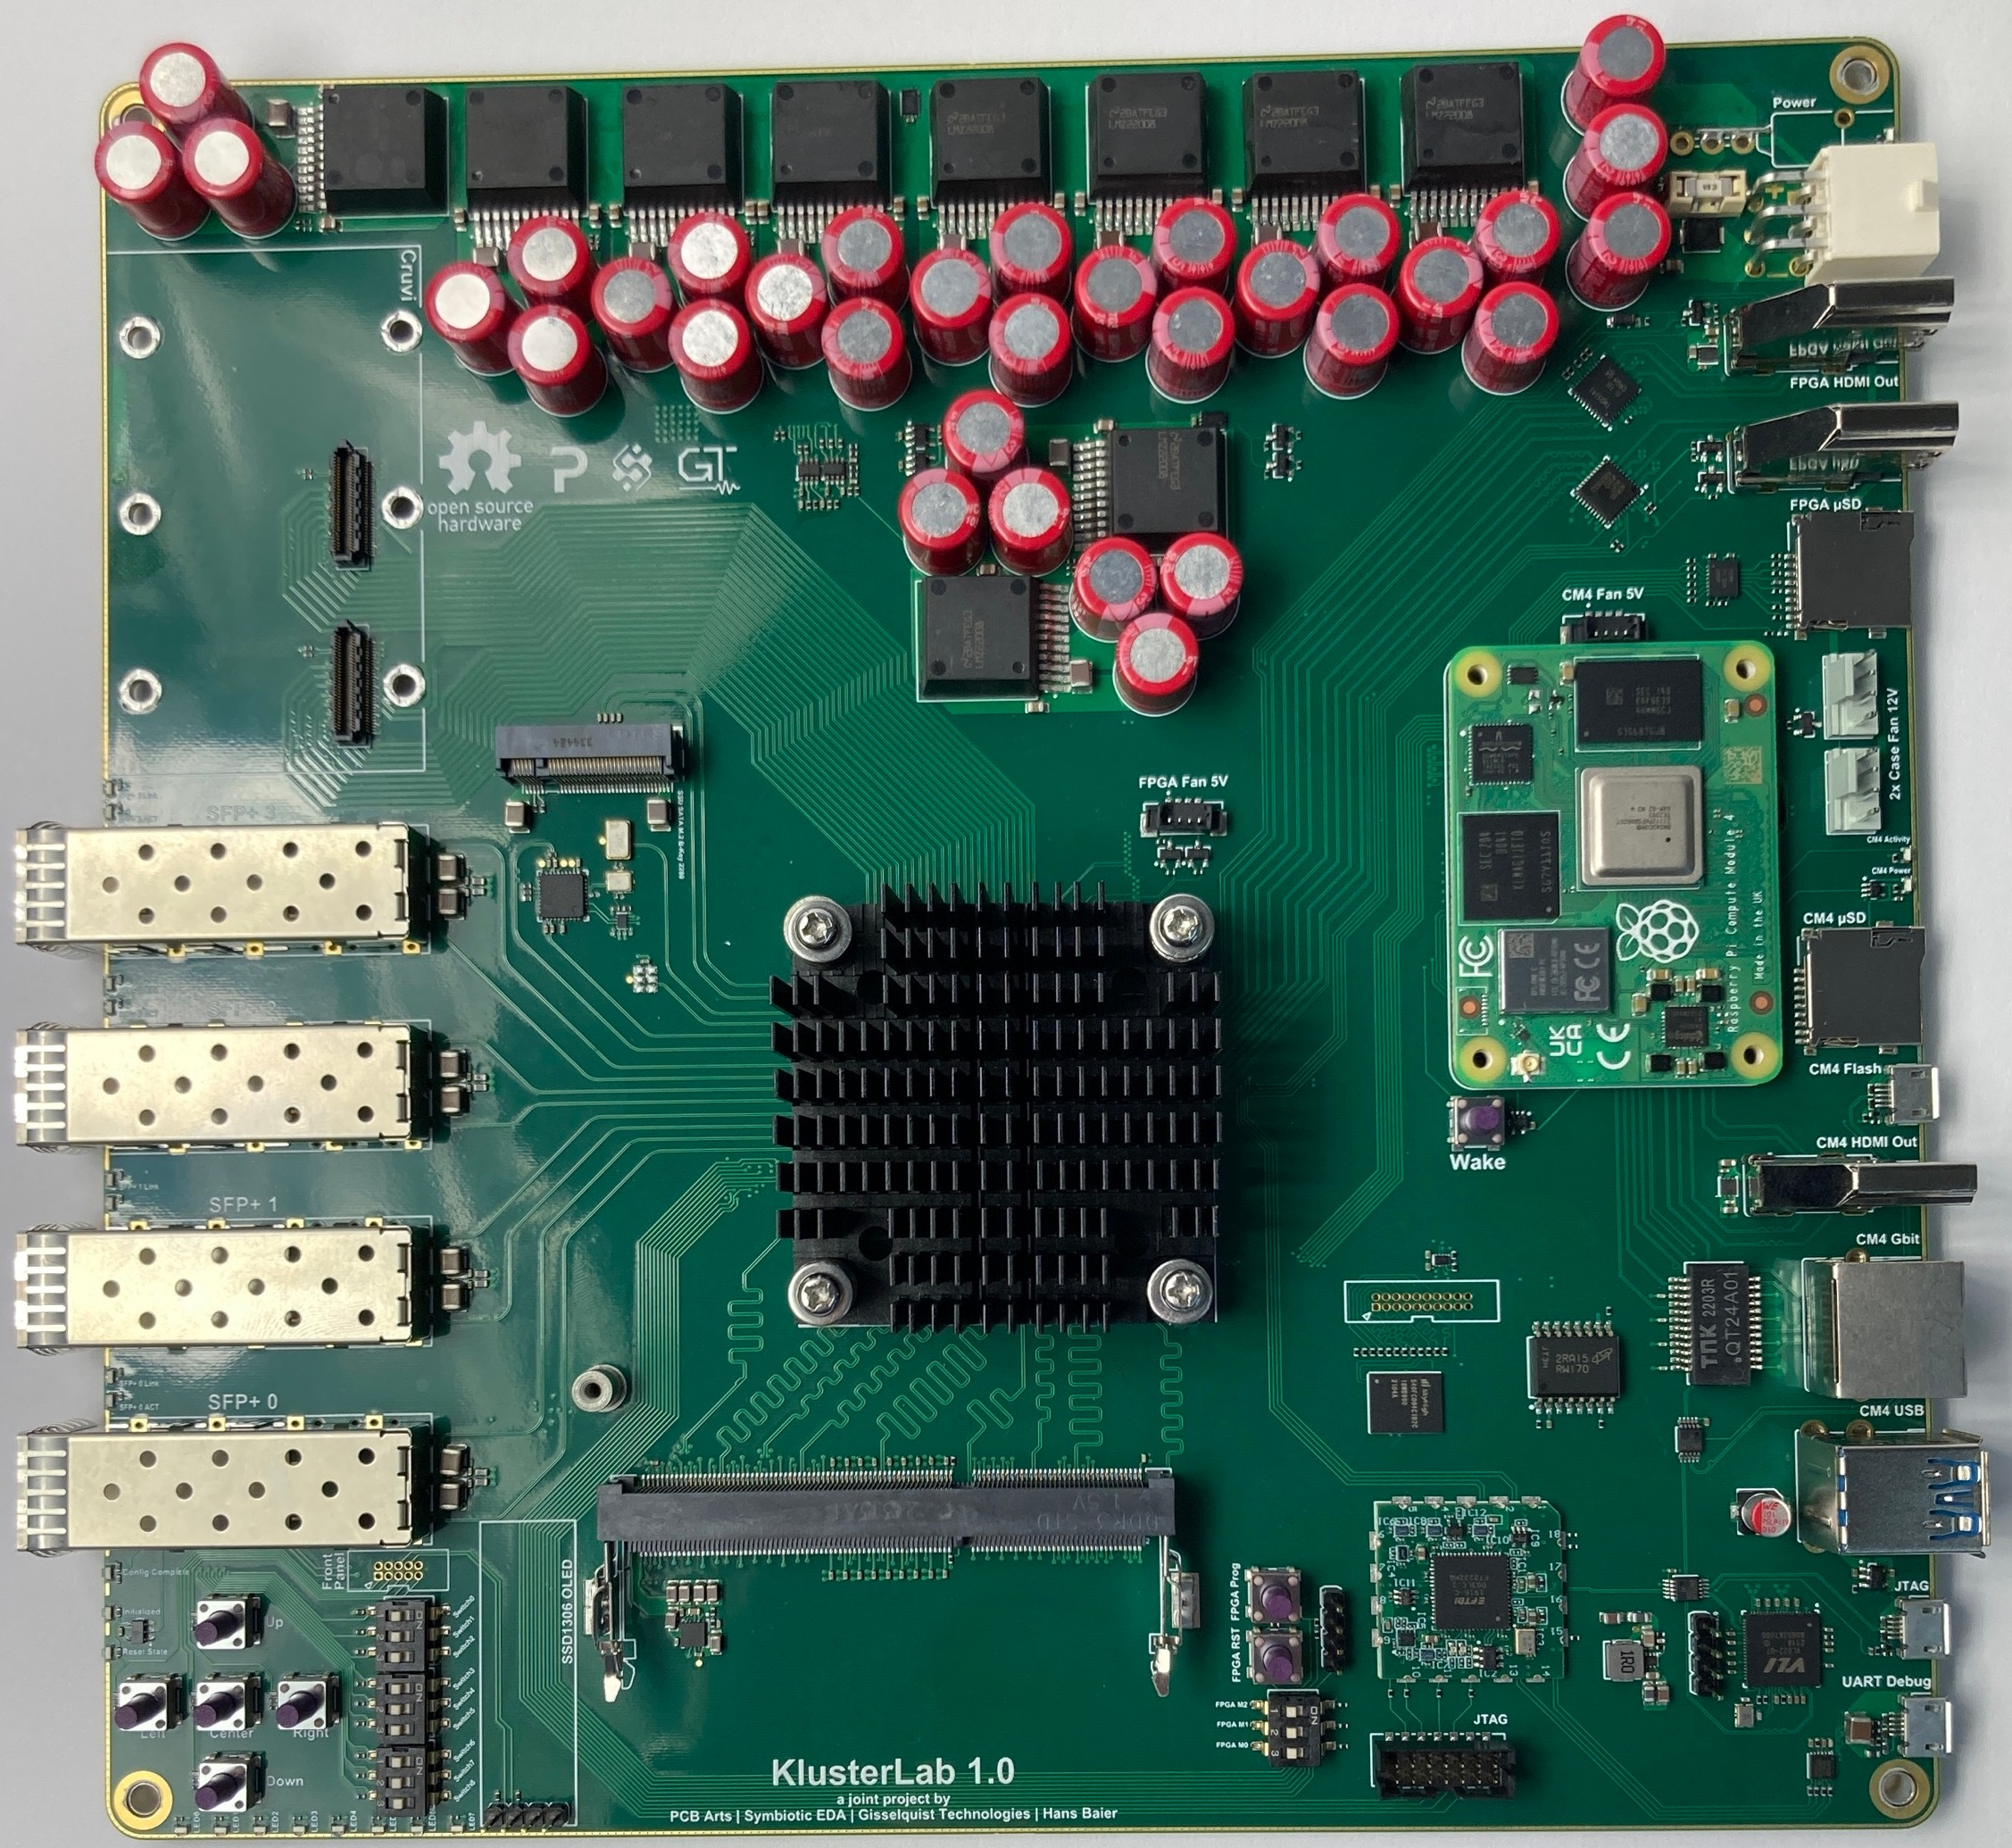
Rpi CM4 with FPGA Kintex-7 160T with 4 Ethernet 10Gb

Slide 12
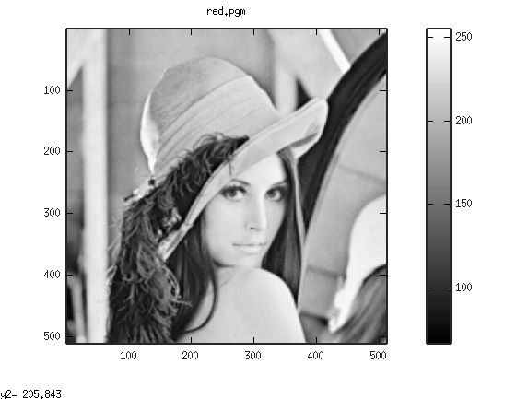
500 x 500 red subband lena

Slide 13

500 x 500 red subband lena reconstructed after perfoming KLT

Slide 14
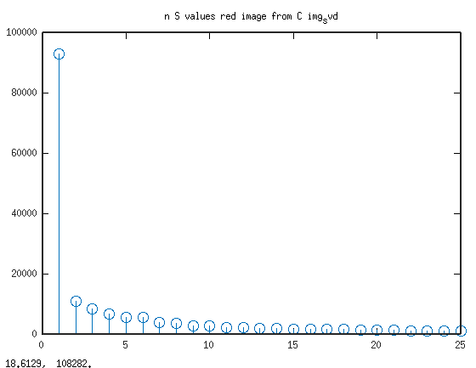
n S values red image from C img_svd

Slide 15
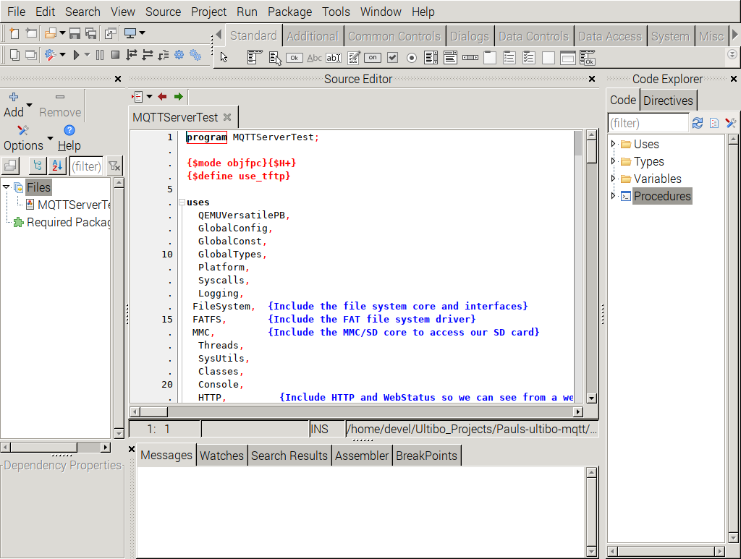
Goal: Accessing 1of 5 RPi4B from the Over the Internet with graphical displays

Slide 16
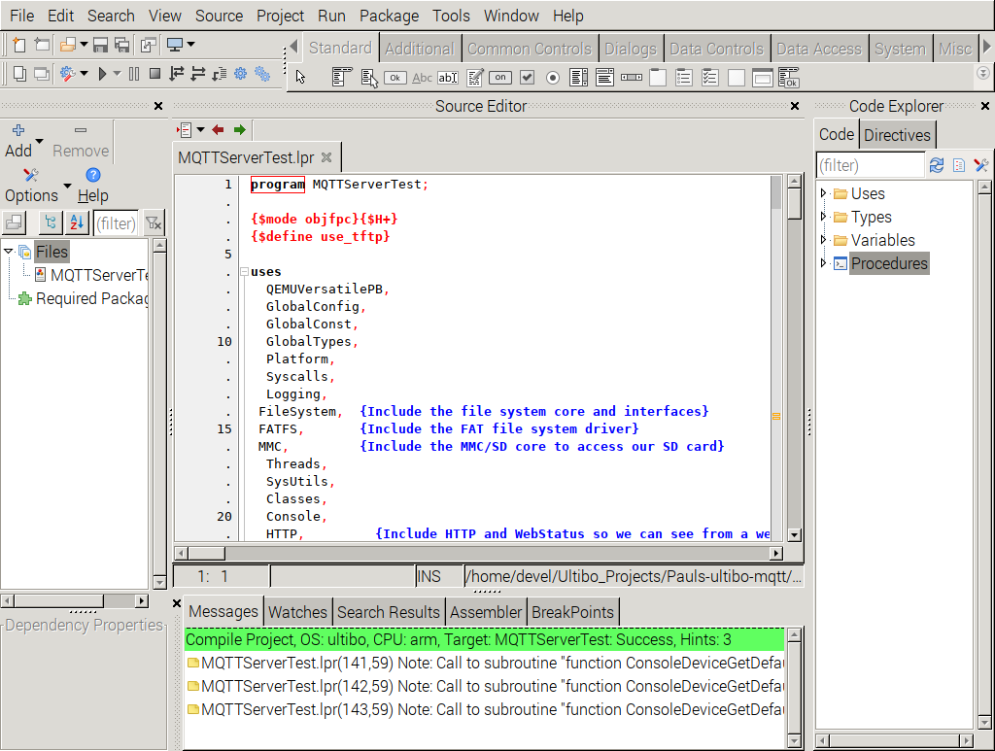
Goal: Accessing 1of 5 RPi4B from the Over the Internet with graphical displays

Slide 17
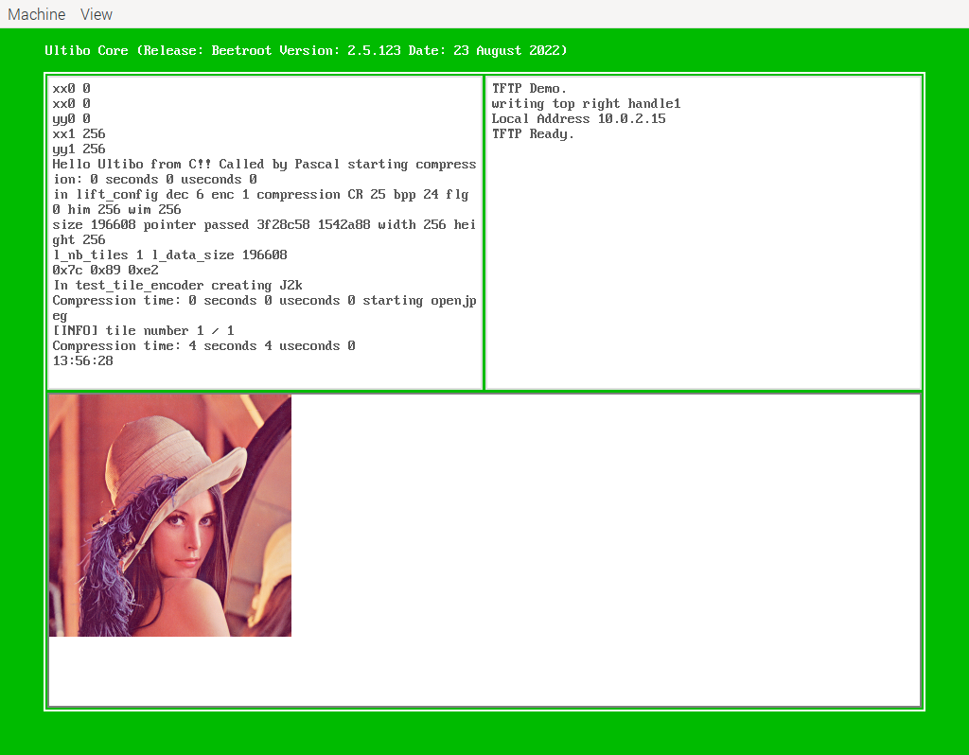
Goal: Accessing 1of 5 RPi4B from the Over the Internet with graphical displays
devel@pi4-20:~/Ultibo_Projects/jpeg2000/QEMU $ ./startqemu.s

Slide 18
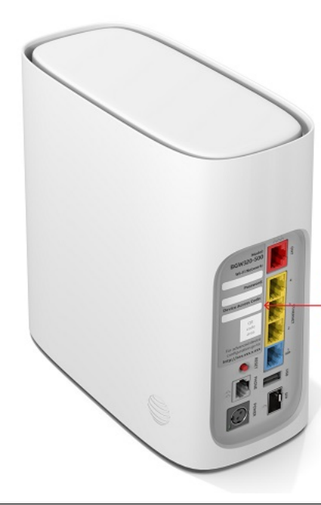
ATT Router

